Slide 1
Tutorial 11 - Week 12
We’ll be starting at the 10 minute mark

Slide 2
Agenda
Lecture review
Object oriented programming, __str__ method
File Methods
Intro to CSV Files
Creating your own modules
Practice questions

Slide 3
Review of Lecture
User-defined Classes

Slide 4
Object Oriented Programming (OOP) Review
An object is a collection of related data and related functions
class Point:
""" A 2d point, at coordinates x, y"""
def __init__(self, x_arg = 0 y_arg = 0):
"""create a new point at x, y"""
self.x = x_arg
self.y = y_arg
def distance_from_origin(self):
"""Compute my distance from the origin"""
return (() + ()) ** 0.5
self refers to the instance of the class being manipulated
Data attributes
Method

Slide 5
Object Oriented Programming (OOP) Review
An object is a collection of related data and related functions
class Point:
""" A 2d point, at coordinates x, y"""
def __init__(self, x_arg = 0 y_arg = 0):
"""create a new point at x, y"""
self.x = x_arg
self.y = y_arg
def distance_from_origin(self):
"""Compute my distance from the origin"""
return (() + ()) ** 0.5
point1 = Point(0,0)
print(point1) #<__main__.Point object at 0x7fa3438f1310>
Why do we get this output?

Slide 6
Object Oriented Programming (OOP) Review
An object is a collection of related data and related functions
class Point:
""" A 2d point, at coordinates x, y"""
def __init__(self, x_arg = 0 y_arg = 0):
"""create a new point at x, y"""
self.x = x_arg
self.y = y_arg
def printer(self):
"""Compute my distance from the origin"""
return (self.x, self.y)
point1 = Point(9,4)
point1.printer() # 9 4
Is there a better way?

Slide 7
__str__ method
How do we produce a string representation of an object?
⇒ When we pass an object to print(), print will call method __str__ of the object
to get its string representation. It will then print that string representation.
class <class name>:
def __init__(self, param):
self.param = param
def __str__(self):
return str(self.param)
__str__ needs a string-type return!

Slide 8
__str__ method cont.
class Point:
""" A 2d point, at coordinates x, y"""
def __init__(self, x_arg = 0 y_arg = 0):
"""create a new point at x, y"""
self.x = x_arg
self.y = y_arg
def __str__(self):
return str(self.x) + " " + str(self.y)
point1 = Point(9,4)
print(point1) # 9 4

Slide 9
Review of Lecture
More File Methods, CSV Files

Slide 10
Opening Files
The general form for opening a file is:
open(file_path, mode)
mode can be:
'r' for reading
'w' for writing
'a' for appending
'r+' for reading and writing
'a+' for appending and reading
open()returns a file object.

Slide 11
Writing to a File
The following statement opens the file for writing (note parameter mode is set to 'w')
myfile = open("test.txt", "w")
To write something to the file we can use the write method of the file object:
myfile.write("My first file ...")
Once we have finished with the file, we need to close it:
myfile.close()
my_file is a file object

Slide 12
Reading a file
Approach | Code | When to use it
The read approach | myfile = open(filename, ‘r’) contents = myfile.read() myfile.close() | When you want to read the whole file at once and use it as a string
The readline approach | myfile = open(filename, ‘r’) contents = ‘’ line = myfile.readline() contents = contents + line while line != ‘’: contents += myfile.readline() myfile.close() | When you want to process only part of a file
The for line in file approach | myfile = open(filename, ‘r’) contents = ‘’ for line in myfile: contents += line myfile.close() | When you want to process every line in the file one at a time
The readlines approach | myfile = open(filename, ‘r’) lines = myfile.readlines() myfile.close() | When you want to examine each line of a file by index

Slide 13
File I/O with for line in lines
What if we wanted to process lines in a file one at a time? Consider this example of cleaning a file input:
Circle_radius.txt:
1
2
3
file = open('circle_radius.txt', 'r')
circle_area = []
for line in file:
circle_area.append(float(line)**2 * math.pi)
file.close()
print(circle_area)
>>> [3.14, 12.56, 28.27]

Slide 14
File I/O with readlines
What if we wanted to process a file line by line, and retrieve a particular line quickly with an index?
file = open('test.txt', 'r')
lines = file.readlines() # lines is a list of strings
file.close()
print(lines)
>>> ['Hello world!\n’,Hello world again!\n']
print(lines[0])
>>> 'Hello world!\n’

Slide 15
File I/O with Context Managers - the with statement
Every time we open a file we must also close it.
Python allows us to use context managers, which will automatically close files when the context is exited.
We can create context managers using the with statement.
Example:
There’s no need to call the close()method within the with statement.
The file opened in the context manager used by the with statement will be closed automatically when the context is exited.
open() returns a context manager object
with open('test.txt', 'r') as file:
contents = file.read()
>>> contents
'Hello world!\nHello world again!'

Slide 16
File I/O with Context Managers - the with statement
We can also use the context manager with the other read methods we just learned:
with open('test.txt', 'r') as file:
for line in file:
print('The next line:', line)
>>>
'The next line: Hello world!'
'The next line: Hello world again!'

Slide 17
File I/O with Context Managers - the with statement
We can also use the context manager with the other read methods we just learned:
with open('test.txt', 'r') as file:
lines = file.readlines()
print(lines) # print out the list object
for line in lines:
print('The next line:', line)
>>>
['Hello world!\n','Hello world again!\n']
>>>
'The next line: Hello world!\n'
'The next line: Hello world again!\n'

Slide 18
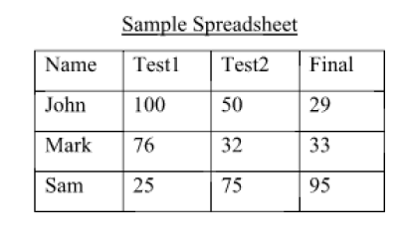
File I/O – Working with CSV Files
CSV files are text files containing values separated by commas.
To read the contents of a CSV file 'grades.csv'using a context manager:
NOTE: contents is a string containing all the data in the CSV file (the rows are separated by new line characters and the “columns” are separated by commas)
with open('grades.csv', 'r') as file:
contents = file.read()
>>> contents
'Name,Test1,Test2,Final\nJohn,100,50,29\n,Mark,76,32,33\nSam,25,75,95\n'

Slide 19
File I/O – Working with CSV Files using the CSV reader Class of the CSV module¹
The csv module provides functions that work with CSV files
Method csv.reader() takes a csv file object as input and returns a csv reader object that holds the content of the file
The csv reader object can be iterated through

Slide 20
File I/O – Working with CSV Files using the CSV reader Class of the CSV module²
import csv
with open('grades.csv', 'r') as csvfile:
grades_reader = csv.reader(csvfile)
row_num = 1
for row in grades_reader:
print('Row #', row_num, ':', row)
row_num += 1
Open the csv file and create a csv reader object
Iterate through each row in the csv reader object
Display the content of the file to the standard output
Row # 1 : ['Name', 'Test1', 'Test2', 'Final']
Row # 2 : ['John', '100', '50', '29']
Row # 3 : ['Mark', '76', '32', '33']
Row # 4 : ['Sam', '25', '75', '95']
Output

Slide 21
Review of Lecture
User-Defined Modules

Slide 22
Different ways to import from a module
import math
from math import *
from math import pi
from math import sin, cos, pi
Imports all classes, functions, variables (i.e. * (star) means all)
Import only specific functions, variables from a module; always comma-separated!

Slide 23
Different ways to import from a module
import math
print(math.pi)
from math import *
print(cos, pi)
from math import pi #specific import
import math
print(math.cos, pi)
from math import sin, cos, pi
print(cos, pi)
Imports all classes, functions, variables (i.e. * (star) means all)

Slide 24
Different ways to import from a module
import math as m
print(m.pi)
# print(math.pi) -> will give an error!
from math import pi as mathpi
print(mathpi) # notice math is not needed!
Useful to add a shorthand!

Slide 25
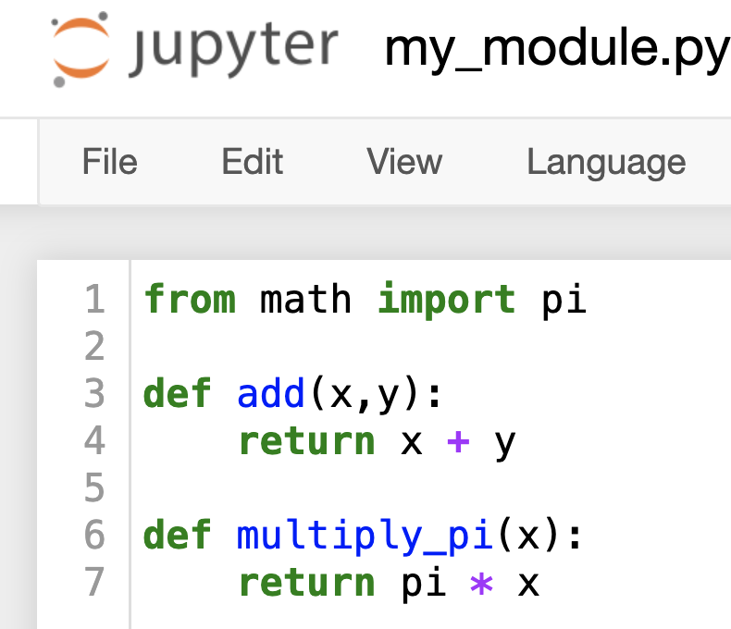
We can also make our own .py file (aka module!)
Notice that we imported math into my_module
We can add .py files into our directory tree,
import my_module
print(my_module.add(3,4))
>>> 7
from my_module import multiply_pi
print(multiply_pi(1))
>>> 3.1415…

Slide 26
Practice Problems

Slide 27


Which of the following statements correctly describes the effect of the import statements used in the provided code snippets?
ⓘ
Click Present with Slido or install our Chrome extension to activate this poll while presenting.
Notes:
📣 This is Slido interaction slide, please don't delete it. ✅ Click on 'Present with Slido' and the poll will launch automatically when you get to this slide.

Slide 28
Review Practice Problem 1
Which of the following statements correctly describes the effect of the import statements used in the provided code snippets?
The statement "import math" imports only the pi constant from the math module.
The statement "from math import *" imports all functions and variables defined in the math module, and can be used with the math. prefix
The statement "from math import pi" imports the entire math module, making all its functions and constants available with the math. prefix.
The statement "from math import sin, cos, pi" allows sin, cos and pi to be used without the math. prefix
None of the above

Slide 29
Given the following csv file, how would you print out only the colors (last entry in each row)? Assume you have these lines of code:
import csv
with open('file.csv', 'r') as file:
reader = csv.reader(file)
ⓘ
Click Present with Slido or install our Chrome extension to activate this poll while presenting.
Notes:
📣 This is Slido interaction slide, please don't delete it. ✅ Click on 'Present with Slido' and the poll will launch automatically when you get to this slide.

Slide 30
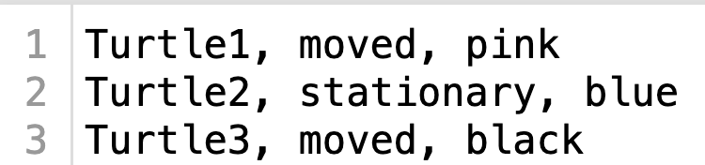
Review Practice Problem 2
Given the following csv file, how would you print out only the colors (last entry in each row)? Assume you have these lines of code:
import csv
with open('file.csv', 'r') as file:
reader = csv.reader(file)
print(reader)
for row in reader:
print(row)
for row in reader:
print(row[-1])
print(reader[-1])

Slide 31
Coding Question 1
Write a Python function count_vowels to count the frequency of vowels in a file. count_vowels takes takes as input a file path and returns a dictionary with items vowel : vowel frequency. (The input file is provided on Tutorial Quercus page. )
Usage example:
>>> count_vowels(</path/to/file>)
{'a': 29, 'e': 40, 'i': 40, 'o': 29, 'u': 4}

Slide 32
Coding Question 2
Write a Python function maximal_subsets() that takes in a string representing the path to a csv file where each line is a set of numbers and returns a list with the maximal subsets in that file. A maximal subset is a set that is not a subset of another.
For example, when run on a file with content:
1, 2, 3
1, 2, 3
1, 2
2, 3
2, 4
maximal_subsets() returns
[{1, 2, 3}, {1, 2, 3}, {2, 4}]

Slide 33
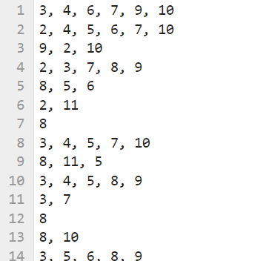
Coding Question 2: Step 1
The each line of the input is a set of numbers
Step 1: Convert the file into a list of sets.
For example:
[{3, 4, 6, 7, 9, 10}, {2, 4, 5, 6, 7, 10}, {2, 9, 10}, ... ]

Slide 34
Coding Question 2: Step 2
Step 2: Given the list of sets, find the maximal subsets (i.e. remove all sets that are subsets of other sets in the list).
Example:
the maximal subsets in:
[{1, 2, 3}, {1, 2, 3}, {1, 2}, {2, 3}, {2, 4}]
are:
[{1, 2, 3}, {1, 2, 3}, {2, 4}]

