Slide 1
Tutorial 3 - Week 4
We’ll be starting at the 10 minute mark

Slide 2
Agenda
Lab 2 Review
Lecture Review
Booleans
If-statements
String operators
Practice Questions
Questions?

Slide 3
Review of Lab 2
Circles :)

Slide 4
Lab 2 Review- Nested Conditions to Check for Overlap
There are a few ways to approach the problem, nesting if/elif/else statements together if the simplest approach.
Beneficial to create an intermediate distance variable between the two centers of circle1 and circle2.
Check if either circle contained fully in the other
Partial overlap
Zero overlap
Complete overlap
If distance > (rad1 + rad2)
If equal radius and centers
Else if (elif) circle radius greater than (distance + circle radius)
Else overlap

Slide 5
Review of Lecture
Topic 1: Booleans

Slide 6
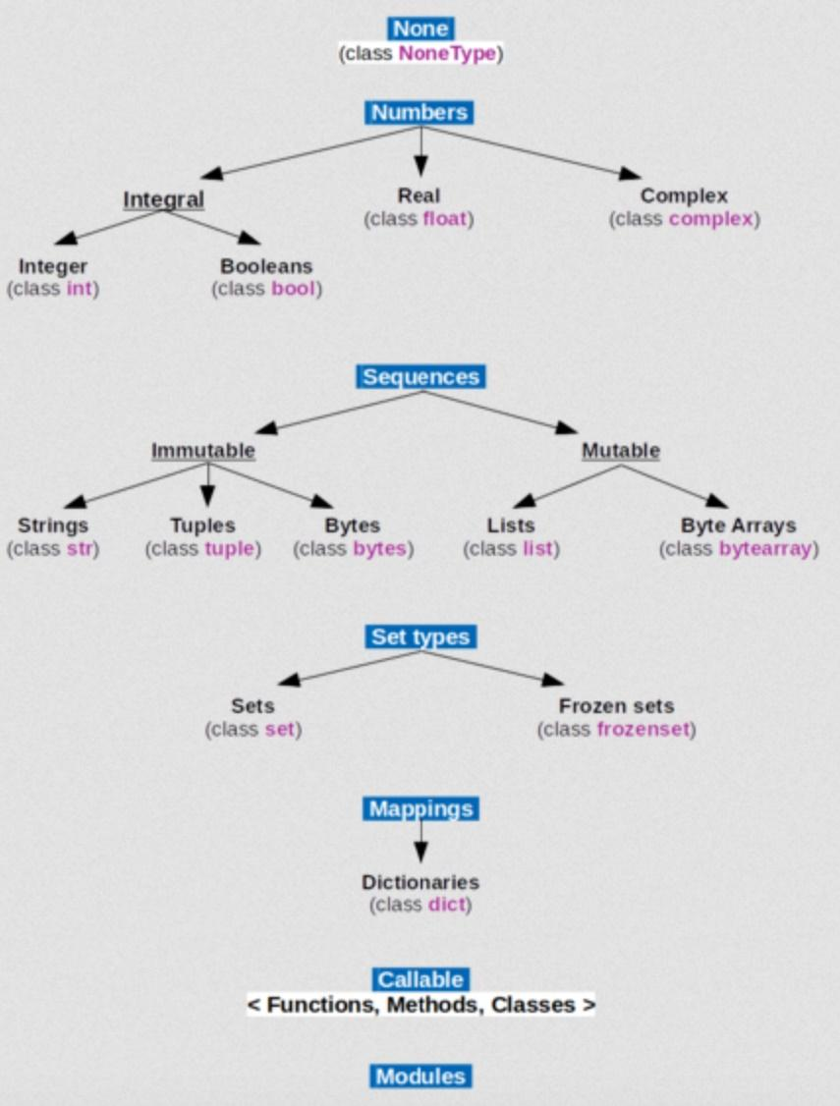
Lecture Review: Python Data Types: bool
bool only has two possible values: True and False
bool is a subtype of integers:
True is represented internally as 1 and False as 0
For example, the expression True * 75 will evaluate to 75, an integer value

Slide 7
Every Python object has a corresponding truth (Boolean) value !
Use the built-­in function bool()to determine the truth value of an object.
bool() will return False when called on the following values:
The number zero (0)
Boolean value False
None
An empty string, i.e., '' or “ ”
An empty list , i.e. []
An empty tuple, i.e., ()
An empty dictionary, i.e., {}
NOTE: the value and the truth value of an object are not the same thing !!!

Slide 8
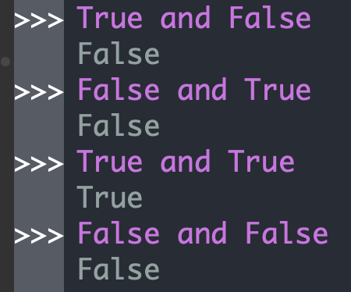
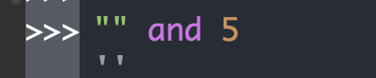
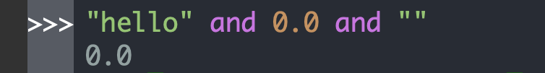
Python Operators: and
When applied to operands of type bool, operator and functions as the boolean / logic operator conjunction. It returns False if one of its operands is False and returns True otherwise.
When applied to operands of types other than bool,operator and returns the value of the first operand, if the truth value of that operand is False. Otherwise, it returns the value of the second operand.
Explanation:
"hello" and 0.0 is evaluated first. Its result is 0.0 (the value of the second operand)
0.0 and "" is evaluated next. Its result is 0.0 (the value of the first operand).

Slide 9
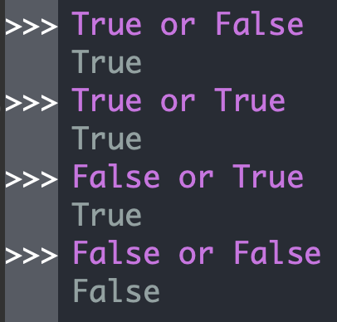
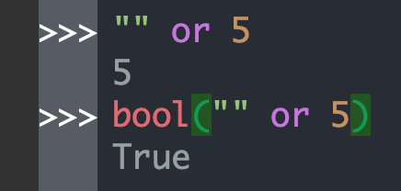
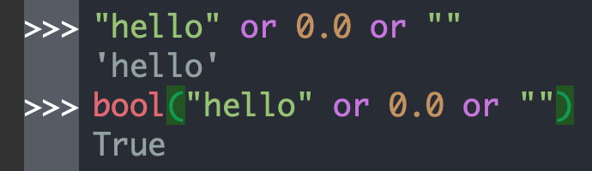
Python Operators: or
When applied to operands of type bool, operator or functions as the boolean/logic operator disjunction. It returns False if both of its operands are False, and returns True otherwise.
When applied to operands of types other than bool, operator or returns the value of the first operand, if its truth value is True. Otherwise, it returns the value of the second operand.
Explanation:
"hello" or 0.0 is evaluated first. Its result is "hello" (the value of the first operand)
"hello" and "" is evaluated next. Its result is "hello" (the value of the first operand).

Slide 10
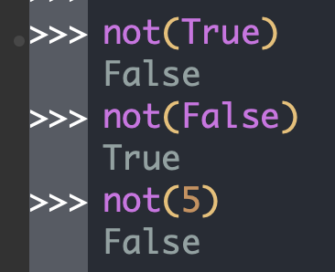
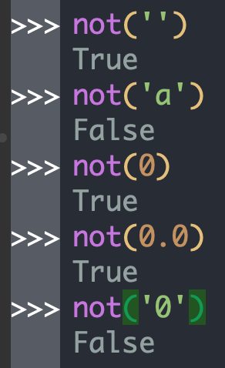
Python Operators: not
When applied to operands of type bool, operator not functions as the boolean / logic operator negation. It returns False if its operand is True, and returns True if its operand is False.
When applied to operands of types other than bool, operator not acts as a mapping to Boolean values: it returns False if the truth value of the operand is True, and returns True if the truth value of the operand is False.

Slide 11
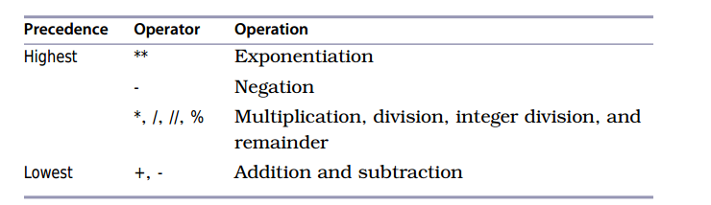
Order of Precedence for Python Operators
Brackets () are always first!
Order of precedence for unparenthesized expressions:
Arithmetic (see table below)
Relational (<=, >, <, ==, etc.) .. More on this soon ☺
not
and
or

Slide 12
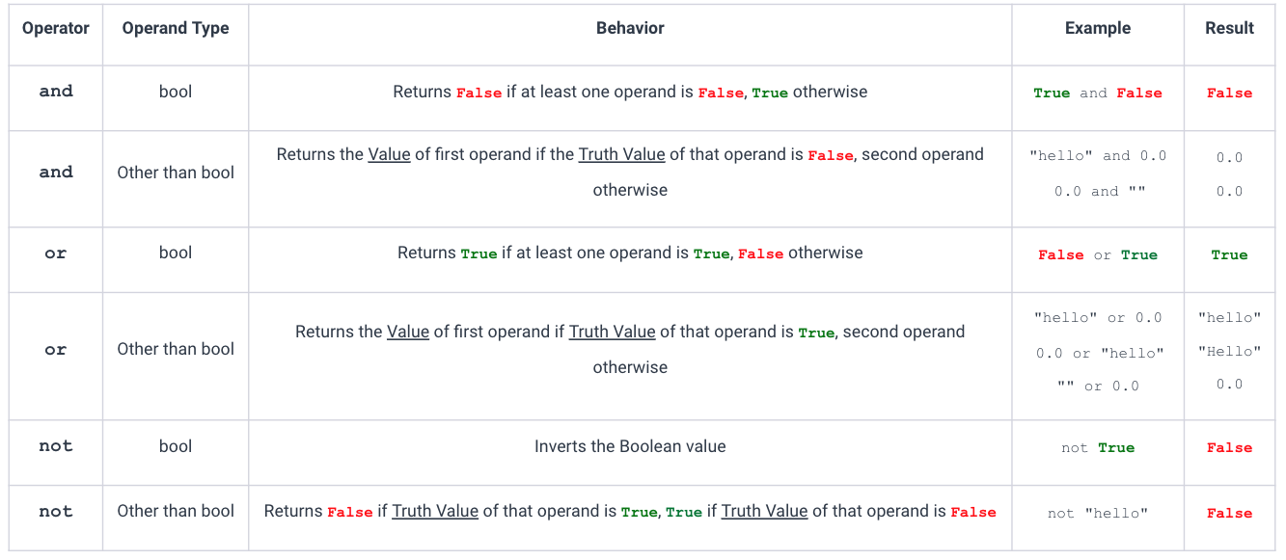
Summary of and, not and or behaviour

Slide 13


What would this code output?
ⓘ
Click Present with Slido or install our Chrome extension to activate this poll while presenting.
Notes:
📣 This is Slido interaction slide, please don't delete it. ✅ Click on 'Present with Slido' and the poll will launch automatically when you get to this slide.

Slide 14
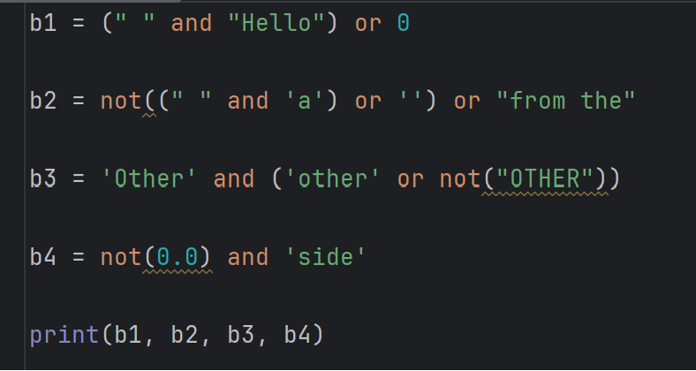
Practice Problem: Boolean Expressions
What would this code output??

Slide 15

Practice Problem: Boolean Expressions
What would this code output??
answer:

Slide 16
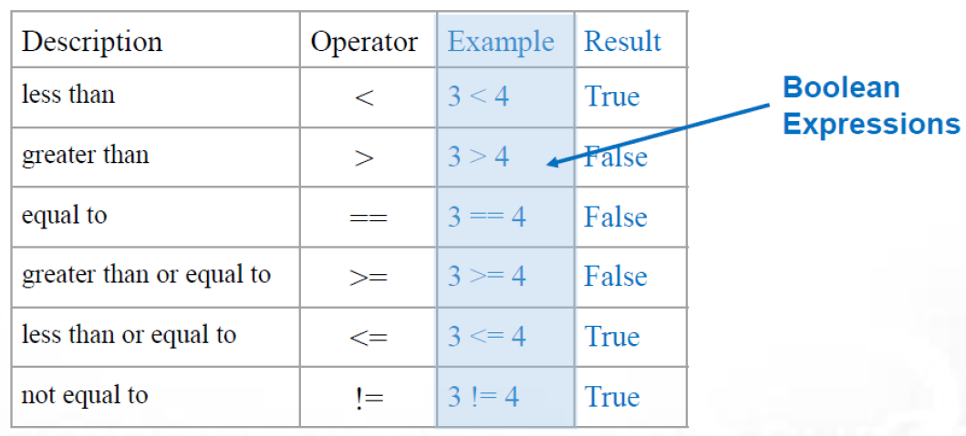
Python Comparison Operators
Comparison operators compare two values and produce a bool value (either True or False)
Warning: There is a BIG difference between = and ==
= is the symbol for the assignment operator
== is the symbol for the “equal to” operator
It is a common error to mistakenly use only one = sign when intending to apply the “equal to” operator.

Slide 17
Python Comparison Operators Continued
Operator | Description
is | Object identity. Returns True if both operands are the same object. (we will discuss more about this operator when we discuss Python objects in the future)
is not | Negated object identity. Returns True if the operands are not the same object. (we will discuss more about this operator when we discuss Python objects in the future)
in | Returns True if the first operand is contained in the second operand. Example: >>> "ti" in "tie" True
not in | Returns True if the first operand is not contained in the second operand. (examples will follow in the next few slides when we talk about strings) Example: >>> "te" not in "tie" True

Slide 18
Review of Lecture
Topic 2: If-statements

Slide 19
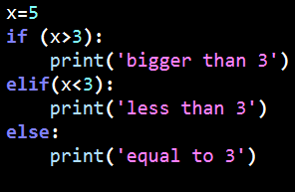

Choice / Conditional Statements: if-statements¹
if condition1:
body1
elif condition2:
body2
elif condition3:
body3
if condition1:
body1
elif condition2:
body2
…
else: #everything else
body3
if condition:
body
Examples:

Slide 20
Choice / Conditional Statements: if-statements²
Multiple if-statements if-­statements can appear one after another in a program. They are independent of each other.
if condition1: # First independent if statement
body1
if condition2: # Second independent if statement
body2
Nested if-­statements It is possible to place an IF-­statement within the body of another if statement.
if condition1:
if condition2:
body1
else:
body2
Equivalent of
if condition1 and condition2:
body1
elif condition1:
body2
Nesting if-statements is not necessary, but it may make code more readable

Slide 21
Review of Lecture
Topic 3: String Operations

Slide 22
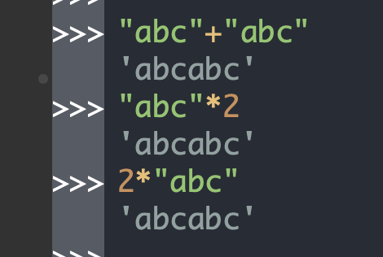
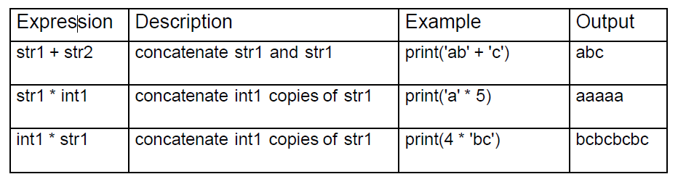
Python String Operators: Concatenation and Repetition
Two useful operators that can be applied to strings: *, aka repetition, and +, aka concatenation
Concatenation is a means for generating new values of type string. Note that the desired string can be achieved in multiple ways.
For example, let's generate “abcabc” in multiple ways
Summary:

Slide 23


Comparing Strings
In Python, strings are compared based on the ASCII/UNICODE encoding of their components.
The characters in both strings are compared one by one.
When different characters are found then their ASCII/Unicode value is compared.
The character with lower ASCII/Unicode value is considered to be smaller
Examples:
c’s encoding in ASCII is 99 while a’s encoding is 97
Z’s encoding in ASCII is 90 while a’s encoding is 97

Slide 24
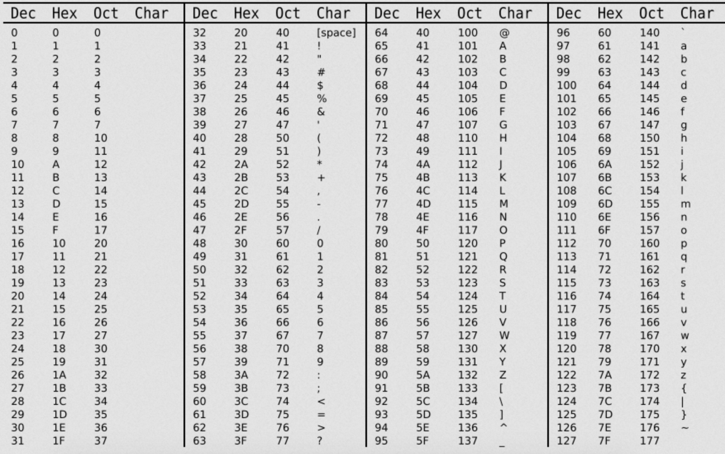
ASCII encoding

Slide 25
ASCII encoding

Slide 26
String methods
Method name | Description
isalnum() | Returns True if string is alphanumeric
isalpha() | Returns True if string contains only alphabets
isdigit() | Returns True if string contains only digits
isidentifier() | Return True if string is valid identifier
islower() | Returns True if string is in lowercase
isupper() | Returns True if string is in uppercase
isspace() | Returns True if string contains only whitespace
A comprehensive list of string method can be found in the official documentation: https://docs.python.org/3/library/stdtypes.html#string-methods

Slide 27
Practice Problems

Slide 28

What is the output from this code?
ⓘ
Click Present with Slido or install our Chrome extension to activate this poll while presenting.
Notes:
📣 This is Slido interaction slide, please don't delete it. ✅ Click on 'Present with Slido' and the poll will launch automatically when you get to this slide.

Slide 29
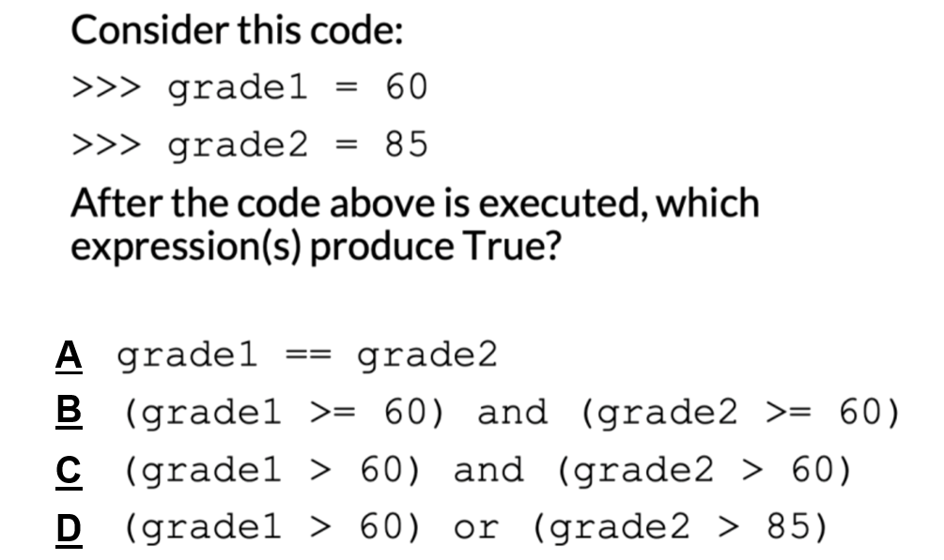
Review Practice Problem 1

Slide 30
Select the code fragment that is not equivalent to one of the above:
ⓘ
Click Present with Slido or install our Chrome extension to activate this poll while presenting.
Notes:
📣 This is Slido interaction slide, please don't delete it. ✅ Click on 'Present with Slido' and the poll will launch automatically when you get to this slide.

Slide 31
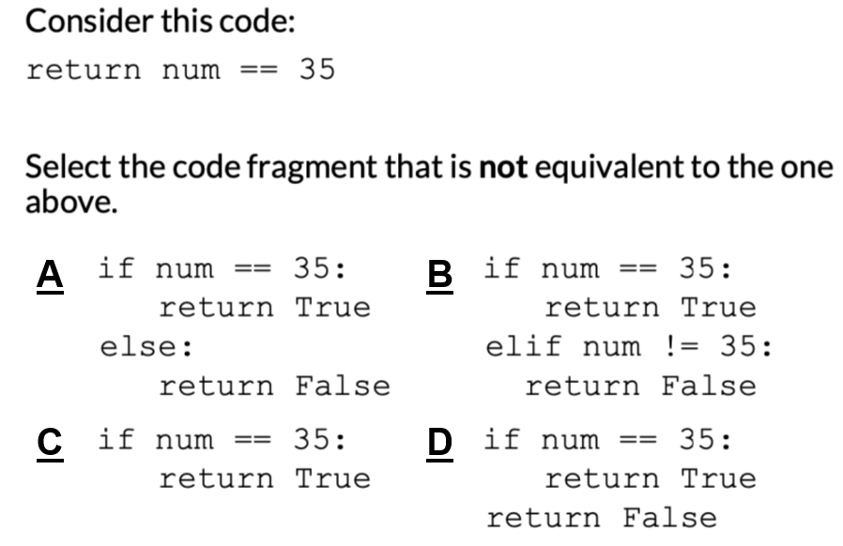
Review Practice Problem 2

Slide 32
What is the outcome of the following code?
ⓘ
Click Present with Slido or install our Chrome extension to activate this poll while presenting.
Notes:
📣 This is Slido interaction slide, please don't delete it. ✅ Click on 'Present with Slido' and the poll will launch automatically when you get to this slide.

Slide 33
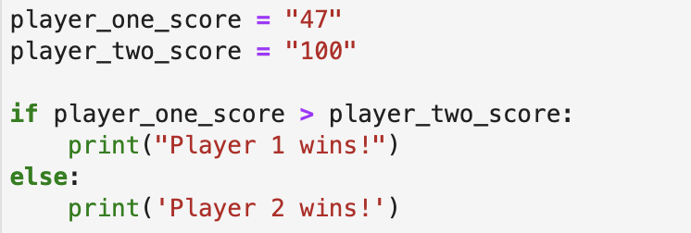
Review Practice Problem 3
What is the outcome of the following code?
Player 1 wins! is printed
Player 2 wins! is printed
An error is thrown
None of the above

Slide 34
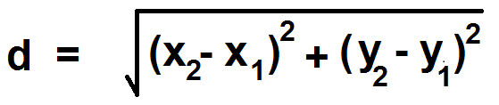
Coding Problem
Write a function that takes in 3 points, and returns the distance between the two points that are closest to each other.
Things to consider before you start writing your code:
What would be the parameters of your function?
def closest_points(x1, y1, x2, y2, x3, y3)
Maybe having one function just for finding distance may be useful?

