Slide 1
Tutorial 4 - Week 5
We’ll be starting at the 10 minute mark

Slide 2
Learning Objectives
After completing this tutorial, learners should be able to:
understand the semantics of functions in the built-in module random
understand how to use min and max to limit the value of a variable to a given range
understand the concept of iteration/looping
recognize while loops
understand the concept of “loop variable”
understand the need to initialize and update loop variables
understand the concept of “loop entry condition”
recognize the need for using/implementing an iterative structure
write syntactically and semantically correct while loops

Slide 3
Review of Python Built-in Functionality

Slide 4
Python built-in functions: min() and max()
Semantics: min() / max() return the smallest / largest value among the given inputs.
Function call syntax:
min(arg1, arg2, arg3,...)
max(arg1, arg2, arg3,...)
var_min = min(6, 3, 8, 10)
print(var_min)
var_max = max(4, 3, 5, 8)
print(var_max)

Slide 5
Python built-in module random
random implements pseudo-random number generators for various distributions
Functions defined in module random (a partial list):
randrange(start, stop, step): returns a randomly selected element from range(start, stop, step)
random(): returns the next random floating point number in the range [0.0, 1.0).
randint(a, b): returns a random integer N such that a <= N <= b
uniform(a, b): returns a random floating point number N such that a <= N <= b for a <= b and b <= N <= a for b < a.
dice = random.randint(1,6)
What does this do?

Slide 6
Review of Lecture
Topic 1: Iteration
WHILE Loops

Slide 7
Iteration using while loops
When to use it?
When you want a piece of code to be executed repeatedly, as long as a particular condition is True.
Syntax (general structure) of a while loop:
while condition:
body
Must be indented !
Don’t forget the colon !

Slide 8
Flowchart representation of a generic while loop
Flowchart representation of a generic while loop
variables used in the loop-entry condition must be given a value before the condition is assessed
Initialization of loop variables
Loop entry condition
False
True
loop body
Next instruction (after the loop)

Slide 9
Lazy Evaluation #solazy
Just like for if-statements, if you use and or or in a while loop statement, it is subject to lazy evaluation
For example, only if x < 4 is True will y < 4 be evaluated
x = 3
y = 1.5
while x < 4 and y < 4:
print(“Hello”)
y *= 2
How many times will this while loop execute?

Slide 10
Order of conditions matters!
def some_function(x):
print(‘function’, x)
return True
x = 12
while x > 10 and some_function(x):
print(‘while’, x)
x = x - 1
def some_function(x):
print(‘function’, x)
return True
x = 12
while some_function(x) and x > 10:
print(‘while’, x)
x = x - 1
function 12
while 12
function 11
while 11
function 12
while 12
function 11
while 11
function 10
Out:
Out:
Why does this happen?

Slide 11
Notes on while loops
A while loop is particularly useful when you don’t know how many iterations will occur, but you know when the iteration should stop.
Make sure to appropriately update in the body the loop the variables that appear in the entry condition.
Failing to make sure that the condition statement becomes False at some point may result in an infinite loop.

Slide 12
Practice Problems

Slide 13


What is the output of the following code?
ⓘ
Click Present with Slido or install our Chrome extension to activate this poll while presenting.
Notes:
📣 This is Slido interaction slide, please don't delete it. ✅ Click on 'Present with Slido' and the poll will launch automatically when you get to this slide.

Slide 14
Review Practice Problem 1
What is the output of the following code?
0 3
1 4
2 8
A
i = 0
j = 3
while 0 < j < 10:
if j % 2 == 0:
j = j * 2
else:
j = j + 1
print(i, j)
i += 1
0 4
1 8
2 16
B
1 4
2 8
3 16
C
D
Error is thrown
E
None of the above

Slide 15
What is the result of executing the following code?
ⓘ
Click Present with Slido or install our Chrome extension to activate this poll while presenting.
Notes:
📣 This is Slido interaction slide, please don't delete it. ✅ Click on 'Present with Slido' and the poll will launch automatically when you get to this slide.

Slide 16
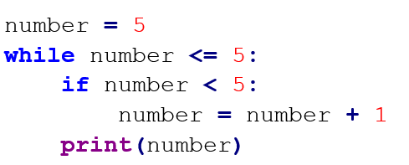
Review Practice Problem 2
What is the result of executing the following code?
A. The program will loop indefinitely
B. The value of number will be printed exactly 1 time
C. The while loop will never get executed
D. The value of number will be printed exactly 5 times

Slide 17
Coding Question 1
Problem statement
Write a Python program that:
asks the user to input an integer value (in base 10)
finds the smallest digit(s) of the representation of the integer value in base 10.
Additional requirements
Your solution should:
not cast the integer value into a string value.
use while loops

Slide 18
Coding Question 2
Problem Statement
Write a python program to find the first 9 prime numbers of the Fibonacci sequence.
Recall that:
Each number in the Fibonacci sequence is the sum of the two preceding ones. The sequence starts with 0 and 1.
>> For example: 0, 1, 1, 2, 3, 5, 8, 13, 21, 34, 55, 89, 144, …
Prime numbers are numbers that have only 2 factors: 1 and themselves
Hints: continue on the next page →

Slide 19
Coding Question 2 Hints
Take baby steps:
Write a function to check if a number is prime. Your function should take in an integer and return a boolean value (True if the input is prime and False otherwise).
a flowchart describing a strategy for primality checking is given on the next slide.
Write a while loop that:
at every iteration
generates the next number in the Fibonacci sequence
checks if the number just generated is a prime number using the function you implemented at Step 1
stops after 9 primes were generated

Slide 20
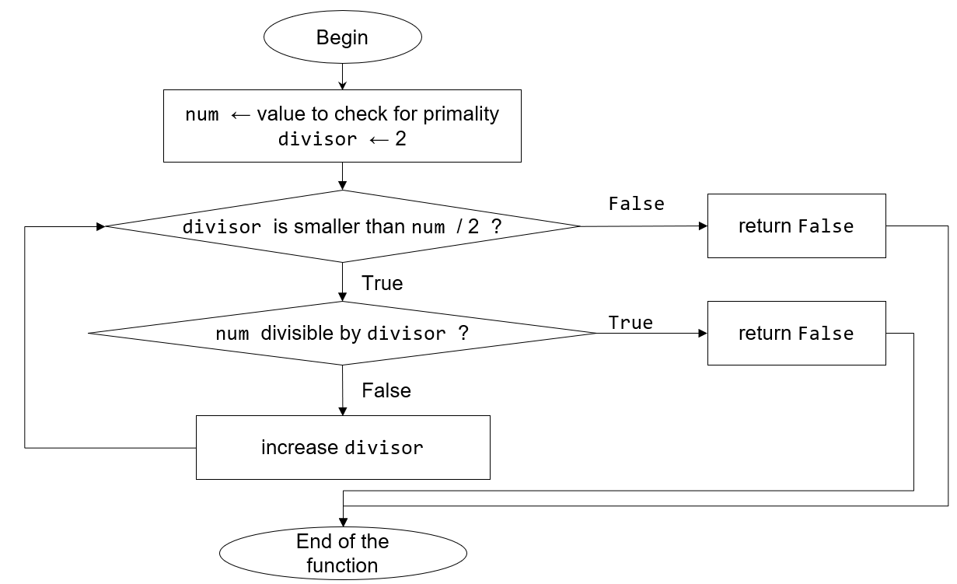
return True

