Slide 1
Tutorial 5 - Week 6
We’ll be starting at the 10 minute mark

Slide 2
Agenda
Lecture Review
Objects & Methods
String Objects & String Methods
Introduction to Files
Practice problems

Slide 3
Learning Objectives
After completing this tutorial, learners should:
understand the notion of object
understand the notion of method (including method parameters/arguments, returned values)
understand the connections between objects, methods, and arguments
know how to call methods on objects
know what an escape sequence is
know how to use escape sequence
know how to convert a value from one representation (i.e., data type) into another
know how to access string components using the index and slice operations (using both positive and negative indices)
understand the notion of “mutability” (and its reverse, aka ‘immutability’)
know several frequently used string methods
know how to “chain”/compose methods

Slide 4
Review of Lecture
Objects and Methods

Slide 5
Lecture Review: Objects In Python, (almost) EVERYTHING is an OBJECT!!
In Python every value, variable, function, etc. is embodied by an object
How to check if something is an (instance) object:
>>> isinstance(4, int)
True
Each object has specific functions that can be applied to that object. These functions are called methods !!
General syntax: object_name.method_name(arguments)
notice the dot !

Slide 6
Remember Lab 1?
Step 1. gain access to the “Turtle” class definition that is packaged in module “turtle”
import turtle
tina = turtle.Turtle()
tina.forward(50)
tina.left(90)
tina.forward(50)
tina.right(90)
tina.forward(90)
tina.right(90)
tina.forward(50)
tina.left(90)
tina.forward(50)
turtle.done()
Notice the difference between “turtle” and “Turtle()”
class name
Step 2. create an object of type Turtle, named tina
module name

Slide 7
Remember Lab 1? (cont)
import turtle
tina = turtle.Turtle()
tina.forward(50)
tina.left(90)
tina.forward(50)
tina.right(90)
tina.forward(90)
tina.right(90)
tina.forward(50)
tina.left(90)
tina.forward(50)
turtle.done()
What is the object ?
What are the methods ?
What are the method arguments ?

Slide 8
Review of Lecture
String Objects & String Methods

Slide 9
String Objects: Displaying / Printing Strings Formatting Strings - Escape Sequences
The \ is a special character, called an escape character
When used in strings in sequence with other characters, print() treats \ as follows:
Escape Sequence | Name | Example | Output
\n | newline (ASCII linefeed - LF) | "How\nare\nyou?" | How are you?
\t | tab (ASCII horizontal tab - TAB) | '3\t4\t5' | 3 4 5
\\ | blackslash | '\\' | \
\' | single quote | 'don\'t' | don’t
\" | double quote | "He says, \"hi\"." | He says, "hi".

Slide 10
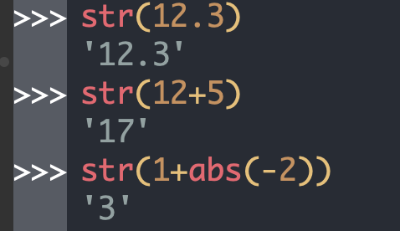
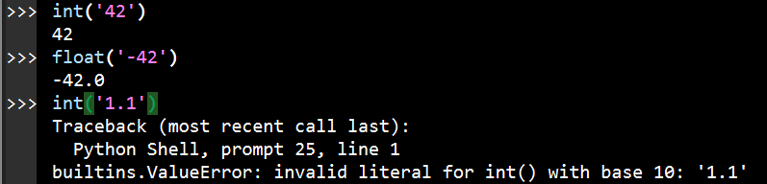
Converting between Data Types
str() takes in an object and returns the string representation of that object.
int() and float() take in an object and attempt to return its number representation

Slide 11
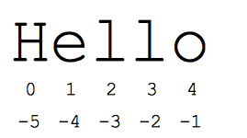

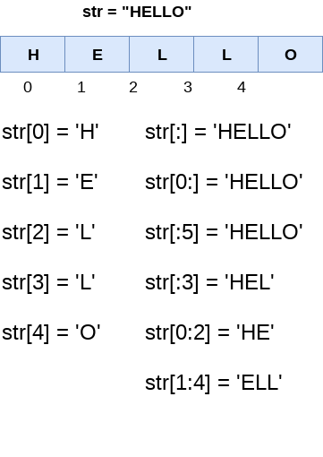
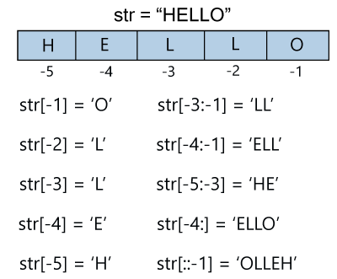
Accessing the Components of a String via indexing
An index is a position in the string
The syntax of the index operator (the bracket notation):
String[ind], where ind is an integer, e.g., s[5],"Hello"[-3]
the index operator returns a string
Indexing starts at position 0 !! (In Python and other languages, but not all)
The index must be an integer !!
The index operator, [ ], does not modify the string it is applied to !
⇒ It only gives access to a string’s element….. More on this soon ☺
Positive Indices:
Negative Indices:
Indexing Examples

Slide 12
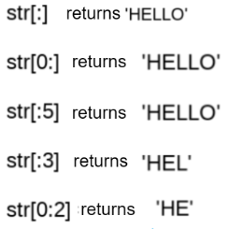
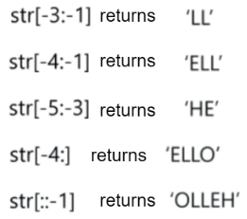
String Slicing
Syntax of the slicing operator:
string [ start : finish ]
string [ start : finish : step ]
The slice operator returns a string !
Indexing starts at position 0 !! (In Python and other languages, but not all)
start, finish, and step must be integers
The slice operator, [ : ], does not modify the string it is applied to !
Positive Indices:
Negative Indices:

Slide 13
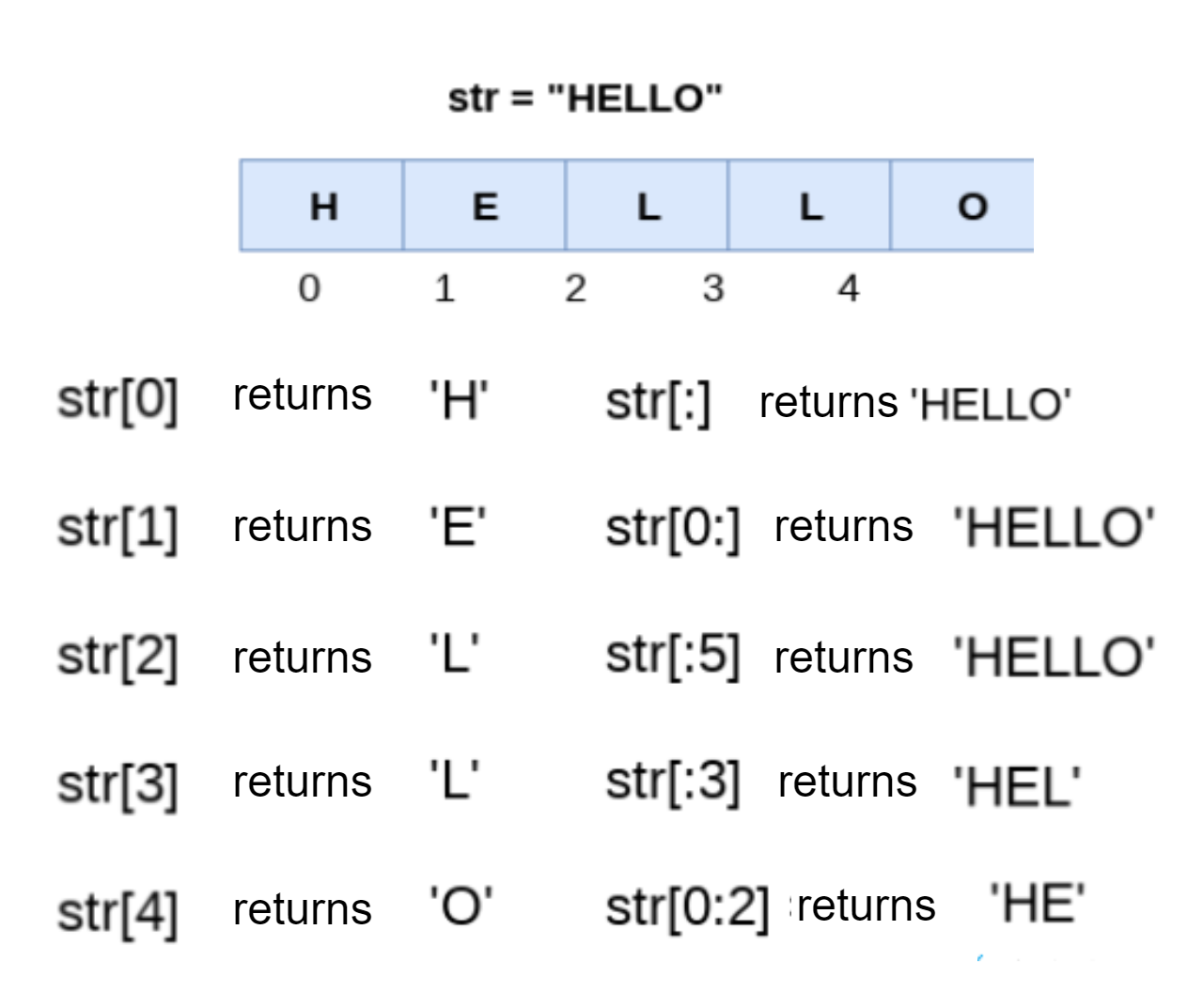
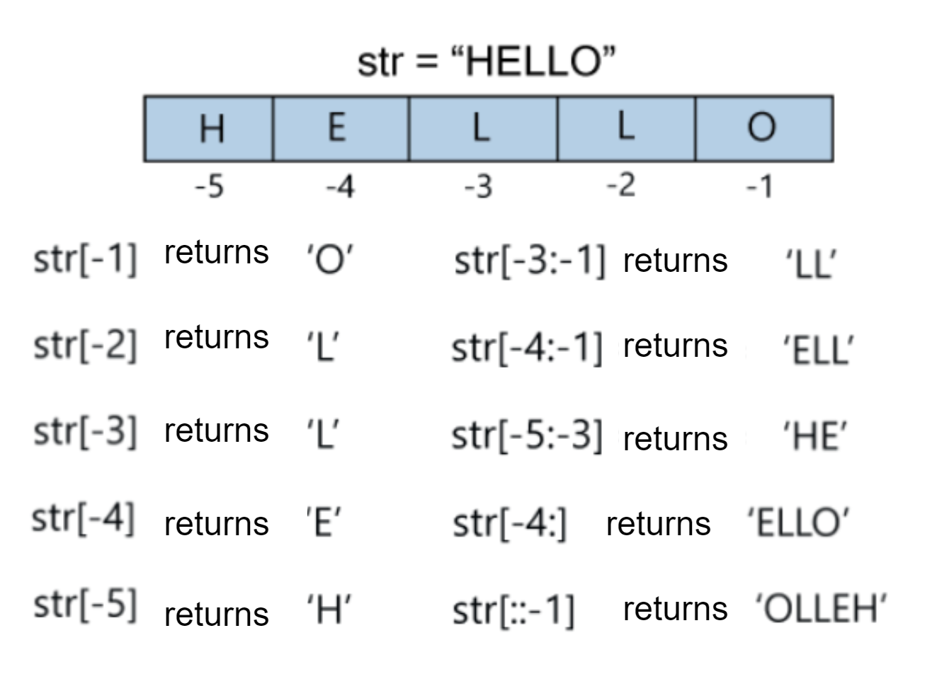
String Indexing vs Slicing - Examples
indexing vs slicing
Note that the values returned by the index and slice operators are strings

Slide 14
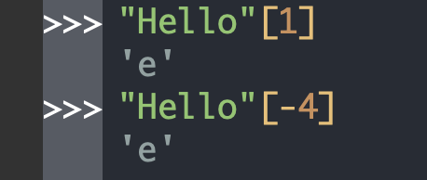
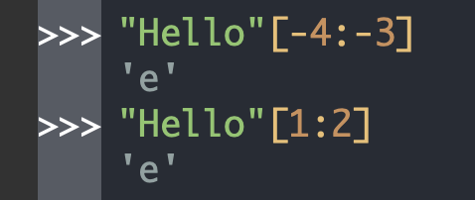
String Indexing vs Slicing Examples (cont’)
If we want to extract substrings of length 1, we can use using either the slice or the index operators.
String Indexing
when you know the exact index you want to access
String Slicing
when you know from where to where you want to slice
For example: In the first scenario, we do not need to know the size of the string, just that it's the third and fourth last characters
If we want to extract substrings of length greater than 1, we can use the slice operator.

Slide 15
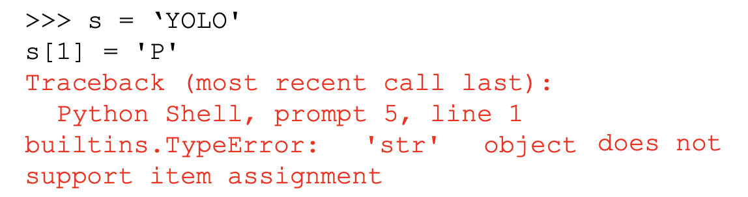
“Modifying” Strings
Strings are IMMUTABLE:
Slicing and indexing DO NOT modify the string they are acting on

Slide 16
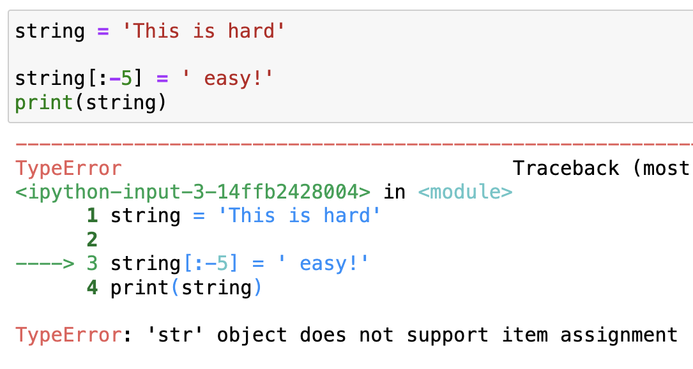
How to “modify” a string ? ⇒ We CANNOT modify strings!
If you need to change the value of a variable and:
A. wish to preserve the existing string value (aka the value to be “modified”)
Create a new variable
Assign the “old” string to the new variable
Assign the desired new string to the “original” variable
B. do not wish to preserve the existing string value
Assign to the variable the desired new string

Slide 17
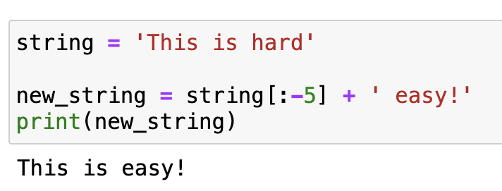
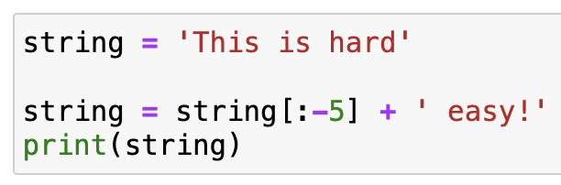
How to “modify” a string ? ⇒ We CANNOT modify strings!
If you need to change the value of a variable and:
A. wish to preserve the existing string value (aka the value to be “modified”)
Create a new variable
Assign the “old” string to the new variable
Assign the desired new string to the “original” variable
B. do not wish to preserve the existing string value
Assign to the variable the desired new string
What do you think would output?

Slide 18
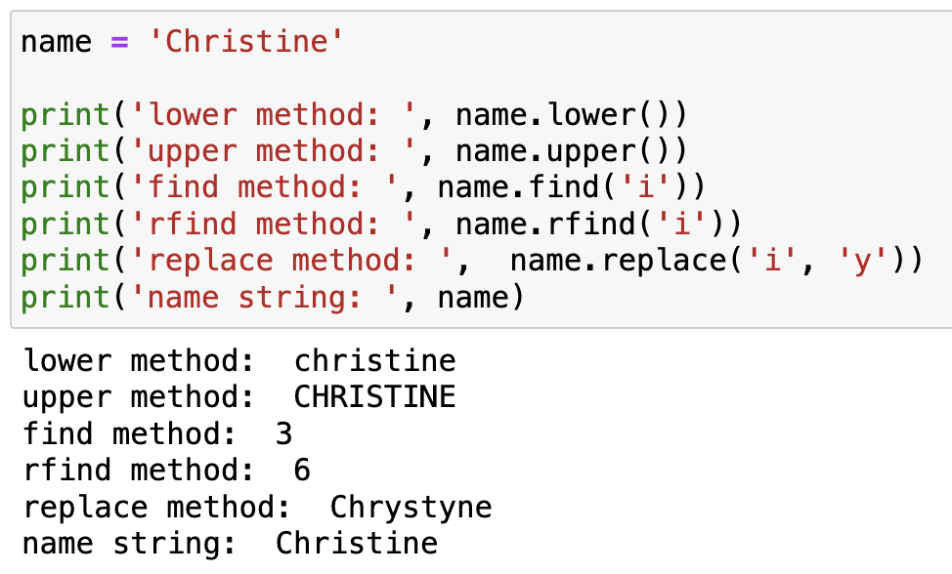
String Methods
find(), rfind(), replace(), lower(), upper(), …
Note: find() and rfind() are different
find() starts looking from index 0
rfind() starts looking from index -1

Slide 19
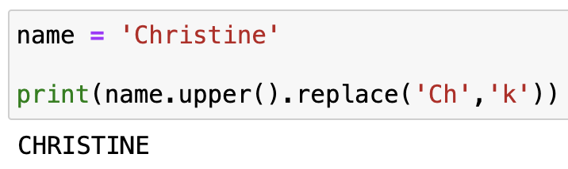
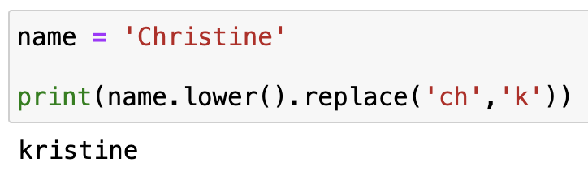
Method “Chaining”
Methods can be “chained”
What would the following code return?

Slide 20
Method “Chaining”
Methods can be “chained”
What would the following code return?
Result:
Result:

Slide 21
Review of Lecture
Program Input and Output - Files

Slide 22
Opening Files
The general form for opening a file is:
open(file_path, mode)
mode can be:
'r' for reading
'w' for writing
'a' for appending
'r+' for reading and writing
'a+' for appending and reading
open()returns a file object.

Slide 23
Writing to a File
The following statement opens the file for writing (note parameter mode is set to 'w')
myfile = open("test.txt", "w")
To write something to the file we can use the write method of the file object:
myfile.write("My first file ...")
Once we have finished with the file, we need to close it:
myfile.close()
my_file is a file object
Where does the file save?

Slide 24
Reading a File
The following statement opens the file for reading (note parameter mode is set to 'r')
storyfile = open("my_story.txt", "r")
We want to store the contents from the file into a variable by using the read method:
story_string = storyfile.read()
Once we have finished with the file, we need to close it:
storyfile.close()
To print out the contents of the file, print the variable we created:
print(story_string)
WARNING: If the text file is large this is not optimal! Also, what do you think happens if my_story.txt does not exist?

Slide 25
Reading a File - The readline() approach
Instead, we can read the file line-by-line into a string using readline()! Safer as will not put the file into memory all at once. The file does have to stay open until loop through all the lines:
storyfile = open("my_story.txt", "r")
line = storyfile.readline()
contents = ""
while line != "":
contents += line
line = storyfile.readline()
myfile.close()
print(contents)
This reads only the first line
We loop through the rest of the file, one line at a time until we get to an empty line (“”)
After we read the line, append it to the contents string iteratively. The \n is preserved

Slide 26
Reading a file
Approach | Code | When to use it
The read approach | myfile = open(filename, ‘r’) contents = myfile.read() myfile.close() | When you want to read the whole file at once and use it as a string
The readline approach | myfile = open(filename, ‘r’) contents = ‘’ line = myfile.readline() contents = contents + line while line != ‘’: contents += myfile.readline() myfile.close() | When you want to process only part of a file
The for line in file approach | myfile = open(filename, ‘r’) contents = ‘’ for line in myfile: contents += line myfile.close() | When you want to process every line in the file one at a time
The readlines approach | myfile = open(filename, ‘r’) lines = myfile.readlines() myfile.close() | When you want to examine each line of a file by index
Current
Future!

Slide 27
Practice Problems

Slide 28


Consider the code below. Which expression does not produce 'asap'
ⓘ
Click Present with Slido or install our Chrome extension to activate this poll while presenting.
Notes:
📣 This is Slido interaction slide, please don't delete it. ✅ Click on 'Present with Slido' and the poll will launch automatically when you get to this slide.

Slide 29
Review Practice Problem 1
Q1. Consider the code below. Which expression does NOT produce 'asap'
A
phrase[0] + phrase[3] + phrase[8] + phrase[11]
B
phrase[:4:3] + phrase[-11] + phrase[-8]
phrase = "as soon as possible"
phrase[1] + phrase[4] + phrase[8] + phrase[-8]
C
phrase[-19] + phrase[-16] + phrase[-11] + phrase[-8]
D

Slide 30
What is printed after the code below executes?
ⓘ
Click Present with Slido or install our Chrome extension to activate this poll while presenting.
Notes:
📣 This is Slido interaction slide, please don't delete it. ✅ Click on 'Present with Slido' and the poll will launch automatically when you get to this slide.

Slide 31
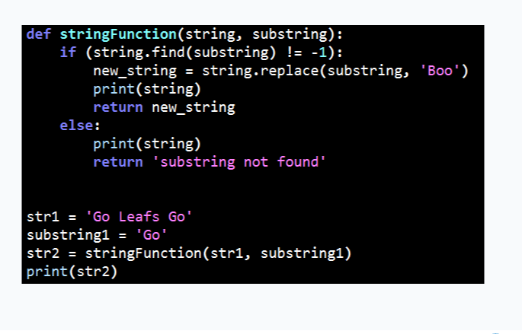
Review Practice Problem 2
Q2. What is printed after the code below executes?
A
Go Leafs Go
Boo Leafs Boo
B
Go Leafs Go
substring not found
C
Boo Leafs Boo
Boo Leafs Boo
D
Go Leafs Go
Go Leafs Go
E
None of the above

Slide 32
Coding Question 1
Problem statement
write a function string_sum() that takes in a string and returns the sum of the digits that appear in the input string. Characters other than digits are ignored.
>>> string_sum("PYnative29@#8496")
38
Additional requirement:
use a while loop to solve this question.

Slide 33
Coding Question 2
Problem statement
write a function string_avg() that takes in a string and returns the average of the digits that appear in the input string, rounded to 2 decimals. Characters other than digits are ignored.
>>> string_avg("PYnative29@#8496")
6.33
Additional requirement:
use a while loop to solve this question.

