Slide 1
Tutorial 6 - Week 7
We’ll be starting at the 10 minute mark

Slide 2


Slide 3
Agenda
Lecture review
List fundamentals
List methods
List operators
List iteration
Practice questions

Slide 4
Learning objectives
After this tutorial, learners should be able to:
recognize / describe / create objects of type list
access and modify individual elements of a list using subscription and slicing
insert and remove elements from the list using appropriate list methods/operators
test whether a value/object belongs to a list using the membership operator
sort a list using the sort method
Iterate over lists
understand the concept of aliasing and use it effectively

Slide 5
Review of Lecture
Python list fundamentals

Slide 6
Python lists
Lists are ordered collections of values
Lists elements may be of any type, including of type list !
["apple", "banana", "potato"]
[17, -4, 23]
["Hello world", -17.0, 23, "March-2022"]
[["APS106", "MY", 150], ["APS106", "BA", 1190]]
a “nested” list
lists that contain elements which are lists are called nested lists.

Slide 7
Creating lists
Using the literal notation [ ]
>>> my_list = []
>>> my_list
[]
>>> my_list = ["a", "b", "c"]
>>> my_list
['a', 'b', 'c']
Using built-in function list() #less common
>>> my_list = list()
>>> my_list
[]
>>> my_list = list('abc')
>>> my_list
['a', 'b', 'c']

Slide 8
Creating lists using helper variables
>>> a = 1
>>> b = 2
>>> my_list = [a, b]
>>> my_list
[1, 2]
>>> s1_grades = [72, 100, 52]
>>> s2_grades = [89, 77, 81]
>>> s3_grades = [44, 82, 90]
>>> grades = [s1_grades, s2_grades, s3_grades]
>>> grades
[[72, 100, 52], [89, 77, 81], [44, 82, 90]]
Create a nested list whose elements are s1_grades, s2_grades, and s3_grades

Slide 9
Built-in Functions
Several of Python's built-in functions can be applied to lists, including:
len(list) : return the number of elements in list (i.e. the length)
min(list) : return the value of the smallest element in list.
max(list) : return the value of the largest element in list.
sum(list) : return the sum of elements of list (list items must be numeric).

Slide 10
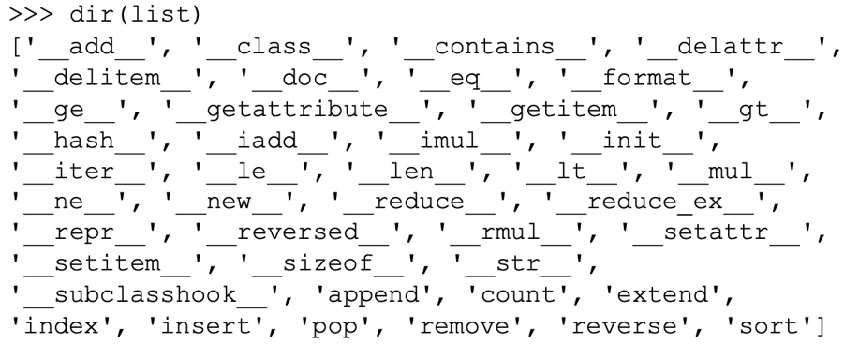
List methods
Recall that a method is a function associated with an object
You can find out the methods associated with type list by:
typing dir(list)in the Python shell
searching the online Python documentation

Slide 11
Adding elements to a list
Recall that strings, integers, and booleans are immutable !!
Python lists are mutable, i.e., their contents can be changed
Lists can be modified in several ways, e.g., using the concatenation operator + or using list methods such as append() and extend():
append(): Add an item to the end of a list
>>> fruits = ["apple", "banana", "pear"]
>>> fruits.append("blueberry")
>>> fruits
['apple', 'banana', 'pear', 'blueberry']
extend(): Add one or more items to the end of a list
>>> veggies = ["asparagus", "broccoli"]
>>> fruits.extend(veggies)
>>> fruits
['apple', 'banana', 'pear', 'blueberry', 'asparagus','broccoli']

Slide 12
Removing elements from a list
List method remove() removes the first occurrence of an item from a list
>>> fruits.remove("pear")
>>> fruits
['apple', 'banana', 'blueberry', 'asparagus’, 'broccoli']

Slide 13
List Operators¹
subscription selects an item of a sequence
Accessing list elements using subscription, i.e., the indexing operator:
>>> my_list = ["apple", "banana", "potato"]
>>> my_list[1]
'banana'
>>> grades
[[72, 100, 52], [89, 77, 81], [44, 82, 90]]
>>> grades[0]
[72, 100, 52]
>>> grades
[[72, 100, 52], [89, 77, 81], [44, 82, 90]]
>>> grades[0][0] + grades[0][1] + grades[0][2]
124

Slide 14
List Operators²
Accessing list elements using using the slicing operator
>>> class_grades = [72,100,52,89,77,81,44,82,90]
>>> grades[0:2]
[72, 100]
>>> grades[::-2]
[90, 44, 77, 52, 72]

Slide 15
List Operators³
Modifying list elements using subscription
>>> my_list = ["apple", "banana", "pear"]
>>> my_list[1] = "plantain"
>>> my_list ['apple', 'plantain', 'pear']
Modifying list elements using the slicing operator
>>> class_grades[0:2] = [40, 45]
>>> class_grades
[40, 45, 52, 89, 77, 81, 44, 82, 90]
>>> list1 = [[1, 2], [3, 4], [5, 6, 7, 8]]
>>> list1[2][1:3] = [11, 22, 33, 44]
>>> list1
[[1, 2], [3, 4], [5, 11, 22, 33, 44, 8]]

Slide 16
List operators⁴
Testing if a value is in a list using the membership operator
>>> 'asparagus' in ['apple', 'asparagus', 'broccoli']
True
Creating new lists using the concatenation operator
>>> list1 = ['apple', 'banana', 'pear']
>>> list2 = list1 + ['peach', 'orange']
>>> list2
['apple', 'banana', 'pear', 'peach', 'orange']
Creating new lists using the repetition operator
>>> list1 = ['apple', 'banana', 'pear']
>>> list1 * 2
['apple', 'banana', 'pear', 'apple', 'banana', 'pear']

Slide 17
Review of Lecture
Aliasing in Python

Slide 18
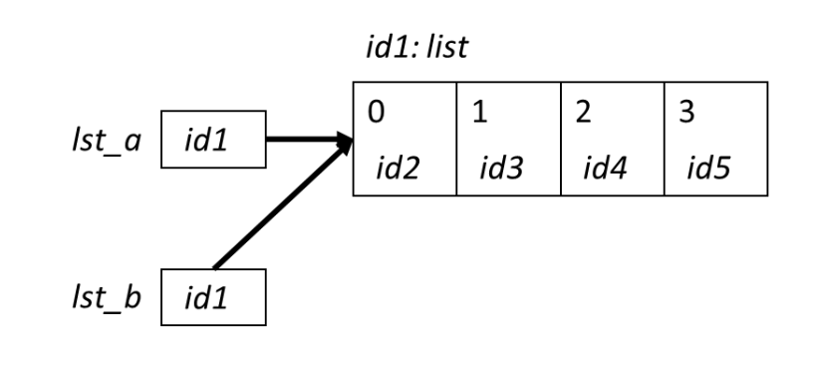
Aliasing and Lists - 1
In Python, variables are just names that store references to values (aka objects).
⇒ When more than one variable refers to the same object, they function as aliases
for that object.
>>> list = [0, 1 ,2 ,3]
>>> lst_a = list
>>> lst_b = list
Sometimes we want to take advantage of aliasing..
Other times we need to avoid it.
=> How do we avoid aliasing?
> By using a copy of the list of interest !
>>> list = [0, 1 ,2 ,3]
>>> lst_a = list[:]
>>> lst_b = list[:]

Slide 19
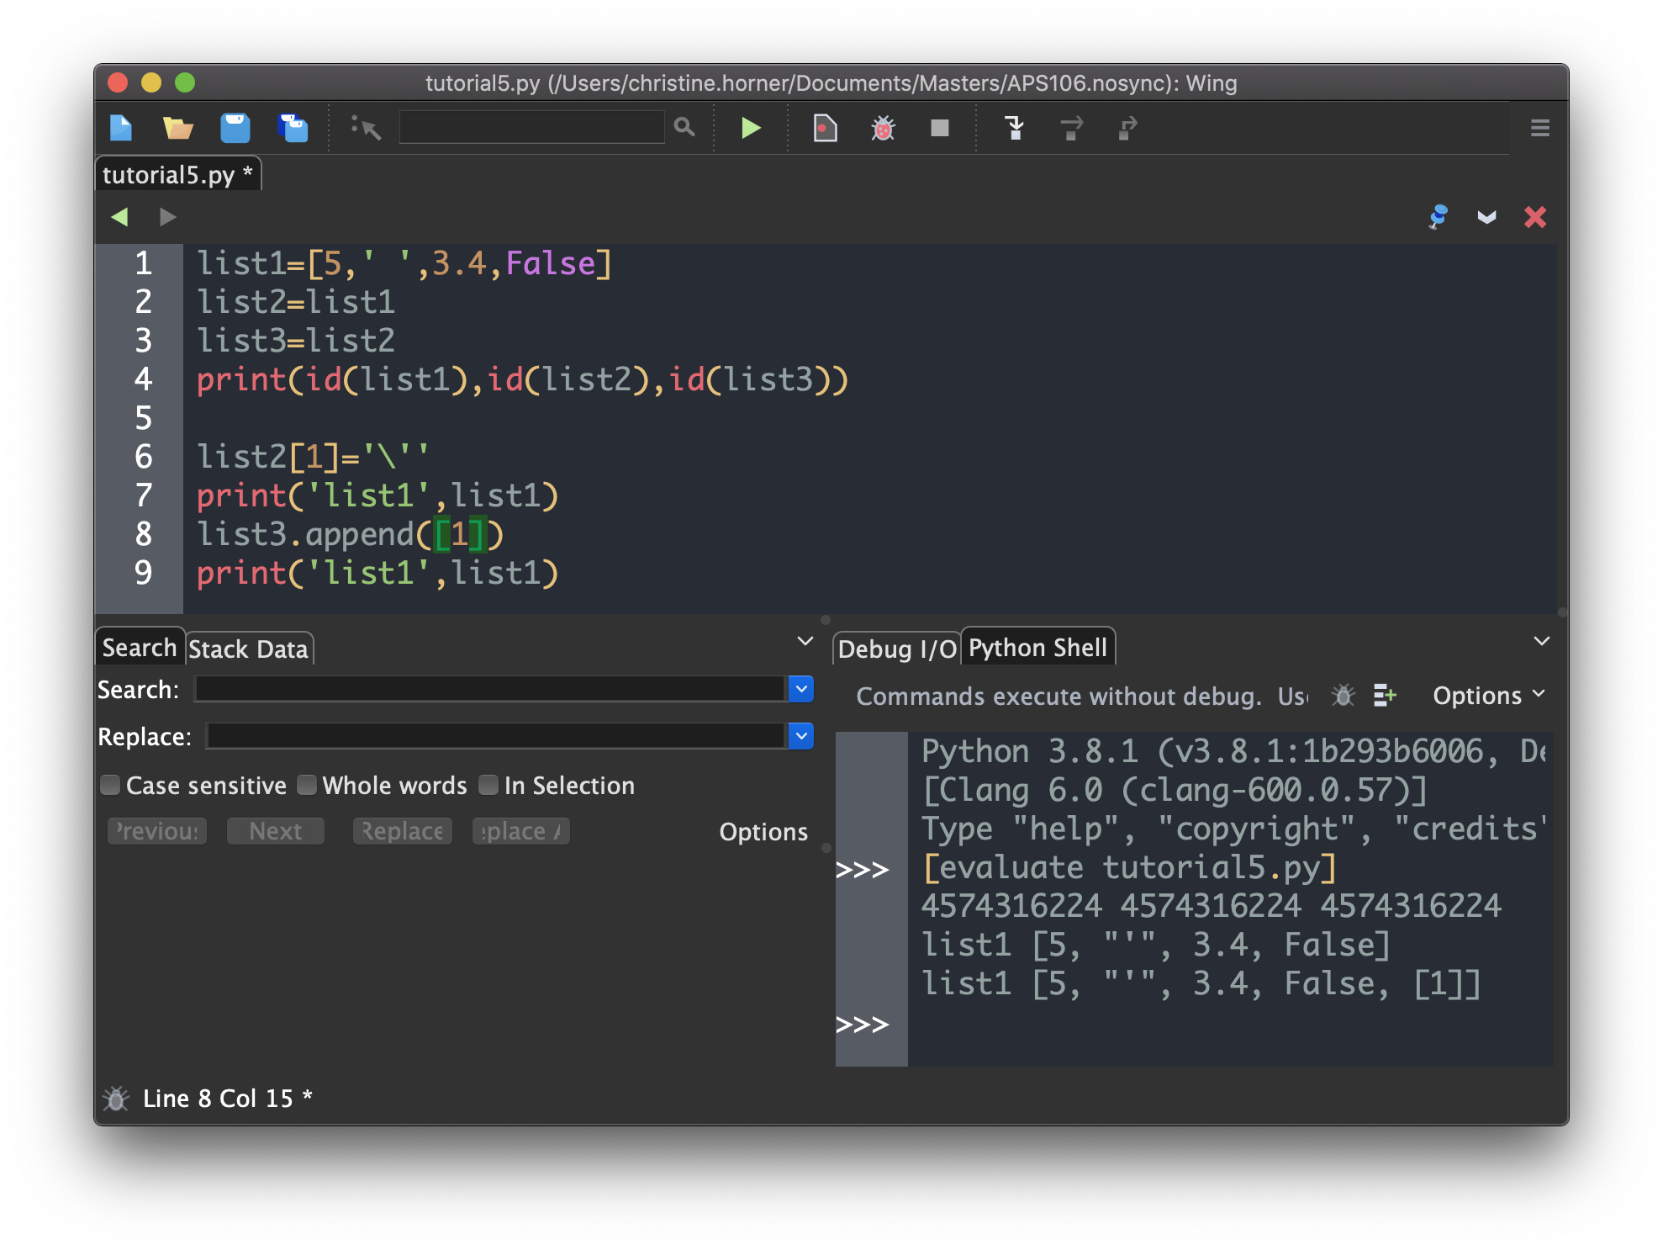
Aliasing and Lists -2
Modifying the object referred to by one of these variable will affect the other variables !!
list1, list2 and list3 refer to the same object
Changes made to list2, and list3 are “visible” to list1

Slide 20
Review of Lecture
Iterating over lists

Slide 21
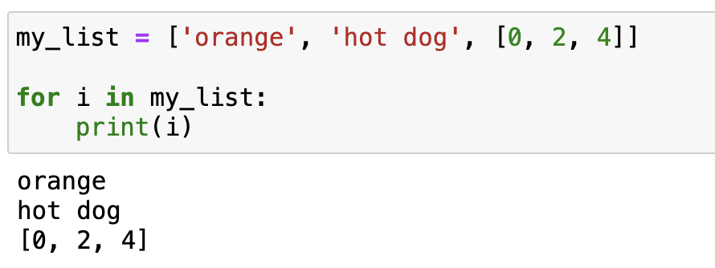
Looping through a list
for list_item in list_object:
loop_body
This syntactic pattern can be used to iterate over all Python sequences, e.g.,
lists, strings, etc.
⇒ each element in the sequence is
“visited” only once

Slide 22
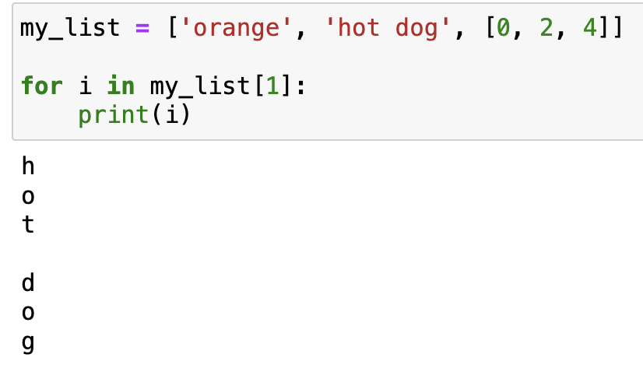

Looping through a list
for list_item in list_object:
loop_body
This syntactic pattern can be used to iterate over all Python sequences, e.g.,
lists, strings, etc.
⇒ each element in the sequence is
“visited” only once

Slide 23
Looping through a list
for list_item in list_object:
loop_body
This syntactic pattern can be used to iterate over all Python sequences, e.g.,
lists, strings, etc.
⇒ each element in the sequence is
“visited” only once

Slide 24
Practice Problems

Slide 25


What is the answer to the question below?
ⓘ
Click Present with Slido or install our Chrome extension to activate this poll while presenting.
Notes:
📣 This is Slido interaction slide, please don't delete it. ✅ Click on 'Present with Slido' and the poll will launch automatically when you get to this slide.

Slide 26
Review Practice Problem 1
Q1. What is answer to the question below?
The following list is created in Python:
my_list = ['hello', 'hey’]
Which of the options do NOT change the value of my_list to :
['hello', 'hey', 'hi']
Note that multiple answers may be selected
my_list.append("hi")
my_list.append(["hi"])
my_list.extend("hi")
my_list.extend(["hi"])
my_list = my_list + "hi"

Slide 27
What does this code output?
ⓘ
Click Present with Slido or install our Chrome extension to activate this poll while presenting.
Notes:
📣 This is Slido interaction slide, please don't delete it. ✅ Click on 'Present with Slido' and the poll will launch automatically when you get to this slide.

Slide 28
Review Practice Problem 2
Q1. What does this code output?
[5, 10, 15]
[1, 2, 3, 4, 8, 12]
[1, 2, 3, 2, 4, 6, 2, 4, 6]
Error is thrown
x = [1, 2, 3]
y = [2, 4, 6]
print(x + 2 * y)

Slide 29
Coding Question 1
Write a function sort_list() that takes in a list of integers, sorts it in an ascending order, and returns the sorted list.
The function should not modify the original input list: that list must remain unchanged
Usage example:
>>> sort_list([48, 39, 1, 444, 39,2398])
[1, 39, 39, 48, 444, 2398]

Slide 30
Coding Question 2
Write a program that repeatedly asks the user for grocery items (strings) until the user inputs ‘exit’, then display all their grocery items in alphabetical order.
Hint:
You can use question 1 to alphabetize the list

