Slide 1
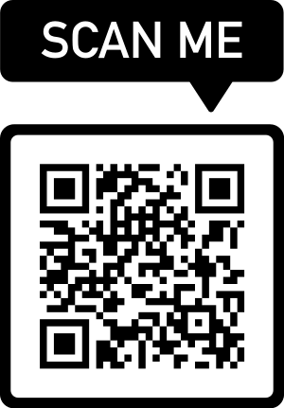

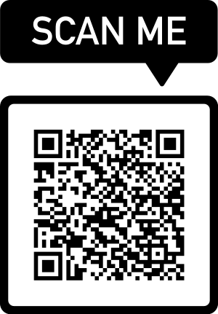
TERM TEST 1 REVIEW
APS106
Two heart-research-specific summer programs with projects in AI, wearable electronics, etc.
UofT Eng Research Opportunities

Slide 2
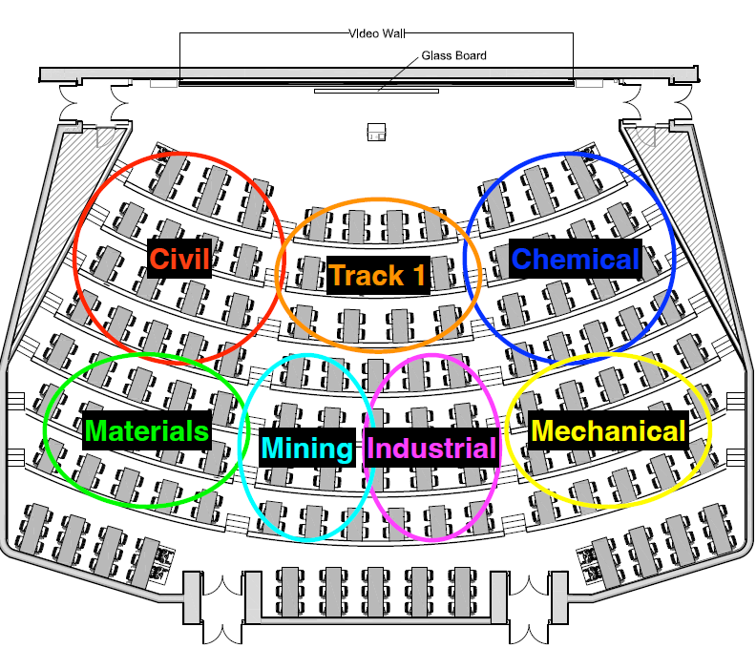

Slide 3
Rules of the GAME
Must use button on the table to answer question verbally and explain your answer – you will be called on to answer by one of the instructors
Must tell us which discipline you’re in before you answer for points (we’ll rely on the honour system)
If you get the answer right, you pick the next category
If you get the answer wrong, the next person whose hand is up can steal
Everyone is here to learn and review for the midterm so be kind to everyone who answers!

Slide 4
Panel
THE GOOD, the BAD, and the FUNCTION
WHILE, WHILE, WHILE
To output or not to OUTPUT
MONTy learns PYTHON
$250
$250
$250
$250
$500
$500
$500
$500
$750
$750
$750
$750
$1000
$1000
$1000
$1000

Slide 5
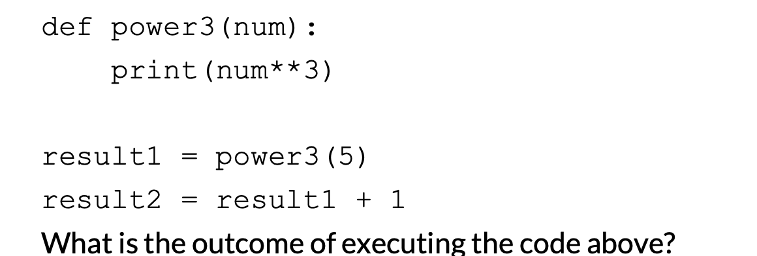
What is the output?
THE GOOD, the BAD, and the FUNCTION · $250
Question board

Slide 6
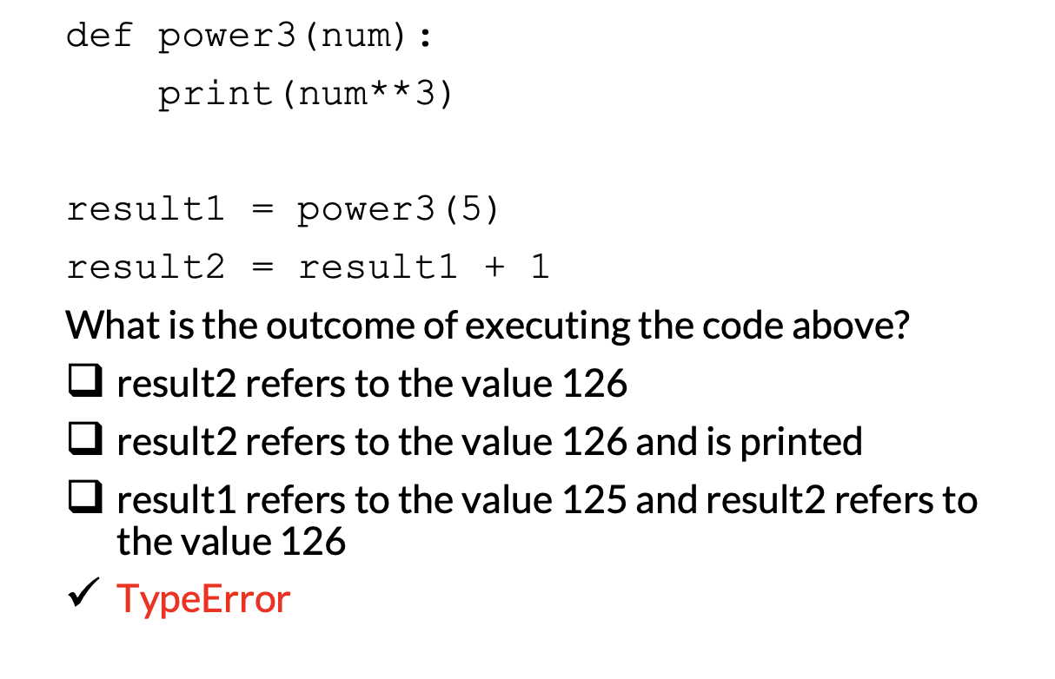
THE GOOD, the BAD, and the FUNCTION · $250
Question board

Slide 7
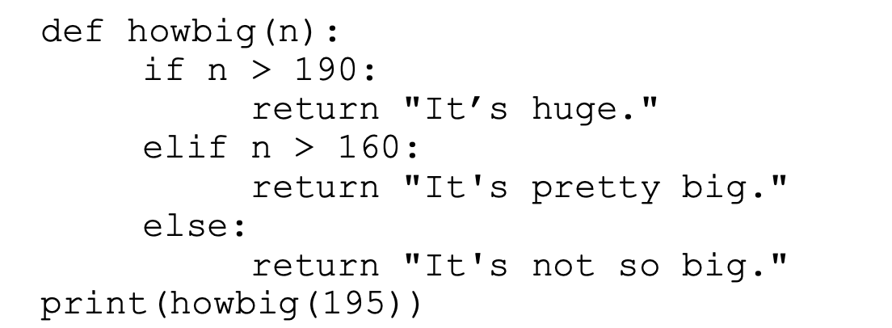
What is the output?
THE GOOD, the BAD, and the FUNCTION · $500
Question board

Slide 8
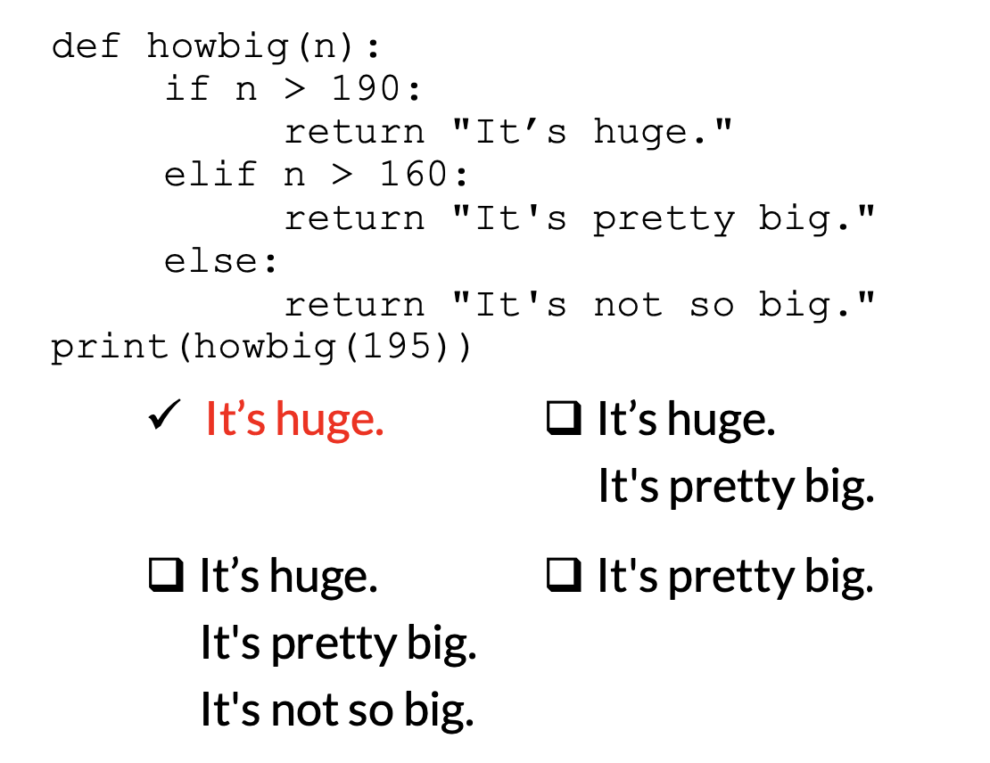
THE GOOD, the BAD, and the FUNCTION · $500
Question board

Slide 9
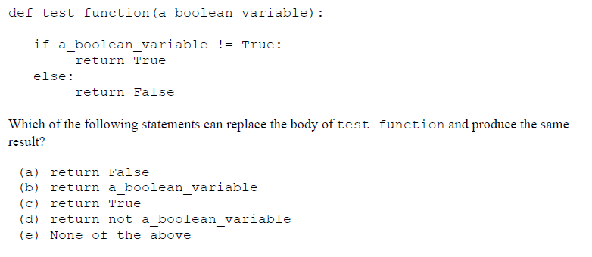
THE GOOD, the BAD, and the FUNCTION · $750
Question board

Slide 10
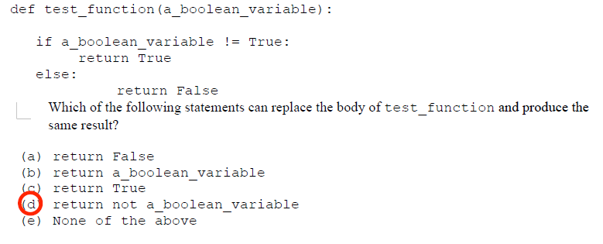
THE GOOD, the BAD, and the FUNCTION · $750
Question board

Slide 11
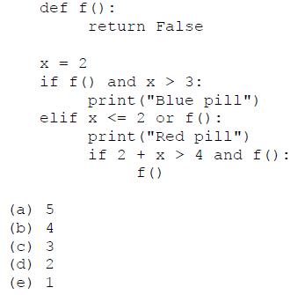
How many times in total is the function f() called?
THE GOOD, the BAD, and the FUNCTION · $1000
Question board

Slide 12
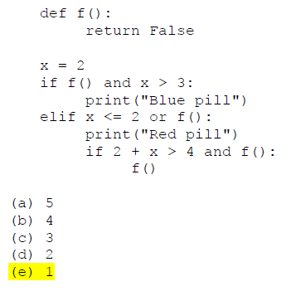
THE GOOD, the BAD, and the FUNCTION · $1000
Question board

Slide 13
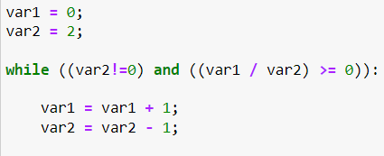
What are the values of var 1 and var 2 after the following code segment is executed and the while loop finishes?
WHILE, WHILE, WHILE · $250
Question board
Notes:
Go to python notebook

Slide 14
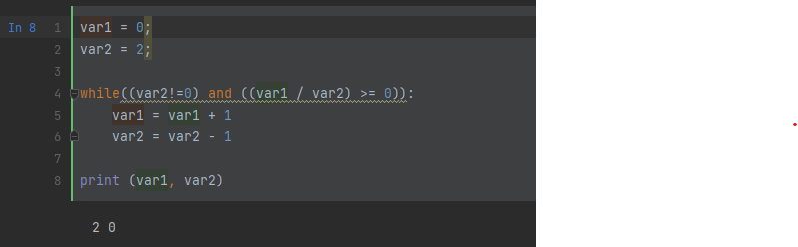
What are the values of var 1 and var 2 after the following code segment is executed and the while loop finishes?
WHILE, WHILE, WHILE · $250
Question board
Notes:
Go to python notebook

Slide 15
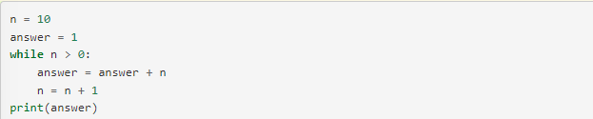
Verbally explain what happens in the following piece of code:
WHILE, WHILE, WHILE · $500
Question board

Slide 16
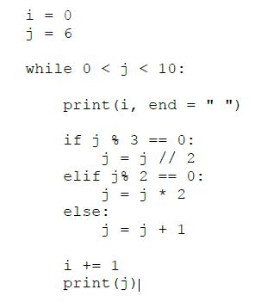
What will the code print?
WHILE, WHILE, WHILE · $750
Question board

Slide 17
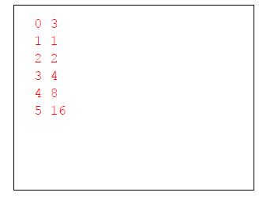
What will the code print?
WHILE, WHILE, WHILE · $750
Question board

Slide 18
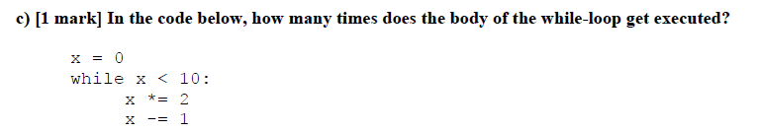
WHILE, WHILE, WHILE · $1000
Question board
Notes:
Infinite

Slide 19
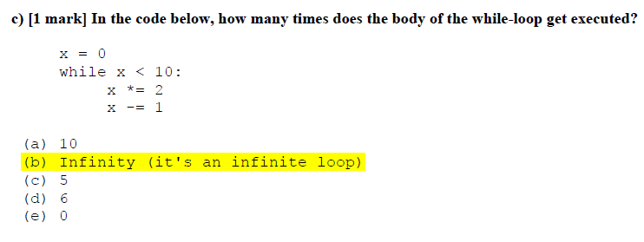
WHILE, WHILE, WHILE · $1000
Question board
Notes:
Infinite

Slide 20
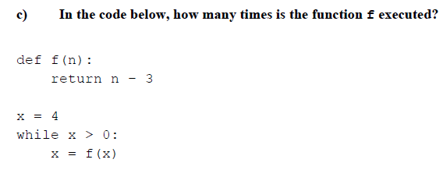
WHILE, WHILE, WHILE · $1000
Question board
Notes:
2

Slide 21
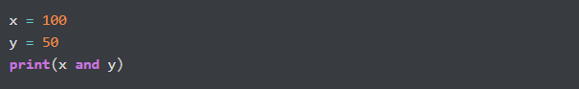
What is the output?
To output or not to OUTPUT · $250
Question board

Slide 22
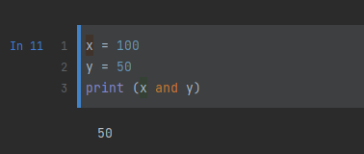
What is the output?
To output or not to OUTPUT · $250
Question board

Slide 23
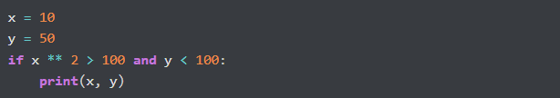
What is the output?
To output or not to OUTPUT · $500
Question board
Notes:
No output

Slide 24
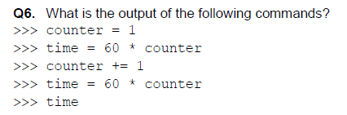
To output or not to OUTPUT· $750
Question board
Notes:
120

Slide 25
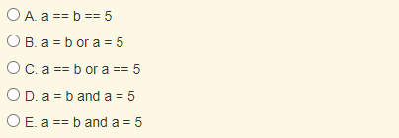
Which of the following evaluates to True when a is equal to b or when a is equal to 5?
To output or not to OUTPUT · $1000
Question board
Notes:
C

Slide 26
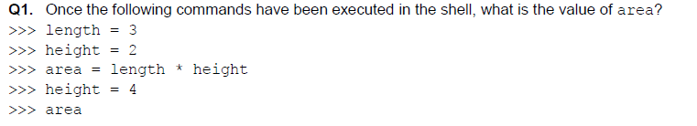
MONTy learns PYTHON · $250
Question board
Notes:
6

Slide 27
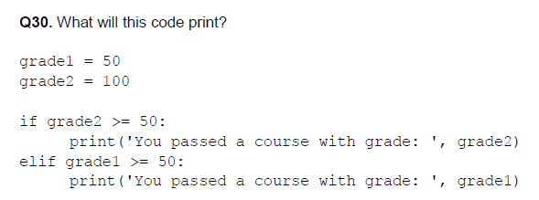
MONTy learns PYTHON · $500
Question board
Notes:
You passed a course with grade: 100

Slide 28

MONTy learns PYTHON · $750
a. – (7 % 4) b. 2 ** 3 c. 6 / 2 d. 3
e. 6.0
Question board

Slide 29
MONTy learns PYTHON · $750
a. – (7 % 4) b. 2 ** 3 c. 6 / 2 d. 3
e. 6.0
Question board

Slide 30
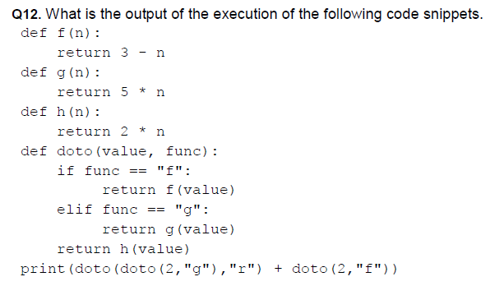
MONTy learns PYTHON · $1000
Question board
Notes:
21

Slide 31
Final Jeopardy

Slide 32
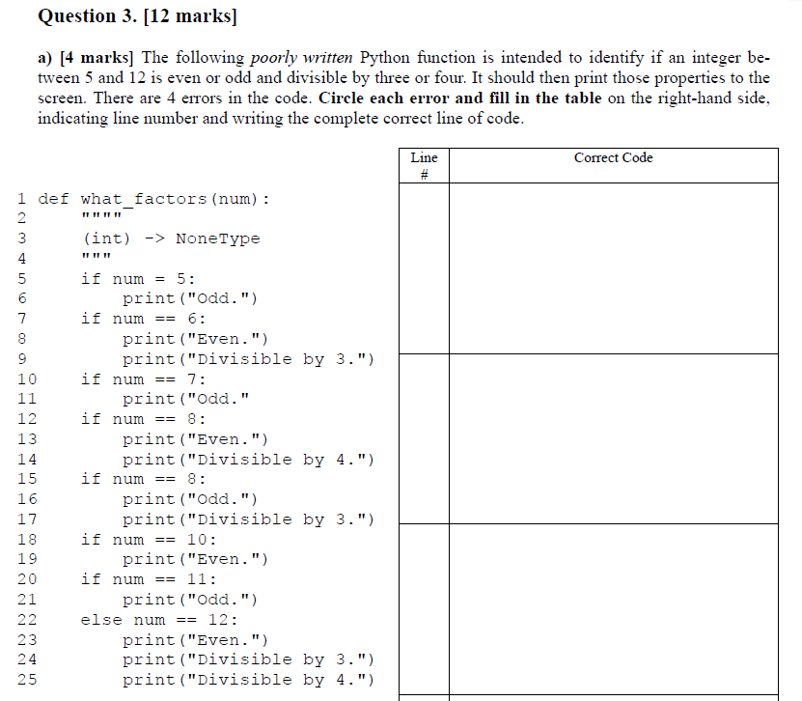
Question 1 · FINAL JEOPARDY

Slide 33
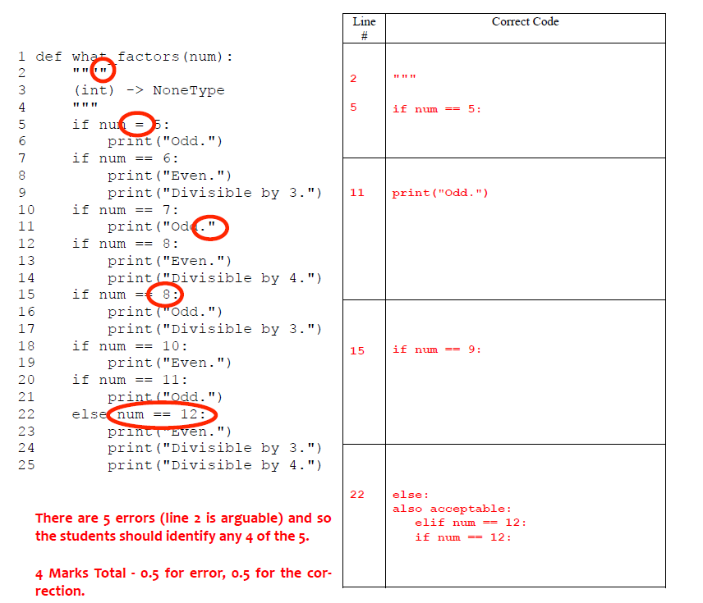
Question 1· FINAL JEOPARDY

Slide 34
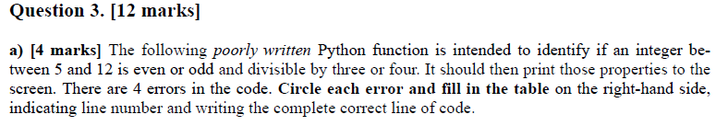
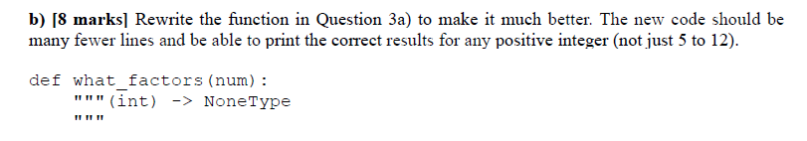
Question 2 · FINAL JEOPARDY

Slide 35
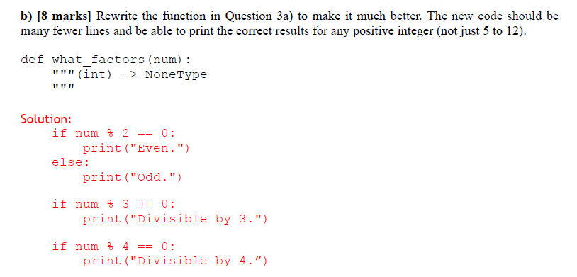
Question 2 · FINAL JEOPARDY

Slide 36
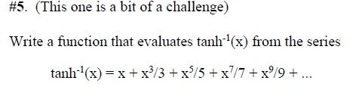
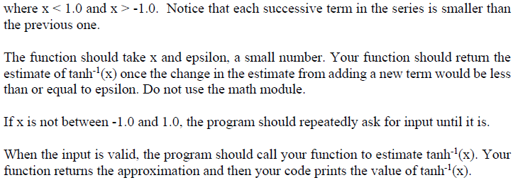
EXTRA Question 3 · FINAL JEOPARDY

Slide 37
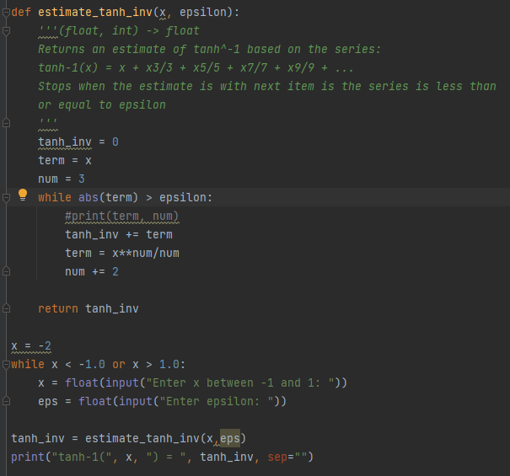
EXTRA Question 3 · FINAL JEOPARDY

