Slide 1
MIDTERM REVIEW
APS106

Slide 2
Rules of the GAME
Must use button on the table to answer question verbally and explain your answer – you will be called on to answer by one of the instructors
Must tell us which discipline you’re in before you answer for points (we’ll rely on the honour system)
If you get the answer right, you pick the next category
If you get the answer wrong, the next person whose hand is up can steal
Everyone is here to learn and review for the midterm so be kind to everyone who answers!

Slide 3
Panel
Things and strings
For a while there…
Fantastic containers and where to find them
Check your
Method-ology
All things index
$250
$250
$250
$250
$250
$500
$500
$500
$500
$500
$1000
$1000
$1000
$1000
$1000

Slide 4
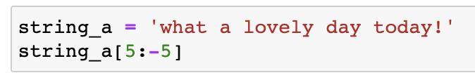
What is the output?
things and strings · $250
Question board

Slide 5
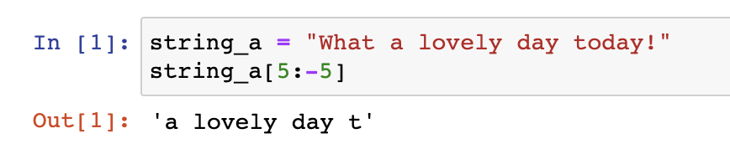
What is the output?
things and strings · $250
Question board

Slide 6
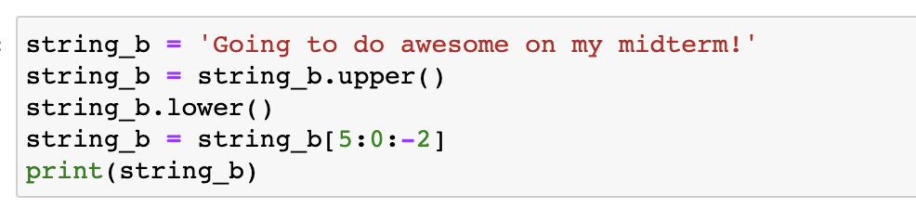
What is the output?
Things and strings · $500
Question board

Slide 7
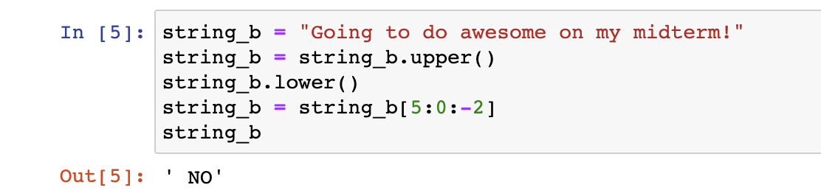
What is the output?
Things and strings · $500
Question board

Slide 8
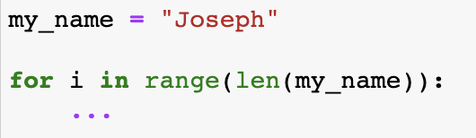
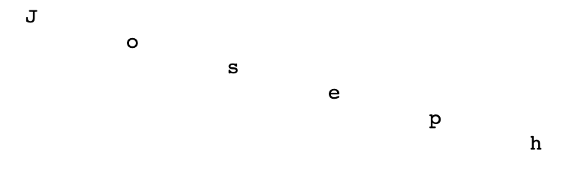
Provide the print statement that will give this output
Things and strings · $1000
Output:
Question board

Slide 9
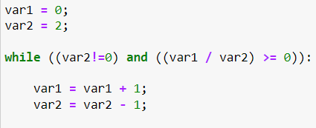
What are the values of var 1 and var 2 after the following code segment is executed and the while loop finishes?
TIME TO COMPARE AND GET LOOPY · $250
Question board

Slide 10
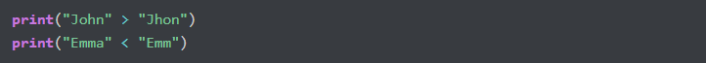
What is the output of the code?
TIME TO COMPARE AND GET LOOPY · $500
Question board

Slide 11
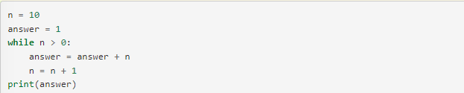
Verbally explain what happens in the following piece of code:
TIME TO COMPARE AND GET LOOPY · $1000
Question board

Slide 12
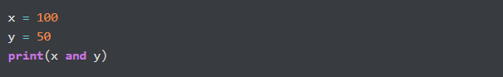
What is the output?
To AND OR NOT TO AND · $250
Question board

Slide 13
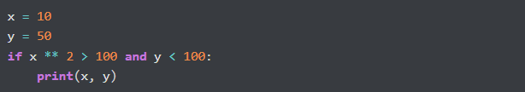
What is the output?
To AND OR NOT TO AND · $500
Question board

Slide 14
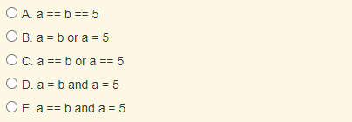
Which of the following evaluates to True when a is equal to b or when a is equal to 5?
To AND OR NOT TO AND · $1000
Question board

Slide 15
Which of the following evaluates to True when a is equal to b or when a is equal to 5?
To AND OR NOT TO AND · $1000
Question board

Slide 16
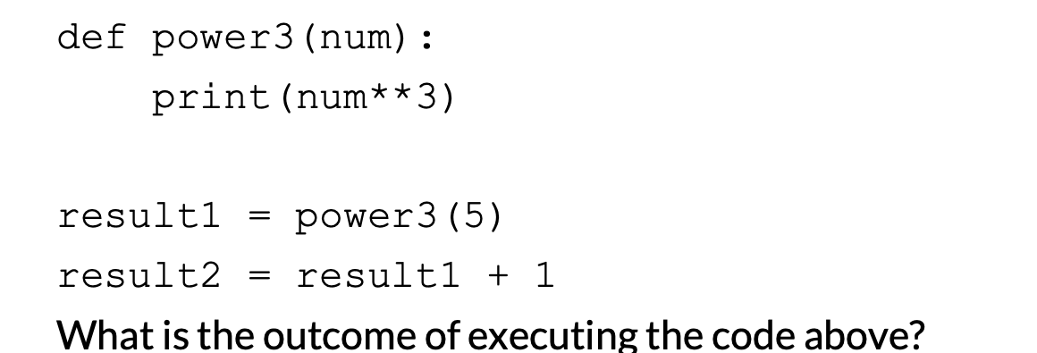
What is the output?
Get func-y with it · $250
Question board

Slide 17
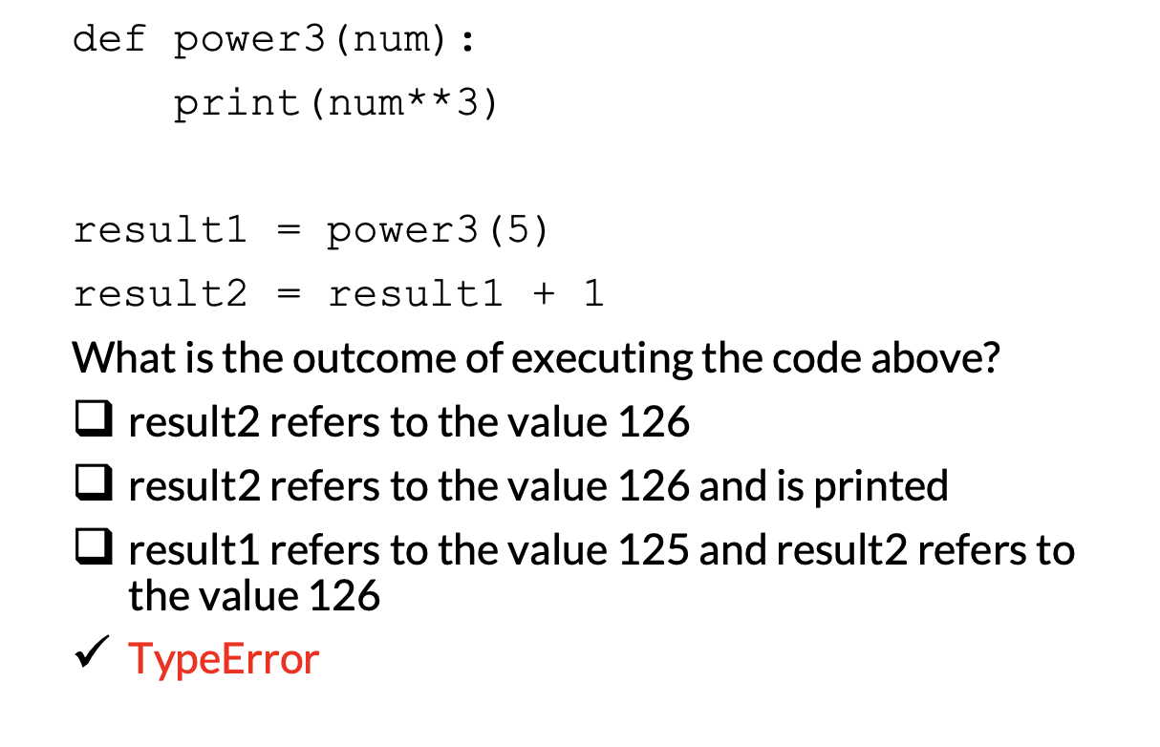
Get func-y with it · $250
Question board

Slide 18
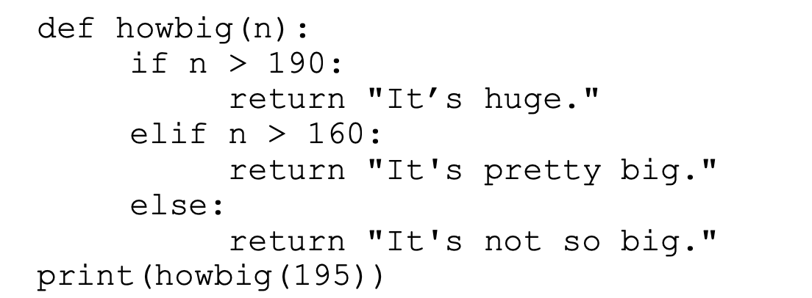
What is the output?
Get func-y with it · $500
Question board

Slide 19
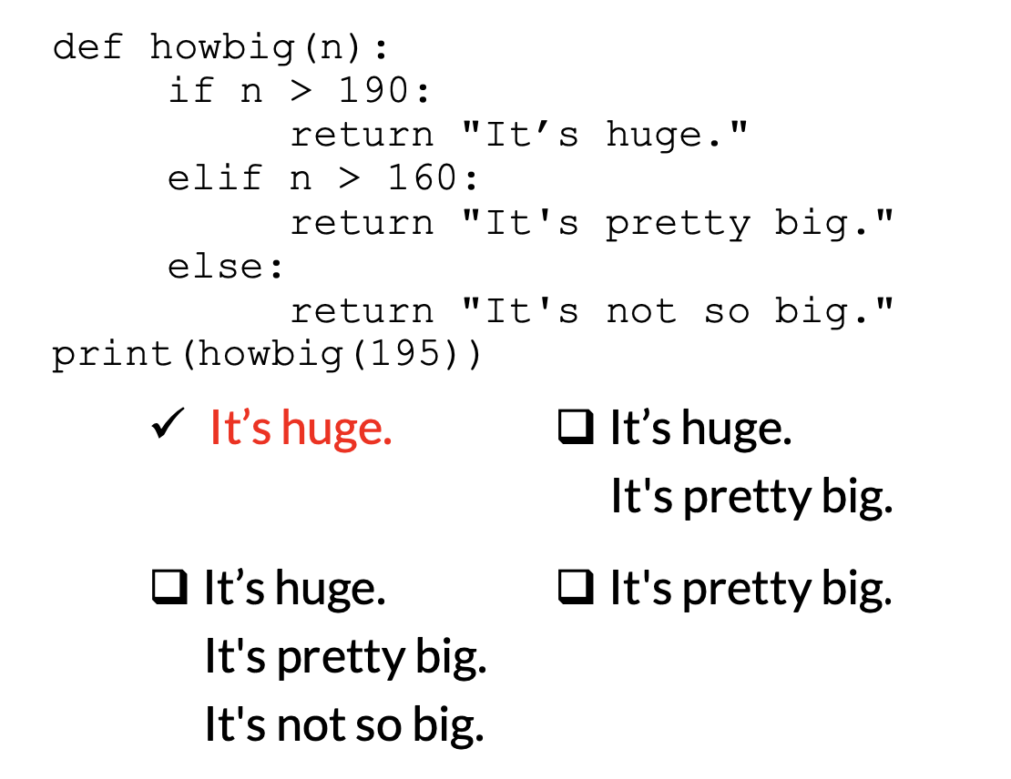
Get func-y with it · $500
Question board

Slide 20
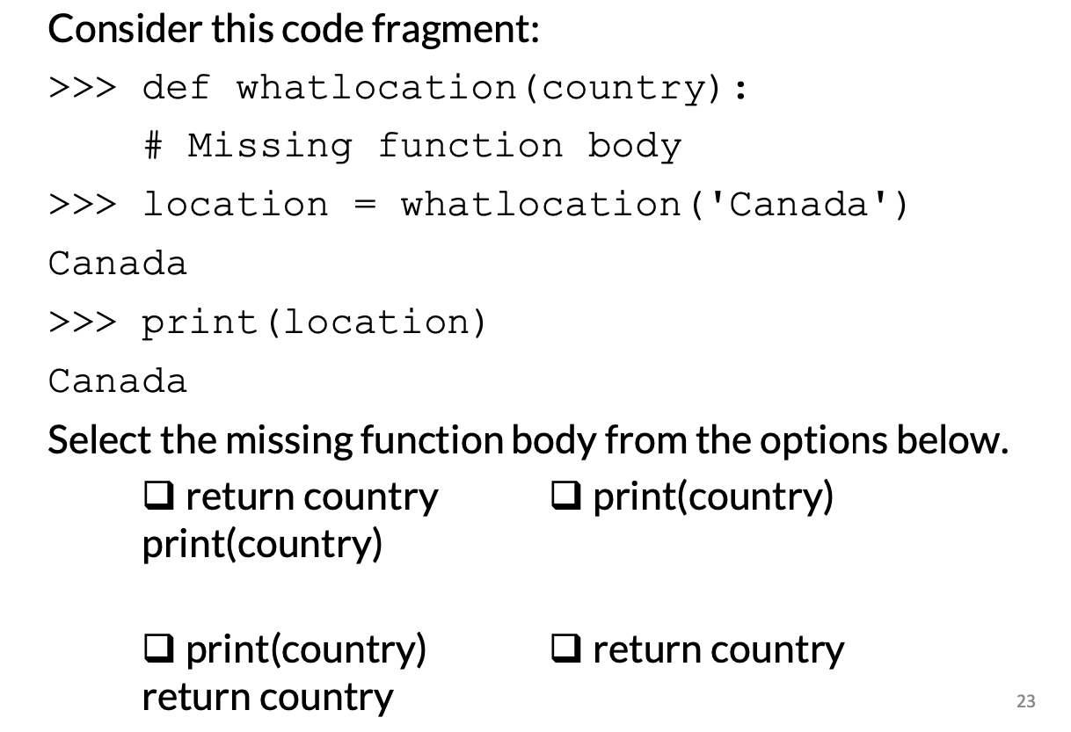
Get func-y with it · $1000
Question board

Slide 21
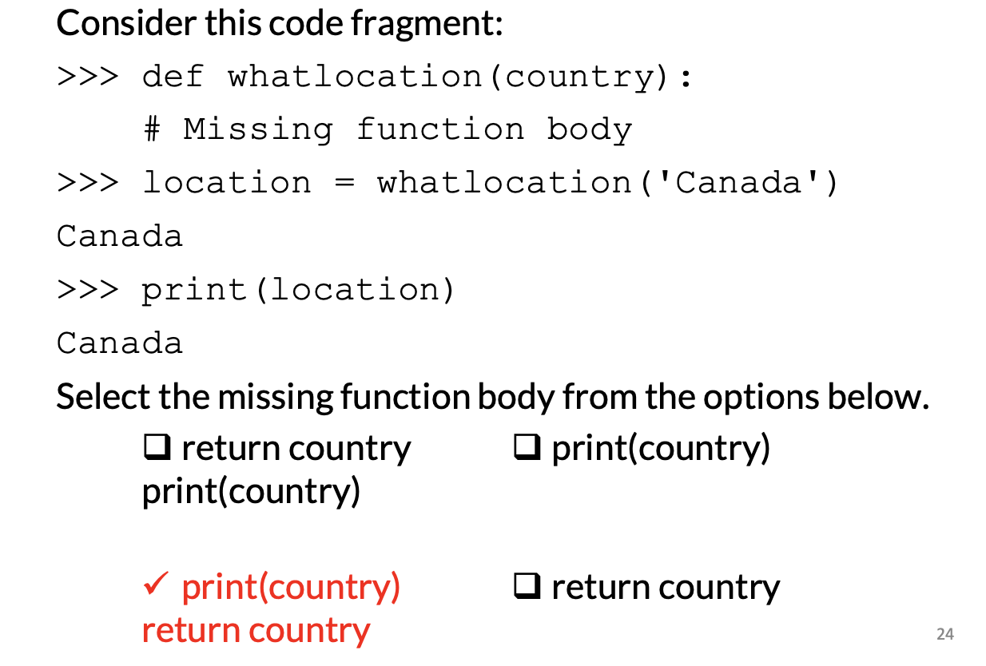
Get func-y with it · $1000
Question board

Slide 22
A program runs and, during running is asked to divide by zero. The program crashes. What type of error is this?
Err-ing on the side of caution · $250
Question board

Slide 23

What will the output be from the following code?
Err-ing on the side of caution · $500
Question board

Slide 24
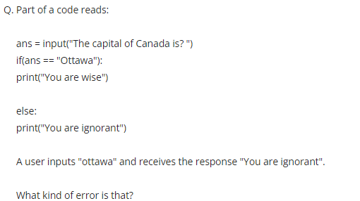
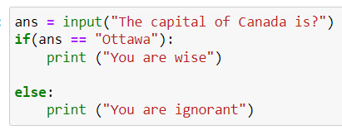
Err-ing on the side of caution · $1000
Question board

Slide 25
Final Jeopardy

Slide 26
Water exists in three states- solid, liquid, and gas. Write a function that takes in the temperature in Celsius and returns a string “solid”, “liquid”, or “gas” depending on the temperature. Write a program using this function that prompts the user for a temperature and prints out the resulting state of water.
STATES OF MATTER · FINAL JEOPARDY

