Slide 1
writing your own function.
Week 2 | Lecture 2 (2.2)
Upcoming
Lab 0 Due 11:59 pm Friday.
Lab 1 Released Thursday 6:00 pm.
Reflection 2 Released Friday 6:00 pm.
Tutorial and Practical sessions running all week.

Slide 2
This Week’s Content
Lecture 2.1
Functions, input & output, importing modules
Lecture 2.2
Defining your own function
Lecture 2.3
Design Problem: Forward Kinematics

Slide 3
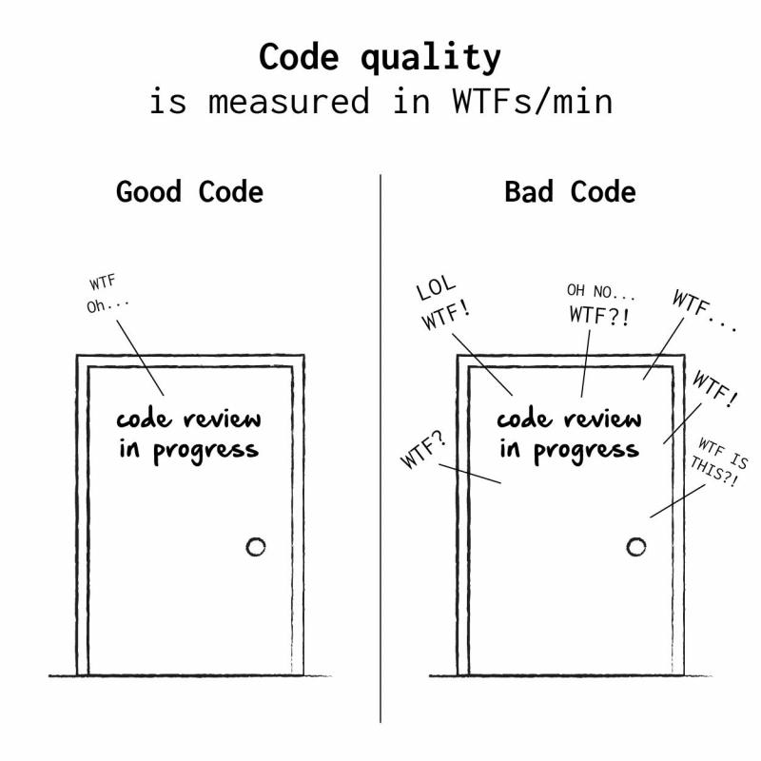
Defining Your Own Functions
The real power of functions is in defining your own.
Good programs typically consist of many small functions that call each other.
If you have a function that does only one thing (like calculate the sine of an angle), it is likely not too large.
If its not too large, it will be easy to test and maintain.

Slide 4
Function Definitions
(parameter1,
parameter2, …)
Definition
Function Name
Colon
def function_name(parameters):
“““DOCSTRING”””
body
return
Indent
Docstring (Optional)
What are we returning?
What is in the body?

Slide 5
Function Definitions
def function_name(parameters):
body
return
def - is a keyword, standing for "definition". All function definitions must begin with def. The def statement must end with a colon.
function_name - is the name you will use to call the function (like sin, abs but you need to create your own name).
parameters - are the variables that get values when you call the function. You can have 0 or more parameters, separated by commas. Must be in parenthesis.
body - body is a sequence of commands like we've already seen (assignment, multiplication, function calls).
return – ends the function and returns data (like the sine of an angle.
Important: all the lines of body must be indented. That is how Python knows that they are part of the function.

Slide 6
Calling Functions
The stuff we pass to the function.
Arguments
The general form of a function call:
Terminology
argument: a value given to a function.
pass: to provide an argument to a function.
call: ask Python to execute a function (by name).
return: give a value back to where the function was called from.
function_name(arguments)
Function
Call
Function
()
function_name()
function_name
Would not result in a function call.
The stuff the function returns to us after we call it.
Returns

Slide 7
Function Definitions
Calling Functions
def function_name(parameters):
body
return
def square(x):
return x * x
function_name(arguments)
square(2)
2 is the argument (data) passed to the square function.
x is the parameter.

Slide 8
Function Definitions
Calling Functions
def function_name(parameters):
body
return
def square(x = 2):
return x * x
function_name(arguments)
square(2)
2 is the argument (data) passed to the square function.
x is the parameter.
2 is the argument.

Slide 9
Function Definitions
def function_name(parameters):
1. “““DOCSTRING””” (optional)
2. Code that does the thing
3. return expression
The return statement is optional and if it is not included, it’s the same as writing return None
Open your notebook
Click Link:
1. Defining Your Own Functions

Slide 10
Design Recipe
How do we go about writing a function?
You should follow these six steps.
Examples (What do you want your function calls to look like?)
Type Contract (Specify the type(s) of parameters and return values)
Header (Decide on the name of the function)
Description (Write a short description of what the function does)
Body (Write the code that actually does the thing that you want)
Test (Verify the function using examples)

Slide 11
Design Recipe
Write a function that converts from Fahrenheit to Celsius.
1. Examples (What do you want your function calls to look like?)
celsius = convert_to_celsius(32)
celsius = convert_to_celsius(212)
celsius = convert_to_celsius(98.6)

Slide 12
Design Recipe
Write a function that converts from Fahrenheit to Celsius.
2. Type Contract (Specify the type(s) of parameters and return values)
def convert_to_celsius(degrees_f):
"""
...
"""
... Do something
return degrees_c
What types are passed in?
What types are returned?

Slide 13
Design Recipe
Write a function that converts from Fahrenheit to Celsius.
2. Type Contract (Specify the type(s) of parameters and return values)
def convert_to_celsius(degrees_f):
"""
(number) -> number
"""
... Do something
return degrees_c
What types are passed in? Number
What types are returned?
Number

Slide 14
Design Recipe
Write a function that converts from Fahrenheit to Celsius.
3. Header (Decide on the name of the function and parameters)
(you probably already did this in step 1)
def convert_to_celsius(degrees_f):
"""
(number) -> number
"""
... Do something
return degrees_c

Slide 15
Design Recipe
Write a function that converts from Fahrenheit to Celsius.
4. Description (Write a short description of what the function does)
def convert_to_celsius(degrees_f):
"""
(number) -> number
Return the temperature in degrees Celsius corresponding to
the degrees Fahrenheit passed in.
"""
... Do something
return degrees_c

Slide 16
Design Recipe
Write a function that converts from Fahrenheit to Celsius.
5. Body (Write the code that actually does the thing that you want)
def convert_to_celsius(degrees_f):
"""
(number) -> number
Return the temperature in degrees Celsius corresponding to
the degrees Fahrenheit passed in.
"""
degrees_c = (degrees_f - 32) * 5 / 9
return degrees_c

Slide 17
Design Recipe
Write a function that converts from Fahrenheit to Celsius.
6. Test (Verify the function using examples)
- Run all the examples that you created in Step 1.
- Testing is so important.
- In industry, you’ll be expected to provide tests for everything.
celsius = convert_to_celsius(32) # celsius should be 0
celsius = convert_to_celsius(212) # celsius should be 100
celsius = convert_to_celsius(98.6) # celsius should be 37.0

Slide 18
Design Recipe
How do we do about writing a function?
You should follow these six steps.
Type
Contract
Header
Description
Body
Test
Open your notebook
Click Link:
2. Design Recipe

Slide 19
Docstring
A Python documentation string, commonly known as docstring, helps you understand the capabilities of a function (or module, class).
def convert_to_celsius(degrees_f):
"""
(number) -> number
Return the temperature in degrees Celsius corresponding to
the degrees Fahrenheit passed in.
"""
degrees_c = (degrees_f - 32) * 5 / 9
return degrees_c
This is the docstring

Slide 20
Docstring
As we saw before, help() prints information about a function.
The help function actually prints out the “docstring” that we write as part of a function definition.
For the function we just wrote, we could type:
help(convert_to_celsius)
>>>
Help on function convert_to_celsius in module __main__:
convert_to_celsius(degrees_f)
(number) -> number
Return the temperature in degrees Celsius corresponding to the degrees
Fahrenheit passed in

Slide 21
Docstring
These are the most popular Docstrings format available.
Formatting Type | Description
NumPy/SciPy docstrings | Combination of reStructured and GoogleDocstrings and supported by Sphinx
PyDoc | Standard documentation module for Python and supported by Sphinx
EpyDoc | Render Epytext as series of HTML documents and a tool for generating API documentation for Python modules based on their Docstrings
Google Docstrings | Google's Style

Slide 22
Docstring
This can be very valuable:
For other programmers to figure out what a function is supposed to do.
For you in the future when you have forgotten what you wrote (this happens a lot!).
You should write a docstring for every function!
Remember good vs bad code review.
Open your notebook
Click Link:
3. Docstring

Slide 23
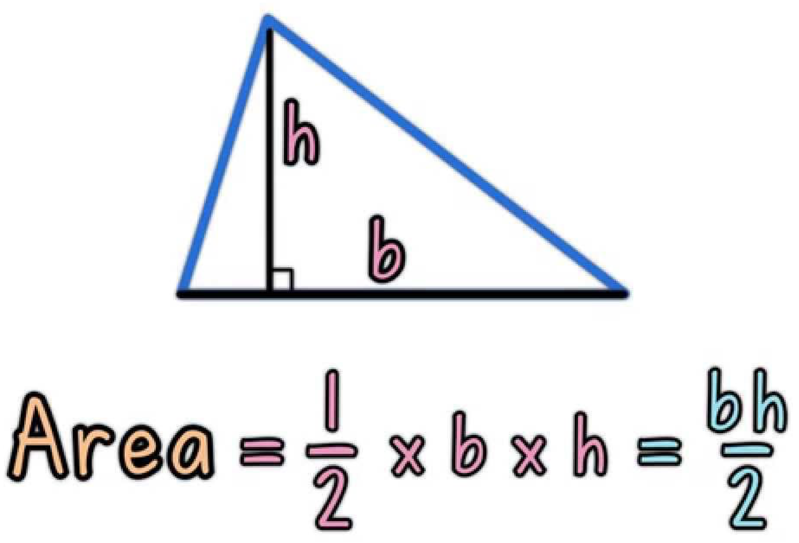
Breakout Session 1
Following the Design Recipe, write a function to calculate the area of a triangle.
Open your notebook
Click Link:
6. Breakout Session 1

Slide 24
More Stuff You Can Do With Functions
Nested Function Calls
Calling Functions within Functions
Open your notebook
Click Link:
4. Nested Function Calls
5. Calling Functions within Functions
print(3 + 7 + abs(-5))
Function
Function
Function Definition
def my_function():
print("Hello from a function")
Function

Slide 25
Variable Scope
A variable is only available from inside the region it is created, which is called the variable’s scope.
Python has four different scopes, and we will discuss the two most important for this course.
Local Scope
Global Scope
Global
Local
Variable Lookup

Slide 26
Local Scope
Whenever you define a variable within a function, its scope lies ONLY within the function.
It is accessible from the point at which it is defined until the end of the function and exists for as long as the function is executing.
This means its value cannot be changed or even accessed from outside the function.
Global
Local
Variable Lookup

Slide 27
Local Scope
Example 1
What will happen when this code is run?
def my_function():
name = ‘Sebastian’
my_function()
print(name)

Slide 28
Local Scope
Example 1
def my_function():
name = ‘Sebastian’
my_function()
print(name)
>>> Error
name is local to the function and not accessible outside in the global scope.

Slide 29
Local Scope
Example 1
Global
def my_function():
name = ‘Sebastian’
my_function()
print(name)

Slide 30
Local Scope
Example 1
Global
def my_function():
name = ‘Sebastian’
my_function()
print(name)
Local
(my_function)

Slide 31
Local Scope
Example 1
Global
def my_function():
name = ‘Sebastian’
my_function()
print(name)
Local
(my_function)
name = “Sebastian”

Slide 32
Local Scope
Example 1
Global
def my_function():
name = ‘Sebastian’
my_function()
print(name)
>>> Error
Local
(my_function)
name = “Sebastian”
Variable Lookup
Is name in global?
No (Done)

Slide 33
Local Scope
Example 2
What will happen when this code is run?
def my_function():
name = ‘Sebastian’
my_function()
name = ‘Ben’
print(name)

Slide 34
Local Scope
Example 2
What will happen when this code is run?
def my_function():
name = ‘Sebastian’
my_function()
name = ‘Ben’
print(name)
>>> Ben

Slide 35
Local Scope
Example 2
Global
def my_function():
name = ‘Sebastian’
my_function()
name = ‘Ben’
print(name)

Slide 36
Local Scope
Example 2
Global
def my_function():
name = ‘Sebastian’
my_function()
name = ‘Ben’
print(name)
Local
(my_function)

Slide 37
Local Scope
Example 2
Global
def my_function():
name = ‘Sebastian’
my_function()
name = ‘Ben’
print(name)
Local
(my_function)
name = “Sebastian”

Slide 38
Local Scope
Example 2
Global
name = “Ben”
def my_function():
name = ‘Sebastian’
my_function()
name = ‘Ben’
print(name)
Local
(my_function)
name = “Sebastian”

Slide 39
Local Scope
Example 2
Global
name = “Ben”
def my_function():
name = ‘Sebastian’
my_function()
name = ‘Ben’
print(name)
>>> Ben
Local
(my_function)
name = “Sebastian”
Variable Lookup
Is name in global?
Yes (Done)

Slide 40
Local Scope
Whenever you define a variable within a function, its scope lies ONLY within the function.
It is accessible from the point at which it is defined until the end of the function and exists for as long as the function is executing.
This means its value cannot be changed or even accessed from outside the function.
Open your notebook
Click Link:
6. Local Scope

Slide 41
Global Scope
Whenever a variable is defined outside any function, it becomes a global variable, and its scope is anywhere within the program.
This means that variables and functions defined outside of a function are accessible inside of a function.
Global
Local
Variable Lookup

Slide 42
Global Scope
Example 1
What will happen when this code is run?
def my_function():
print(name)
name = ‘Sebastian’
my_function()

Slide 43
Global Scope
Notice that name is not defined anywhere in the function.
Example 1
What will happen when this code is run?
def my_function():
print(name)
name = ‘Sebastian’
my_function()
>>> Sebastian
name is in the global scope and is accessible inside the function.

Slide 44
Global Scope
Example 1
Global
def my_function():
print(name)
name = ‘Sebastian’
my_function()

Slide 45
Global Scope
Example 1
Global
def my_function():
print(name)
name = ‘Sebastian’
my_function()
Local
(my_function)

Slide 46
Global Scope
Example 1
Global
name = “Sebastian”
def my_function():
print(name)
name = ‘Sebastian’
my_function()
Local
(my_function)

Slide 47
Global Scope
Example 1
Global
name = “Sebastian”
def my_function():
print(name)
name = ‘Sebastian’
my_function()
Local
(my_function)
Variable Lookup
Is name in local?
No

Slide 48
Global Scope
Example 1
Global
name = “Sebastian”
def my_function():
print(name)
name = ‘Sebastian’
my_function()
>>> Sebastian
Local
(my_function)
Variable Lookup
Is name in local?
No
Is name in global?
Yes (Done)

Slide 49
Global Scope
Example 2
What will happen when this code is run?
def my_function():
name = ‘Ben’
print(name)
name = ‘Sebastian’
my_function()

Slide 50
Global Scope
Example 2
What will happen when this code is run?
def my_function():
name = ‘Ben’
print(name)
name = ‘Sebastian’
my_function()
>>> Ben
name is in the local and global scope. Python will use the local version.

Slide 51
Global Scope
Example 2
Global
def my_function():
name = ‘Ben’
print(name)
name = ‘Sebastian’
my_function()

Slide 52
Global Scope
Example 2
Global
def my_function():
name = ‘Ben’
print(name)
name = ‘Sebastian’
my_function()
Local
my_function

Slide 53
Global Scope
Example 2
Global
name = ‘Sebastian’
def my_function():
name = ‘Ben’
print(name)
name = ‘Sebastian’
my_function()
Local
my_function

Slide 54
Global Scope
Example 2
Global
name = ‘Sebastian’
def my_function():
name = ‘Ben’
print(name)
name = ‘Sebastian’
my_function()
>>> Ben
Local
my_function
name = ‘Ben’
Variable Lookup
Is name in local?
Yes (Done)

Slide 55
Global Scope
Example 3
What will happen when this code is run?
def my_function():
print(name)
my_function()

Slide 56
Global Scope
Example 3
What will happen when this code is run?
def my_function():
print(name)
my_function()
>>> Error
name is not defined in the local or global scope.

Slide 57
Global Scope
Global
def my_function():
print(name)
my_function()

Slide 58
Global Scope
Global
def my_function():
print(name)
my_function()
Local
my_function

Slide 59
Global Scope
Global
def my_function():
print(name)
my_function()
Local
my_function
Variable Lookup
Is name in local?
No

Slide 60
Global Scope
Global
def my_function():
print(name)
my_function()
>>> Error
Local
my_function
Variable Lookup
Is name in local?
No
Is name in global?
No

Slide 61
Global Scope
Whenever a variable is defined outside any function, it becomes a global variable, and its scope is anywhere within the program.
This means that variables and functions defined outside of a function are accessible inside of a function.
Open your notebook
Click Link:
7. Global Scope

Slide 62
print v.s. return
The difference between print and return is a point of confusion year after year.
So, let’s be proactive and address this.
Are we the same?
Eww, no.
return
print

Slide 63
print
return
Use cases
Debugging.
Displaying messages to users.
Use cases
Used to end the execution of the function call and “return” the result.

Slide 64
print
return
def square(x):
output = x * x
print(output)
>>> square(2)
4
def square(x):
output = x * x
return output
>>> square(2)
4

Slide 65
print
return
The stuff we pass to the function.
Arguments: 2
The stuff we pass to the function.
Arguments: 2
def square(x):
output = x * x
print(output)
def square(x):
output = x * x
return output
Function
square
Function
square
The stuff the function returns to us after we call it.
The stuff the function returns to us after we call it.
Returns: None
Returns: 4

Slide 66
print v.s. return
Open your notebook
Click Link:
8. print v.s. return
def square(x):
output = x * x
print(output)
def square(x):
output = x * x
print(output)
return None
These two functions return the same thing.

Slide 67
From Functions to Programs
The recipe we discussed earlier highlights a few of the realities about programming whether for individual functions or for large pieces of software.
1. A formal design process (or even a recipe) can help.
Especially when you are writing a large program with many programmers, it is easy to get lost.
In fact, it is more often impossible to hold the entire program in your head.
Having a process helps you to figure out where you are and what you should do next.

Slide 68
From Functions to Programs
The recipe we discussed earlier highlights a few of the realities about programming whether for individual functions or for large pieces of software.
2. Functions can be written and then their insides can be forgotten about.
Do you know how Python calculates sin()?
Do you care?
You can successfully use functions without knowing how they are implemented if you know what they take in and what they return.
This is very important for large projects.

Slide 69
From Functions to Programs
The recipe we discussed earlier highlights a few of the realities about programming whether for individual functions or for large pieces of software.
3. Start with examples.
This helps in communication with the client, helps (a lot) to figure out what the problem really is, and is the core for testing your code.

Slide 70
A Design Process for Programming
APS111/112, a key part of engineering is the design of objects, processes, and systems.
Programming is the design, implementation, testing, and documentation of a piece of software that solves a particular problem.
The software might be part of a larger system (e.g., the avionics software of an aircraft, the accounting or human resources software of a business), but it represents the solution to a design problem (or part of a design problem).

Slide 71
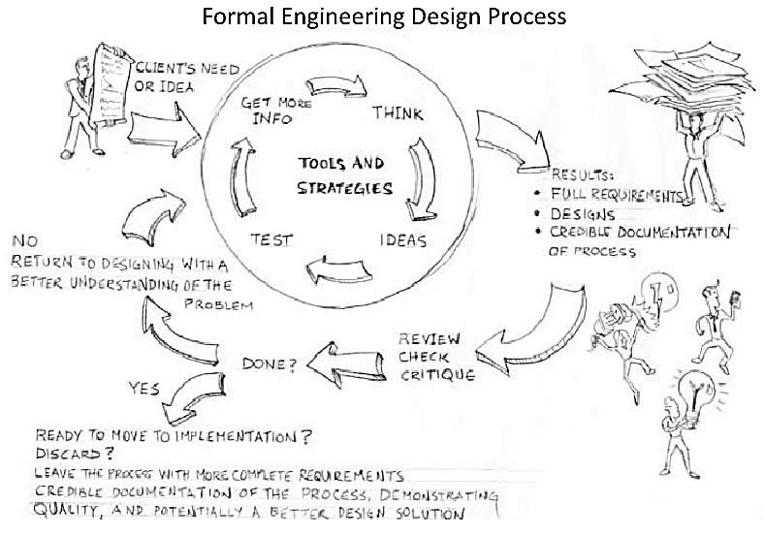
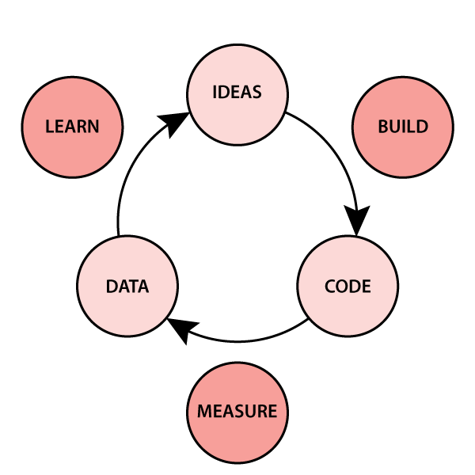
A Design Process for Programming
Taken from: Designing Engineers: An Introductory Text
We will approach programing as an engineering design process and adapt the process you have already seen in APS111/112.
Design is iterative.
users

Slide 72
A Design Process for Programming
In the next lecture, we are going to talk about a detailed design process for programming, based on the engineering design processes that are key to any engineering.
The steps are as follows:
Define the Problem.
Define Test Cases.
Generate Multiple Solutions.
Select a Solution.
Implement the Solution.
Perform Final Testing.

Slide 73
A Design Process for Programming
Define the Problem.
Write down what the problem actually is.

Slide 74
A Design Process for Programming
Define Test Cases.
Create some examples that reflect your code solving the problem: input and output.

Slide 75
A Design Process for Programming
Generate Multiple Solutions.
At this point a "solution" consists of an algorithm plan (the high-level sequence steps defining what your algorithm will do) and a programming plan (the high-level sequence of steps that you will take to code the algorithm).

Slide 76
A Design Process for Programming
Select a Solution.
Based on the different algorithm and programming plans, decide which is the most promising.

Slide 77
A Design Process for Programming
Implement the Solution.
Start to execute your programming plan.
Test as you go!
You may realize that your algorithm plan doesn't solve the problem, or even that you do not understand the problem.
If so, go back to earlier steps.

Slide 78
A Design Process for Programming
Perform Final Testing.
Make sure that your original test cases as well as any others that you have thought up work.

Slide 79
A Design Process for Programming
It is critical to realize that programming is:
Iterative: you will go back and change your algorithm/programming plan. You will write some code during Step 3: you might not be able to define a solution without writing some code to solve part of the problem. You will move back-and-forth in this process.
This process is a lot about finding your own mistakes: even for good programmers, most of their time is spent testing and debugging!

Slide 80
PRACTICE!

Slide 81
writing your own function.
Week 2 | Lecture 2 (2.2)

