Slide 1
MIDTERM REVIEW
APS106

Slide 2
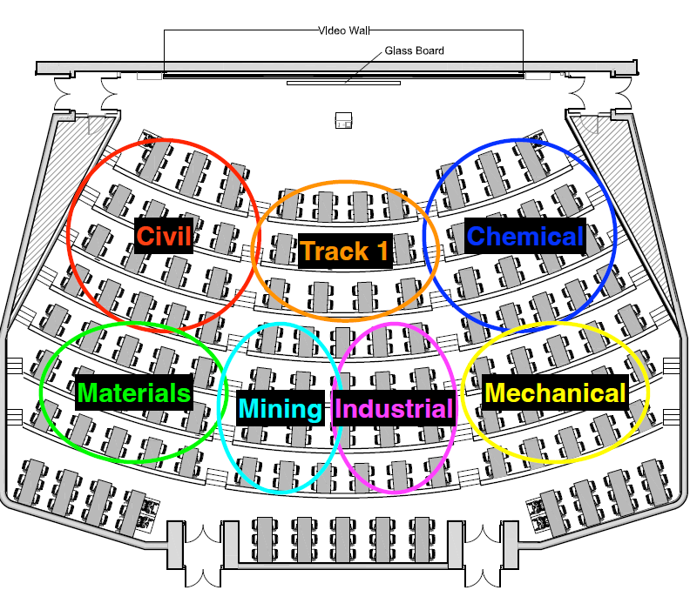

Slide 3
Rules of the GAME
Must use button on the table to answer question verbally and explain your answer – you will be called on to answer by one of the instructors
Must tell us which discipline you’re in before you answer for points (we’ll rely on the honour system)
If you get the answer right, you pick the next category
If you get the answer wrong, the next person whose hand is up can steal
Everyone is here to learn and review for the midterm so be kind to everyone who answers!

Slide 4
Panel
Pokémon GO:
Catch ‘Em All
SUPER Mario:
COIN RUSH!
Minecraft: Mastering Resources & Trades
Super Contra: Power-Up Tactics
$250
$250
$250
$250
$500
$500
$500
$500
$1000
$1000
$1000
$1000
FINAL JEOPARDY

Slide 5

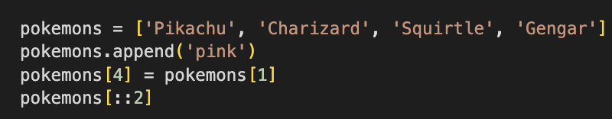
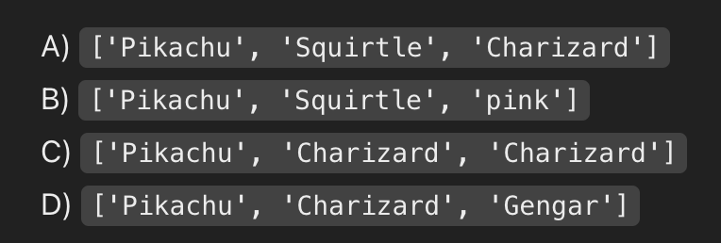
Rearranging Pokémon Stats· $250
Which is the correct output?
Question board
Notes:
Correct option -> A
['Pikachu', 'Squirtle', 'Charizard']

Slide 6

Pokémon Power Rankings · $500
How can you transform the following list:
into this output in the fewest steps??
Question board
Notes:
LIST.SORT() -> pokemon_power_list.sort()
LIST.REVERSE() ->pokemon_power_list.reverse()

Slide 7
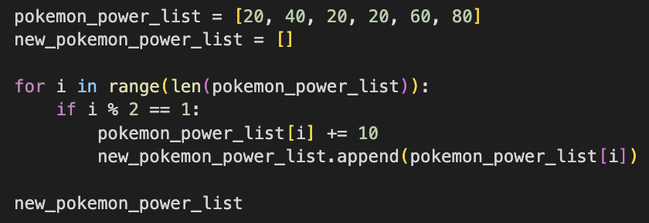
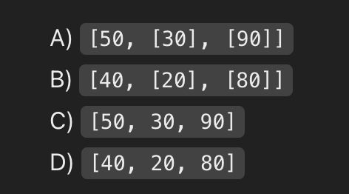
Pokémon Training BoosT · $1000
Which is the correct output?
Question board
Notes:
Correct Option: C
[50, 30, 90]

Slide 8

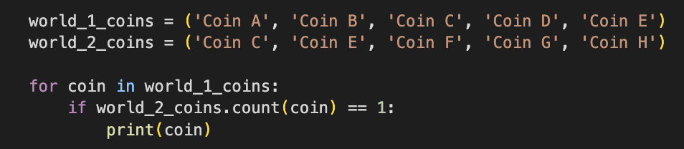
Collecting Coins · $250
What is the output?
Question board
Notes:
Coin C
Coin E

Slide 9
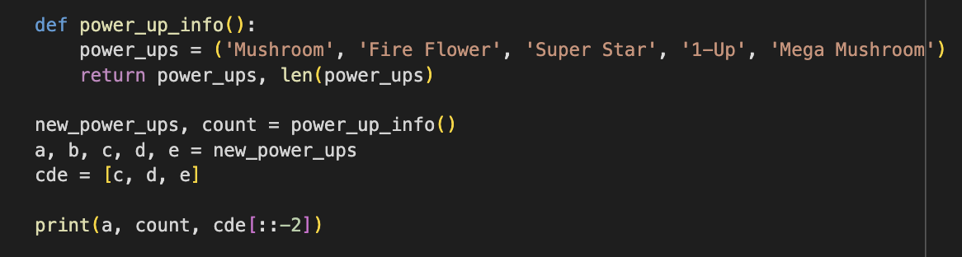
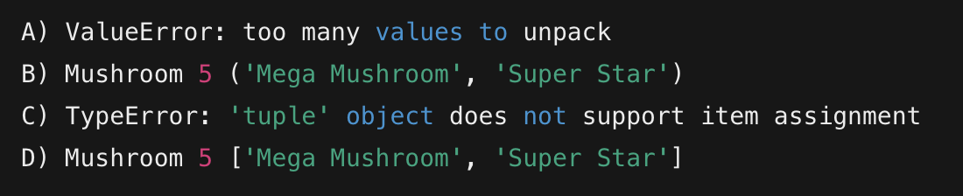
Power-Ups in Mario’s Inventory · $500
Which is the correct output?
Question board
Notes:
Correct Option: D
Mushroom 5 ['Mega Mushroom', 'Super Star']

Slide 10
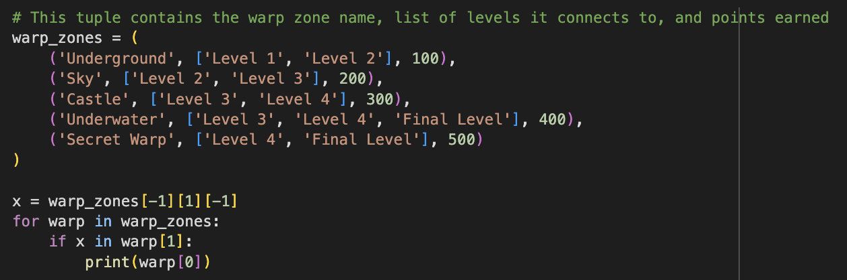
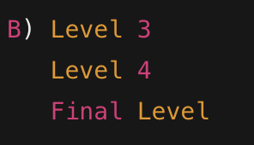
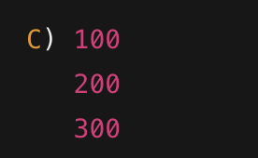
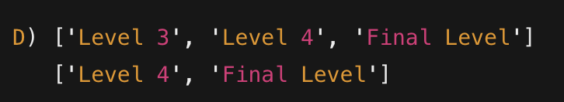
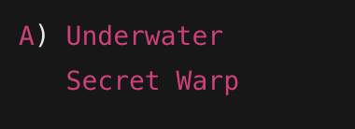
Navigating the Warp Zones · $1000
Which is the correct output?
Question board
Notes:
A Underwater
Secret Warp

Slide 11
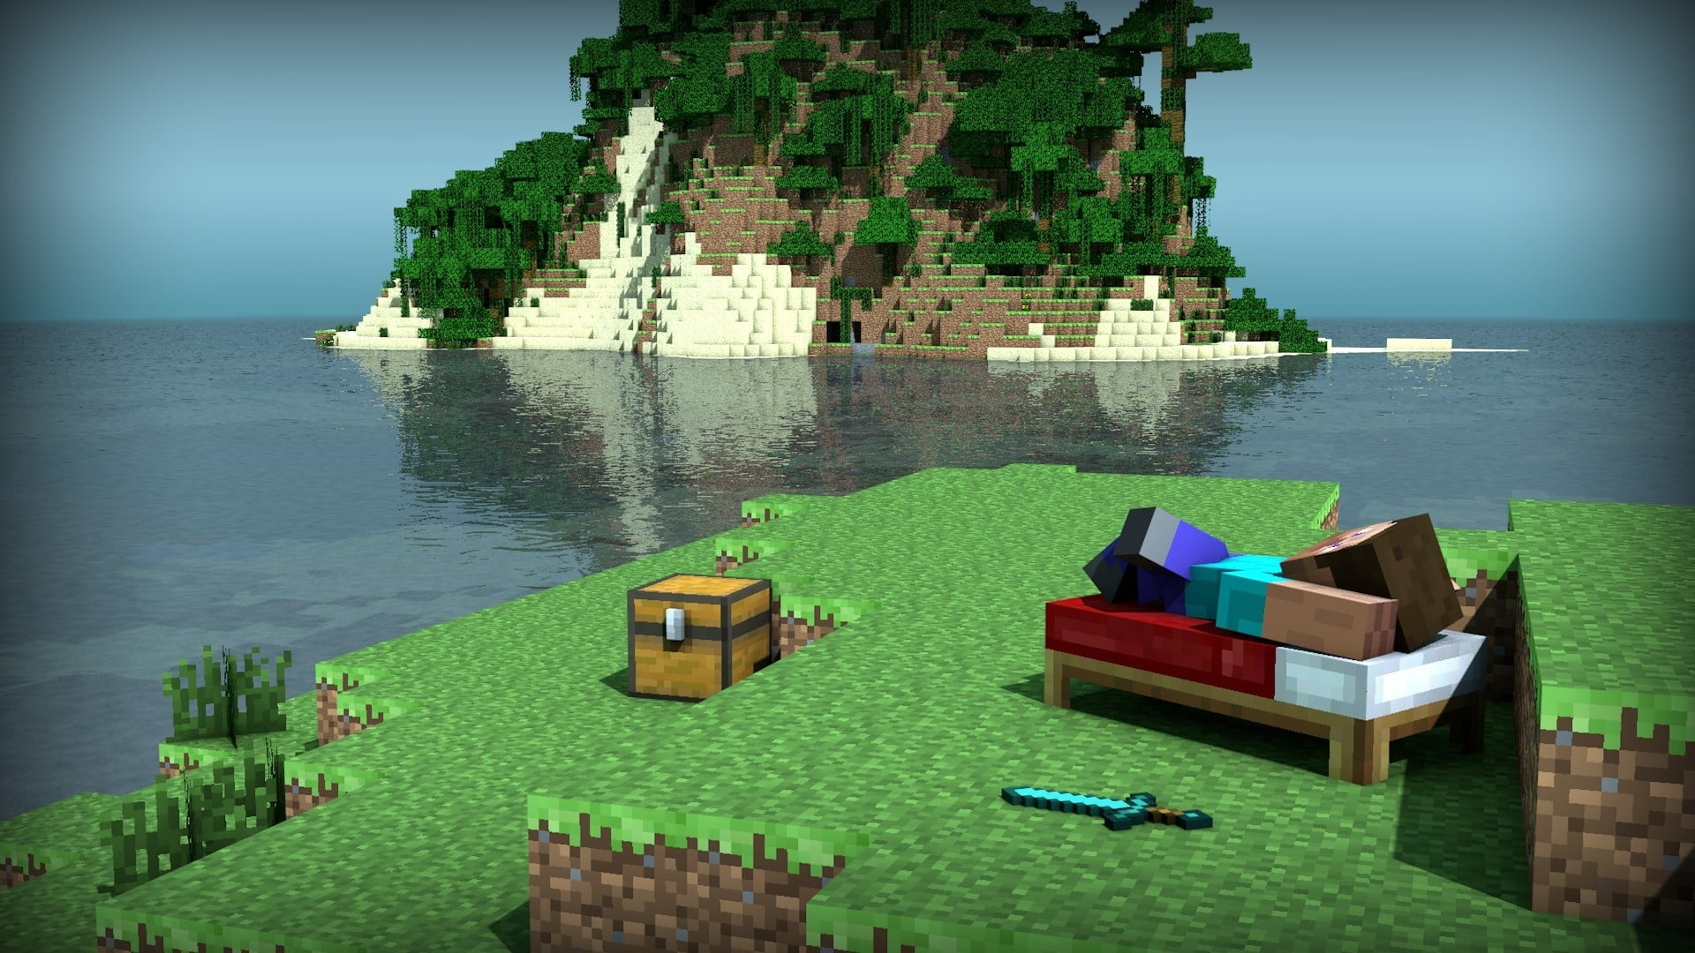
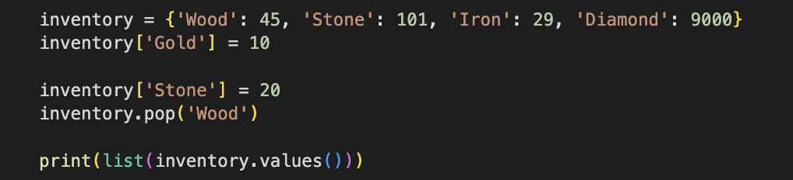
Managing Your Minecraft Inventor · $250
What is the Output?
Question board
Notes:
[20, 29, 9000, 10]

Slide 12
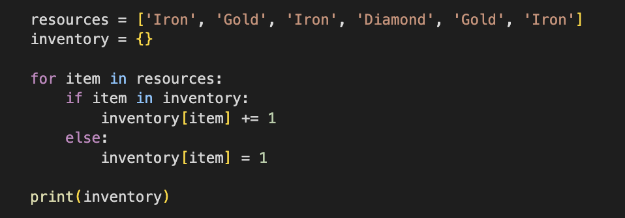
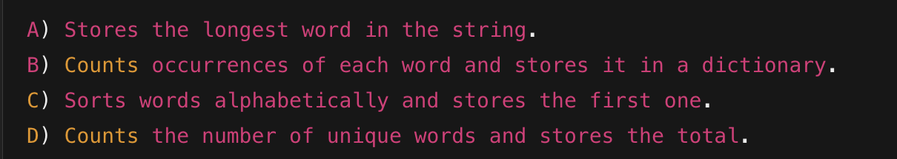
Resources in Your Chest · $500
What does the following code do?
Question board
Notes:
B) Counts occurrences of each word and stores it in a dictionary.

Slide 13
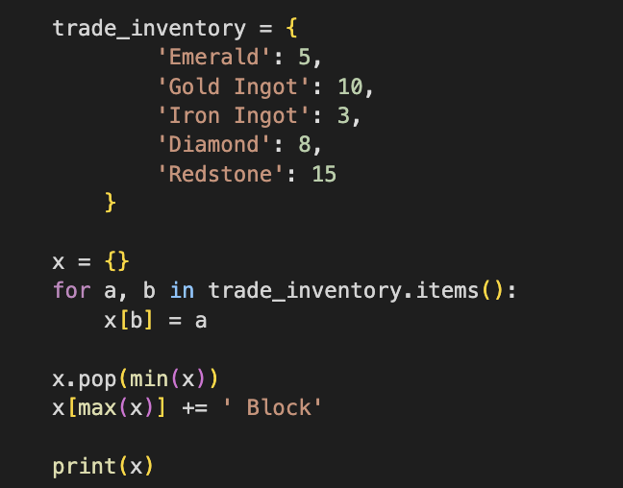
Trading with Villagers · $1000
What is the output?
Question board
Notes:
Output -> {5: 'Emerald', 10: 'Gold Ingot', 8: 'Diamond', 15: 'Redstone Block’}
Pops iron ingot
Concatenates Redstone with <space>Block

Slide 14
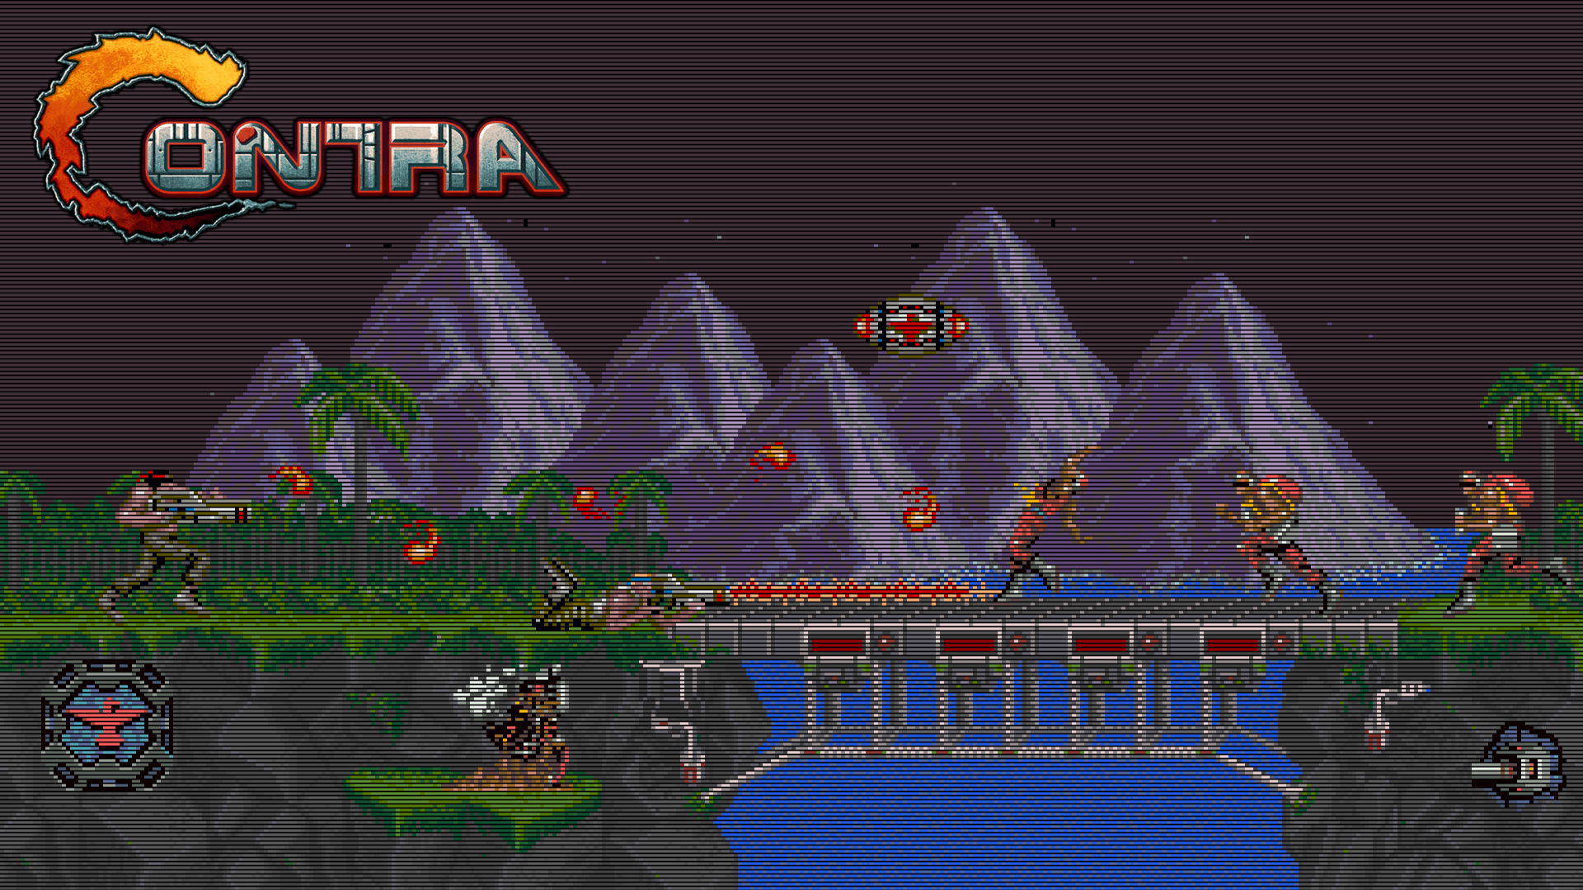
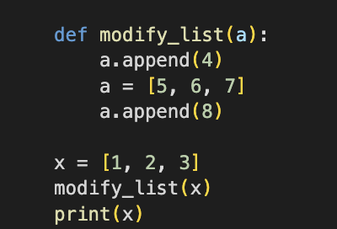
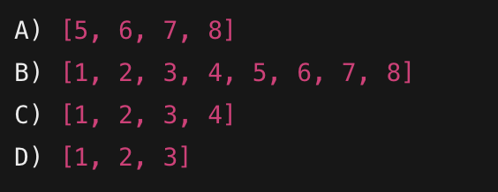
Upgrading Weapons· $250
Which one is the correct output?
Question board
Notes:
C -> [1,2,3,4]

Slide 15
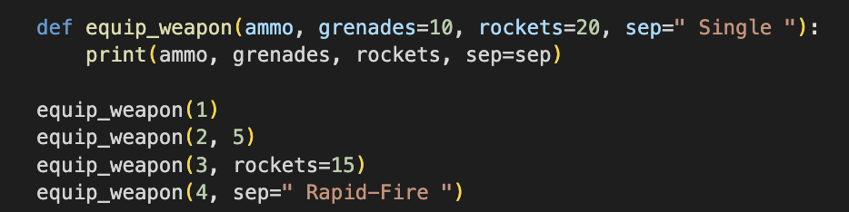
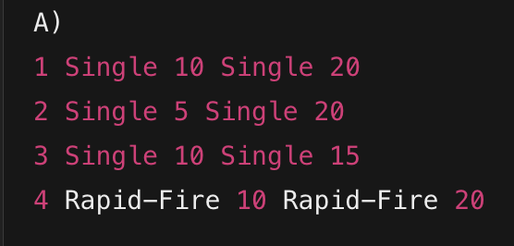
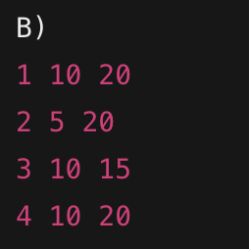
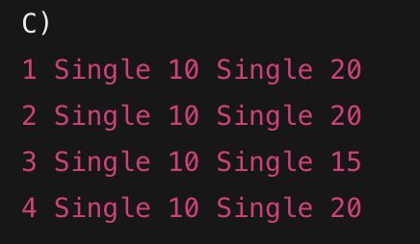
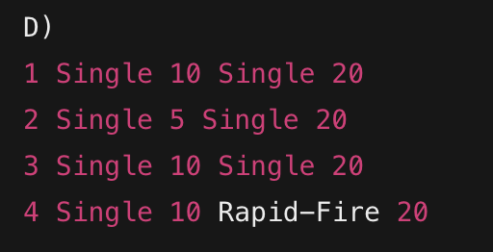
Weapon Loadout Configuration · $500
What is the Output?
Question board
Notes:
A 1 Single 10 Single 20
2 Single 5 Single 20
3 Single 10 Single 15
4 Rapid-Fire 10 Rapid-Fire 20

Slide 16
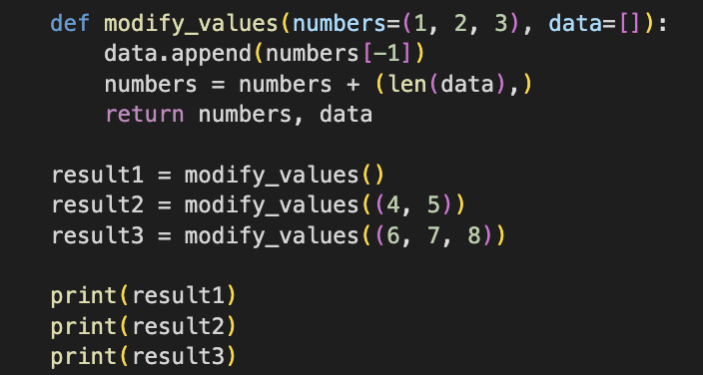
Extra Lives & Score Calculation· $1000
What is the output?
Question board
Notes:
((1, 2, 3, 1), [3, 5, 8])
((4, 5, 2), [3, 5, 8])
((6, 7, 8, 3), [3, 5, 8])

Slide 17

The Library of Survival
You are given access to a massive library, you must pass this Test to advance. Fail, and you’re eliminated!
Go to the Task

Slide 18
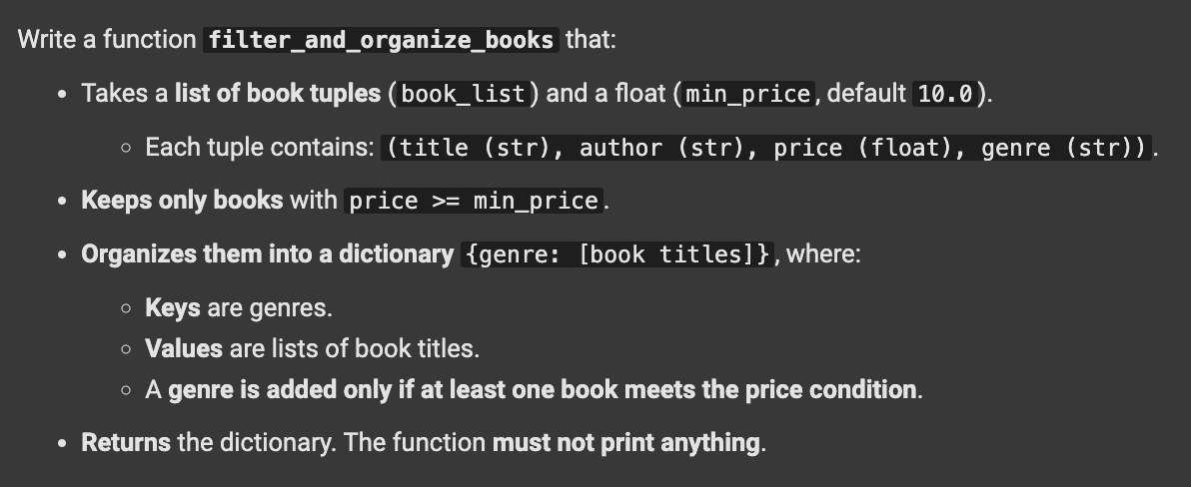
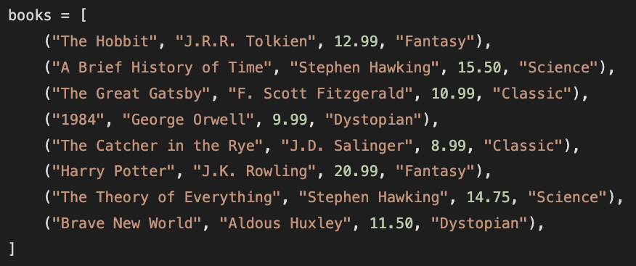

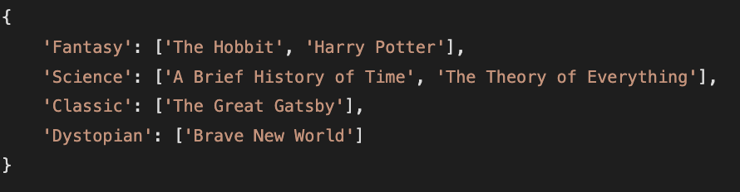
TASK: Filter and Organize Books by Genre
Function Description
Example Input
Function Call
Expected output
Question board

