Slide 1
while loops.
Week 4 | Lecture 1 (4.1)
Upcoming
Lab 2 Due 11:59 pm Friday.
Lab 3 is released this Thursday 6:00 pm.
Reflection 4 Released Friday 6:00 pm.
Tutorial (Online), Practical, Office Hour sessions running all week.

Slide 2
This Week’s Content
Lecture 4.1
function review, while loops
Lecture 4.2
More while loops
Lecture 4.3
Design Problem: Cryptography

Slide 3
function confusion
Review.
parameters and arguments.
print and return.
When is a function done?

Slide 4
function, what are they?
A function is best explained as a self-contained piece of code that has inputs and an output.
The stuff we pass to the function.
day=1, month=1, year=2022
base=1, height=1
angle=90
Function
age
Function
triangle_area
Function
sine
The stuff the function returns to us after we call it.
1
0.5
1

Slide 5
function, what are they?
Let’s look at a real example of using function.
Open your notebook
Click Link:
1. Function use cases

Slide 6
parameters & arguments
Arguments
1
1
Function
triangle_area
Parameters
base
height
def triangle_area(base, height):
"""
(number, number) -> number
""“
area = 0.5 * base * height
return area
Returns
0.5

Slide 7
Function Definitions
Calling Functions
def function_name(parameters):
body
return
def triangle_area(base, height):
return x * x
function_name(arguments)
triangle_area(1, 1)
1 and 1 are the arguments (data) passed to the triangle_area function.
base and height are the parameter.

Slide 8


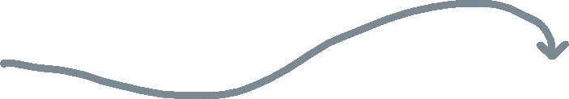
parameters & arguments
Arguments
1
1
Function
triangle_area
Parameters
base
height
def triangle_area(base, height):
"""
(number, number) -> number
""“
area = 0.5 * base * height
return area
return
Returns
0.5

Slide 9
parameters & arguments
Arguments
1
1
Function
triangle_area
Parameters
base
height
>>> area = triangle_area(1, 1)
>>> print(area)
0.5
return
Returns
0.5

Slide 10
parameters & arguments
Arguments
2
4
Function
triangle_area
Parameters
base
height
>>> area = triangle_area(2, 4)
>>> print(area)
4
return
Returns
4

Slide 11
parameters & arguments
Arguments
?
?
Function
triangle_area
Parameters
base
height
>>> area = triangle_area(1+1, 2/2)
>>> print(area)
?
return
Returns
?

Slide 12
parameters & arguments
Arguments
2
1
Function
triangle_area
Parameters
base
height
>>> area = triangle_area(1+1, 2/2)
>>> print(area)
1
return
Returns
1

Slide 13
parameters & arguments
Arguments
?
?
Function
triangle_area
Parameters
base
height
>>> x = 2
>>> y = 4
>>> area = triangle_area(x, y)
>>> print(area)
?
return
Returns
?

Slide 14
parameters & arguments
Arguments
2
4
Function
triangle_area
Parameters
base
height
>>> x = 2
>>> y = 4
>>> area = triangle_area(x, y)
>>> print(area)
4
return
Returns
4

Slide 15
parameters & arguments
Arguments
2
4
Function
triangle_area
Parameters
>>> x = 2
>>> y = 4
>>> area = triangle_area(x, y)
>>> print(area)
4
base
height
Same arguments.
>>> base = 2
>>> height = 4
>>> area = triangle_area(base, height)
>>> print(area)
4
return
Returns
4

Slide 16
parameters & arguments
Let’s look at some examples.
Open your notebook
Click Link:
2. Parameters & Arguments

Slide 17
print v.s. return
The difference between print and return is a point of confusion year after year.
So, let’s be proactive and address this.
Are we the same?
Eww, no.
return
print

Slide 18
print
return
Use cases
Debugging.
Displaying messages to users.
Use cases
Used to end the execution of the function call and “return” the result.

Slide 19
print
return
def square(x):
output = x * x
print(output)
>>> square(2)
4
def square(x):
output = x * x
return output
>>> square(2)
4

Slide 20
print
return
The stuff we pass to the function.
Arguments: 2
The stuff we pass to the function.
Arguments: 2
def square(x):
output = x * x
print(output)
def square(x):
output = x * x
return output
Function
square
Function
square
The stuff the function returns to us after we call it.
The stuff the function returns to us after we call it.
Returns: None
Returns: 4

Slide 21
print
Standard Out is a single area of text shared by all the code in a program.
return
The stuff we pass to the function.
Arguments: 2
The stuff we pass to the function.
Arguments: 2
def square(x):
output = x * x
print(output)
def square(x):
output = x * x
return output
Function
square
Function
square
Standard
Out.
Standard
Out.
The stuff the function returns to us after we call it.
4
The stuff the function returns to us after we call it.
Returns: None
Returns: 4

Slide 22
print v.s. return
Let’s look at some examples.
Open your notebook
Click Link:
3. print v.s. return

Slide 23
When is a function done?
A function is done executing if one of the following things occurs:
All the indented code finishes running.
A return statement is encountered.

Slide 24
When is a function done?
def func(x):
output = x * x
output += 10
return output
>>> out = func(2)
>>> print(out)
?
def func(x):
output = x * x
output += 10
output /= 2
>>> out = func(2)
>>> print(out)
?
def func(x):
output = x * x
return output
output += 10
output /= 2
>>> out = func(2)
>>> print(out)
?

Slide 25
When is a function done?
def func(x):
output = x * x
output += 10
return output
>>> out = func(2)
>>> print(out)
?
def func(x):
output = x * x
output += 10
output /= 2
>>> out = func(2)
>>> print(out)
?
def func(x):
output = x * x
return output
output += 10
output /= 2
>>> out = func(2)
>>> print(out)
?

Slide 26
When is a function done?
def func(x):
output = x * x
output += 10
return output
>>> out = func(2)
>>> print(out)
14
def func(x):
output = x * x
output += 10
output /= 2
>>> out = func(2)
>>> print(out)
?
def func(x):
output = x * x
return output
output += 10
output /= 2
>>> out = func(2)
>>> print(out)
?
end.

Slide 27
When is a function done?
def func(x):
output = x * x
output += 10
return output
>>> out = func(2)
>>> print(out)
14
def func(x):
output = x * x
output += 10
output /= 2
>>> out = func(2)
>>> print(out)
?
def func(x):
output = x * x
return output
output += 10
output /= 2
>>> out = func(2)
>>> print(out)
?
end.

Slide 28
When is a function done?
def func(x):
output = x * x
output += 10
return output
>>> out = func(2)
>>> print(out)
14
def func(x):
output = x * x
output += 10
output /= 2
return None
>>> out = func(2)
>>> print(out)
None
def func(x):
output = x * x
return output
output += 10
output /= 2
>>> out = func(2)
>>> print(out)
?
end.
end.
(end of
indented
code)
If there is no return statement, Python adds one and returns None.

Slide 29
When is a function done?
def func(x):
output = x * x
output += 10
return output
>>> out = func(2)
>>> print(out)
14
def func(x):
output = x * x
output += 10
output /= 2
return None
>>> out = func(2)
>>> print(out)
None
def func(x):
output = x * x
return output
output += 10
output /= 2
>>> out = func(2)
>>> print(out)
?
end.
end.
(end of
indented
code)
If there is no return statement, Python adds one and returns None.

Slide 30
When is a function done?
def func(x):
output = x * x
output += 10
return output
>>> out = func(2)
>>> print(out)
14
def func(x):
output = x * x
output += 10
output /= 2
return None
>>> out = func(2)
>>> print(out)
None
def func(x):
output = x * x
return output
output += 10
output /= 2
>>> out = func(2)
>>> print(out)
4
end.
end.
end.
(end of
indented
code)
If there is no return statement, Python adds one and returns None.

Slide 31
When is a function done?
Let’s look at some examples.
Open your notebook
Click Link:
4. When is a function done?

Slide 32
Looping (Iterating)
Looping means repeating something over and over until a particular condition is satisfied.
Looping (aka iteration) is the second key control structure in programming (if-statements/branching was the first).

Slide 33

Looping (Iterating)
List of Customers
Looping means repeating something over and over until a particular condition is satisfied.
Looping
Send Promotional Email
Email

Slide 34
Looping (Iterating)
List of Tweets
Looping means repeating something over and over until a particular condition is satisfied.
Looping
Does the Tweet contain #cleancode
Yes/No

Slide 35
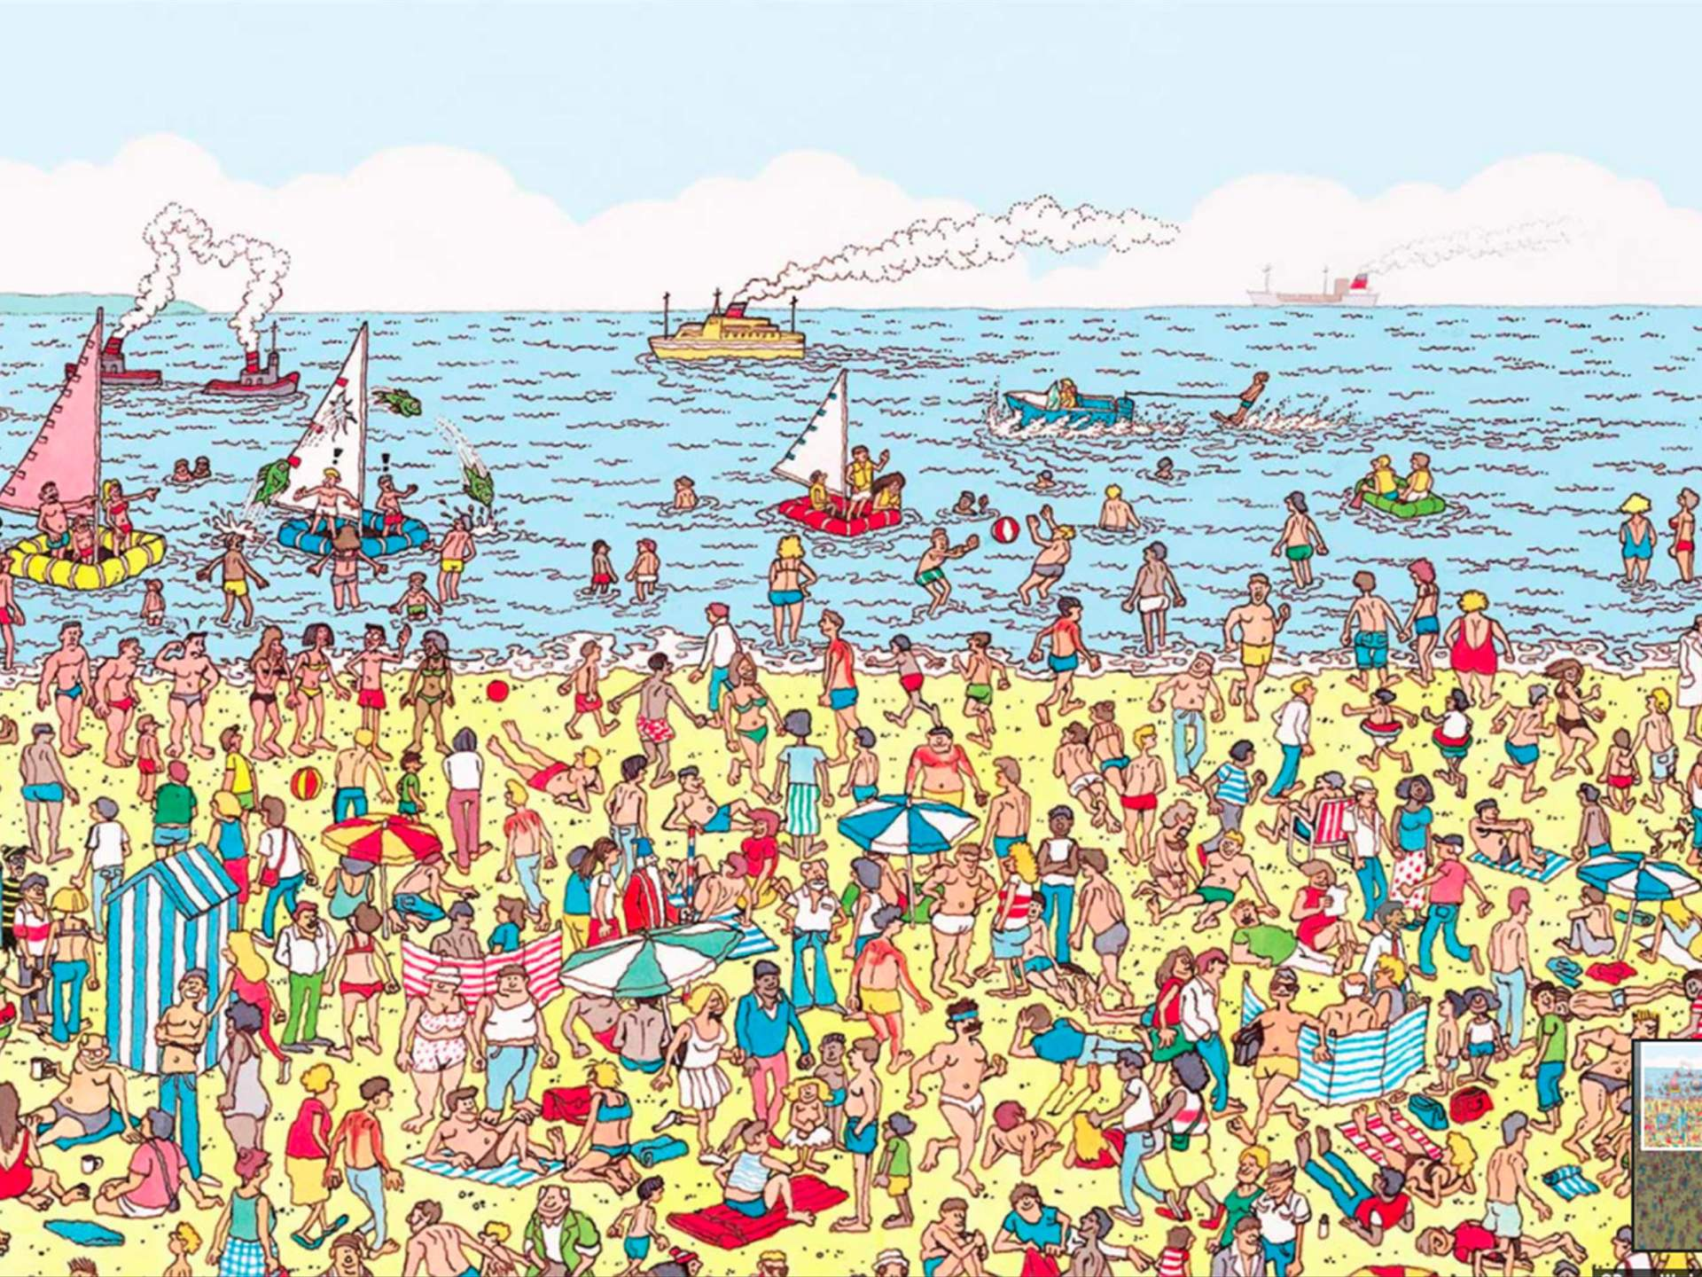
Looping (Iterating)
Looping means repeating something over and over until a particular condition is satisfied.
Check for Waldo
Looping
Yes/No

Slide 36
Looping (Iterating)
Looping means repeating something over and over until a particular condition is satisfied.
Check for Waldo
Looping
Yes/No

Slide 37
Looping (Iterating)
Looping means repeating something over and over until a particular condition is satisfied.
Check for Waldo
Looping
Yes/No

Slide 38
Looping (Iterating)
Looping means repeating something over and over until a particular condition is satisfied.
Check for Waldo
Looping
Yes/No

Slide 39
Looping (Iterating)
Looping means repeating something over and over until a particular condition is satisfied.
Check for Waldo
Looping
Yes/No

Slide 40



While Loops
Sometimes we need to keep looping as long as some condition is True, and stop when it becomes False.
Let's say you want to ask the user a question.
"Do you think the Toronto Maple Leafs will win the Stanley Cup in your lifetime?"
If the user answers 'y', print out "You are going to live for a very long time." If the user answers 'n', print out "Well, sometimes miracles happen."
Open your notebook
Click Link:
5. Asking the User a Question

Slide 41
While Loops
Our code kinda worked but if the user makes a typo, they can’t participate in the questionnaire.
The general solution is to loop: to execute the same lines of code more than once. This is also called iteration.
We're going to talk about one loop construct today: the while-loop where you loop while some boolean expression is True.

Slide 42
While Loops
Must evaluate to
True or False
Colon
The while loop keeps executing a piece of code as long as a particular condition is True.
There must be a colon (:) at the end of the while statement.
The action to be performed must be indented.
while expression:
do something.
Indent

Slide 43

While Loops
Will loop until condition is False
The condition that gets evaluated is just a boolean expression.
In particular it can include:
Something that evaluates to True or False.
logical operators (and, or, not)
comparison operators
function calls
... really anything that evaluates to True or False.
Do Something
while
Condition
True
Exit
Loop
False

Slide 44
Do Something
True
if
Condition
while
Condition
True
Do Something
False
False

Slide 45
While Loops
x = 0
while x < 5:
print(‘x = ', x)
x += 1
Do Something
while
Condition
True
False

Slide 46
While Loops
x = 0
while x < 5:
print(‘x = ', x)
x += 1
x = 0
print(‘x = ', x)
x += 1
x < 5
True
Standard Out.
False

Slide 47
While Loops
x = 0
while x < 5:
print(‘x = ', x)
x += 1
x = 0
print(‘x = ', x)
x += 1
x < 5
0 < 5
True
True
Standard Out.
False

Slide 48
While Loops
x = 0
while x < 5:
print(‘x = ', x)
x += 1
x = 0
print(‘x = ', x)
x += 1
x < 5
0 < 5
True
True
Standard Out.
x = 0
False

Slide 49
While Loops
x = 0
while x < 5:
print(‘x = ', x)
x += 1
x = 1
print(‘x = ', x)
x += 1
x < 5
0 < 5
True
True
Standard Out.
x = 0
False

Slide 50
While Loops
x = 0
while x < 5:
print(‘x = ', x)
x += 1
x = 1
print(‘x = ', x)
x += 1
x < 5
1 < 5
True
True
Standard Out.
x = 0
False

Slide 51
While Loops
x = 0
while x < 5:
print(‘x = ', x)
x += 1
x = 1
print(‘x = ', x)
x += 1
x < 5
1 < 5
True
True
Standard Out.
x = 0
x = 1
False

Slide 52
While Loops
x = 0
while x < 5:
print(‘x = ', x)
x += 1
x = 2
print(‘x = ', x)
x += 1
x < 5
1 < 5
True
True
Standard Out.
x = 0
x = 1
False

Slide 53
While Loops
x = 0
while x < 5:
print(‘x = ', x)
x += 1
x = 2
print(‘x = ', x)
x += 1
x < 5
2 < 5
True
True
Standard Out.
x = 0
x = 1
False

Slide 54
While Loops
x = 0
while x < 5:
print(‘x = ', x)
x += 1
x = 2
print(‘x = ', x)
x += 1
x < 5
2 < 5
True
True
Standard Out.
x = 0
x = 1
x = 2
False

Slide 55
While Loops
x = 0
while x < 5:
print(‘x = ', x)
x += 1
x = 3
print(‘x = ', x)
x += 1
x < 5
2 < 5
True
True
Standard Out.
x = 0
x = 1
x = 2
False

Slide 56
While Loops
x = 0
while x < 5:
print(‘x = ', x)
x += 1
x = 3
print(‘x = ', x)
x += 1
x < 5
3 < 5
True
True
Standard Out.
x = 0
x = 1
x = 2
False

Slide 57
While Loops
x = 0
while x < 5:
print(‘x = ', x)
x += 1
x = 3
print(‘x = ', x)
x += 1
x < 5
3 < 5
True
True
Standard Out.
x = 0
x = 1
x = 2
x = 3
False

Slide 58
While Loops
x = 0
while x < 5:
print(‘x = ', x)
x += 1
x = 4
print(‘x = ', x)
x += 1
x < 5
3 < 5
True
True
Standard Out.
x = 0
x = 1
x = 2
x = 3
False

Slide 59
While Loops
x = 0
while x < 5:
print(‘x = ', x)
x += 1
x = 4
print(‘x = ', x)
x += 1
x < 5
4 < 5
True
True
Standard Out.
x = 0
x = 1
x = 2
x = 3
False

Slide 60
While Loops
x = 0
while x < 5:
print(‘x = ', x)
x += 1
x = 4
print(‘x = ', x)
x += 1
x < 5
4 < 5
True
True
Standard Out.
x = 0
x = 1
x = 2
x = 3
x = 4
False

Slide 61
While Loops
x = 0
while x < 5:
print(‘x = ', x)
x += 1
x = 5
print(‘x = ', x)
x += 1
x < 5
4 < 5
True
True
Standard Out.
x = 0
x = 1
x = 2
x = 3
x = 4
False

Slide 62
While Loops
x = 0
while x < 5:
print(‘x = ', x)
x += 1
x = 5
print(‘x = ', x)
x += 1
x < 5
5 < 5
False
True
Standard Out.
x = 0
x = 1
x = 2
x = 3
x = 4
False

Slide 63
While Loops
x = 0
while x < 5:
print(‘x = ', x)
x += 1
x = 5
print(‘x = ', x)
x += 1
x < 5
5 < 5
False
True
Standard Out.
x = 0
x = 1
x = 2
x = 3
x = 4
Exit
Loop
False

Slide 64
While Loops
Must evaluate to
True or False
Colon
Open your notebook
Click Link:
6. While Loops
while expression:
do something.
Indent

Slide 65
while & for Loops
In Python there are two types of loops for and while.
For loops will be introduced in Week 6.
What is the difference between for loops and while loops and when would we use one over the other?
for item in iterable:
do something.
while expression:
do something.

Slide 66
while & for Loops
for loop
The number of iterations to be done is already known.
for item in iterable:
do something.
cats = [‘Persian’, ‘Siamese’, ‘Ragdoll’]
for cat in cats:
print(cat)
>>> Persian
>>> Siamese
>>> Ragdoll
while expression:
do something.

Slide 67
while & for Loops
while loop
The number of iterations to be done is NOT known and iteration continues until a condition is met.
for item in iterable:
do something.
x = 0
while x*x < 200:
print(x)
x += 1
>>> 0
>>> …
>>> 14
while expression:
do something.
I don’t know how many times I should iterate but I know when I should stop.

Slide 68
while & for Loops
List of Customers
for loop or while loop?
Looping
Send Promotional Email
Email

Slide 69
while & for Loops
List of Tweets
for loop or while loop?
Looping
Does the Tweet contain #cleancode
Yes/No

Slide 70
while & for Loops
for loop or while loop?
Check for Waldo
Looping
Yes/No

Slide 71
Infinite Loops
x = 0
while x < 10:
print(x)
x += 1
Remember that a while loop ends when the condition is False.
A common error when working with while loops is for the condition to never be satisfied and therefore, the loop to continue forever (till infinity).
We need some way inside the loop for the condition to become false.
True
x = 0, 1, 2, 3, 4, 5, 6, 7, 8, 9
False
x = 10

Slide 72
Infinite Loops
Remember that a while loop ends when the condition is False.
A common error when working with while loops is for the condition to never be satisfied and therefore, the loop to continue forever (till infinity).
We need some way inside the loop for the condition to become false.
Open your notebook
Click Link:
7. Infinite Loops

Slide 73
Variable Scope and Loops
x (Global)
def func(x):
x += 1
x = 0
func(x)
x = 0
while x < 10:
x += 1
x (Local)
x (Global)
x (Global)

Slide 74
While Loops
Let’s revisit our User Input code and see if the While Loop will solve out problem.
Open your notebook
Click Link:
8. Back to User Input

Slide 75
Breakout Session 1
Write code to print all the numbers from 0 to 20 that aren’t evenly divisible by either 3 or 5.
Zero is divisible by everything and should not appear in the output.
Open your notebook
Click Link:
9. Breakout Session 1

Slide 76

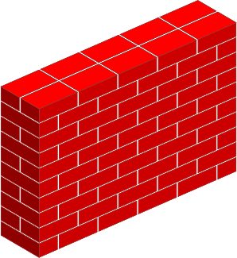
Turtles and while loops
I’m a little turtle and I want to take steps to the right until I get to the brick wall.
However, I don’t know how far away the brick wall I.
Open your notebook
Click Link:
10. Turtles and while loops

Slide 77
Random Module
This module implements pseudo-random number generators for various distributions.
Open your notebook
Click Link:
11. Random Module
import random
random.uniform()
random.random()
random.randint()
…

Slide 78
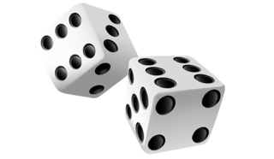
Breakout Session 2
Write a function that roles a 6-sided dice until a lucky number is rolled.
Open your notebook
Click Link:
12. Breakout Session 2

Slide 79
PRACTICE!

Slide 80
while loops.
Week 4 | Lecture 1 (4.1)
Upcoming
Lab 2 Due 11:59 pm Friday.
Lab 3 is released this Thursday 6:00 pm.
Reflection 4 Released Friday 6:00 pm.
Tutorial (Online), Practical, Office Hour sessions running all week.

