Slide 1
Rock, paper, scissors, lizard, Spock.
Design Problem 2

Slide 2
Agenda
Problem Background
Learning Objectives
Coding

Slide 3
Our problem background starts in a famous TV show apartment…

Slide 4


Slide 5
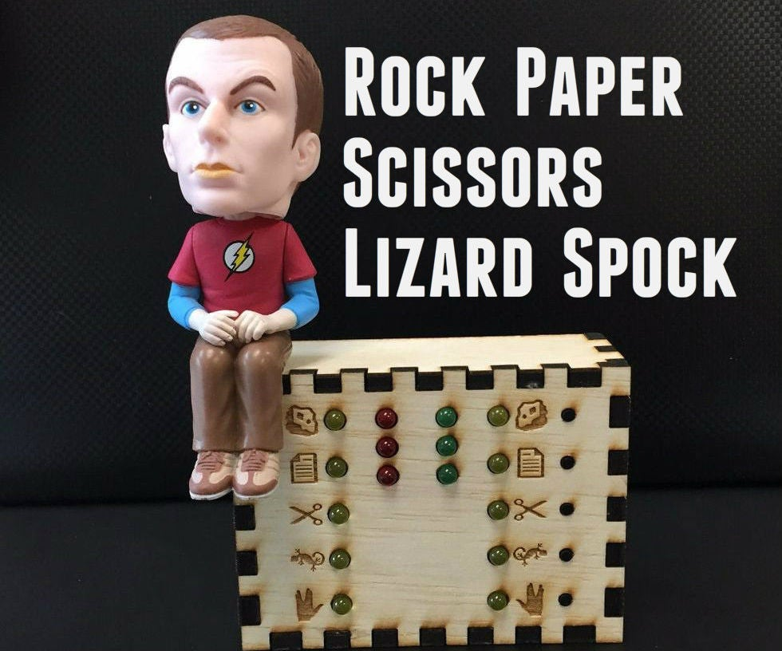
Background
Will rely on conditional statements and imported libraries to create a basic computer game!
Goal Write a Python program that using conditional statements and user input to play Rock-Paper-Scissors-Lizard-Spock against a computer program with random choice selection.

Slide 6
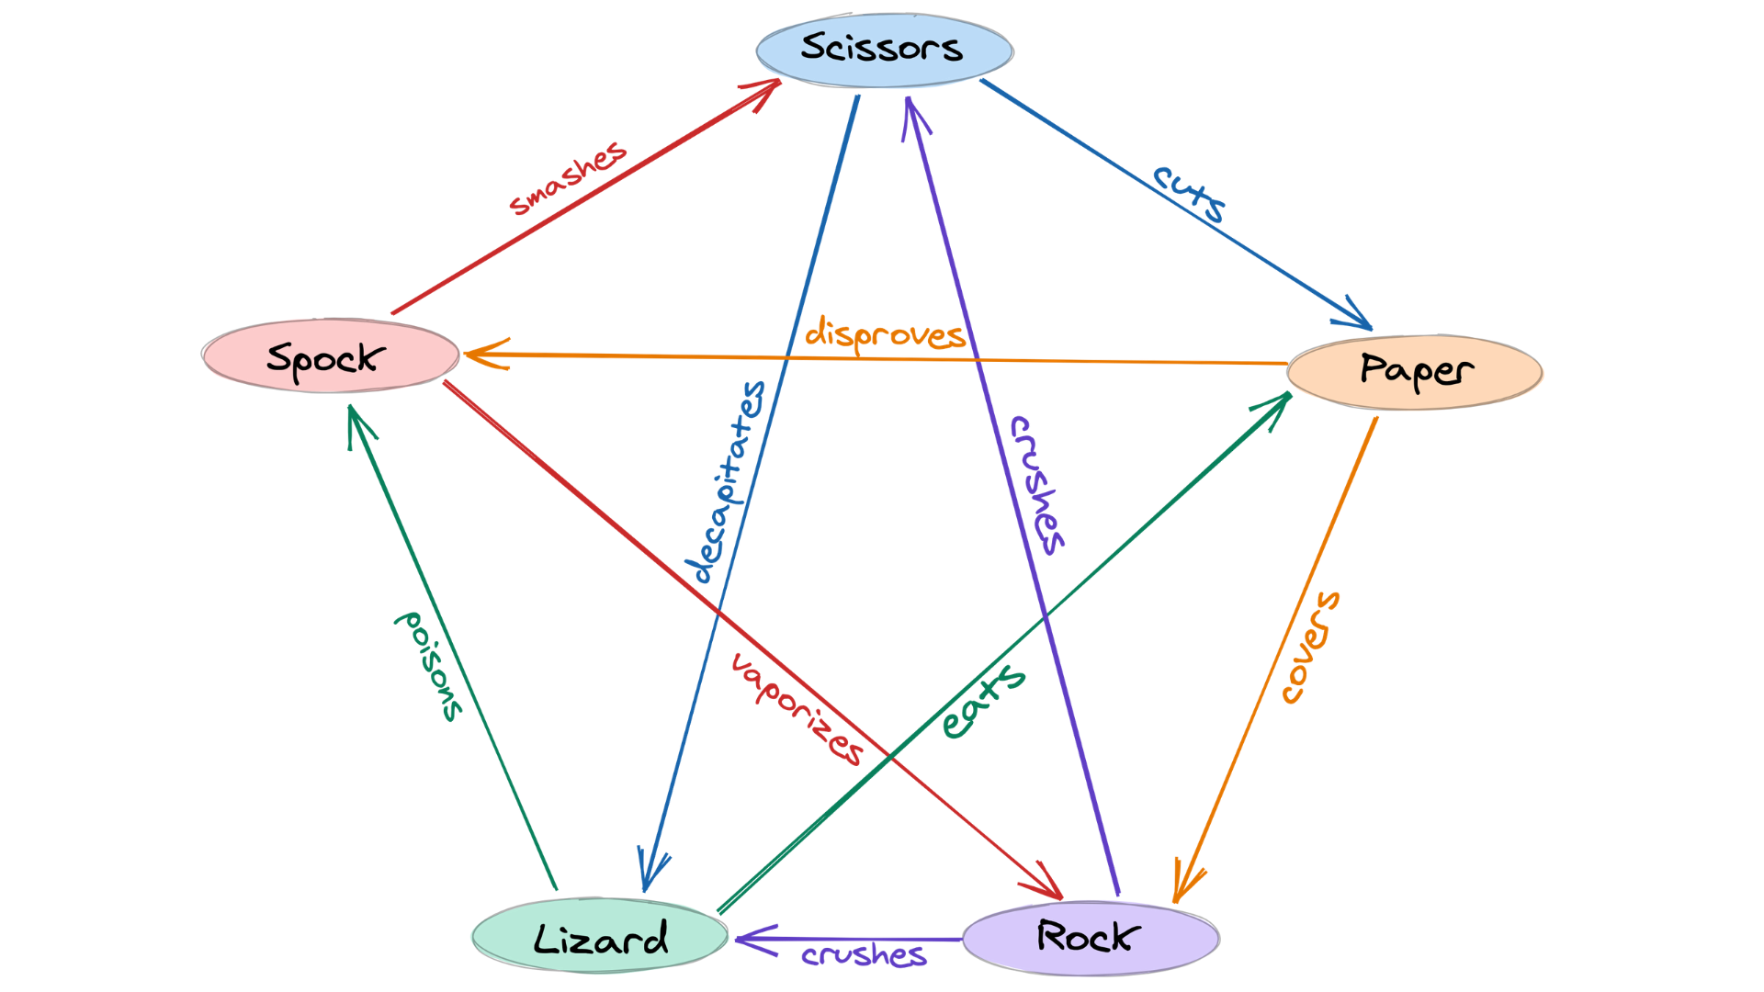
Learning Objectives
Practice using many conditional statements.
Practice with user input.
Practice creating custom functions.
Practice with built-in libraries.

Slide 7
Rock, paper, scissors, lizard, Spock.
Design Problem 2

Slide 8
Some reminders.

Slide 9

RECAP: Making Choices
statements
Sequential structure
statements
Conditional structure
if
True
condition
statements
statements
statements
False
statements

Slide 10


Adding the elif (else if) statement
The most general form of the if conditional statement is:
if condition1:
body1
elif condition2:
body2
elif conditionN:
bodyN
else:
other_body
Note the colons (:) and the indents!
ONLY 1 body will be executed.
if statement is True, execute body1, exits if structure
if statement is False, continue to elif statement
elif statement is True, execute elif body, exits if structure
elif statement is False, continue to next elif statement
All if’s and elif’s are False, execute else statement

Slide 11

Making Choices
statements
True
if
condition
Conditional structure
False
statements
True
elif
condition
statements
False
else
statements

Slide 12
Function Definitions
Definition
Function Name
Colon
def function_body(parameters):
body
Indent
(parameter1,
parameter2, …)
What is in the body?

Slide 13
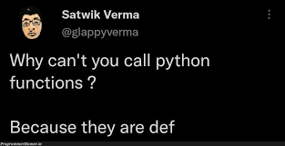
Function Definitions
def function_body(parameters):
1. “““DOCSTRING””” (optional)
2. Code the does the thing
3. return [expression]
The return statement is options and if it is not included, it’s the same as writing return None

Slide 14
Calling Functions
In Python names of variables and functions use low case and underscores.
function_name
Function_Name
FunctionName
The general form of a function call:
Terminology
argument: a value given to a function.
pass: to provide an argument to a function.
call: ask Python to execute a function (by name).
return: give a value back to where the function was called from.
function_name(arguments)

Slide 15
Input
Python has a built-in function named input for reading text from the user.
The general form of an input function call:
The argument is the text you want displayed to the user.
“What is your name?”
The value returned by the input function is always a string.
input(argument)

Slide 16
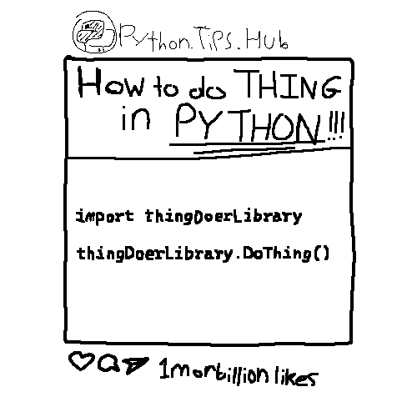
Importing Functions and Modules
The general for of an import statement is:
import module_name
To access a function within a module:
module_name.function_name

Slide 17
Engineering Design Process
Learn to define the problem.
Practice defining test cases.
Develop an algorithm plan (i.e. a workflow!).
Program your solution and debugging.

