Slide 1
How Does That Work?
Debugging with PyCharm

Slide 2
What is debugging?
Debugging is the process of identifying, isolating, and fixing problems or bugs within software. It involves systematically testing and tracing how a program operates to ensure it functions as intended.
Debugging in PyCharm involves setting breakpoints in the code to pause execution, allowing the developer to inspect variables, evaluate expressions, and step through the code line by line to identify and fix errors.

Slide 3
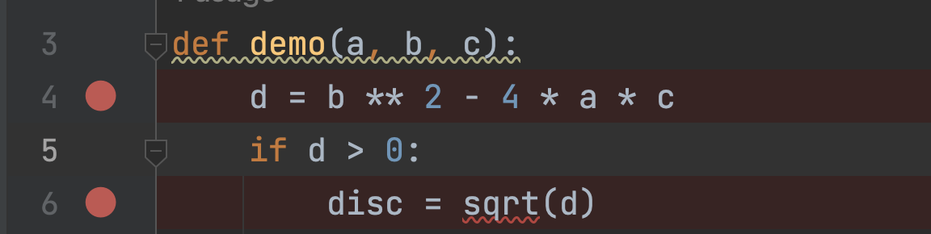
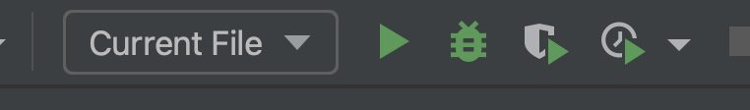
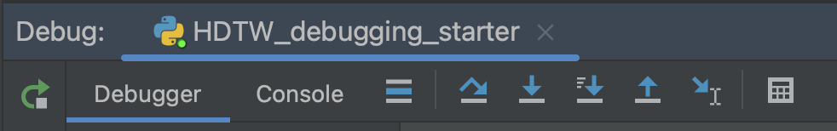
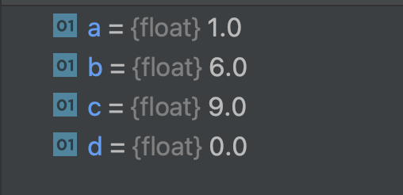
Workflow of Debugger in PyCharm
Set a breakpoint
Run your code with the debugger
Step-through, check the values of your variables
Optional: check scenarios with watches
Fix your code ☺

Slide 4
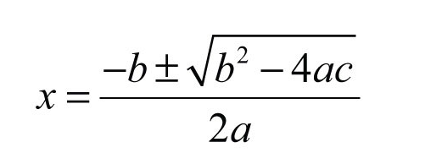
Example: Finding the Square Root of a Quadratic Equation
We can find the roots using the following equation:
where a, b and c are the coefficients in your quadratic function.
x has the following solutions:
2 roots
1 root
No roots (i.e. indicated by the negative value in the square root (b² – 4ac)

Slide 5
Test Cases for Types of Roots
2 real roots
x² – 14x + 45
x = 9, x = 5
1 real root
x² + 6x + 9
x = -3
No roots
x² + 4x + 5

