Slide 1
How Does That Work?
Python Environments and Packages/External Libraries

Slide 2
Why use external libraries?
Using external libraries in Python can enhance your Python projects and make development more efficient
External libraries often provide functionalities that you would otherwise need to code from scratch
Many of these libraries are maintained by experts
In addition, a lot of libraries have advanced functionalities that are optimized for performance, let you work with complex data and do advanced processing tasks (like computer vision and machine learning!)

Slide 3
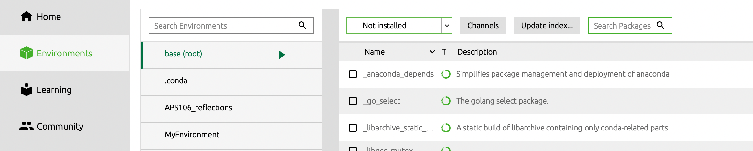
What are packages?
Two main ways to get these:
Installation by running pip in terminal or a notebook cell
Environment management tools, like Anaconda
!pip install numpy
Python Package Installer
Library name

Slide 4
What is an Environment
An environment is a directory that contains a specific collection of Python packages that have been installed, along with the specific version of Python.
There are a few use cases to use them:
Need to ensure that dependencies are managed on large projects between different people.
Working with a specific version of code meant to run with specific libraries.
Resolving conflicts in different environment versions.

Slide 5
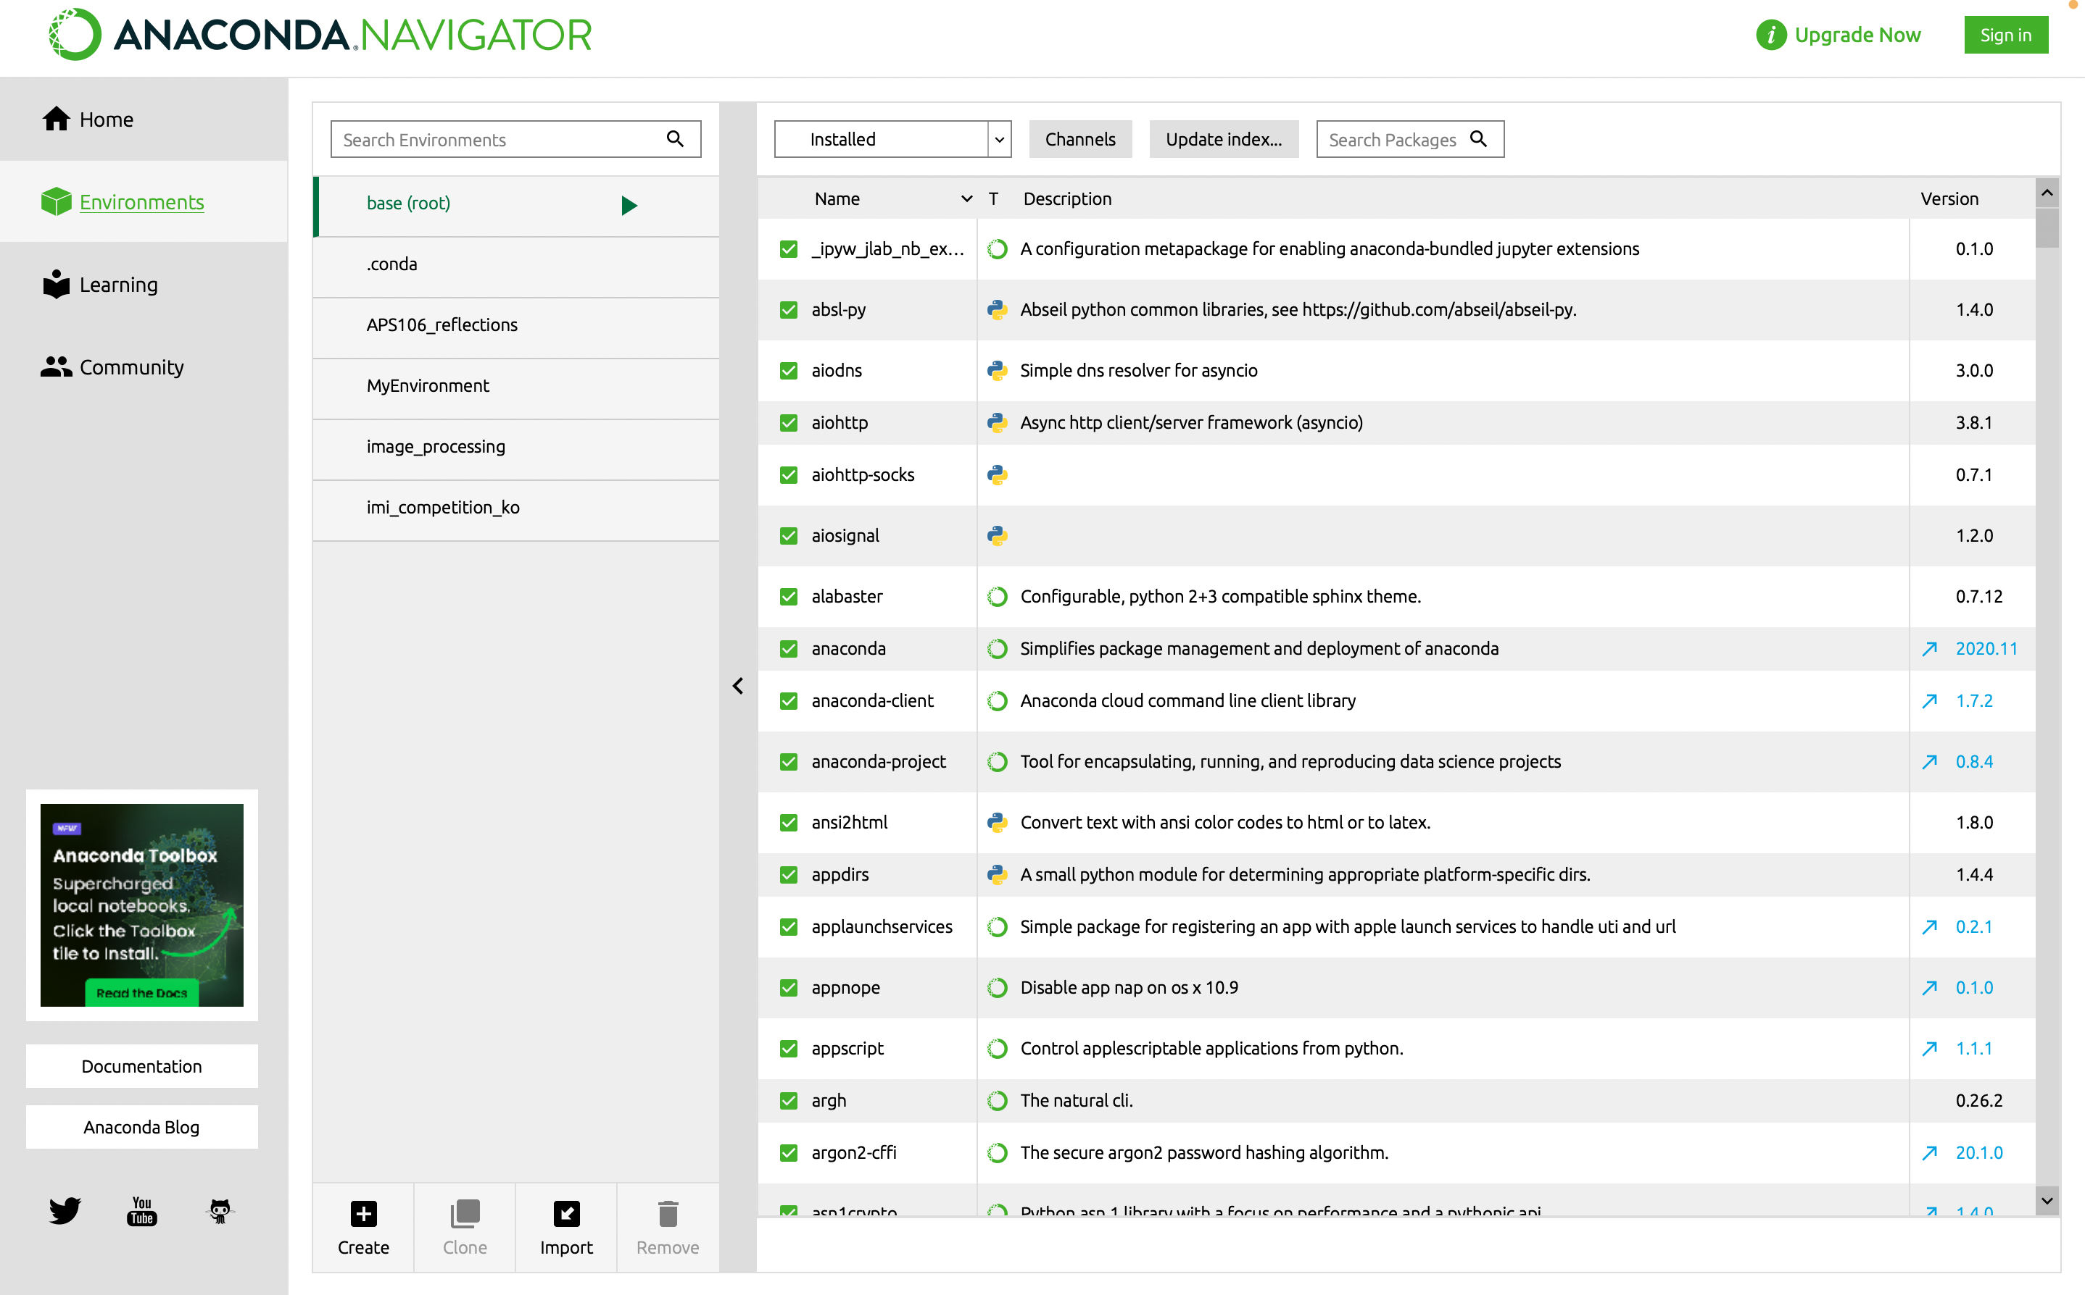
Anaconda simplifies environment management
You can create, export, list, remove and update environments
Also can create requirements.txt files from an environment, that can be shared as a pip install package as well

Slide 6
Demo

