Slide 1
How Does That Work?
Jupyter Notebooks

Slide 2
Notebooks? Python?
Jupyter Notebooks (.ipynb):
Consists of multiple cells
A cell can contain regular Python code or plain text (markdown)
Very good for visually explaining what is happening in your code, plots
You can also run samples of code at a time
Lecture code are in this format in this course
Python File (.py):
Executable file. You can even run these on your machine without installing any IDE’s!
Run in a linear format, from start to file.
Good for computation, or batching tasks, like a data engineering pipeline!
No intermittent output saved, no formatted text/figures like in a notebook.
Refer to the HDTW PyCharm video for a .py example!

Slide 3


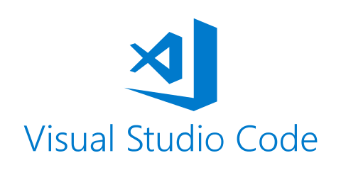

A few different ways we can work with Notebooks
Locally
Juypter IDE through Anaconda
PyCharm Professional IDE* (Community version supports view only)
Visual Studio Code
And more :)
Online
UofT JupyterHub (such as the lecture notes)

Slide 4

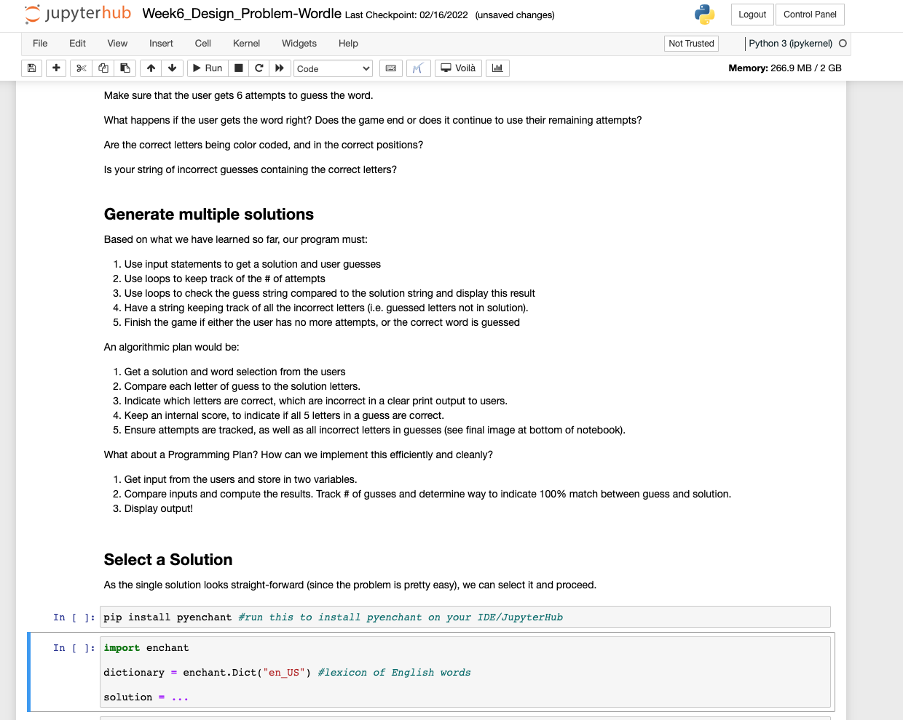
The Anatomy of a Jupyter Notebook (.ipynb)
Cell controls (run, restart, format, copy/paste…)
Kernel information (Python version + memory)
Markdown (.md) Text Cells
Python Code!

Slide 5
Demo.

