Slide 1
How Does That Work?
UofT JupyterHub

Slide 2

What is UofT JupyterHub?
Access at https://jupyter.utoronto.ca/
Cloud solution to run Jupyter Notebooks (.ipynb files), as well as R and Julia files
Linked to your UofT account, all lecture notes are stored as a copy in JupyterHub!
Advantages
Don’t need to install anything, just need internet
Save on local memory by storing work in the cloud
UofT JupyterHub compute is equipped for most programming and data science tasks in your courses

Slide 3
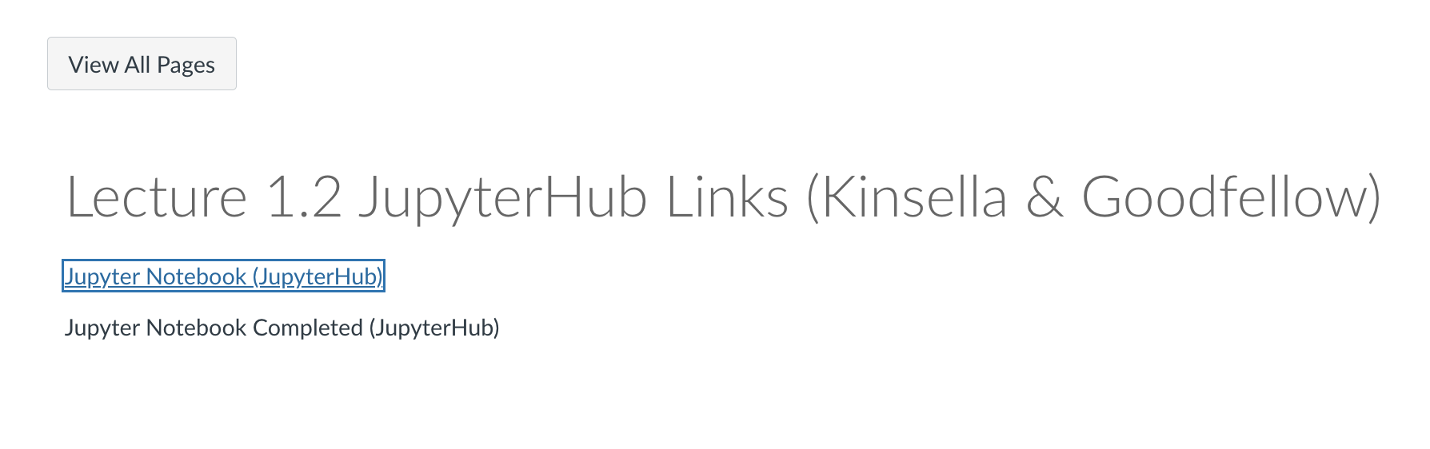
Overview – Course Lecture Notes

Slide 4
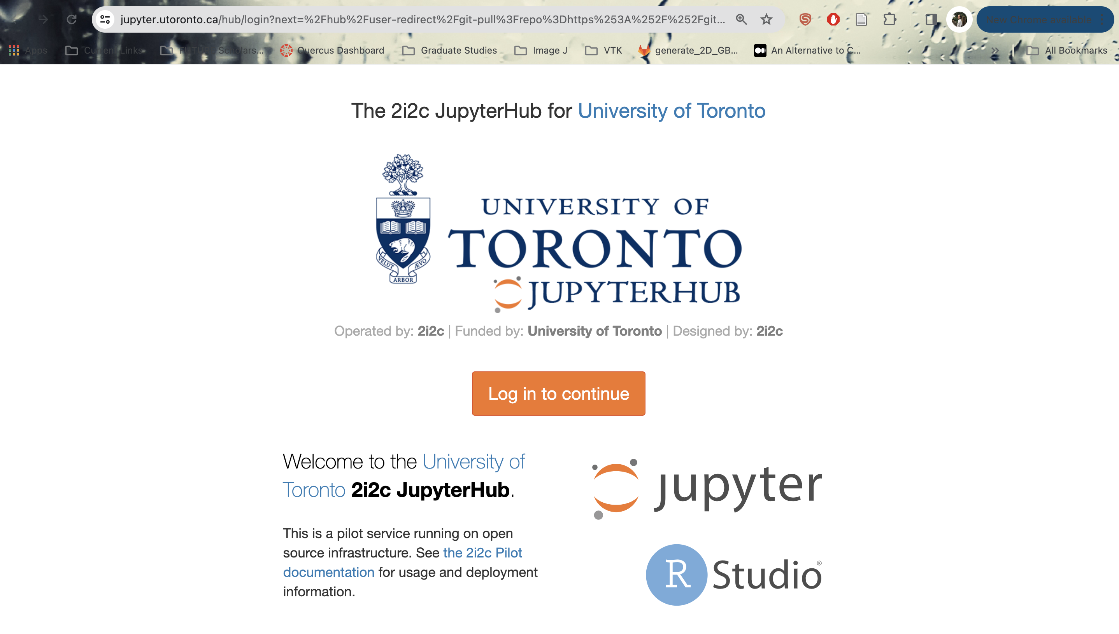
Overview – Course Lecture Notes

Slide 5
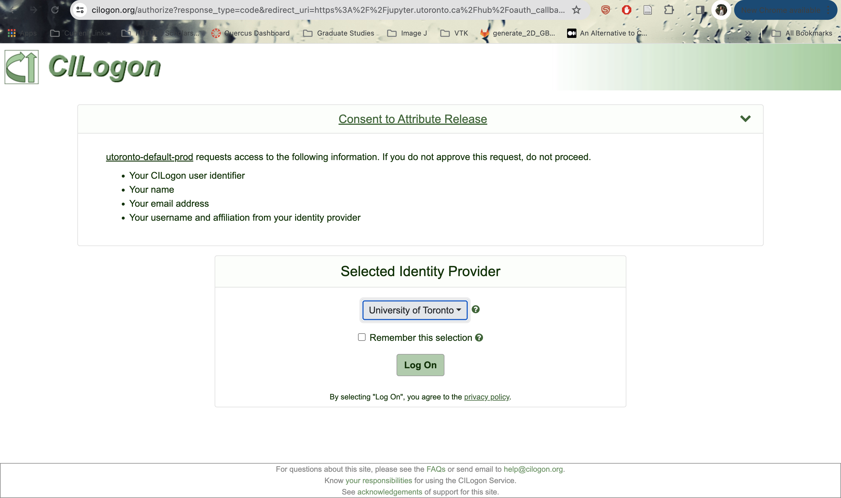
Overview – Course Lecture Notes

Slide 6
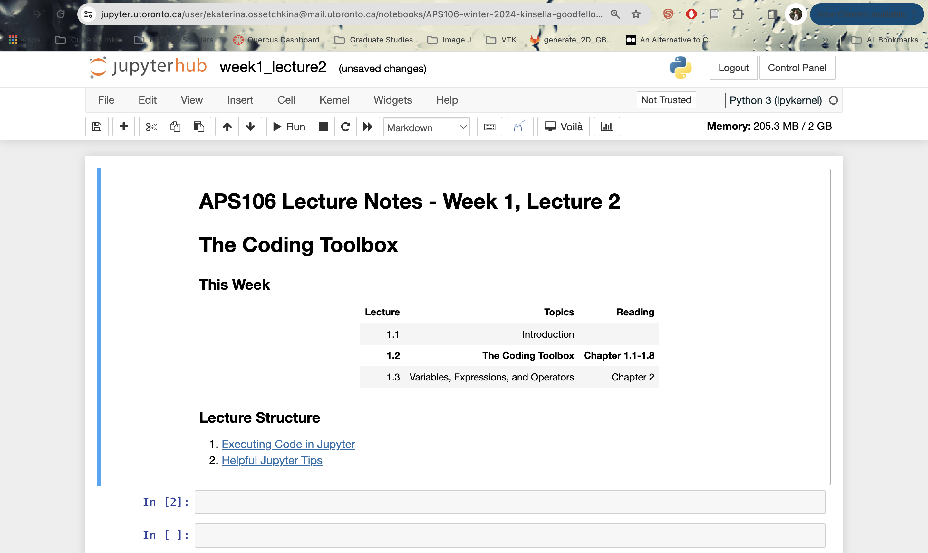
Overview – Course Lecture Notes

Slide 7
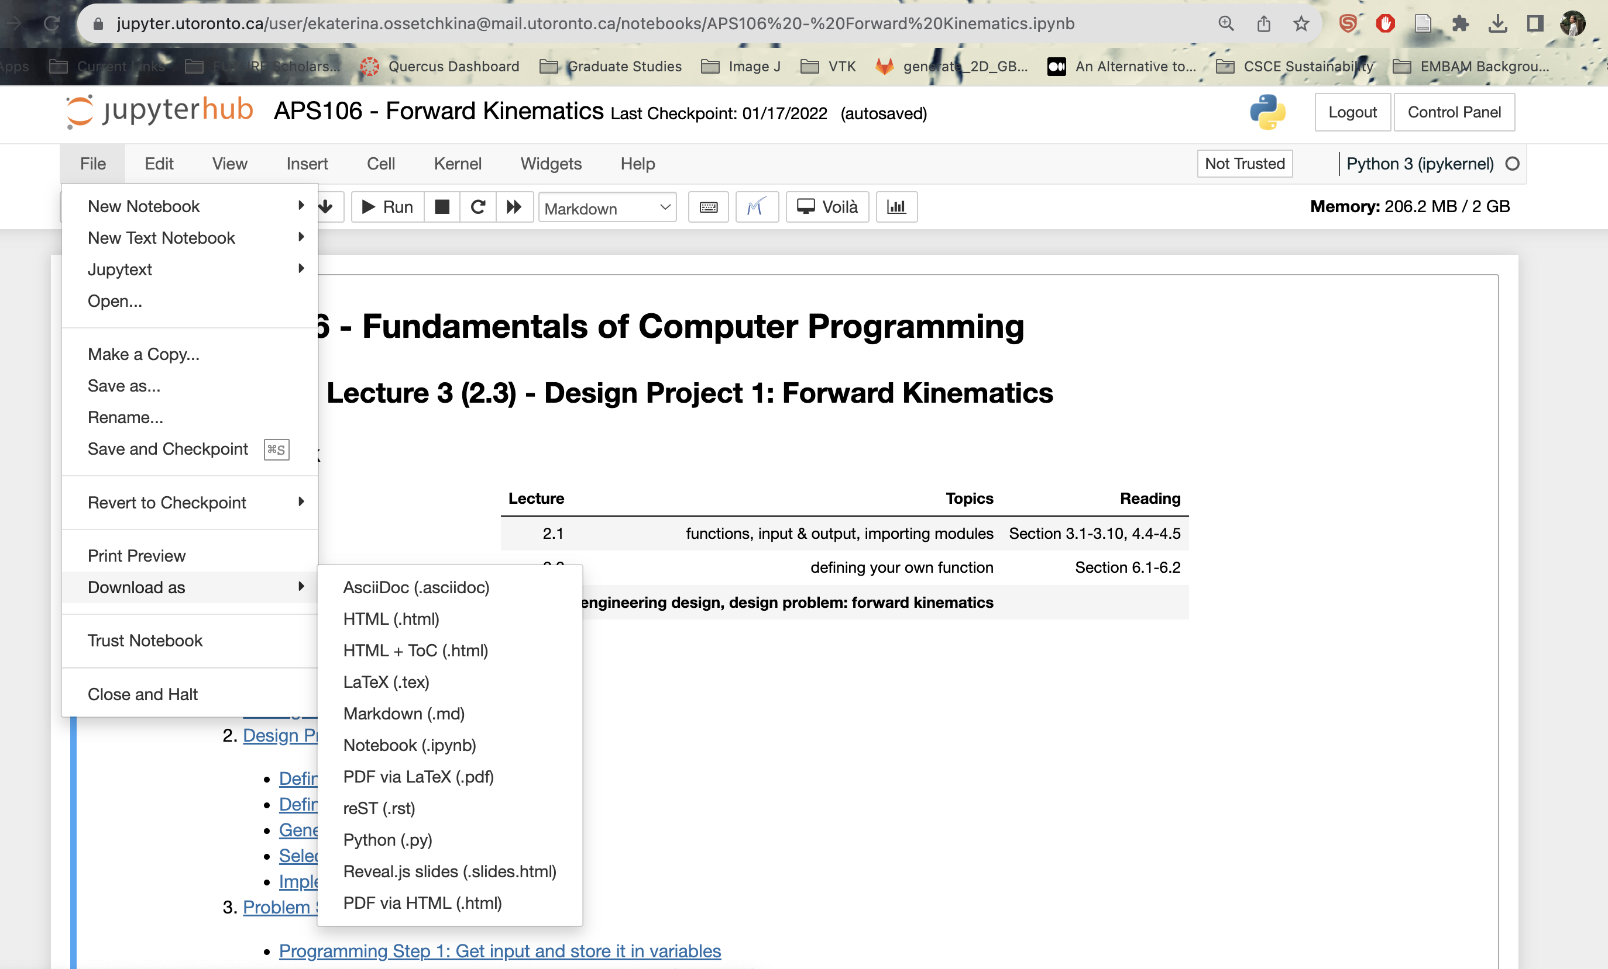
Overview – Inside a Notebook
File path on Jupyter cloud
Compute used (2 GB limit)
Cell type
Download files locally (recommend in .ipynb or HTML format)

Slide 8
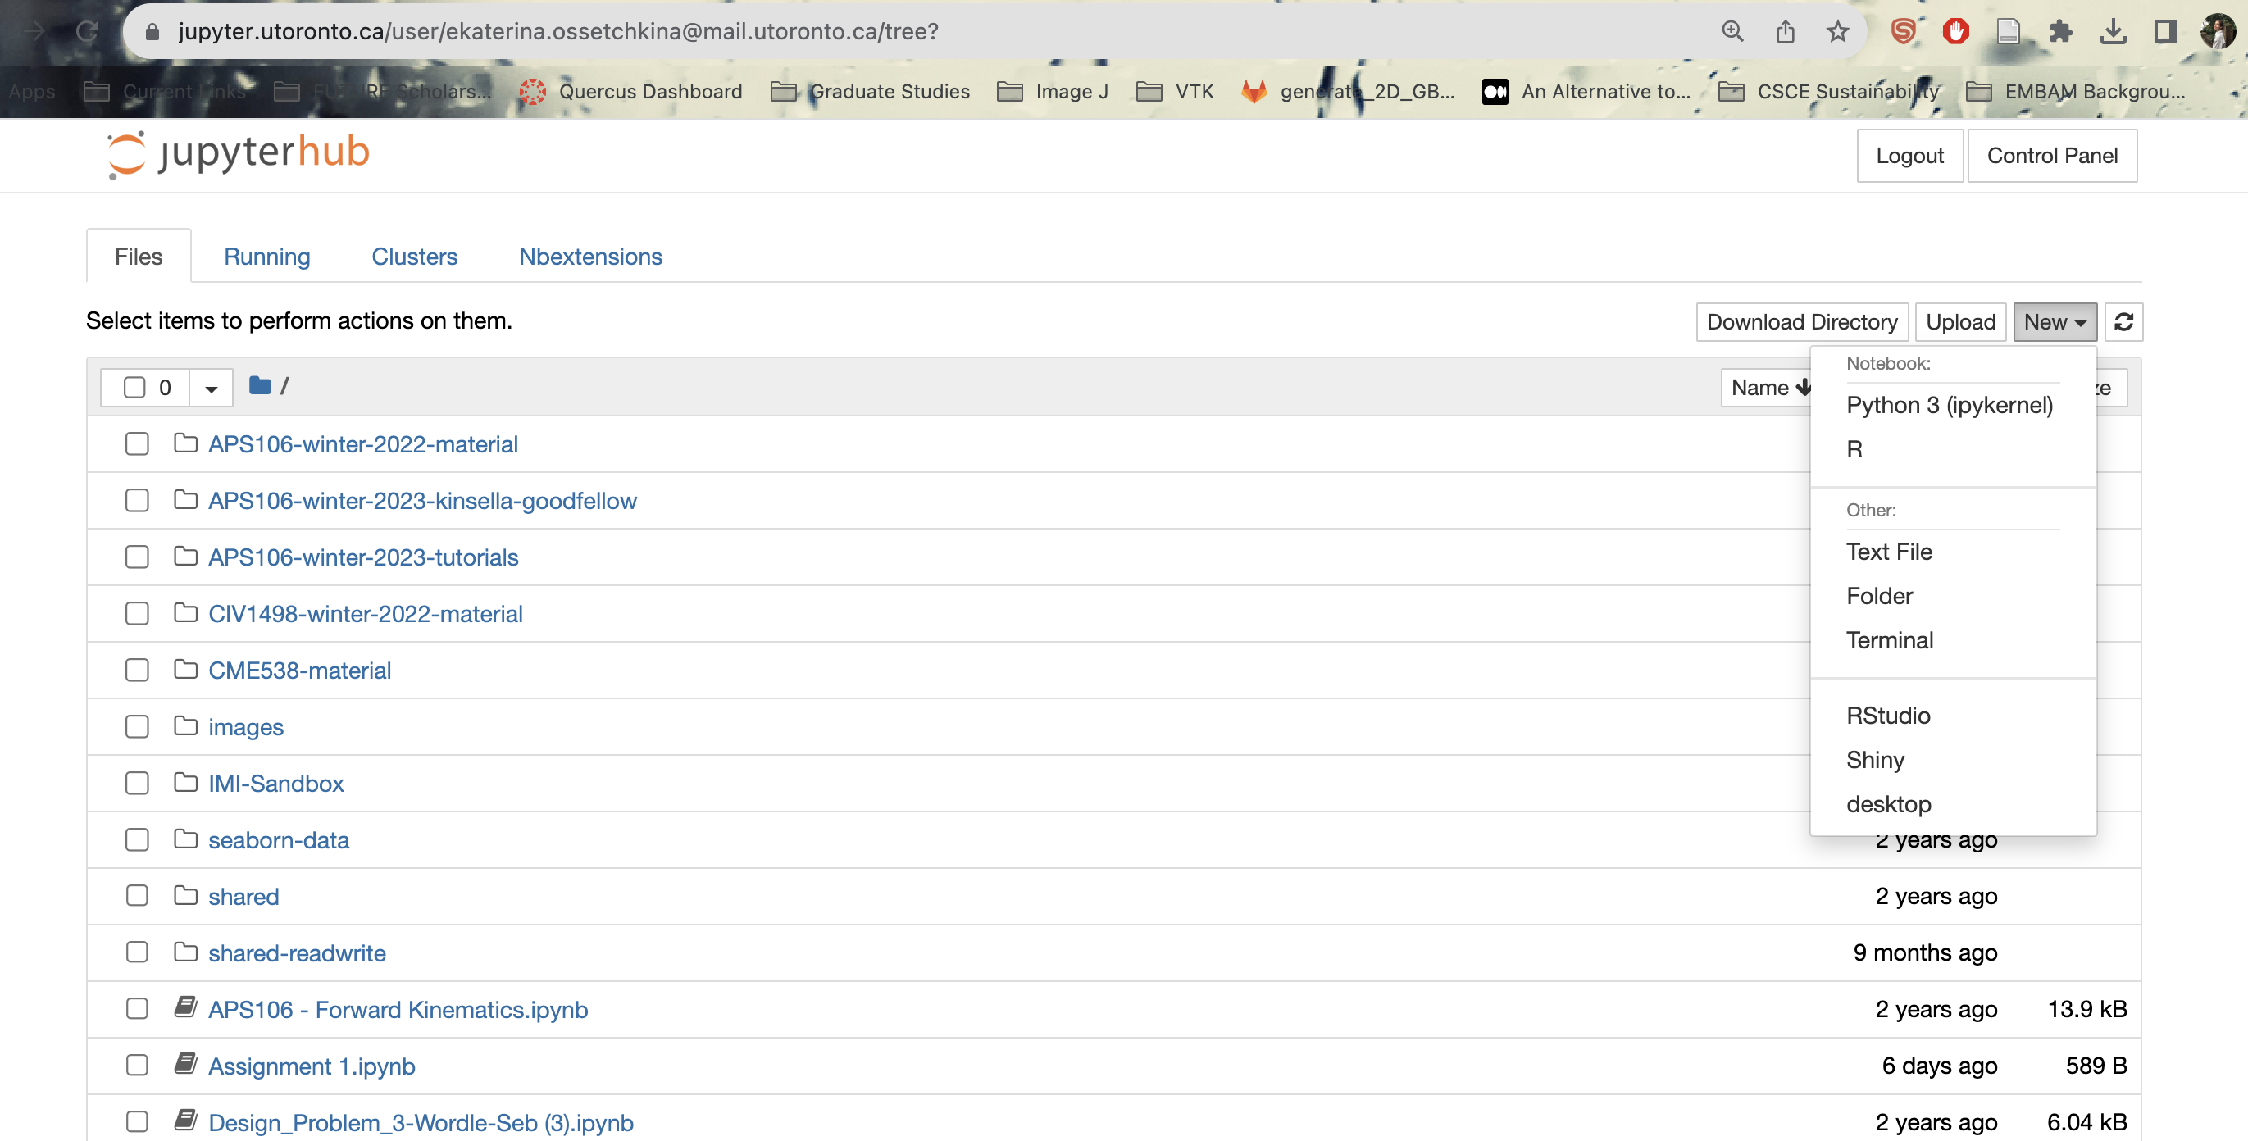
Overview – Main Page (Directory Tree)
Return to
tree/ main dashboard
Create new files
Files and directories

Slide 9
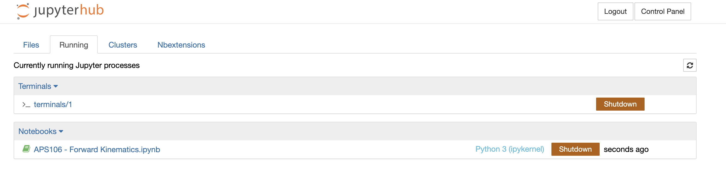
Overview – Running Page
See everything still running
Shut down any notebooks or terminals still running to save memory (not enough to just close a tab)
List of things running and using up compute (memory)

