Slide 1
How Does That Work?
IDEs and PyCharm

Slide 2
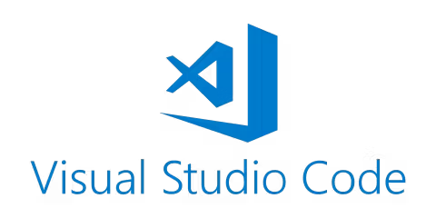
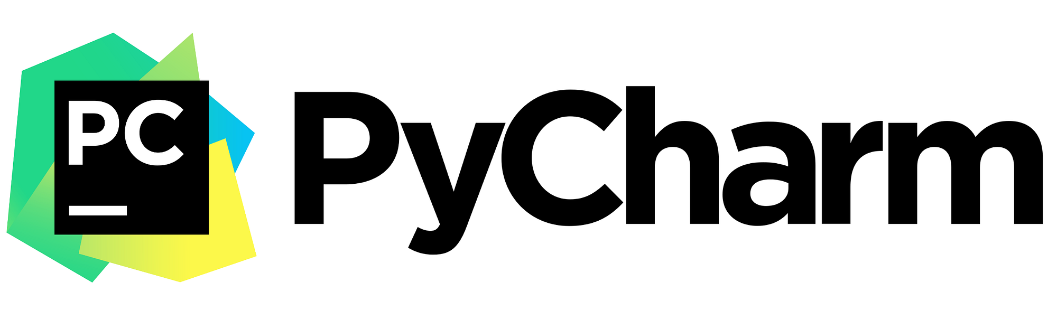


IDE – Integrated Development Environment
A software application that helps you develop code efficiently
For a plain Python executable file, you could use a text editor (such as notepad), but an IDE will include highlighting rules for the language syntax, can help you debug errors, and help refactor/complete your code.
Some IDEs we know:

Slide 3
PyCharm
Community edition – is free, but will give you read-only to notebooks (.ipynb)! But will work properly with Python (.py) extension files
Can get Professional PyCharm with UofT email – need to get form approved (or a 30 day trial without this)
Apply for the student license to get PyCharm here (Apply Now): https://www.jetbrains.com/community/education/#students
Download from JetBrains: https://www.jetbrains.com/pycharm/

Slide 4
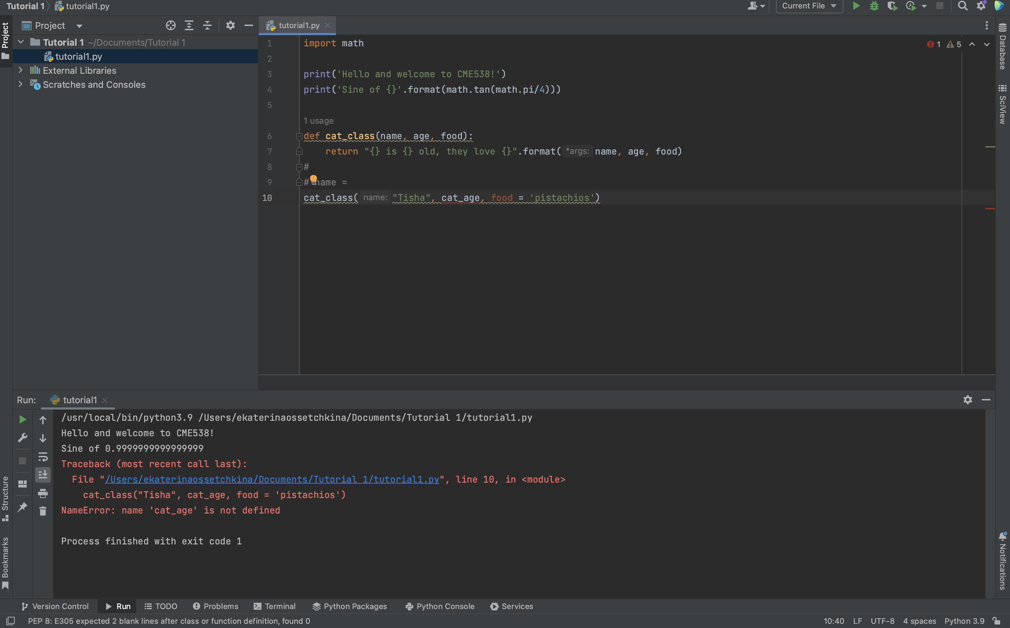
The Anatomy of a Python File (.py) in
File explorer
Your code!
Console (run results)
Python version (or virtual environment*)

Slide 5
Demo.

