Slide 1
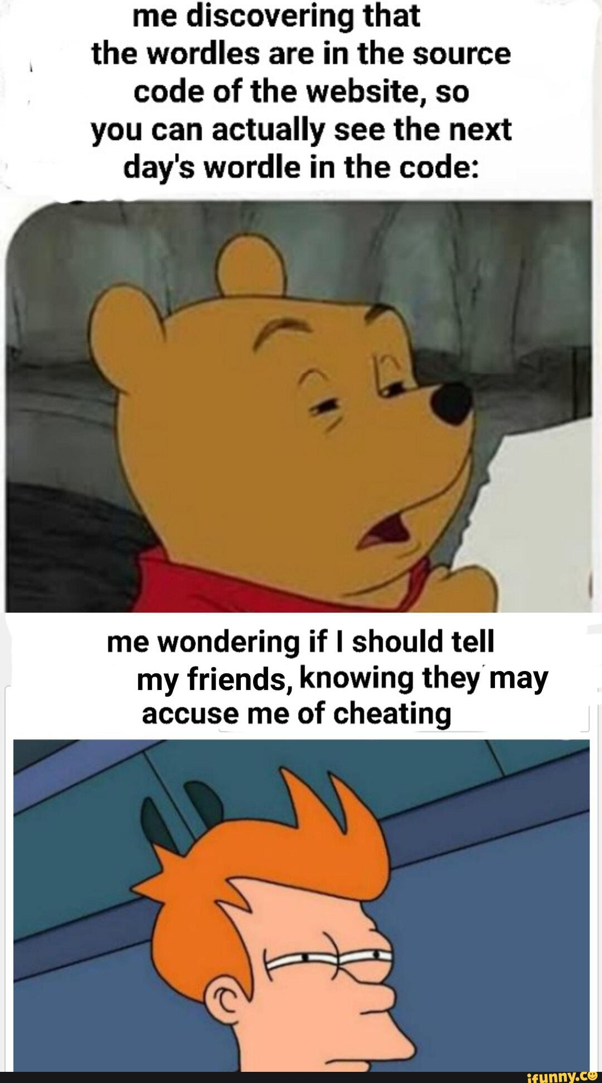
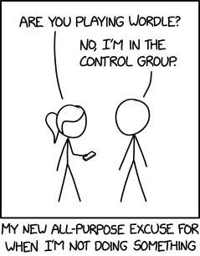
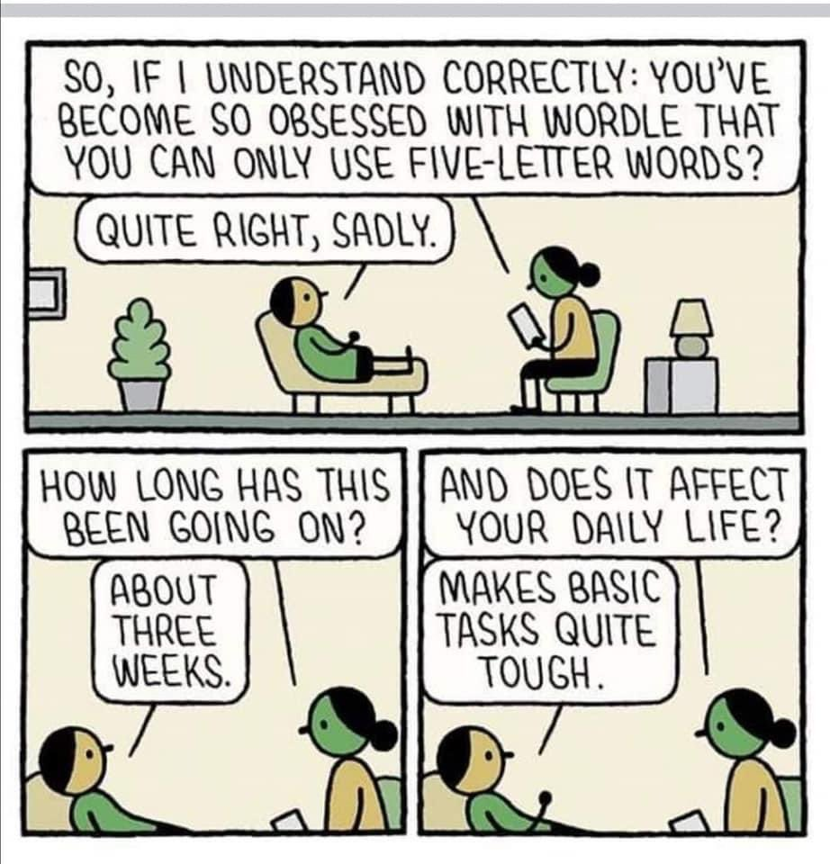
Wordle Part 2: output and gameplay.
Week 10 | Lecture 3 (10.3)
While waiting, open the Jupyter Notebook for today’s lecture
Upcoming
Lab 8 Released Thursday 6:00 pm.
Reflection 10 Released Friday 6:00 pm.

