Slide 1
Turtle setup.

Slide 2
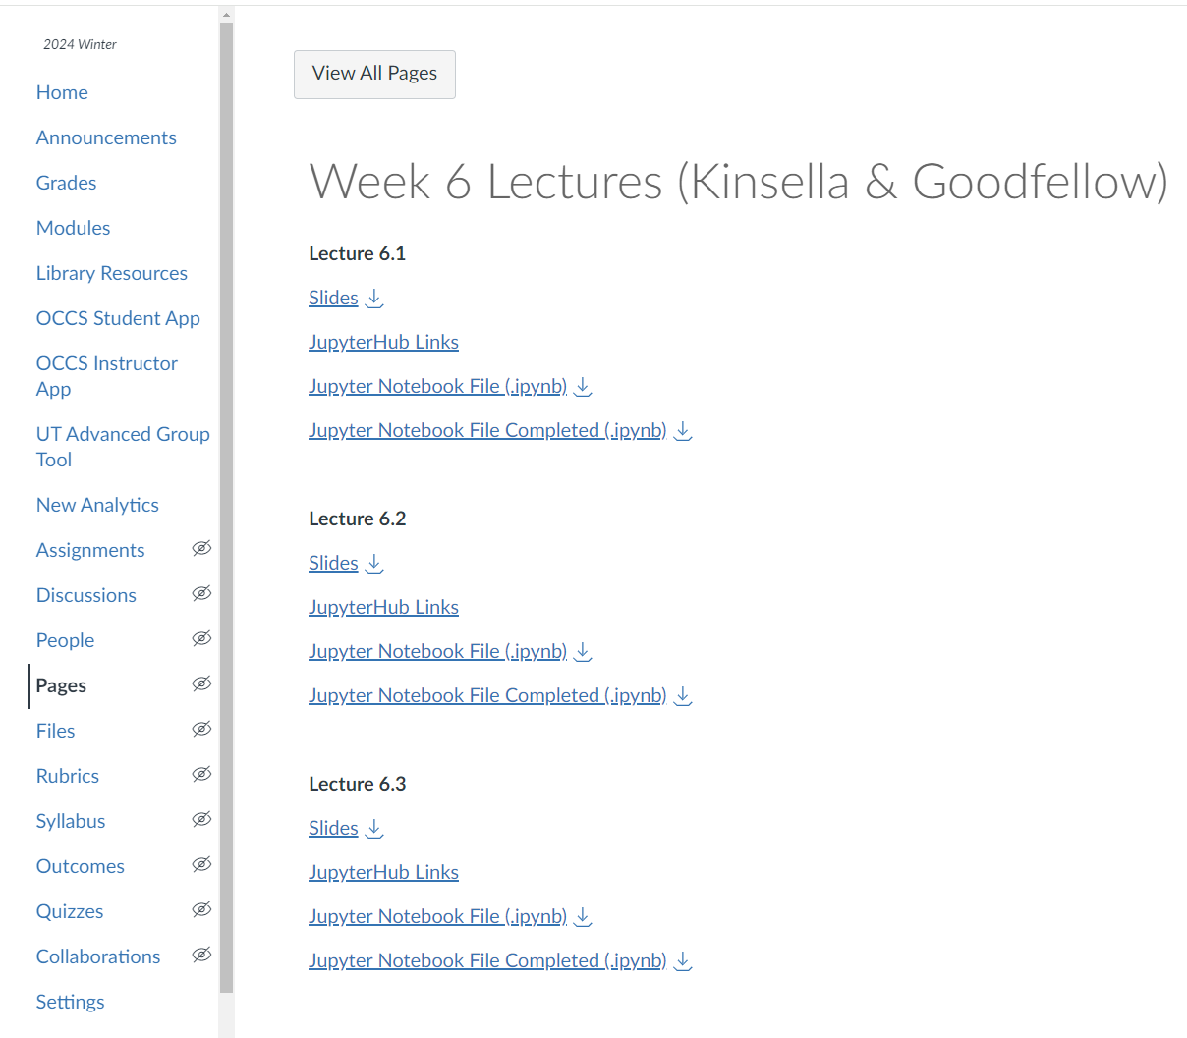
Download Notebook
Download lecture 6.2 notebook.
week6_lecture2_starter.ipynb

Slide 3
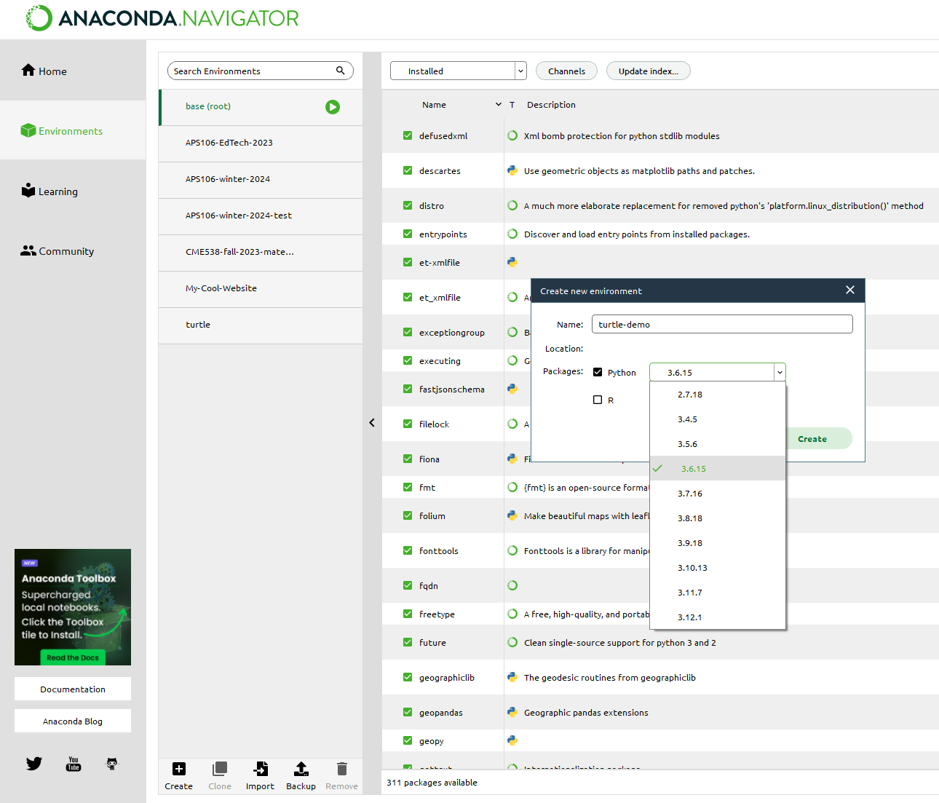
Create New Environment
Create an environment.
Choose a name you’ll remember.
Make sure you use Python version 3.6.
In my case, I have the option to install 3.6.15. Any 3.6 version will work.

Slide 4
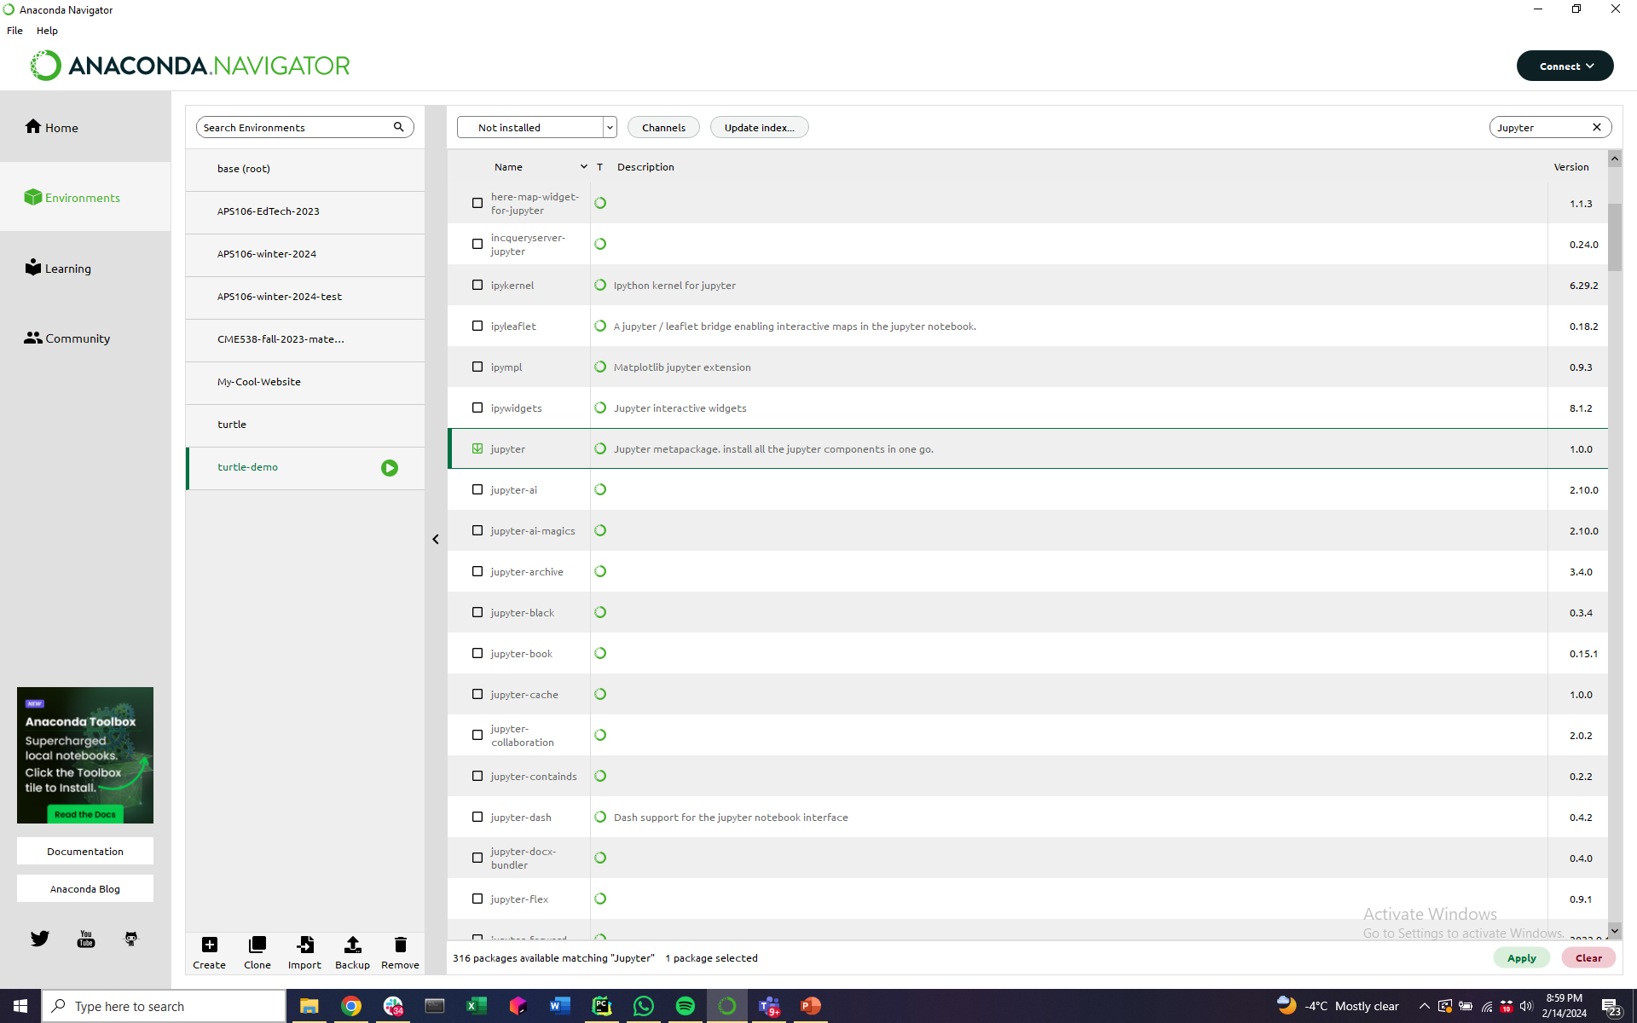
Install Jupyter
See packages that are not installed yet.
Choose Jupyter.
Click Apply (Install).

Slide 5
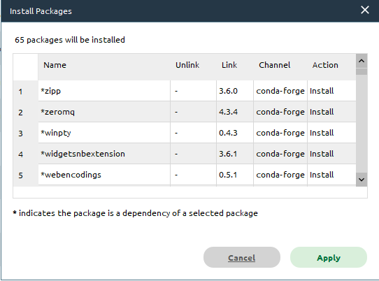
Install Jupyter
This will pop up a window where Anaconda tells you what packages will be installed.
Click Apply (Install).

Slide 6
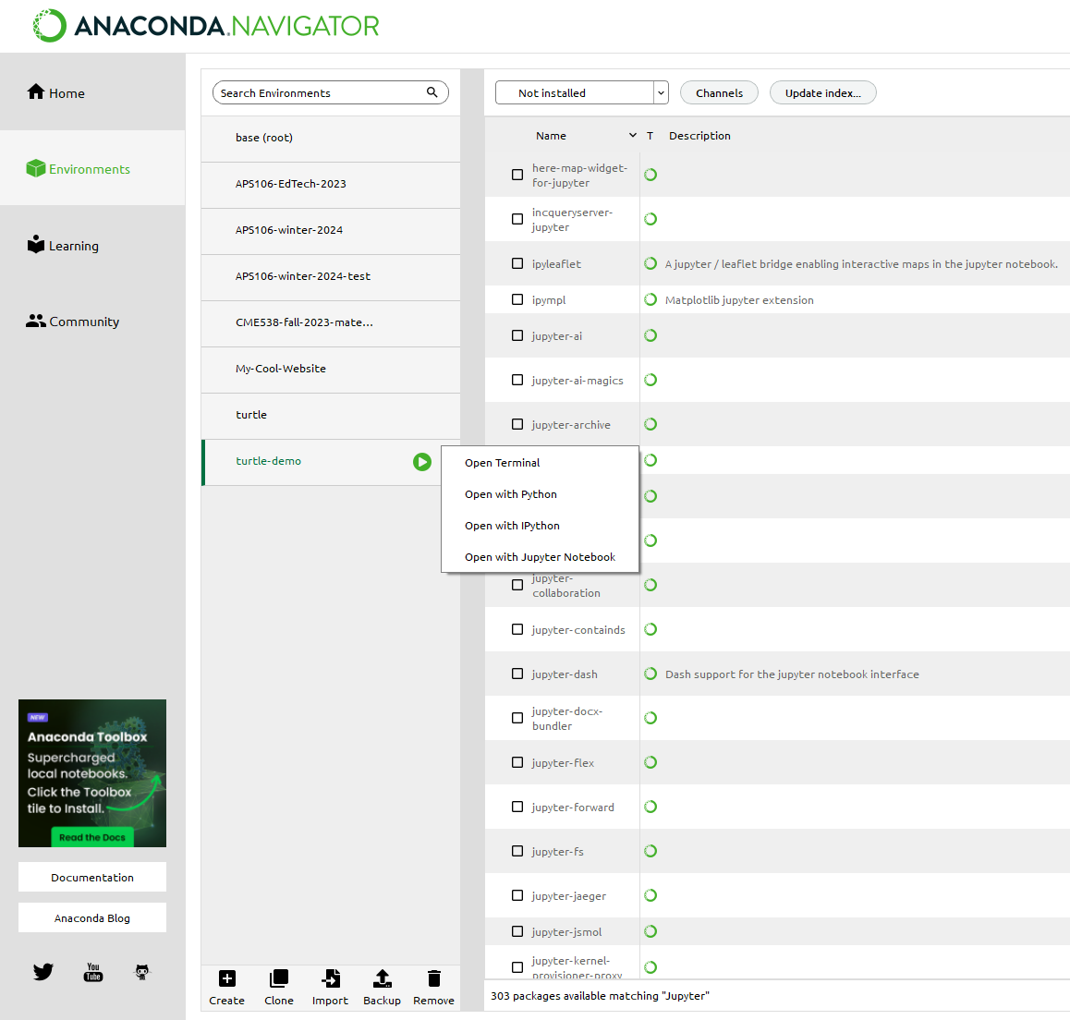
Launch Jupyter
Click the play button for the new environment you created.
Click “Open with Jupyter Notebook”.

Slide 7
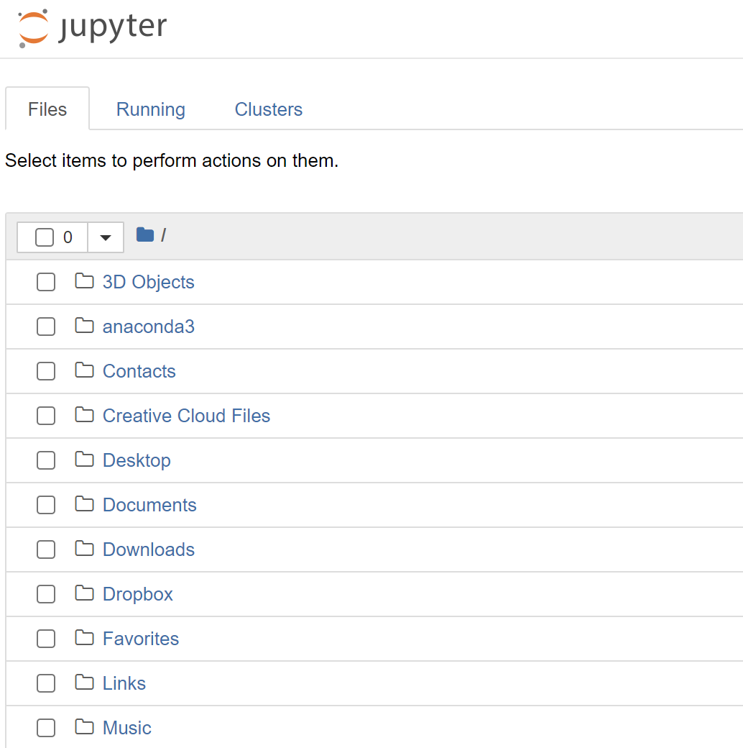
Open Lecture Notebook
Click on the Downloads folder.

Slide 8
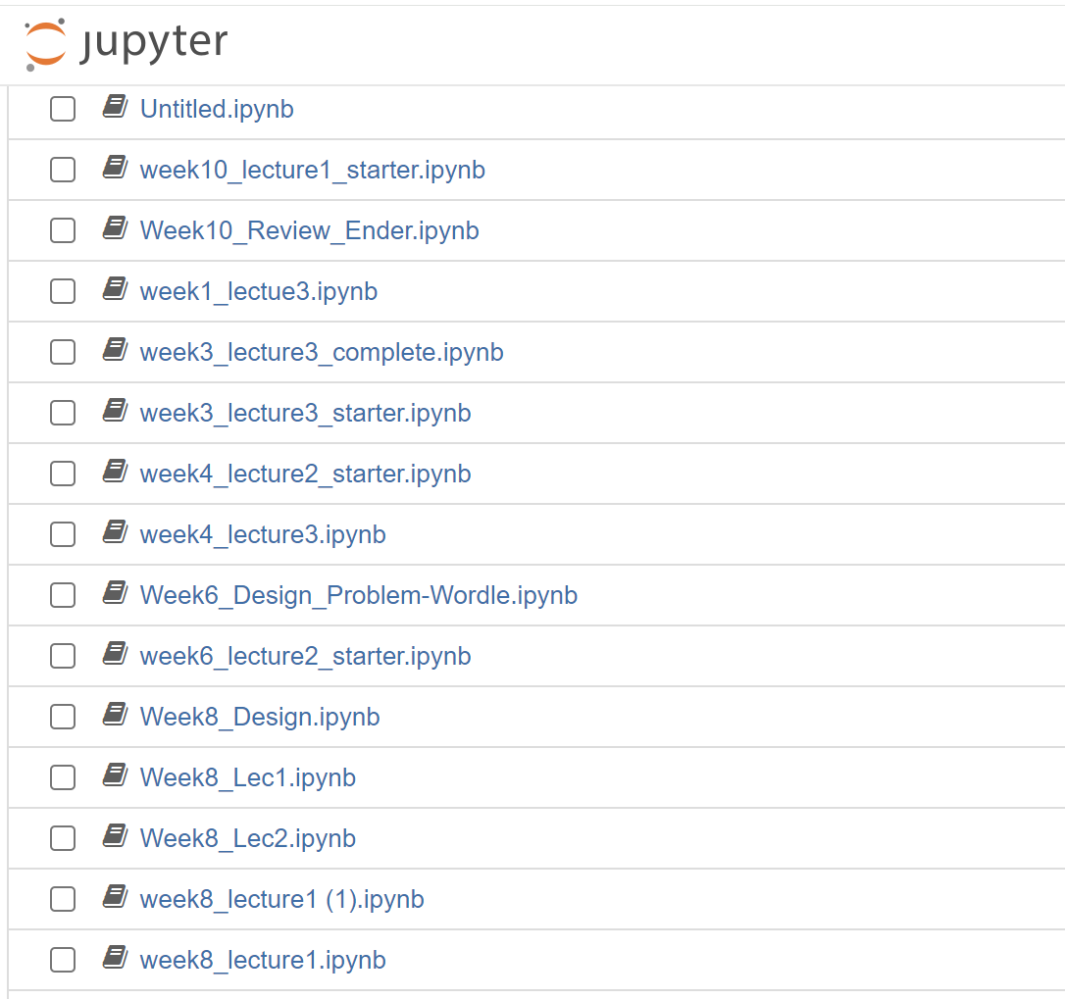
Open Lecture Notebook
Click on the Week 6 Lecture 2 notebook you downloaded.

Slide 9
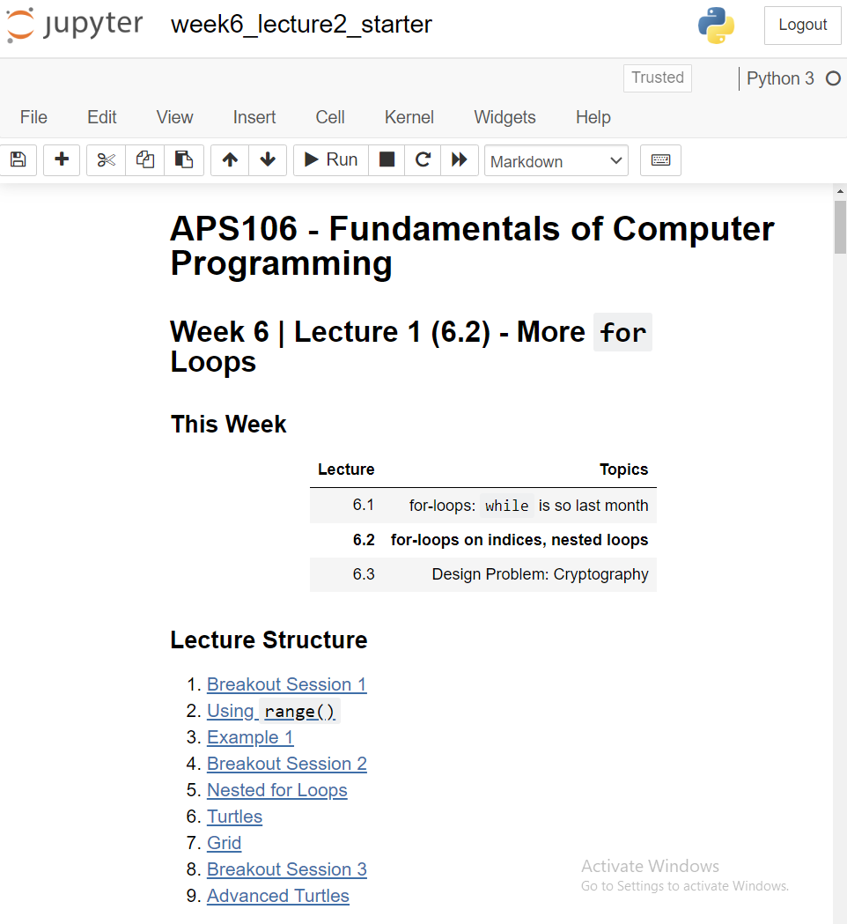
Go To Turtles Section
Click the Turtles link.

Slide 10
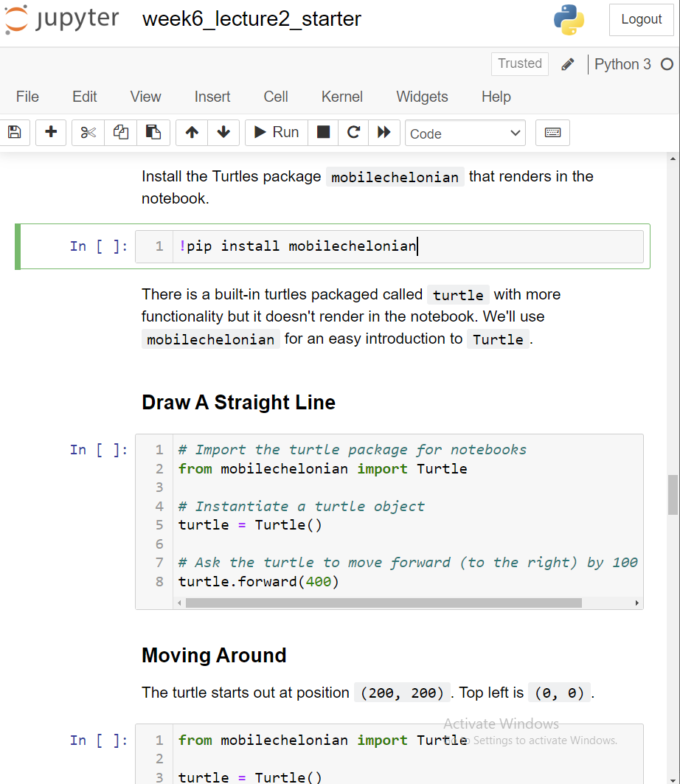
Install Turtles Package
Run this cell which will install the Turtles package.
To run a cell, press SHIFT+ENTER.

Slide 11
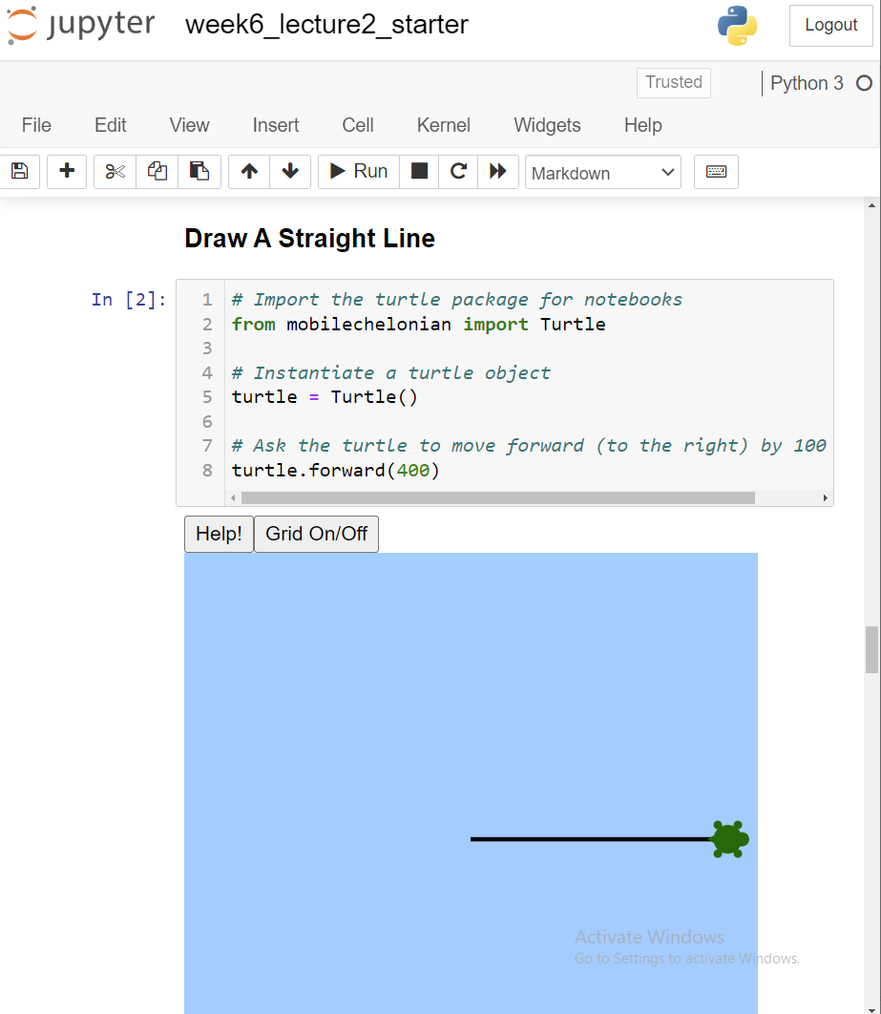
Install Turtles Package
Run this cell which make a turtle walk across the screen.
To run a cell, press SHIFT+ENTER.

Slide 12
Turtle setup.

