Slide 1
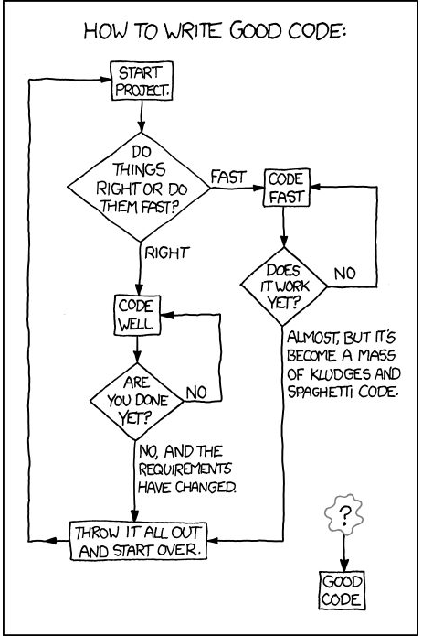
dictionaries.
Week 8 | Lecture 2 (8.2)
While waiting, open the Jupyter Notebook for today’s lecture
Upcoming.
Lab 5 Due Friday 11:59 pm.
Lab 6 Released Thursday 6:00 pm.
Reflection 8 Released Friday 6:00 pm.
Tutorial (in-person AND online) running all week.
Practical sessions (in-person AND online) running ONLY Friday this week.

Slide 2
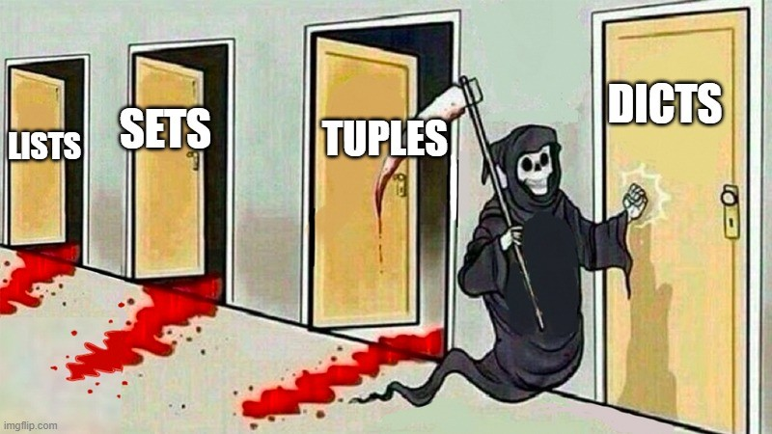
This Week’s Content
Lecture 8.1
tuples and sets
Lecture 8.2
dictionaries
Lecture 8.3
Design Problem: Wordle Part 1

Slide 3
Dictionaries
key: value
“name”: “Pam”
1: [1, 9, 4]
2.35: {‘bee’, ‘ant’}
(3, 6, ‘hi’): False
True: [4, ‘tree’]
None: ‘car’
A dictionary (type dict) is an unordered data structure similar to how sets are unordered.
Dictionaries contain references to objects as key: value pairs.
Each key in the dictionary is associated with a value.
Dictionaries are mutable, entries can be added, modified or removed.

Slide 4
Dictionaries
Set
{‘ford’, ‘tesla’, ‘BMW’}
The general syntax of dict data type is as follows:
Dictionaries are created using curly braces { } around key: value pairs of literals and/or variables.
{key1: val1, key2: val2, ..., keyN: valN}
{‘name’: ‘Pam’, 1: [1, 9, 4], None: ‘car’}

Slide 5
Dictionaries
key: value
“name”: “Pam”
1: [1, 9, 4]
2.35: {‘bee’, ‘ant’}
(3, 6, ‘hi’): False
True: [4, ‘tree’]
None: ‘car’
Keys:
Must be immutable.
int, float, str, tuple, and NoneType, bool. (No lists or sets)
Values:
Can be anything.
int, float, str, tuple, and NoneType, bool, dict, list, and set.
Many other 3rd party datasets.

Slide 6
Dictionaries
Let’s create some dictionaries.
Open your notebook
Click Link:
1. Dictionaries

Slide 7
Dictionary Operations
Dictionaries are mutable so entries can be added, modified, and removed.
Given: grades = {‘Tina’: ‘A+’}
Indexing Operation:
Retrieves the value associated with a key.
We index with keys not position like lists & tuples.
Add/Modify Entry :
Adds an entry if the entry does not exist, otherwise it modifies the existing entry.
Delete Operation:
Removes the key and it’s value from a dictionary.
In Operator:
Tests for existence of key in the dictionary (it does not check the values).
>>> grades[‘Tina’]
‘A+’
>>> grades[‘John’] = ‘B+’
>>> grades
{‘Tina’: ‘A+’, ‘John’: ‘B+’}
>>> del grades[‘Tina’]
>>> grades
{‘John’: ‘B+’}
>>> if ‘John’ in grades: print(grades)
{‘John’: ‘B+’}

Slide 8
Dictionary Operations
Given: grades = {‘Tina’: ‘A+’}
Indexing Operation:
Retrieves the value associated with a key.
We index with keys not position like lists & tuples.
Add/Modify Entry :
Adds an entry if the entry does not exist, otherwise it modifies the existing entry.
Delete Operation:
Removes the key and it’s value from a dictionary.
In Operator:
Tests for existence of key in the dictionary (it does not check the values).
Open your notebook
Click Link:
2. Dictionaries Operations

Slide 9
Dictionary Methods
Dictionaries are objects and just like some of the other object we have seen, there are associated methods that are only valid for dict types.
dict.clear()
dict.keys()
dict.values()
dict.items()
dict.pop(args)
dict.get(args)
dict.update(args)
Open your notebook
Click Link:
3. Dictionaries Methods

Slide 10
Breakout Session 1
Complete the exercises in the notebook.
Open your notebook
Click Link:
4. Breakout Session 1

Slide 11
Iterating
friends = {"Bob": 32, "Jane": 42}
Keys
>>> for key in friends: or friends.keys()
print(key)
“Bob”
“Jane”
Values
>>> for value in friends.values():
print(value)
32
42
Keys and Values
>>> for item in friends.items():
print(item)
(“Bob”, 32)
(“Jane”, 42)
Introducing out 6th iterable!
A for loop can be used to iterate over a dictionary, with the loop variable being set to the key of an entry in each iteration.
The ordering in which the keys are iterated over is not necessarily the order in which the elements were inserted into the dictionary.
Defaults to List-like object of keys.
List-like object
of values.
List-like object
of key-value tuples.

Slide 12
Iterating
A for loop can be used to iterate over a dictionary, with the loop variable being set to the key of an entry in each iteration.
The ordering in which the keys are iterated over is not necessarily the order in which the elements were inserted into the dictionary.
Open your notebook
Click Link:
5. Iterating

Slide 13

Breakout Session 2
#feelinthebern with Bernie Sanders.
Open your notebook
Click Link:
6. Breakout Session 2

Slide 14
Inverting Dictionaries
Reversing a dictionary is not the same as reversing a list; it entails inverting or switching the dictionary's key and value parts.
Open your notebook
Click Link:
7. Inverting Dictionaries
eng2spa = {"two": "dos", "one": "uno"}
spa2eng = {"dos": "two", "uno": "one"}

Slide 15
Breakout Session 3
Invert a dictionary.
Open your notebook
Click Link:
8. Breakout Session 3

Slide 16
Dictionaries as Data Structures
Nested dictionaries also serve as a simple but powerful data structure.
A data structure is a logical and coherent organization of data.
Actually, container objects like lists and dictionaries are already a form of a data structure.
But, nesting such containers provides a programmer with much more flexibility in the way that the data can be organized.
Open your notebook
Click Link:
9. Dictionaries as Data Structures

Slide 17
Lecture Recap
Practice
A container of key:value pairs.
Accessing an element via its key.
Dictionary methods.
Iterating over dictionaries.
Testing membership: in
Dictionaries as data structures.
See Chapter 11 of the Gries textbook.

Slide 18
dictionaries.
Week 8 | Lecture 2 (8.2)

