Slide 1

Pandas.
Course Evaluations.
Help us debug this course.
Week 11 | Lecture 2 (11.2)

Slide 2

This Week’s Content
Lecture 11.1
  More OOP! Encapsulation and Examples
Lecture 11.2
  Files, CSVs, and Modules
Lecture 11.3
  Design Problem: Dungeon Escape

Slide 3

The ”Writing to Files” Recipe.
# open/create a file
myfile = open("grades.txt", "w")
# write to a file
myfile.write(’string’)
# close the file
myfile.close()
These go together.

Slide 4
Let’s Code!
Let’s try writing a dictionary to a file.
Open your notebook
Click Link:
1. Writing a dictionary to file

Slide 5
Different Ways of Reading a File.
Reading a file is similar to writing a file.
First we need to open a file for reading (“r”):
If file doesn’t exist? ERROR!
Then, to read a file, we apply one of the following approaches, which take advantage of various read methods:
      The read approach
      The readline approach
      The for line in file approach
      The readlines approach
myfile = open(‘test.txt’, ‘r’)
No correct approach!
Multiple methods to help with contexts and purposes.

Slide 6
Different ways of Reading a File.
Approach | Code | When to use it
The read approach | myfile = open(filename, 'r') contents = myfile.read() myfile.close() | When you want to read the whole file at once and use it as a single string.
The readline approach | myfile = open(filename, 'r') contents = '' line = myfile.readline() while line != '': contents += line line = myfile.readline() myfile.close() | When you want to process only part of a file. Each time through the loop line contains one line of the file.
The for line in file approach | myfile = open(filename, 'r') contents = '' for line in myfile: contents += line myfile.close() | When you want to process every line in the file one at a time.
The readlines approach | myfile = open(filename, 'r') lines = myfile.readlines() myfile.close() | When you want to examine each line of a file by index.
WEEK 5
TODAY

Slide 7
Let’s Code!
Let’s take a look at how this works in Python!
  Different read approaches:
    read()
    readline()
    for line in file
    readlines()
Open your notebook
Click Link:
2. More file reading methods

Slide 8
The with Statement
Every call on function open should have an accompanying call on the method close.
Python provides a statement with, which automatically closes the file when the end of with block is reached.
The general form of a with statement is as follows:
with open(filename, mode) as variable:
body

Slide 9
Example: with Statement.
Modifying the previous example, of reading a file into a dictionary, to use the with statement.
Without using with.
Using with.
students = {}
myfile = open("grades.txt", "r")
for line in myfile:
parts = line.strip().split(',')
name = parts[0]
grade = parts[1]
students[name] = grade
myfile.close()
students = {}
myfile = open("grades.txt", "r")
with open("grades.txt", "r") as myfile:
for line in myfile:
parts = line.strip().split(',')
name = parts[0]
grade = parts[1]
students[name] = grade
myfile.close()

Slide 10
Let’s Code!
Let’s take a look at how this works in Python!
  Opening and closing files with the with statement.
Beakout Session!
Click Link:
4. The with statement

Slide 11

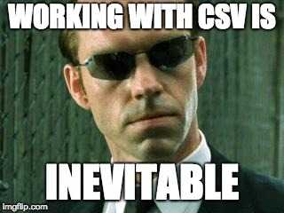
Comma Separated Values files.
We use them often in Excel, and other spreadsheet software.
Remember our old friend MS Excel? They work with Python too…

Slide 12
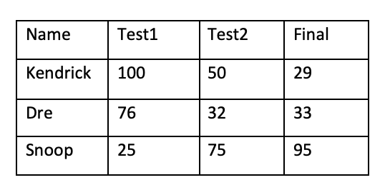
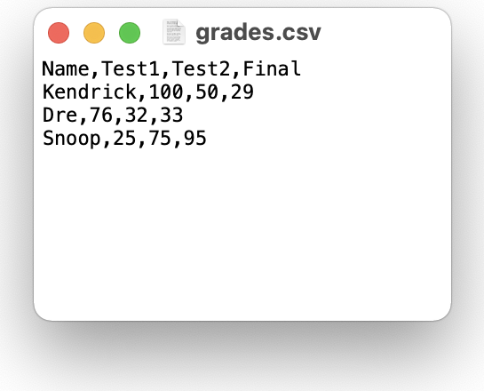
CSV Files.
Text data is commonly organized in a spreadsheet format using columns and rows.
A common way to do this is to use a comma-separated-value (CSV) file format that uses commas to separate data items, called fields.

Slide 13
Example: Opening a CSV File.
Let’s see what happens when we try to read the CSV file, 'grades.csv’, using the file reading techniques discussed earlier.
How can we use this to obtain column and row information?
with open('grades.csv', 'r') as file:
contents = file.read()
>>> contents
'Name,Test1,Test2,Final\nKendrick,100,50,29\nDre,76,32,33\nSnoop,25,75,95\n'

Slide 14

Reading CSV Files.
The CSV module is a powerful solution developed for working with CSV files.
Reading of CSV files is done using the CSV reader. You can construct a reader object using csv.reader(), which takes the file object as input.
The reader object can be used to iterate through the contents of the CSV file, similarly to how a file object was used to iterate through the contents of a text file.

Slide 15
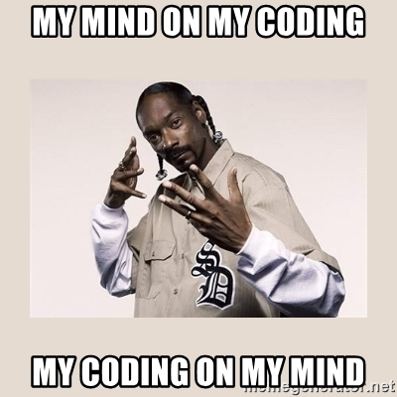
Example: Reading a CSV File (open/close).
Read each row of a CSV file the csv module.
import csv
with open('grades.csv', 'r') as myfile:
grades_reader = csv.reader(myfile)
row_num = 1
for row in grades_reader:
print('Row #', row_num, ':', row)
row_num += 1
Row # 1 : ['Name', 'Test1', 'Test2', 'Final']
Row # 2 : [‘Kendrick', '100', '50', '29']
Row # 3 : [‘Dre', '76', '32', '33']
Row # 4 : [‘Snoop', '25', '75', '95']

Slide 16
Writing CSV Files.
To write to the file we would first need to create a CSV writer object, csv.writer(), which similar to how we made a, CSV reader object.
Once the CSV writer object is created, we can use the writerow()method to populate it with data.
The writerow()method can only write a single row to the file at a time.

Slide 17
Example: CSV Files
In the previous grade example, there were a few marking errors on the final exam and both Kendrick and Dre should have received a higher grade. Update the grades using the CSV writerow()method.
import csv
grades = [['Name', 'Test1', 'Test2', 'Final'],
[‘Kendrick', '100', '50', '69'],
[‘Dre', '76', '32', '53'],
[‘Snoop', '25', '75', '95']]
with open('grades_new.csv', 'w') as myfile:
grades_writer = csv.writer(myfile)
for row in grades:
grades_writer.writerow(row)

Slide 18
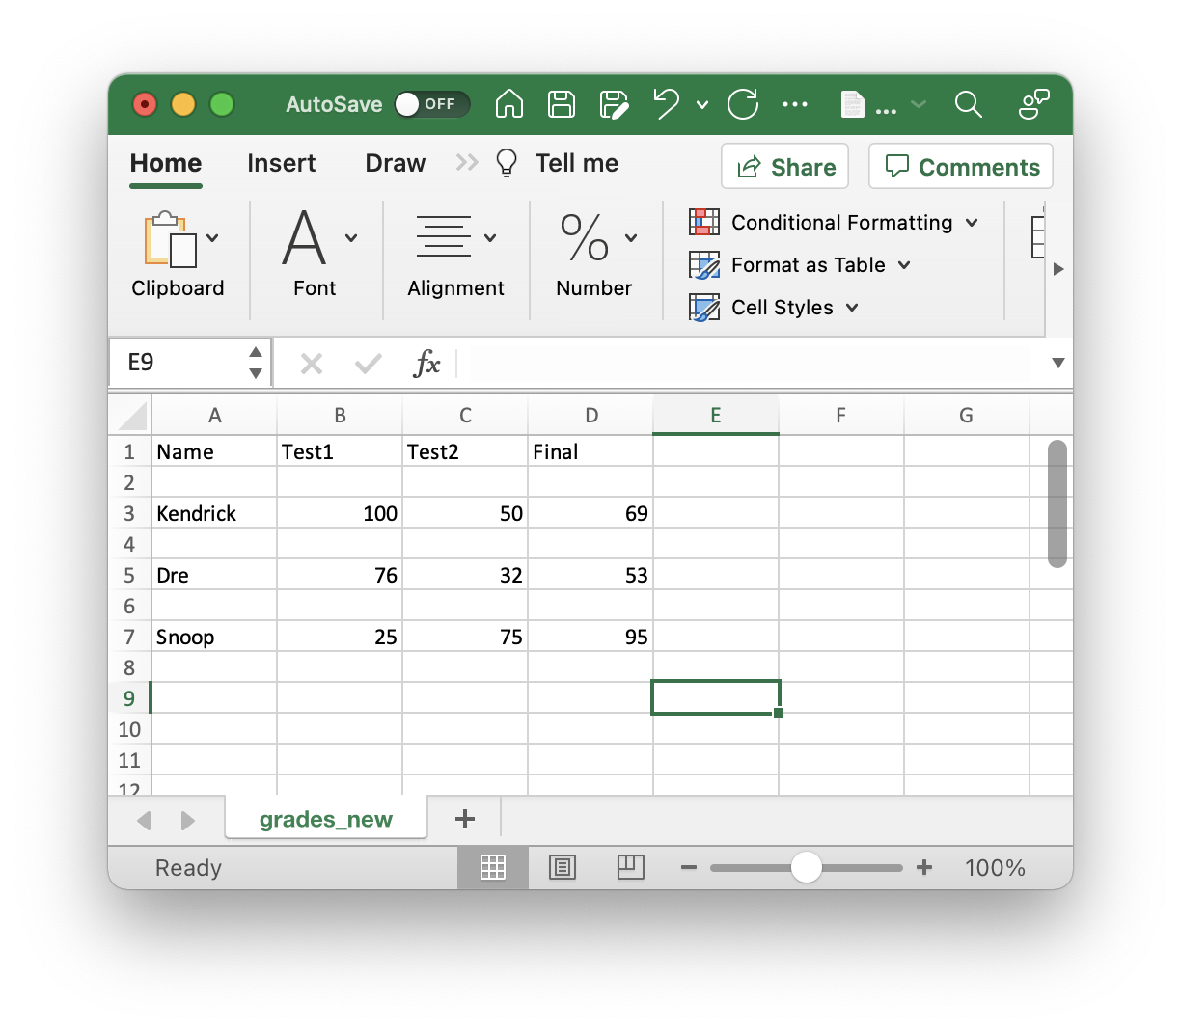
Opening CSV File in Excel.
In the previous example, we created a CSV file which can be opened in any commonly used spreadsheet software (e.g. Excel).
In some cases, a formatting error may occur, probably due to the difference between newlines and carriage returns in Windows vs Mac/Linux.
To correct this error in formatting, we will need to prevent the new line from forming. Add the parameter newline='', and that should resolve the problem.
with open('grades_new.csv', 'w', newline='') as csvfile:

Slide 19
Let’s Code!
Let’s take a look at how this works in Python!
  Reading and Writing to CSV Files.
  Parsing through CSV Files.
  Import the csv modules.
Open your notebook
Click Link:
6. CSV Files

Slide 20
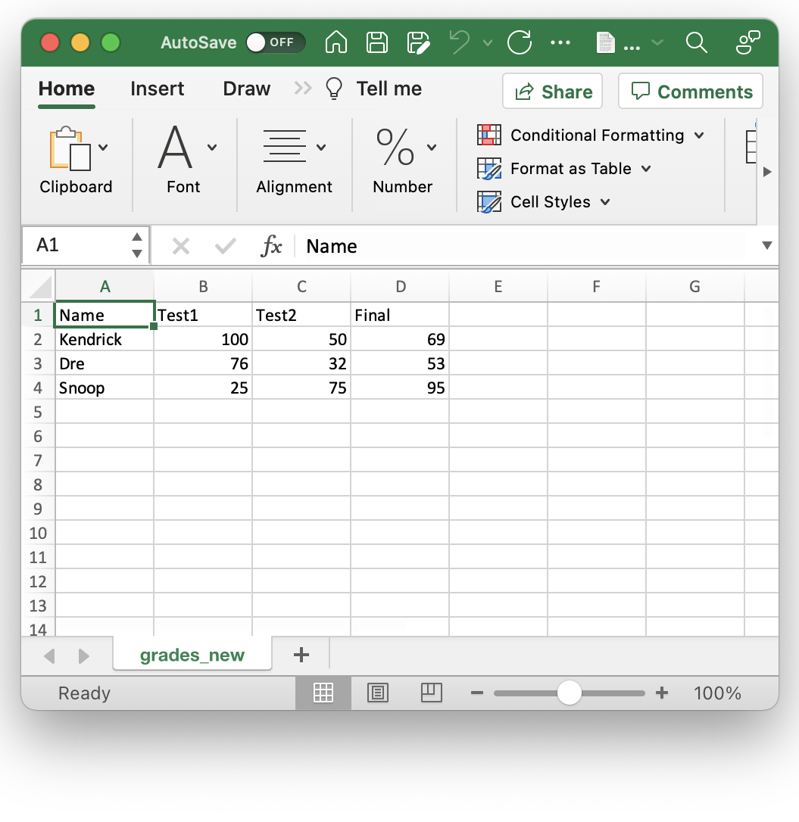
Summary: Reading Files.
Requirement: “grades.csv”.
Reading a file using the standard approach.
# Open communication to a file myfile = open('grades.csv', 'r')
# Read from file
L = myfile.readlines()
for row in L:
print(row, end = '')
myfile.close()
Reading a file using the CSV Module.
import csv
# Open communication to a file myfile = open('grades.csv', 'r')
# Read from file
csv_reader = csv.reader(myfile)
for row in csv_reader:
print(row)
myfile.close()

Slide 21
Summary: Writing Files.
Requirement: grades needs to be defined.
grades = [['Name', 'Test1', 'Test2', 'Final'],
[‘Kendrick', '100', '50', '69'],
[‘Dre', '76', '32', '53'],
[‘Snoop', '25', '75', '95']]
Writing a file using the standard approach.
# Open communication to a file
myfile = open('new_grades.csv', 'w')
# Write to file
for row in grades:
for col in row:
myfile.write(col + ',')
myfile.write('\n')
myfile.close()
Writing a file using the standard approach.
import csv
# Open communication to a file myfile = open('new_grades.csv', 'w')
# Write to file
grades_writer = csv.writer(myfile)
for row in grades:
grades_writer.writerow(row)
myfile.close()

Slide 22
Modules.
A module is simply a file containing Python definitions (functions, classes, variables) that can be imported into your script.
By organizing code into modules, we:
  Keep code maintainable and organized.
  Reuse functions or classes across multiple projects.
  Avoid cluttering a single file with too much logic.
Tip: Any file named something.py can be considered a module.

Slide 23
Importing Modules.
import math
print(math.sqrt(16)) # 4.0
import module_name
  Imports the entire module.
  You call functions with module_name.function().
from module_name import something
  Imports only something (function, class, or variable).
  You can access something without needing module_name.something.
from module_name import *
  Imports everything from that module directly into your file (and scope or ‘namespace’).
  Use sparingly to avoid name conflicts.

Slide 24
Why Modules?
Modularity: Split large applications into smaller, manageable pieces.
  Think back our fancy dictionary printing function called dict_print that we imported from our custom utils module.
Reusability: Reuse functions across multiple projects (don’t rewrite the wheel!).
  Now you can import dict_print into any new python file, instead of needing to copy and paste the function into each file to use it.
Maintainability: Isolate functionality in separate files for easier updates.
  Improve your utils module or add more fancy printing functions to utils without breaking any of your existing files.
Collaboration: Multiple developers can work on different modules in parallel.

Slide 25
Build Your Own Modules.
Step 1: Create a .py file with functions, variables, etc.
Step 2: Import your module into another file.
#inside mymodule.py
pi = 3.14
def and_one(x):
return x + 1
import mymodule
my_pi = mymodule.pi
print(mymodule.and_one(my_pi) #prints 4.14

Slide 26
Let’s Code!
Let’s take a look at how this works in Python!
  Importing modules.
  Renaming modules and controlling our namespace.
  Building our own custom modules.
Open your notebook
Click Link:
8. Modules

Slide 27
Files, CSVs and Modules.
Course Evaluations.
Help us debug this course.
Week 11 | Lecture 2 (11.2)

