Slide 1
more OOP!
Week 11 | Lecture 1 (11.1)

Slide 2
Encapsulation.
Encapsulation
seb.forward(50)
kitty.scratch()
The core of object-oriented programming is the organization of the program by encapsulating related data and functions together in an object.
To encapsulate something means to enclose it in some kind of container.
In programming, encapsulation means keeping data and the code that uses it in one place and hiding the details of exactly how they work together.
Class
Attributes
Methods

Slide 3
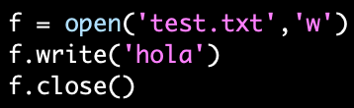
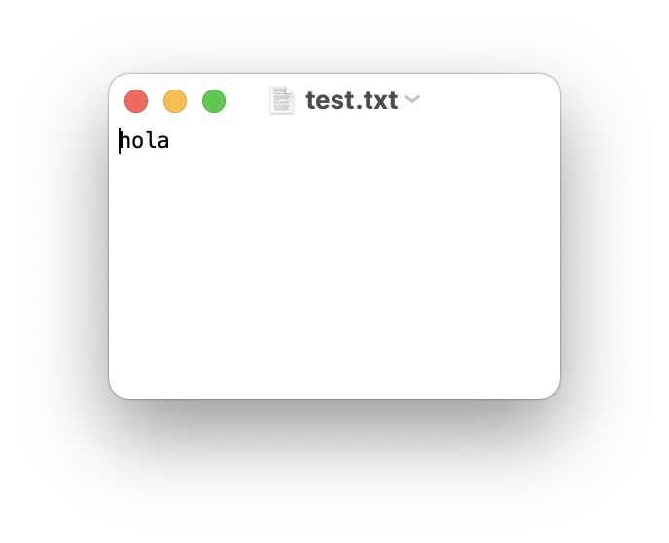
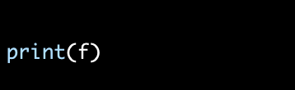
Encapsulate it.
For example, each instance of class file keeps track of which file on the disk it is reading/writing and where it currently is on that file.
The class hides the details of how it is done, so we (as programmers) can use it without needing to know how it is implemented.

Slide 4
Let’s Code!
Let’s look at how this works in Python!
Point Class Recap.
Rectangle Class.
Open your notebook
Click Link:
1. Encapsulation
Point(x2, y2)
Class Rectangle
Point(x1, y1)

Slide 5
Printing Information.
It would be nice to not have to write a print statement when we want to display attribute information:
Is there a better way to encapsulate this? How about a method?
>>> p = Point(3,4)
>>> print(p)
<__main__.Point object at 0x7fd8100778b0>
>>> p = Point(3,4)
>>> print(p.x, p.y)
3 4
>>> p = Point(3,4)
>>> p.to_string()
'(3,4)'
>>> r = p.halfway(Point(5,12))
>>> r.to_string()
'(4,8)'

Slide 6
Printing Information.
>>> p = Point(3,4)
>>> p.to_string()
'(3,4)'
>>> r = p.halfway(Point(5,12))
>>> r.to_string()
'(4,8)'
If we had a method, we just need to format the attributes into a string:
We could make a similar method for any class.
class Point:
"""A class that represents and manipulates 2D points"""
def to_string(self):
"""
(self) -> None
Prints the (x, y) coordinate for the point.
"""
print('(' + str(self.x) + ', ' + str(self.y) + ')')

Slide 7
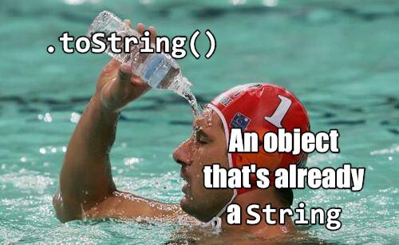
Printing Information.
If every class we made had a to_string() method, great!
Easy to remember.
All formatting specific to printing an object would be encapsulated.
But they won’t all have one…
What if other people made their own method for printing and called it something else?
Then it would no longer be obvious how to quickly display information.
Is it called to_string? tostring? 2stringz? print_point? plz_print_me?
Python has a clever trick for this!

Slide 8
Printing Information.
Special Methods
Magic Methods
These are part of Python’s special object protocol.
If we call our new method __str__ instead of to_string, Python will use our code whenever it needs to convert Point to a string.
class Point:
def __init__(self, x=0 , y=0):
...
def __str__(self):
return (‘(’ + str(self.x) + ‘,’ + str(self.y) + ‘)’)
len(x) → x.__len__()
print(x) or str(x) → x.__str__()
bool(x) → x.__bool__()
>>> p = Point(3,4)
>>> print(p)
'(3,4)'
That’s better!
When we call print(obj), then obj.__str__() is called to find out what string to print.

Slide 9
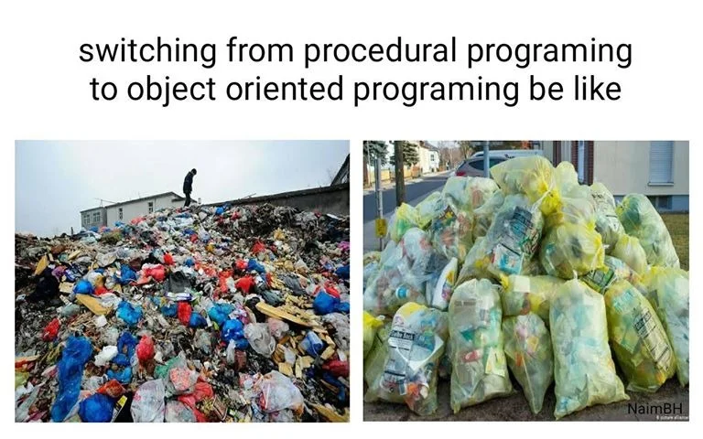
Let’s Code!
Let’s look at how this works in Python!
__str__ method.
Open your notebook
Click Link:
2. Printing Objects

Slide 10
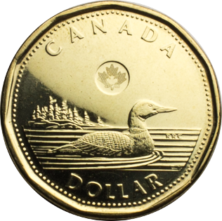

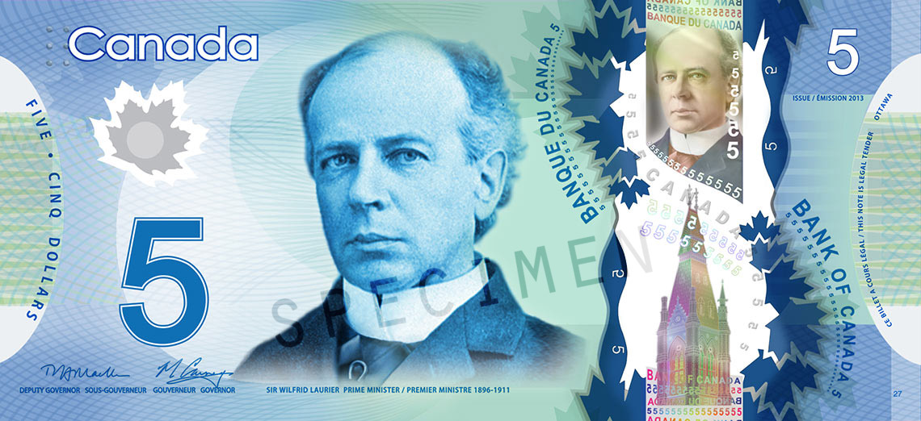
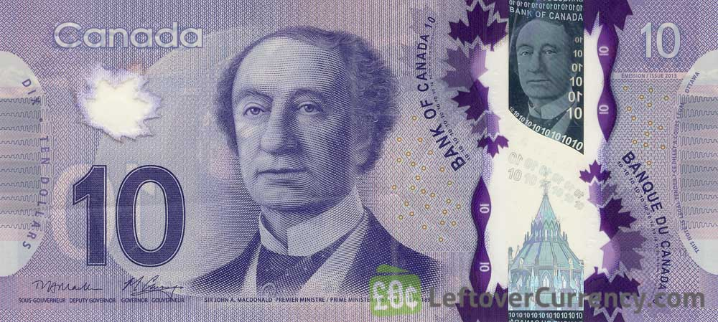
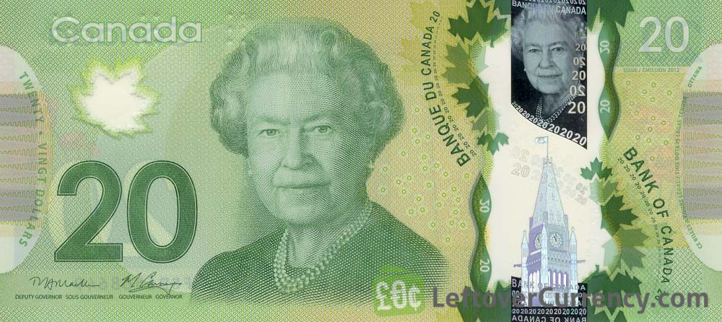
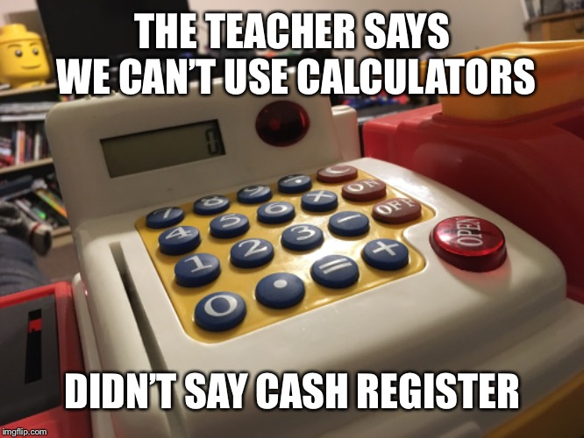
Let’s Build a Cash Register!
We want to build a cash register program. What features do we want?
Track number of:
Loonies.
Toonies.
$5 bills.
$10 bills.
$20 bills.
Accepts cash.
Removes cash.
Calculates value of contents.
Print the entire contents.

Slide 11

Breakout Session!
Let’s look at how this works in Python!
Building a cash register:
Attributes.
Methods.
Including __str__ method.
Open your notebook
Click Link:
3. Building a Cash Register

Slide 12
Let's Code!
We are going to model a solar system using OOP.
Two classes: Planet and SolarSystem.
Planet: name, distance, radius, color, angle.
SolarSystem: add/remove planets, visualize, animate.
Custom module handles the visualization.
Kepler's Third Law for orbital periods.
Let's look at how this works in Python!
Planet class.
SolarSystem class.
Visualization and animation.
Open your notebook
Click Link:
4. Solar System

Slide 13
more OOP!
Week 11 | Lecture 1 (11.1)

