Slide 1
More OOP! Encapsulation and Examples
Week 11 | Lecture 1 (11.1)
Upcoming
Lab 7 due this Friday 11:59 pm.
Reflection 11 Released Friday 6:00 pm.
Tutorial (in-person AND online) running all week.
Practical sessions running all week.
Office Hours (in-person AND online) running all week

Slide 2
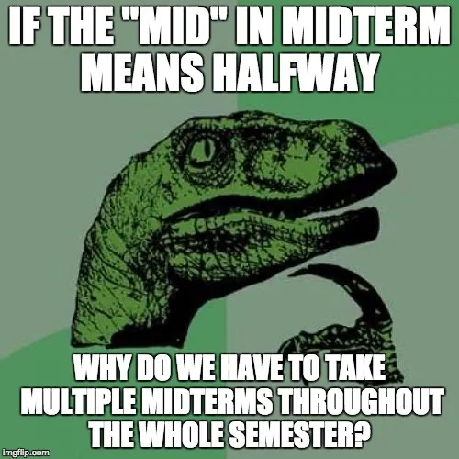
This Week’s Content
Lecture 11.1
More OOP! Encapsulation and Examples
Lecture 11.2
Advanced Files, CSVs, and Modules
Lecture 11.3
Design Problem: Dungeon Escape

Slide 3
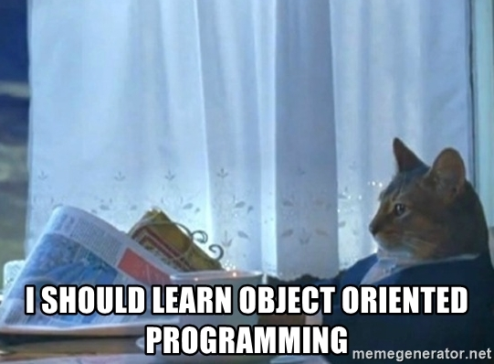
Why OOP?
Models our real-life thinking
Sandwich – ingredients, freshness, etc.
Car – model, year, fuel level, forward, reverse etc.
Movie – actors, director, genre, rating, etc.
Cat – weight, name, colour, scratch, meow, sleep, etc.
Why do we use it in programming?
Default values for a new object (initialization)
Properly set-up, predictable behaviours of different objects within the same class

Slide 4
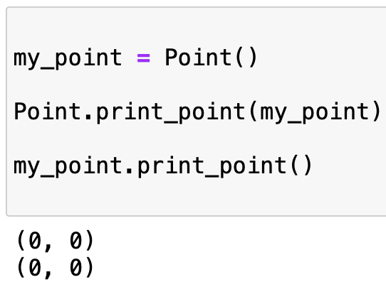
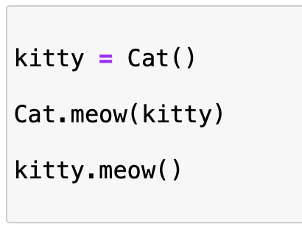

Why OOP?
The reason for this dot operator convention is an implicit metaphor:
The syntax for a function call, Cat.meow(kitty) suggests that the function is the active agent. It says something like, “Hey meow method from the Cat class! Here’s a Cat object (named kitty) for you to meow with.”
In OOP, the objects are the active agents. A method invocation like kitty.meow() says “Hey kitty! Please meow.”

Slide 5
Encapsulation
Encapsulation
seb.forward(50)
kitty.scratch()
The core of object-oriented programming is the organization of the program by encapsulating related data and functions together in an object.
To encapsulate something means to enclose it in some kind of container.
In programming, encapsulation means keeping data and the code that uses it in one place and hiding the details of exactly how they work together.
Class
Attributes
Methods

Slide 6
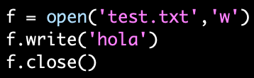
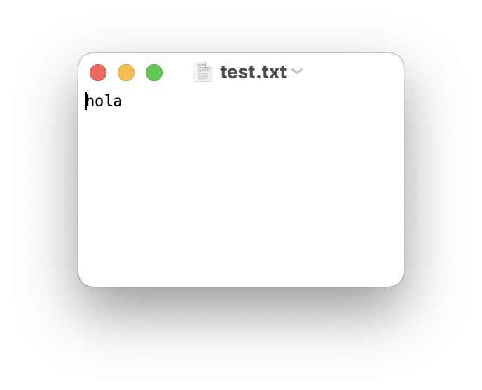
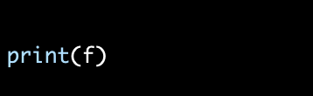
Encapsulate it!
For example, each instance of class file keeps track of which file on the disk it is reading/writing and where it currently is on that file.
The class hides the details of how it is done, so we (as programmers) can use it without needing to know how it is implemented

Slide 7
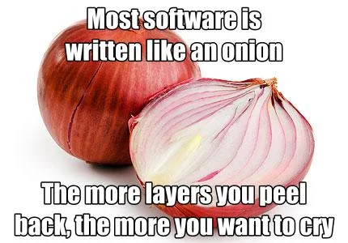
Let’s Code!
Let’s look at how this works in Python!
Point Class Recap
Rectangle Class
Open your notebook
Click Link:
1. Encapsulation

Slide 8
Printing Information
It would be nice to not have to write a print statement when we want to display attribute information:
Is there a better way to encapsulate this? How about a method?
>>> p = Point(3,4)
>>> print(p)
<__main__.Point object at 0x7fd8100778b0>
>>> p = Point(3,4)
>>> print(p.x, p.y)
3 4
>>> p = Point(3,4)
>>> p.to_string()
'(3,4)'
>>> r = p.halfway(Point(5,12))
>>> r.to_string()
'(4,8)'

Slide 9
Printing Information
If we had a method, we just need to format the attributes into a string:
We could make a similar method for any class (ex: Square)
class Point:
"""A class that represents and manipulates 2D points"""
def to_string(self):
"""
(self) -> None
Prints the (x, y) coordinate for the point.
"""
print('(' + str(self.x) + ', ' + str(self.y) + ')')
>>> p = Point(3,4)
>>> p.to_string()
'(3,4)'
>>> r = p.halfway(Point(5,12))
>>> r.to_string()
'(4,8)'

Slide 10
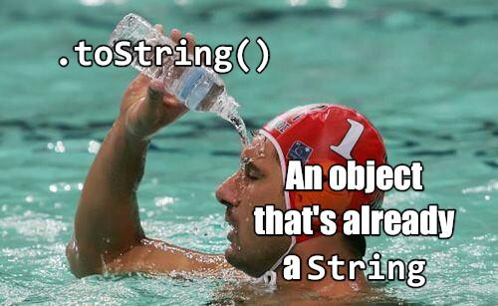
Printing Information
If every class we made had a to_string() method, great!
Easy to remember
All formatting specific to printing an object would be encapsulated
But they won’t all have one…
What if other people made their own method for printing and called it something else?
Then it would no longer be obvious how to quickly display information
Is it called to_string? tostring? 2stringz? print_point? plz_print_me?
Python has a clever trick for this!

Slide 11
Printing Information
If we call our new method __str__ instead of to_string, Python will use our code whenever it needs to convert Point to a string
class Point:
"""A class that represents and manipulates 2D points"""
def __init__(self, x=0 , y=0):
...
def __str__(self):
return (‘(’ + str(self.x) + ‘,’ + str(self.y) + ‘)’)
>>> p = Point(3,4)
>>> print(p)
'(3,4)'
That’s better!
When we call print(obj), then obj.__str__() is called to find out what string to print

Slide 12
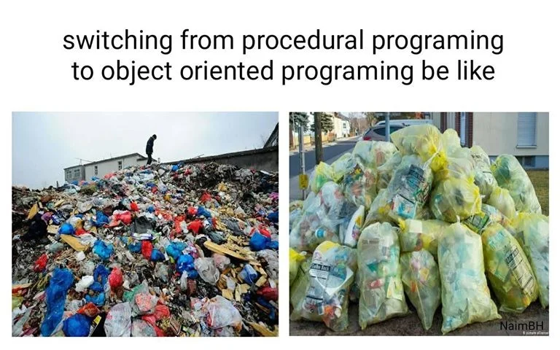
Let’s Code!
Let’s look at how this works in Python!
__str__ method
Open your notebook
Click Link:
2. Printing Objects

Slide 13


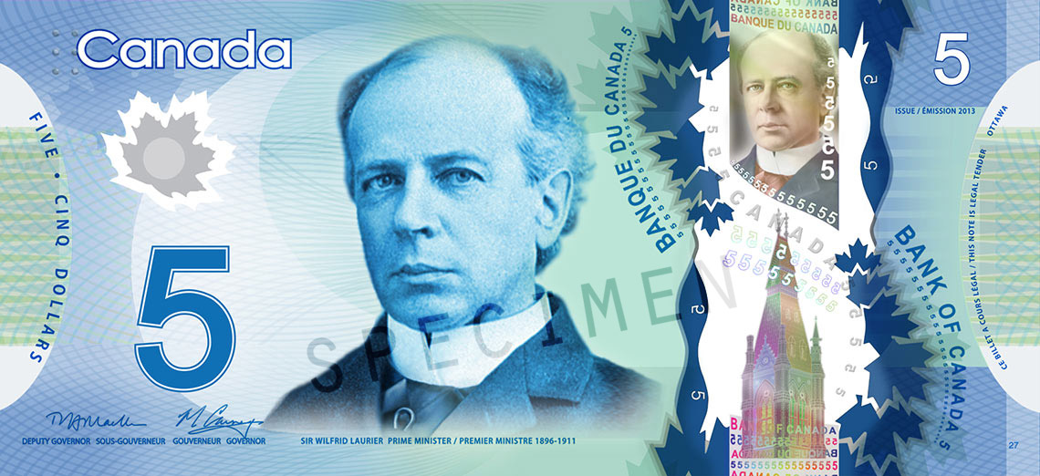
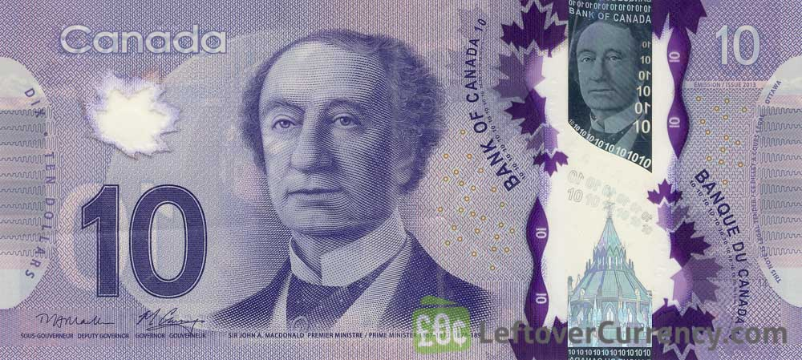
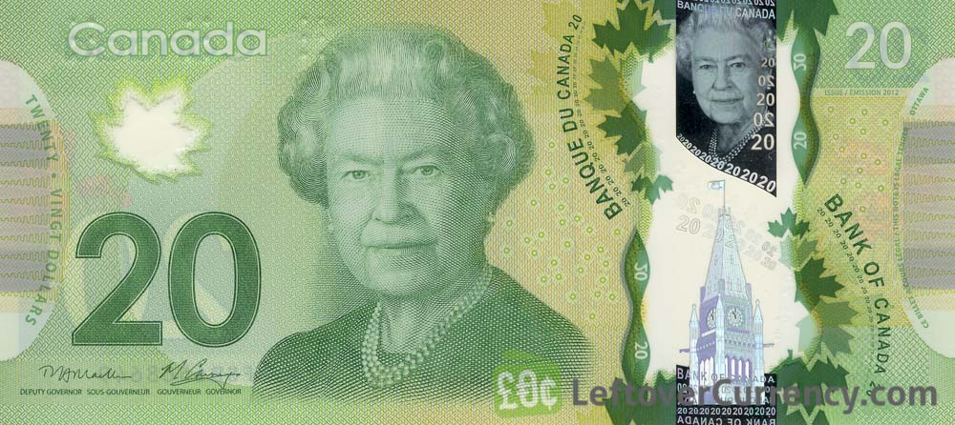
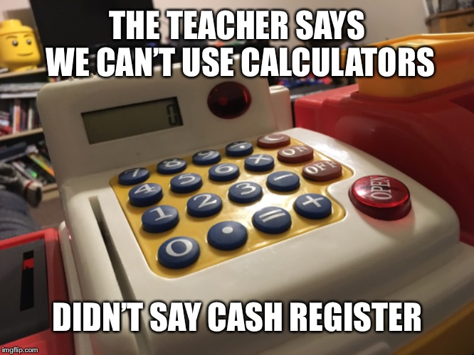
Let’s Build a Cash Register!
We want to build a cash register program. What features do we want?
Track number of:
Loonies
Toonies
$5 bills
$10 bills
$20 bills
Accepts cash
Removes cash
Calculates value of contents
Print the entire contents

Slide 14
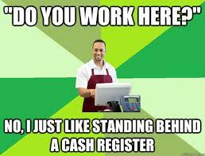
Breakout Session!
Let’s look at how this works in Python!
Building a cash register
Attributes
Methods
Including __str__ method
Open your notebook
Click Link:
3. Building a Cash Register

Slide 15
More OOP! Encapsulation and Examples
Week 11 | Lecture 1 (11.1)

