Slide 1
The Coding Toolbox.
Week 1 | Lecture 2 (1.2)
Upcoming
Lab 0 Released 6 pm Thursday.
Reflection 1 Released Friday 6:00 pm.
Tutorial sessions running all week.
Notes:
Historical figures, history of computer
Extensions, terminal, cPU, RAM, GPU, memory, transistors
Maybe visualise how all the departments disciplines are involved
Tools in course:
Anaconda
Jupyter
Environments
Shortcuts on Jupyter (shift enter) markdown etc.
Cells are linked, variables common across cells
Update cells down doesn’t update cells above
Kernel restarting
Clear output and variables

Slide 2
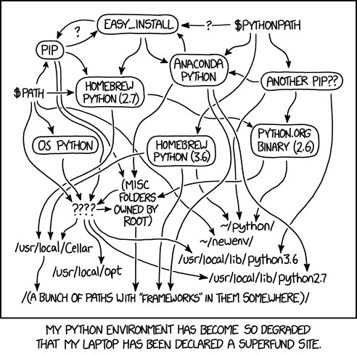
This Week’s Content
Lecture 1.1
Introduction to APS106
Lecture 1.2
Computers, Programs, and The Coding Toolbox
Lecture 1.3
Variables, Expressions, and Operators
Notes:
This week’s plan will be a gentle easing into the world of programming.
Next class we will talk about the tools and programs we’ll be using in this course, please install these beforehand

Slide 3
What you will get out of today’s lecture.
Everything you need to begin coding in APS106.
Learn about the core building blocks of a computer.
Develop computational language and vocabulary for the files and programs used in APS106.
Learn about the key differences in the software and tools used in APS106.
Get experience opening and using the most important tools.
Execute your first files of APS106!
Create a folder structure for APS106.
Assuming You Have Installed Anaconda and VSCode.
If not, try to raise your hand for support.

Slide 4


APS106 Folder Structure.
Downloads
34567543.jpg
aaaaaaaaaaaaaaaa.py
week1_lecture2.ipynb
week1_lecture1.pdf
week1_lecture2(1).ipynb
week1_lecture3.ipynb
please_work2.py
taxes_2024_please_dont_audit_me.xlsx
week12_lecture3(5).ipynb
APS111_Slides.pptx
group_project_final_by_me_because_no_one_else_did_it.py
crypto_strategy_guaranteed_profit.docx
screenshot_2026-01-04_1315.png
python_stuff.zip
lab2_fixed_FIXED2_actuallyfixed.py
passwords.txt (“Don’t do this.”)
DON’T
DO
THIS.

Slide 5
APS106 Folder Structure.
Year 1 Courses
APS106
Lecture
Week 1
Lecture 1
Lecture 2
week1_lecture2_starter.ipynb
week1_lecture2.py
Lecture 3
Tutorial
Lab
Practice Problems
Studying
Term Test 1
Term Test 2
Final Exam
APS111
DO
THIS.
NOW.

Slide 6

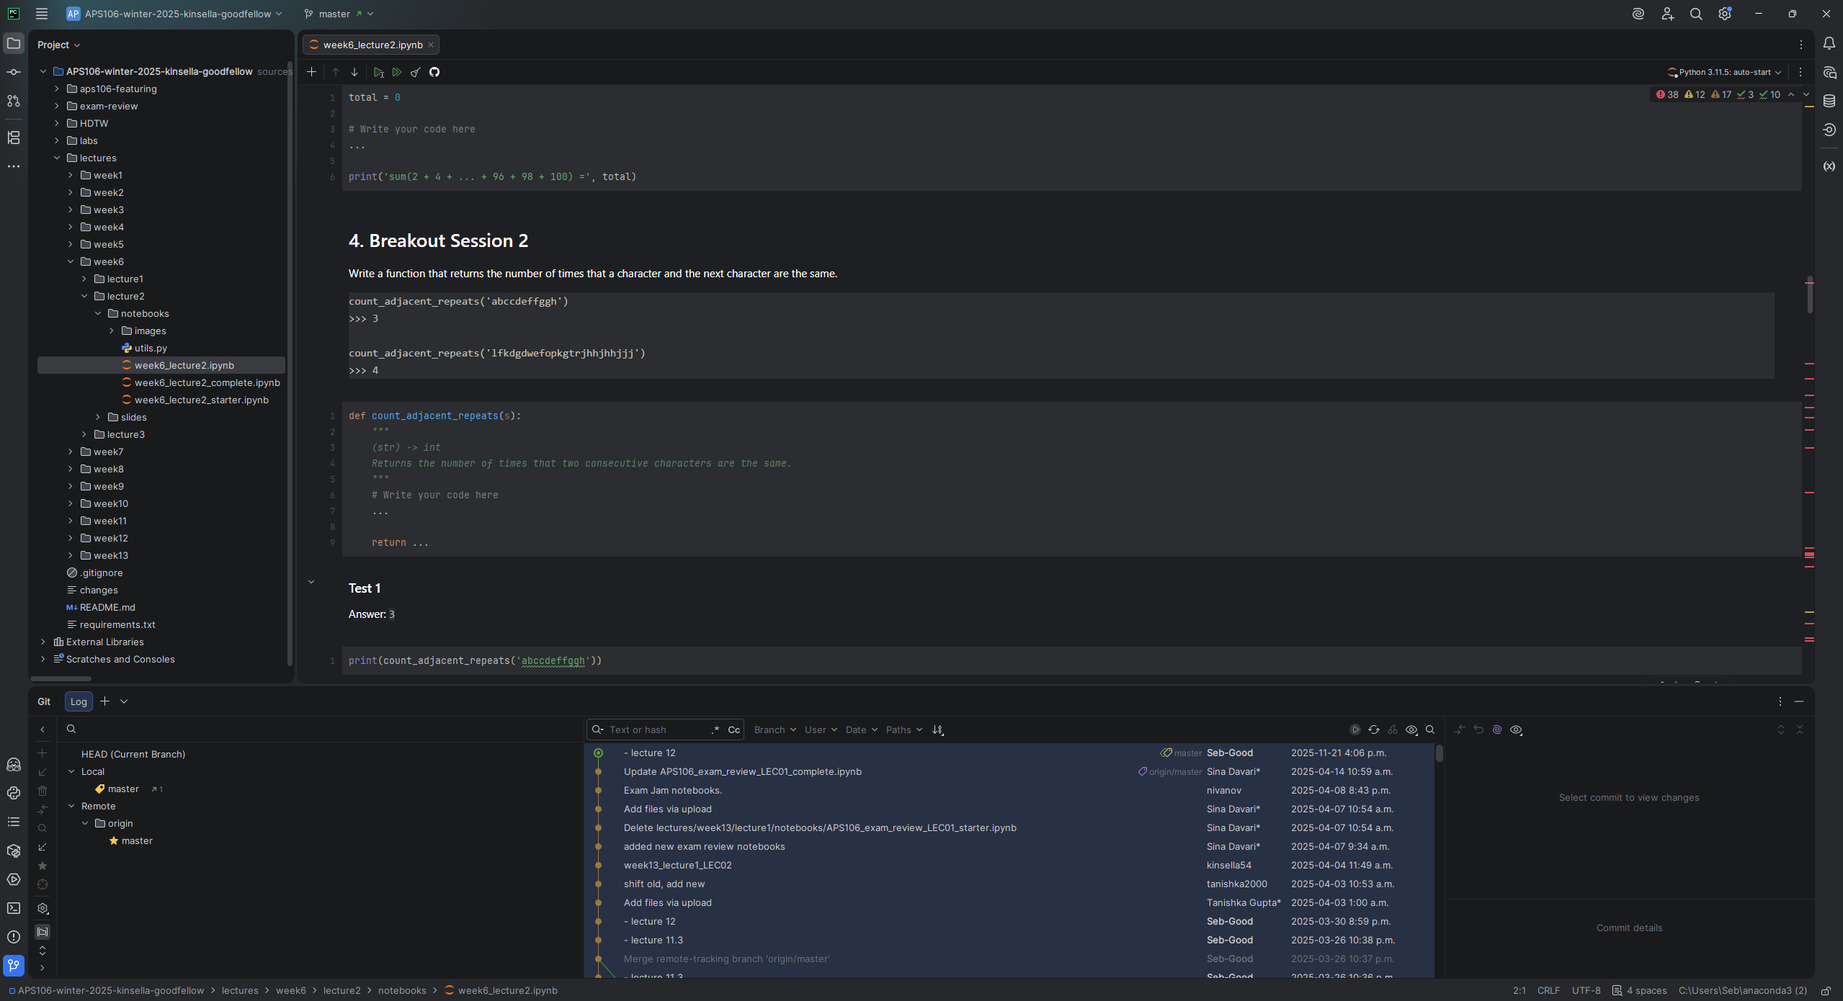







Developer Toolkit.
Computer.
Python Interpreter.
Version Control.
Packages Manager.
Git + GitHub
Terminal.
Editor/IDE.
Developer Seb.
Anaconda Terminal
VSCode + Jupyter

Slide 7
Developer Toolkit.
Computer.
Python Interpreter.
Version Control.
Packages Manager.
Git + GitHub
Terminal.
Editor/IDE.
Developer Seb.
Anaconda Terminal
VSCode + Jupyter

Slide 8

Inside your computer?
Storage.
Disks, hard drives, thumb drives, etc.
Stores long-term data (files, programs, movies, etc.).
Non-volatile: maintains contents when powered off.
Memory.
Random Access Memory (RAM).
Stores short-term data required to open programs and run processes.
Volatile: loses contents when powered off.
Software programs are usually stored and executed from RAM.
Later this term, we will learn how to read from and write to long-term storage.

Slide 9
Inside your computer?
World records for the number of transistors on a chip are held by U of T researchers in ECE!
Central Processing Unit (CPU).
Runs the programs, including the operating system.
Reads and writes the data between storage and memory.
Composed of billions of miniature electronic switches called transistors.
Popular examples include Intel’s Core i7 and AMD’s Ryzen 7.
Clock.
Controls the rate at which processors execute instructions (recall: programming is just a series of instructions).
Modern computers have clocks that beat around 4 GHz (4 billion times per second!).

Slide 10
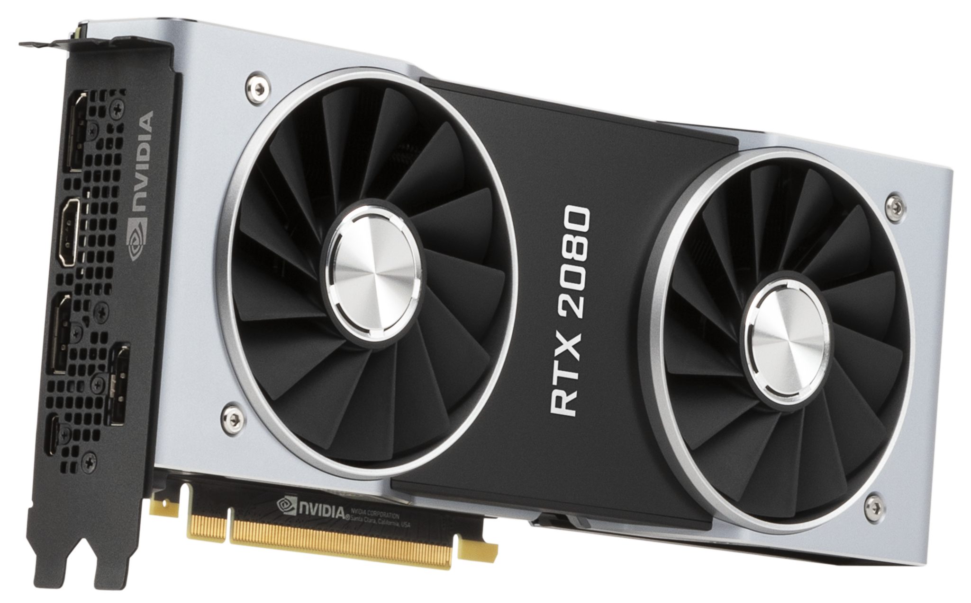
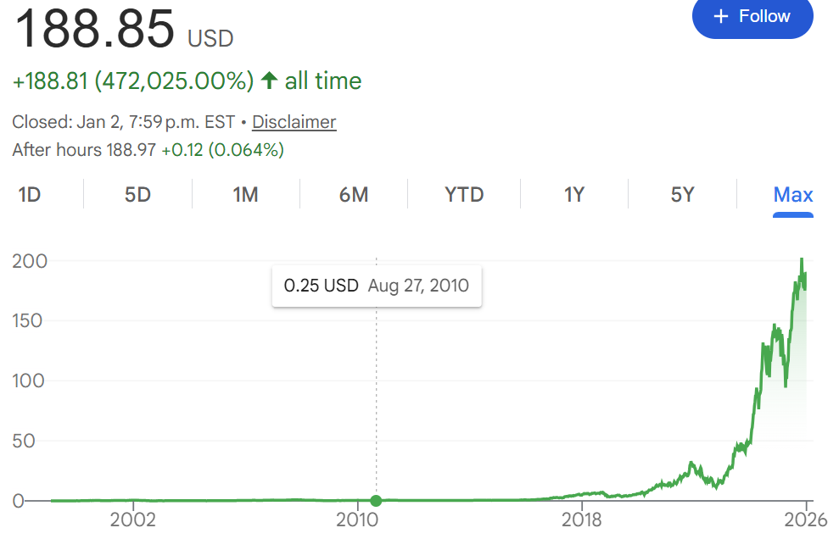
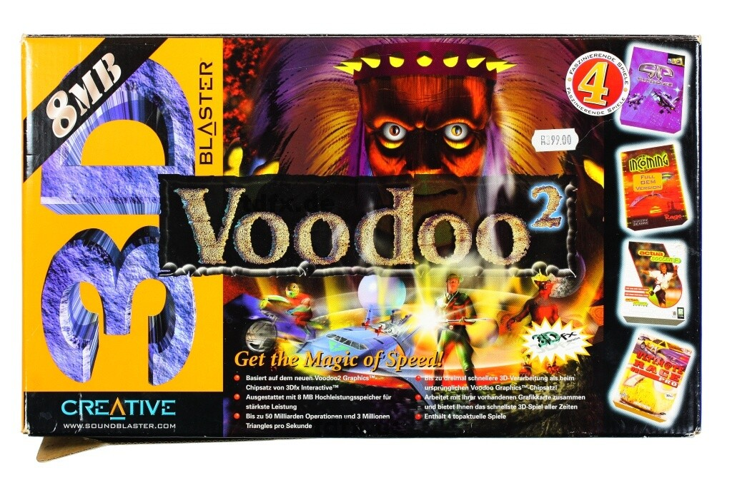
Inside your computer?
Graphics Processing Unit (GPU).
A processor originally designed to render images by doing the same math operation on many pixels at once.
Training neural networks is dominated by matrix multiplications and vector operations (linear algebra), which map extremely well to GPU parallel hardware.
A CPU has a small number of powerful cores optimized for general-purpose, branching tasks (running an OS, game logic, control flow), while a GPU has many more smaller cores optimized for massively parallel math (like the matrix operations that dominate deep learning).
Nvidia RTX 2080 Ti.
(11 GB)
3dfx Voodoo2.
(8 MB)

Slide 11

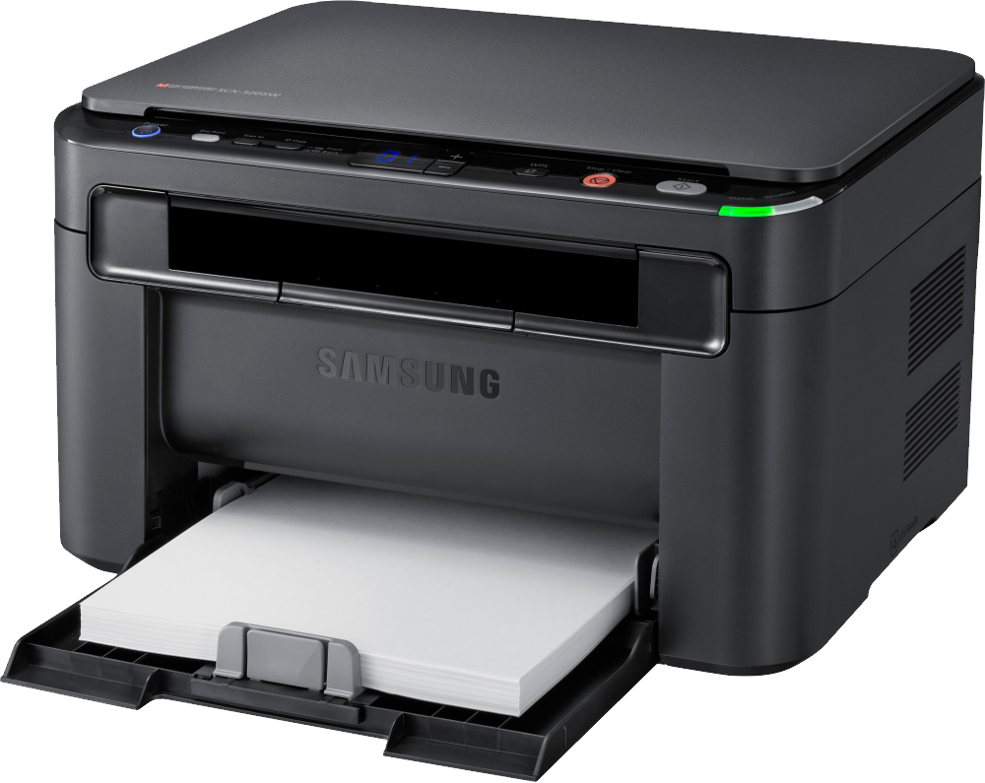
Outside your computer?
Input Devices.
Keyboard.
Mouse.
Trackpad.
Touch screen.
Webcam.
Gesture trackers.
Eye trackers.
Output Devices.
Monitors.
Printers.
Headphones.
Speakers.
Video/sound cards.
Braille readers.

Slide 12
File Formats and Extensions.
Files store data in different formats based on specific definitions.
An “extension” is the file name’s suffix, or the set of characters (usually 2-4) at the end of a file name, separated by a period (.).
File Types | Common Extension Examples
Plain text file | .txt
Document file | .doc, .docx, .pdf
Image file | .jpg, .gif, .png
Compressed/Archive file | .zip, .rar, .7z
Video file | .mpg, .mp4, .avi
Executable file | .exe, .bat, .bin
Python file | .py
Jupyter Notebook file | .ipynb
Comma Separated Value file | .csv
File extensions help indicate:
The file format.
How the data is structured.
Which programs can open it?

Slide 13
Developer Toolkit.
Computer.
Python Interpreter.
Version Control.
Packages Manager.
Git + GitHub
Terminal.
Editor/IDE.
Developer Seb.
Anaconda Terminal
VSCode + Jupyter

Slide 14
Python Interpreter.
test_file.py
print(“Hello Class!”)
You write code in a .py file (plain text).
In the terminal you run:
python myfile.py
The Python interpreter reads your file top to bottom, translating it into actions as it goes.
It executes the instructions (does calculations, calls functions, reads input, etc.).
Results appear as output (printed text, files saved, graphs shown), and if something is wrong you get an error message/traceback.
standard output
(stdout)
Hello Class!

Slide 15
Python Interpreter.
You write code in a .py file (plain text).
In the terminal you run:
python myfile.py
The Python interpreter reads your file top to bottom, translating it into actions as it goes.
It executes the instructions (does calculations, calls functions, reads input, etc.).
Results appear as output (printed text, files saved, graphs shown), and if something is wrong you get an error message/traceback.
Let’s Code!
Open:
Anaconda Prompt
A Text Editor

Slide 16
Developer Toolkit.
Computer.
Python Interpreter.
Version Control.
Packages Manager.
Git + GitHub
Terminal.
Editor/IDE.
Developer Seb.
Anaconda Terminal
VSCode + Jupyter

Slide 17










Editors & IDEs.
Integrated
Development
Environment
(IDE).
Interactive Computing
Environment.
AI-First
IDE.
Text Editors.

Slide 18
Editors & IDEs.
Integrated
Development
Environment
(IDE).
Interactive Computing
Environment.
AI-First
IDE.
Text Editors.

Slide 19
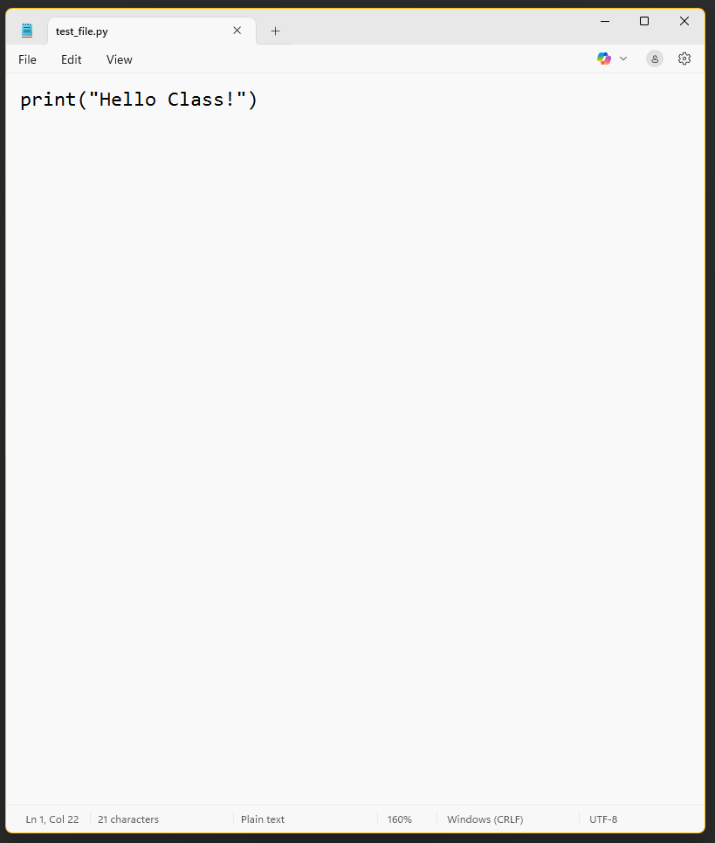
Text Editor.
APS106
File Type #1.
The Python File
.py
What it is: A lightweight app for writing and editing plain-text files (including code), with minimal setup.
What you get: Fast startup, syntax highlighting, find/replace, multiple files/tabs, basic project folders.
What you don’t (usually) get: Integrated debugging, deep refactoring, environment management, and one-click test runners.
Typical workflow: Edit code in the editor, then run it in a separate terminal (python myfile.py).
Best for: Quick edits, small scripts, configuration files, and learning fundamentals without heavy tooling.

Slide 20
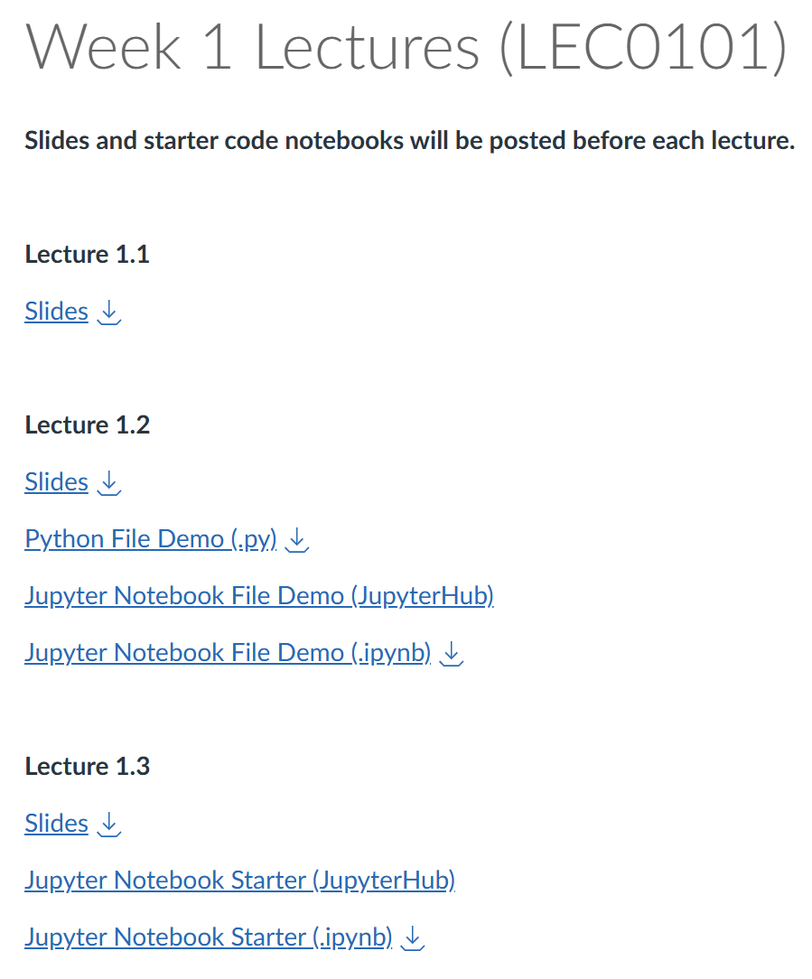
Text Editor.
What it is: A lightweight app for writing and editing plain-text files (including code), with minimal setup.
What you get: Fast startup, syntax highlighting, find/replace, multiple files/tabs, basic project folders.
What you don’t (usually) get: Integrated debugging, deep refactoring, environment management, and one-click test runners.
Typical workflow: Edit code in the editor, then run it in a separate terminal (python myfile.py).
Best for: Quick edits, small scripts, configuration files, and learning fundamentals without heavy tooling.
APS106
File Type #1.
The Python File
.py

Slide 21
Text Editor.
What it is: A lightweight app for writing and editing plain-text files (including code), with minimal setup.
What you get: Fast startup, syntax highlighting, find/replace, multiple files/tabs, basic project folders.
What you don’t (usually) get: Integrated debugging, deep refactoring, environment management, and one-click test runners.
Typical workflow: Edit code in the editor, then run it in a separate terminal (python myfile.py).
Best for: Quick edits, small scripts, configuration files, and learning fundamentals without heavy tooling.
Let’s Code!
DO:
Download week1_lecture2.py
Open in a Text Editor
Open Anaconda Prompt
Run the file

Slide 22
Editors & IDEs.
Integrated
Development
Environment
(IDE).
Interactive Computing
Environment.
AI-First
IDE.
Text Editors.

Slide 23
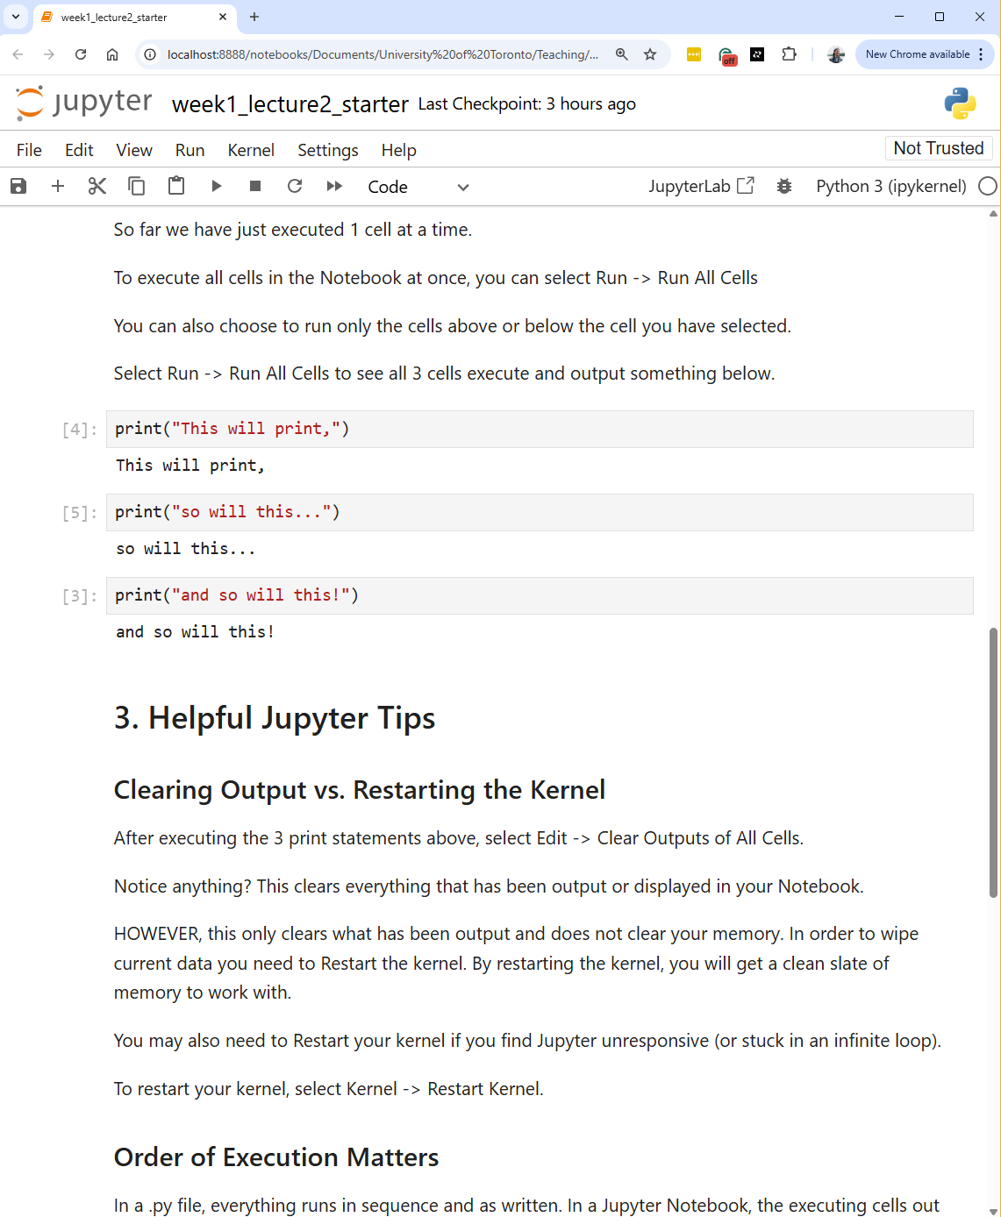
Interactive Computing Environment.
APS106
File Type #2.
The Python File
.ipynb
What it is: An environment for running code interactively in small chunks (cells) while keeping notes and results in the same document.
How it works: A notebook (.ipynb) connects to a live kernel (a running Python process) that remembers variables between cells.
What you get: Immediate output (text/tables/plots), easy experimentation, and a natural format for explanation + code + results.
Typical workflow: Write a cell → run it → inspect output → iterate; often used for data analysis, visualization, and demos.
Best for: Learning, prototyping, data science/ML workflows, and reproducible “computational narratives”.
Key caution: Execution order matters, running cells out of order can create confusing hidden state; “Restart Kernel + Run All” helps verify correctness.

Slide 24
Interactive Computing Environment.
What it is: An environment for running code interactively in small chunks (cells) while keeping notes and results in the same document.
How it works: A notebook (.ipynb) connects to a live kernel (a running Python process) that remembers variables between cells.
What you get: Immediate output (text/tables/plots), easy experimentation, and a natural format for explanation + code + results.
Typical workflow: Write a cell → run it → inspect output → iterate; often used for data analysis, visualization, and demos.
Best for: Learning, prototyping, data science/ML workflows, and reproducible “computational narratives”.
Key caution: Execution order matters, running cells out of order can create confusing hidden state; “Restart Kernel + Run All” helps verify correctness.
APS106
File Type #2.
The Python Notebook File
.ipynb

Slide 25
Interactive Computing Environment.
Three Kinds Of Cells.
Markdown.
Write formatted notes: headings, bullet lists, links, equations, and explanations (no code execution).
Code.
Write and run Python (or other languages) in a cell; the kernel executes it and keeps variables in memory.
Output.
The results produced by running a code cell, printed text, tables, plots, or error messages, are shown directly under the cell.

Slide 26
Interactive Computing Environment.
Three Kinds Of Cells.
Markdown.
Write formatted notes: headings, bullet lists, links, equations, and explanations (no code execution).
Code.
Write and run Python (or other languages) in a cell; the kernel executes it and keeps variables in memory.
Output.
The results produced by running a code cell, printed text, tables, plots, or error messages, are shown directly under the cell.
Let’s Code!
Download:
week1_lecture2_starter.ipynb
Open:
Jupyter App

Slide 27
JupyterHub.
Jupyter Notebook: The notebook application itself, an interface to create and run .ipynb files on a machine (your laptop or a server), typically for a single user.
JupyterHub: A multi-user platform that hosts Jupyter Notebook/Lab for a class or organization, handles logins, starts a separate notebook server for each user, and runs everything on shared infrastructure (Cloud).
What is this JupyterHub thing?

Slide 28
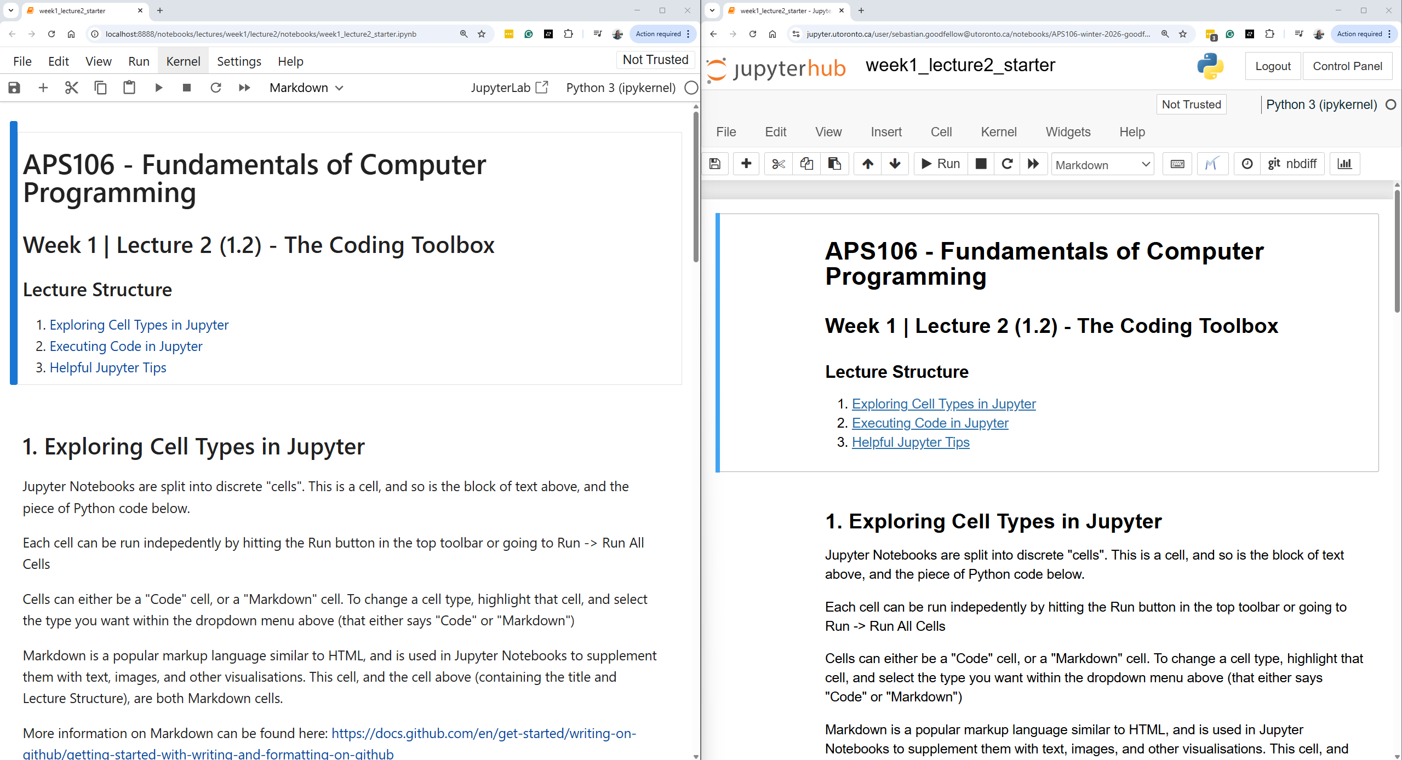
Jupyter Notebook.
Running in the browser.
JupyterHub.
localhost means the computation is happening on your computer.
http://localhost:8888/notebooks/lectures/week1/lecture2/notebooks/week1_lecture2_starter.ipynb
jupyter.utoronto.ca means the computation is happening on another server.
https://jupyter.utoronto.ca/user/sebastian.goodfellow@utoronto.ca/notebooks/APS106-winter-2026-goodfellow-sutton/lectures/week1/lecture2/notebooks/week1_lecture2_starter.ipynb

Slide 29
Running in the browser.
JupyterHub.
Let’s Code!
Demo:
JupyterHub
jupyter.utoronto.ca means the computation is happening on another server.
https://jupyter.utoronto.ca/user/sebastian.goodfellow@utoronto.ca/notebooks/APS106-winter-2026-goodfellow-sutton/lectures/week1/lecture2/notebooks/week1_lecture2_starter.ipynb

Slide 30
Editors & IDEs.
Integrated
Development
Environment
(IDE).
Interactive Computing
Environment.
AI-First
IDE.
Text Editors.

Slide 31
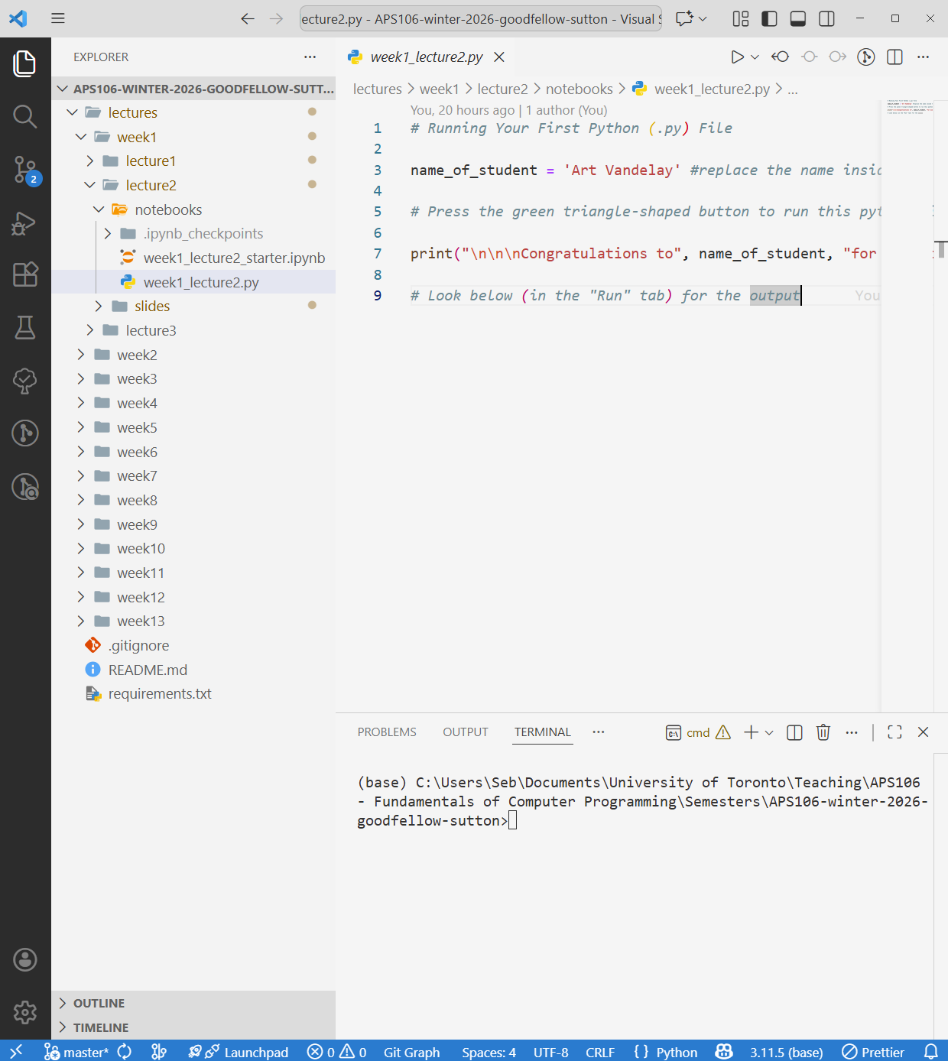
Integrated Development Environment.
What it is: A full-featured environment for building software, editing code, running it, debugging it, and managing a project in one place.
How it works: An IDE understands your project (files, imports, dependencies) and integrates key tools: a run configuration, debugger, terminal, and often Git, testing, and environment selection.
What you get: Autocomplete and code navigation, refactoring, integrated debugging (breakpoints/step-through), linting/formatting, and test runners, designed for scaling beyond a single file.
Typical workflow: Open a project → edit code → run/debug → inspect variables and stack traces → write tests → commit changes to Git.
Best for: Multi-file programs, assignments that grow over time, team projects, and any work where debugging and organization matter.

Slide 32
Integrated Development Environment.
What it is: A full-featured environment for building software, editing code, running it, debugging it, and managing a project in one place.
How it works: An IDE understands your project (files, imports, dependencies) and integrates key tools: a run configuration, debugger, terminal, and often Git, testing, and environment selection.
What you get: Autocomplete and code navigation, refactoring, integrated debugging (breakpoints/step-through), linting/formatting, and test runners, designed for scaling beyond a single file.
Typical workflow: Open a project → edit code → run/debug → inspect variables and stack traces → write tests → commit changes to Git.
Best for: Multi-file programs, assignments that grow over time, team projects, and any work where debugging and organization matter.
Let’s Code!
Open:
VSCode
Run:
week1_lecture2.py
week1_lecture2_starter.ipynb

Slide 33
Editors & IDEs.
Integrated
Development
Environment
(IDE).
Interactive Computing
Environment.
AI-First
IDE.
Text Editors.

Slide 34
Editors & IDEs.
Integrated
Development
Environment
(IDE).
AI-First
IDE.
These IDEs can become AI-enabled with extensions & CLI tools.
These IDEs have a UX that was built from the ground up for AI coding.

Slide 35
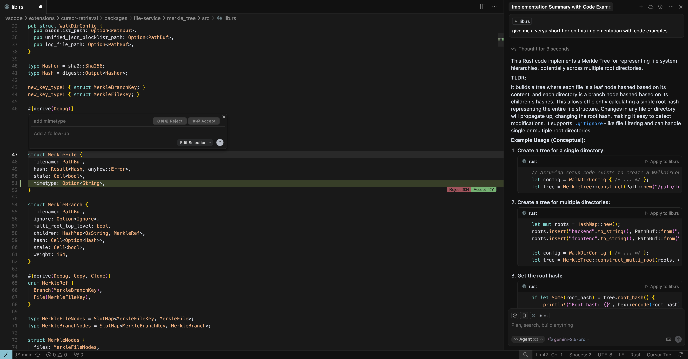
AI-First IDE.
Embedded AI Agent.
What it is: An IDE designed around an integrated AI “pair programmer” that can understand your codebase, suggest changes, and often make multi-file edits on your behalf.
How it works: You prompt the AI in-chat (and/or highlight code); it uses codebase context to propose edits, generate new files, refactor across the project, and help run/debug, typically via an agent-style workflow.
What you get: Faster scaffolding and iteration (boilerplate, examples, explanations), assisted debugging, quick refactors, and “search + understand” across a codebase with natural language.
Typical workflow: Describe the change → AI proposes a diff across files → you review/accept edits → run tests → iterate with follow-up prompts.
Best for: Rapid prototyping, learning patterns by example, refactoring, and reducing time spent on repetitive setup so you can focus on problem-solving.
Key caution: The AI can be confidently wrong or introduce subtle bugs/security issues, treat outputs as drafts, review diffs carefully, and validate by running/tests (you still own correctness).

Slide 36
AI-First IDE.
What it is: An IDE designed around an integrated AI “pair programmer” that can understand your codebase, suggest changes, and often make multi-file edits on your behalf.
How it works: You prompt the AI in-chat (and/or highlight code); it uses codebase context to propose edits, generate new files, refactor across the project, and help run/debug, typically via an agent-style workflow.
What you get: Faster scaffolding and iteration (boilerplate, examples, explanations), assisted debugging, quick refactors, and “search + understand” across a codebase with natural language.
Typical workflow: Describe the change → AI proposes a diff across files → you review/accept edits → run tests → iterate with follow-up prompts.
Best for: Rapid prototyping, learning patterns by example, refactoring, and reducing time spent on repetitive setup so you can focus on problem-solving.
Key caution: The AI can be confidently wrong or introduce subtle bugs/security issues, treat outputs as drafts, review diffs carefully, and validate by running/tests (you still own correctness).
Let’s Code!
Demo:
Cursor

Slide 37
Editors & IDEs.
Integrated
Development
Environment
(IDE).
Interactive Computing
Environment.
AI-First
IDE.
Text Editors.

Slide 38
What We’ll Use.
Integrated
Development
Environment
(IDE).
Interactive Computing
Environment.
AI-First
IDE.
Text Editors.

Slide 39
Developer Toolkit.
Computer.
Python Interpreter.
Version Control.
Packages Manager.
Git + GitHub
Terminal.
Editor/IDE.
Developer Seb.
Anaconda Terminal
VSCode + Jupyter

Slide 40
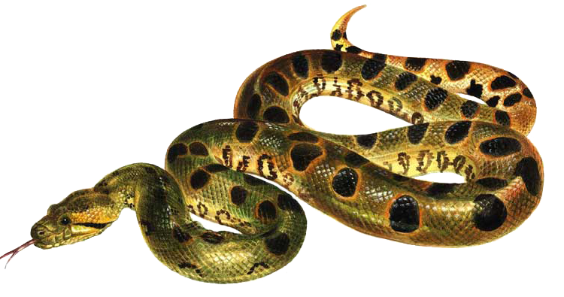
Developer Toolkit.
Computer.
Python Interpreter.
Version Control.
Packages Manager.
Git + GitHub
Terminal.
Editor/IDE.
Developer Seb.
Anaconda Terminal
VSCode + Jupyter

Slide 41
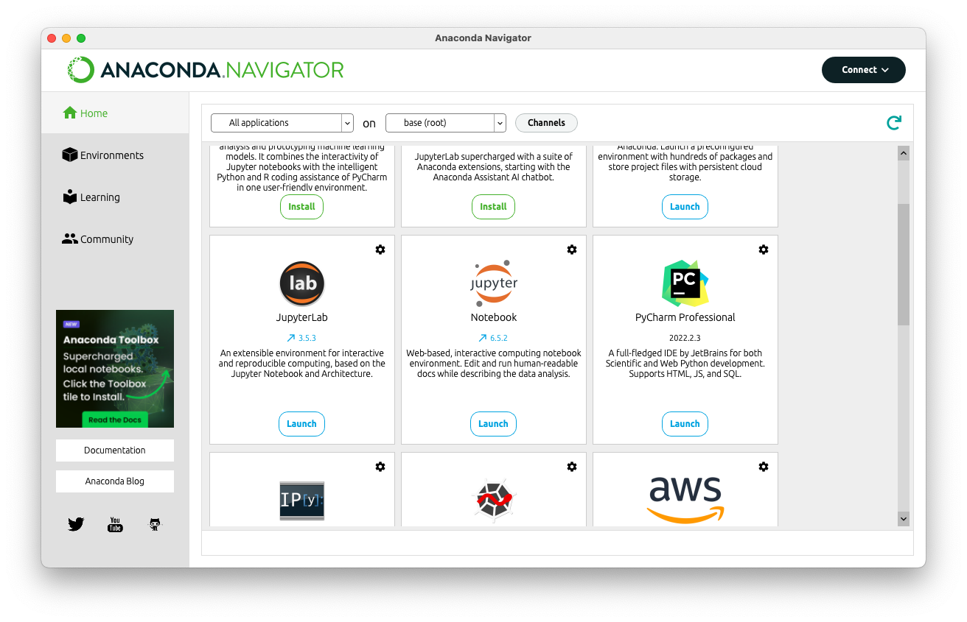


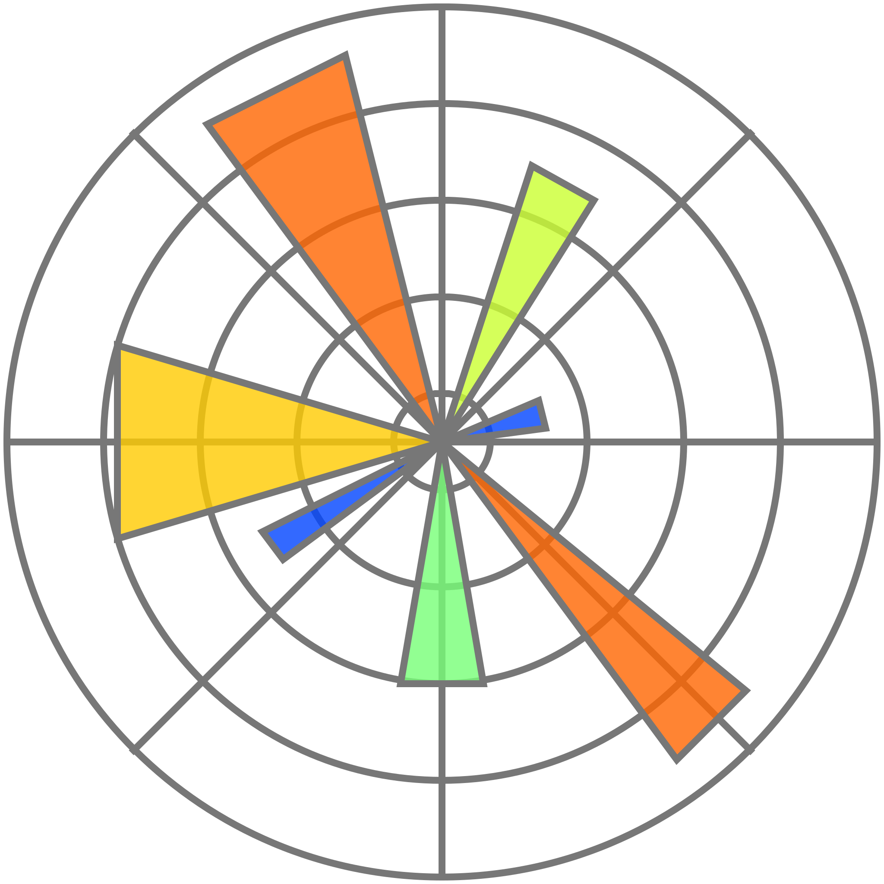


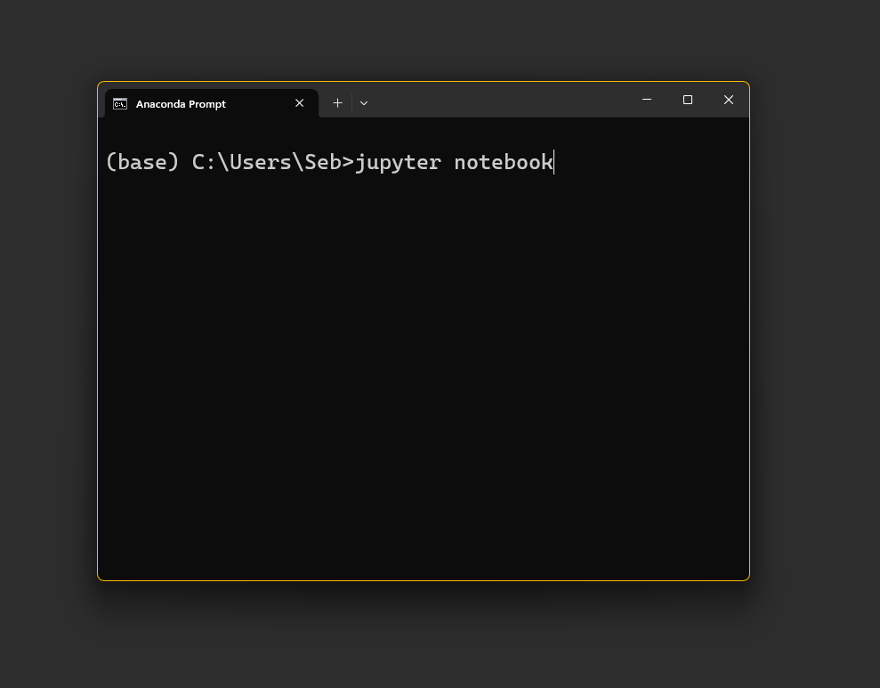
Python Interpreter.
Package +
Environment Manager.
Anaconda Navigator.
Curated Package List.
(base)
Editors.
Anaconda
Prompt.
Anaconda is an all-in-one way to install and manage Python on your computer. It helps you set up the tools and libraries you need for coding without having to configure everything from scratch.

Slide 42
We could install everything on our own.

Slide 43
Python Interpreter.
Package +
Environment Manager.
Anaconda Navigator.
Curated Package List.
(base)
Editors.
Anaconda
Prompt.
But this is much easier!

Slide 44
Python Interpreter.
Package +
Environment Manager.
Anaconda Navigator.
Curated Package List.
(base)
Editors.
Anaconda
Prompt.

Slide 45
Python Interpreter.
Package +
Environment Manager.
Anaconda Navigator.
Curated Package List.
(base)
Editors.
Anaconda
Prompt.

Slide 46
Python Interpreter.
Package +
Environment Manager.
Anaconda Navigator.
Curated Package List.
(base)
Editors.
Anaconda
Prompt.

Slide 47
Python Interpreter.
Package +
Environment Manager.
Anaconda Navigator.
Curated Package List.
(base)
Editors.
Anaconda
Prompt.

Slide 48
Developer Toolkit.
Computer.
Python Interpreter.
Version Control.
Packages Manager.
Git + GitHub
Terminal.
Editor/IDE.
Developer Seb.
Anaconda Terminal
VSCode + Jupyter

Slide 49
Week 11 (Don’t Stress).
Computer.
Python Interpreter.
Version Control.
Packages Manager.
Git + GitHub
Terminal.
Editor/IDE.
Developer Seb.
Anaconda Terminal
VSCode + Jupyter

Slide 50
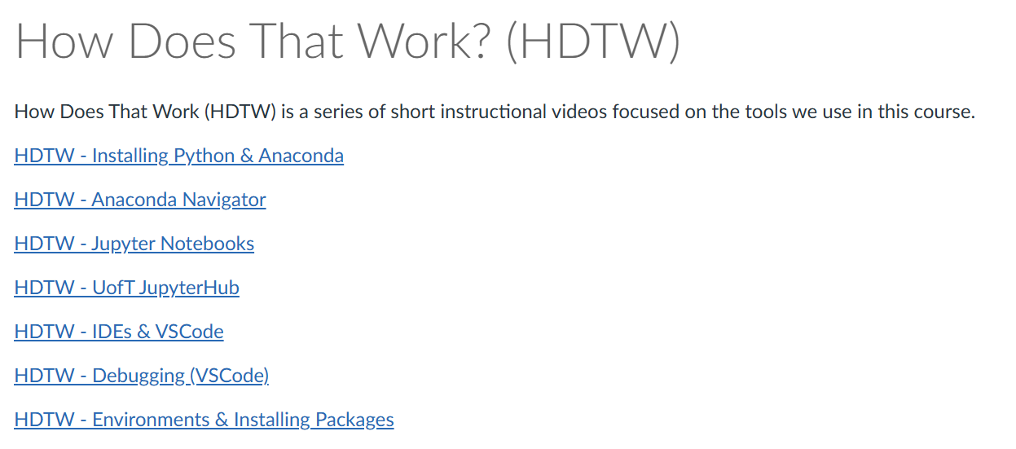
Before Next Class.
How Does That Work?
Modules -> Course Resources -> How Does That Work? (HDTW).
In Tutorial 0 this week -> Set up your development environment.

Slide 51
The Coding Toolbox.
Week 1 | Lecture 2 (1.2)
Upcoming
Lab 0 Released 6 pm Thursday.
Reflection 1 Released Friday 6:00 pm.
Tutorial sessions running all week.
Notes:
Historical figures, history of computer
Extensions, terminal, cPU, RAM, GPU, memory, transistors
Maybe visualise how all the departments disciplines are involved
Tools in course:
Anaconda
Jupyter
Environments
Shortcuts on Jupyter (shift enter) markdown etc.
Cells are linked, variables common across cells
Update cells down doesn’t update cells above
Kernel restarting
Clear output and variables

