Slide 1
Fundamentals of Computer Programming Design Problem: Forward Kinematics.
Week 2 | Lecture 3 (2.3)

Slide 2
Agenda.
Problem Background.
Learning Objectives.
Live Coding!

Slide 3
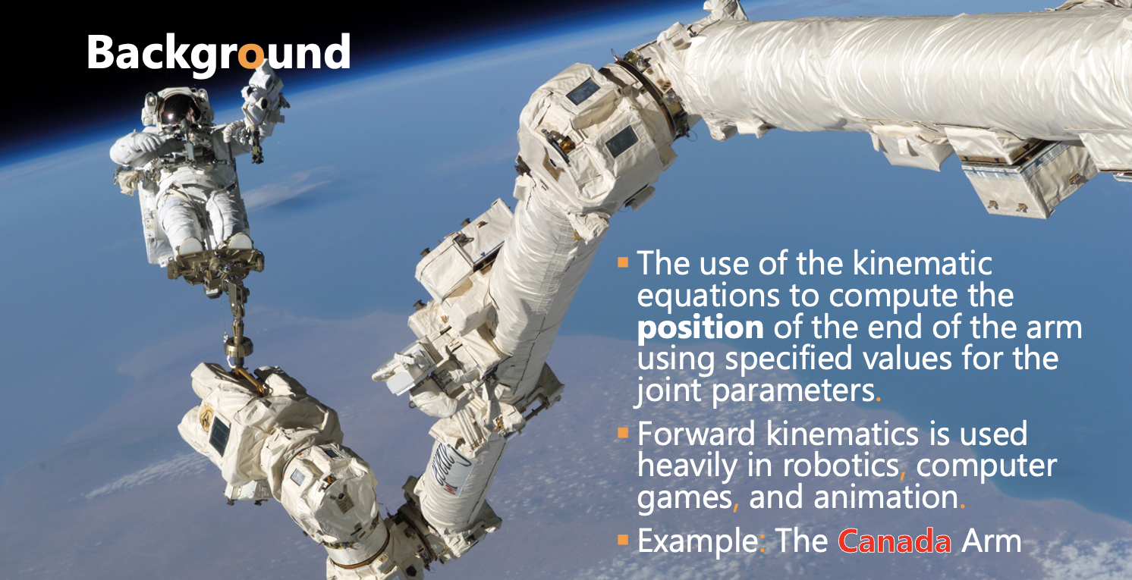

Slide 4
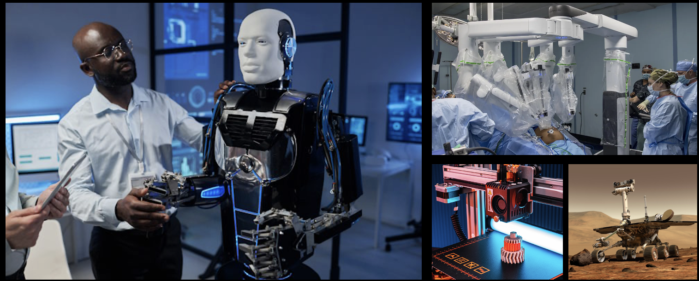
Other Cool Examples.
Humanoid and Industrial Robots, Animations and Gaming, 3D printing…

Slide 5
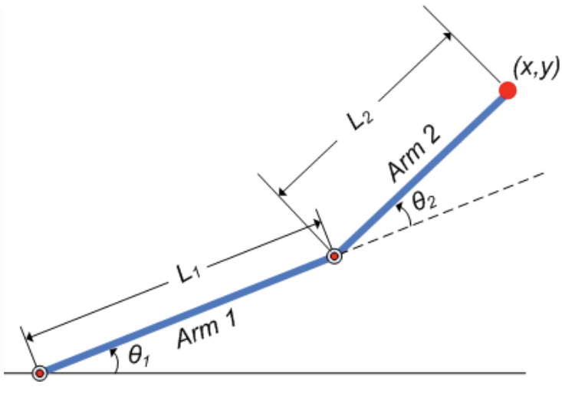
Requirements.
Create a program that finds the x- and y- position of the effector arm (i.e. the end of Arm #2).
Will rely on trigonometry to find the positions.

Slide 6
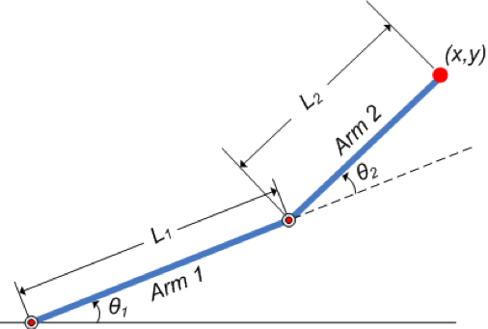
Requirements.
Where is this point?
my_function(Length1, Angle1, Length2, Angle2)
Given
Length1, Length2,
Angle1, Angle2

Slide 7
A Design Process for Programming.
APS111/112, a key part of engineering, is the design of objects, processes, and systems.
Programming is the design, implementation, testing, and documentation of a piece of software that solves a particular problem.
The software might be part of a larger system (e.g., the avionics software of an aircraft, the accounting or human resources software of a business), but it represents the solution to a design problem (or part of a design problem).

Slide 8
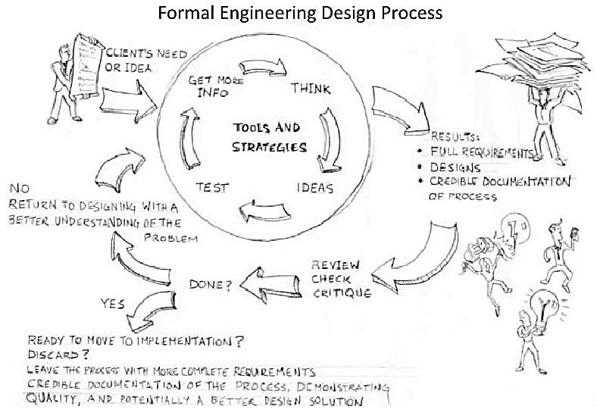
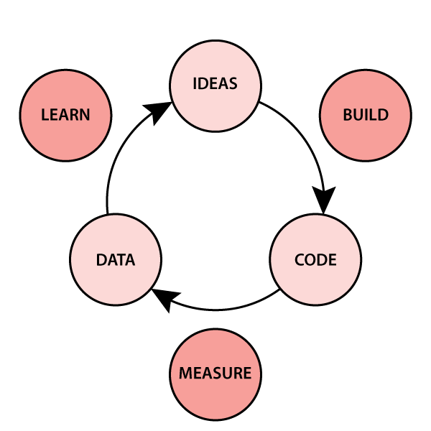
A Design Process for Programming.
We will approach programing as an engineering design process and adapt the process you have already seen in APS111/112.
Taken from: Designing Engineers: An Introductory Text.
Design is iterative.
Users.

Slide 9
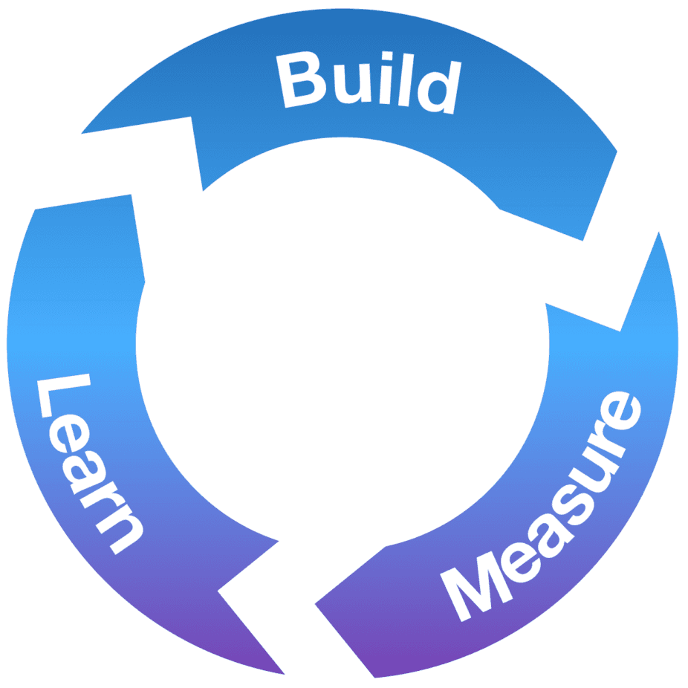
A Design Process for Programming.
The steps are as follows:
Define the Problem.
Define Test Cases.
Generate Multiple Solutions.
Select a Solution.
Implement the Solution.
Perform Final Testing.
Iterate On Feedback.

Slide 10
A Design Process for Programming.
The steps are as follows:
Define the Problem.
Write down what the problem actually is.
Open your notebook
Click Link:
2. Define the Problem

Slide 11
A Design Process for Programming.
The steps are as follows:
Define Test Cases.
Create some examples that reflect your code solving the problem: input and output.
Open your notebook
Click Link:
3. Define Test Cases

Slide 12
A Design Process for Programming.
The steps are as follows:
Generate Multiple Solutions.
At this point, a "solution" consists of an algorithm plan (the high-level sequence of steps defining what your algorithm will do) and a programming plan (the high-level sequence of steps that you will take to code the algorithm).
Open your notebook
Click Link:
4. Generate Multiple Solutions

Slide 13
A Design Process for Programming.
The steps are as follows:
Select a Solution.
Based on the different algorithms and programming plans, decide which is the most promising.
Open your notebook
Click Link:
5. Select a Solution

Slide 14
A Design Process for Programming.
The steps are as follows:
Implement the Solution.
Start to execute your programming plan.
Test as you go!
You may realize that your algorithm plan doesn't solve the problem, or even that you do not understand the problem.
If so, go back to earlier steps.
Open your notebook
Click Link:
6. Implement the Solution

Slide 15
A Design Process for Programming.
The steps are as follows:
Perform Final Testing.
Make sure that your original test cases, as well as any others that you have thought up, work.
Open your notebook
Click Link:
7. Perform Final Testing

Slide 16
A Design Process for Programming.
The steps are as follows:
Iterate On Feedback.
As you or the others use your product, collect feedback.
Use feedback to improve the product.
Open your notebook
Click Link:
8. Iterate On Feedback

Slide 17
Fundamentals of Computer Programming Design Problem: Forward Kinematics.
Week 2 | Lecture 3 (2.3)

