Slide 1
introduction to Object Oriented Programming, and the file object.
Week 5 | Lecture 2 (5.2)
While waiting, download the Jupyter Notebook and text file for today’s lecture

Slide 2
This Week’s Content
Lecture 5.1
Strings: Conversions, Indexing, Slicing, and Immutability
Lecture 5.2
Strings: practice exercise
Introduction to Object-Oriented Programming and the File Object
Lecture 5.3
for loops

Slide 3

Procedural Programming
Real World
Data
Global Variable
Pedestrian 1
x, y Location
Global Variable
Pedestrian 2
x, y Location
Global Variable
Pedestrian 3
x, y Location
x_ped1 = 3
y_ped1 = 5
Global Variable
Traffic Light 1
Color
Global Variable
Car 1
x, y location
traffic_light = ‘red’
Separation of Data and Functions
Function
okToCross
Function
AdvancePosition
Function
isInIntersection

Slide 4
Procedural Programming
Real World
Data
Global Variable
Pedestrian 1
x, y Location
Global Variable
Pedestrian 2
x, y Location
Global Variable
Pedestrian 3
x, y Location
Global Variable
Traffic Light 1
Color
Global Variable
Car 1
x, y location
input
output
Function
okToCross
Function
AdvancePosition
Function
isInIntersection

Slide 5
Object-Oriented Programming
Real World
Data
Object-oriented programming bundle the pedestrian’s Data together with these Functions into a single object
Car Object
x, y Location
Pedestrian in Intersection
Advance Position
Traffic Light Object
Color
Change Color
Pedestrian Object
x, y Location
Ok to Cross
Advance Position
Object: Pedestrian
Data: position, status
Methods:
okToCross()
advancePosition()

Slide 6
Object-Oriented Programming
Often, an object definition corresponds to some object or concept in the real world.
The functions that operate on that object correspond to the ways real-­world objects interact.
Models our real-life thinking
Sandwich – ingredients, freshness, etc.
Car – model, year, fuel level, forward, reverse etc.
Cat – weight, name, colour, scratch, meow, sleep, etc.
Turtle Object – x_position, y_position, forward, up, left, etc.

Slide 7
Object-Oriented Programming
Data
Functions
def up(y):
return y + 1
def goto(x_new, y_new):
return x_new, y_new
def right(x):
return x + 1
Procedural
Object-Oriented
alex_x = 0
alex_y = 0
alex_y = up(alex_y)
alex_x, alex_y = goto(-150, 100)
alex_x = right(alex_x)
print(alex_x, alex_y)
alex = Turtle(0, 0)
alex.up()
alex.goto(-150, 100)
alex.right()
print(alex.x, alex.y)

Slide 8
Objects in Python
Is this an instance
of this class.
Everything in Python is an object.
Every value, variable, function, etc., is an object.
Every time we create a variable we are making a new object.
>>> isinstance(4, object)
True
>>> isinstance(max, object)
True
>>> isinstance(“Hello”, object)
True

Slide 9
Classes
Class
A template or blueprint for object types
An instance of a class refers to one object whose type is defined as the class.
The words "instance" and "object" are used interchangeably.
A Class is made up of attributes (data) and methods (functions).
Attributes
Data
Methods
Functions
str.upper(‘hello’)
‘hello’.upper()

Slide 10
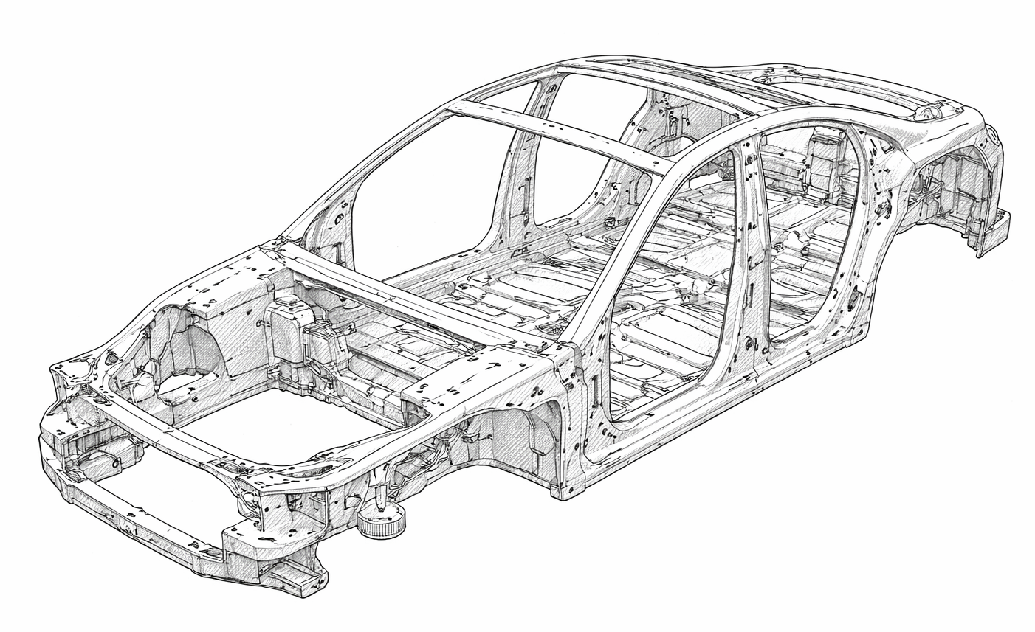
Classes: blueprints
Car
model
company
year
color
brake
accelerate
open trunk

Slide 11
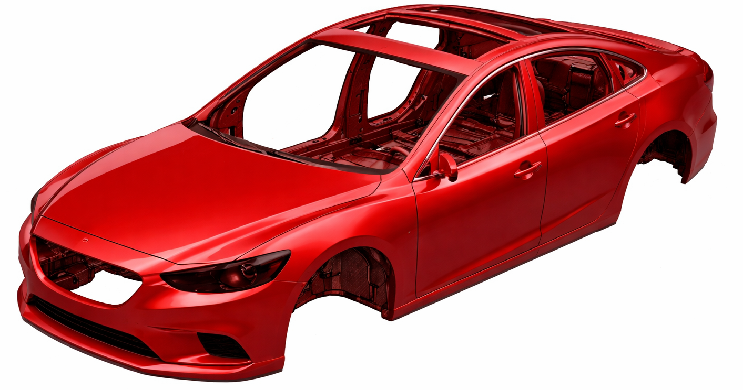
model: Corolla
year: 2024
tires: None
color: red
Car
model
company
year
color
brake
accelerate
open trunk

Slide 12

model: Corolla
year: 2024
tires: None
color: grey
Car
model
company
year
color
brake
accelerate
open trunk

Slide 13

model: Corolla
year: 2024
tires: fancy
color: grey
Car
model
company
year
color
brake
accelerate
open trunk

Slide 14

model: Corolla
year: 2024
tires: monster
color: grey
Car
model
company
year
color
brake
accelerate
open trunk

Slide 15

model: Sierra
year: 2020
tires: monster
color: grey flame decals
Car
model
company
year
color
brake
accelerate
open trunk

Slide 16


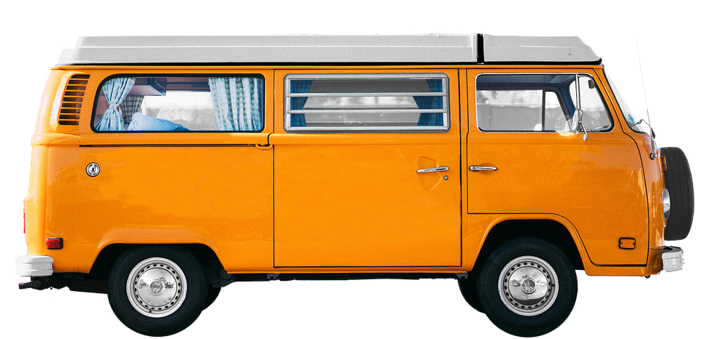
Classes
Car
Instances (objects) of the Car class.
model: Model S
company: Tesla
year: 2017
color: blue
model
company
year
color
model: Corolla
company: Toyota
year: 1980
color: red
brake
accelerate
open trunk
model: Bus
company: Volkswagen
year: 1976
color: orange

Slide 17

Classes
Person
Instances (objects) of the Person class.
name
age
city
gender
name: Majid
age: 28
city: Toronto
gender: they/them
name: June
age: 34
city: Ottawa
gender: she/her
eat
study
sleep
play
name: Ted
age: 31
city: Kingston
gender: he/him

Slide 18

Classes
Turtle
Instances (objects) of the Turtle class.
name
x location
y location
name: Vinodh
x location: 134
y location: 45
name: Lucy
x location: 24
y location: 35
move up
move down
move left
move right
go to
name: Brian
x location: 92
y location: 62

Slide 19
We’ve already been using objects!
math
integer
string
pi
e
inf
…
is_integer
as_integer_ratio
to_bytes
from_bytes
bit_count
…
replace
find
rfind
upper
isupper
islower
capitalize
count
…
factorial
ceil
floor
isfinite
log
…

Slide 20
Classes
We don’t need to know these details to be able to use them!
We will learn more about building custom classes later…
class Turtle:
def __init__(self, x, y):
self.x = x
self.y = y
def up(self):
body
def goto(self, x, y):
body
def down(self):
body
alex = Turtle(0, 0)
alex.up()
alex.goto(-150, 100)
alex.down()
print(alex.x, alex.y)

Slide 21

Classes
File
Instances (objects) of the file class.
filename
mode (ex: read or write)
name: itinerary.txt
mode: write
name: bills.txt
mode: append
read
readline
write
close
…
name: grades.txt
mode: read

Slide 22
Let’s Code!
Let’s take a look at how this works in Python!
Objects in Python
One potential ACORN design
Breakout Session!
Click Link:
1. Objects in Python

Slide 23
Why do we care about files?
Everything we’ve done so far is essentially deleted when our program ends
What if we wanted to store information?

Slide 24

Why work with files?
While a program is running, its data is stored in random access memory (RAM). when the program ends data in RAM disappears.
To make data available the next time the program is started, it must be written to a non-volatile storage medium, such a hard drive, USB drive, cloud storage, or CD-R.
RAM
Disk

Slide 25
Why work with files?
Data on non-volatile storage media are stored in named locations on the media called files.
By reading and writing files, programs can save information between program runs.

Slide 26
It’s like working with a notebook!
A file must be opened.
When you are done, it has to be closed.
While the file is open, it can either be read from or written to.
Like a bookmark, the file keeps track of where you are reading to or writing from.
You can read the whole file in its natural order or you can skip around

Slide 27
Opening a File
Python has a built-in function open that creates and returns a file object with a connection between the file information on the disk and the program.
The general form for opening a file is:
where mode is 'r' (to open for reading), 'w' (to open for writing), or 'a' (to open for appending to what is already in the file).
filename is an external storage location.
open(filename, mode)

Slide 28
Writing to a File
The following statement opens the file test.txt in write mode ‘w’.
If there is no file named "test.txt" on the disk, it will be created. If there already is one, it will be replaced by the file we are writing.
The file information will be assigned to the file object myfile.
myfile = open(‘test.txt’, ‘w’)

Slide 29
Writing to a File
To write something we need to use the write method as shown:
The write method does not attach a new line character by default.
Every time we use myfile.write() a string is added to file “test.txt” where we left off.
myfile.write(‘CATS!…’)
myfile.write(‘\n’)
myfile.write(‘I <3 my second line… \n’)

Slide 30
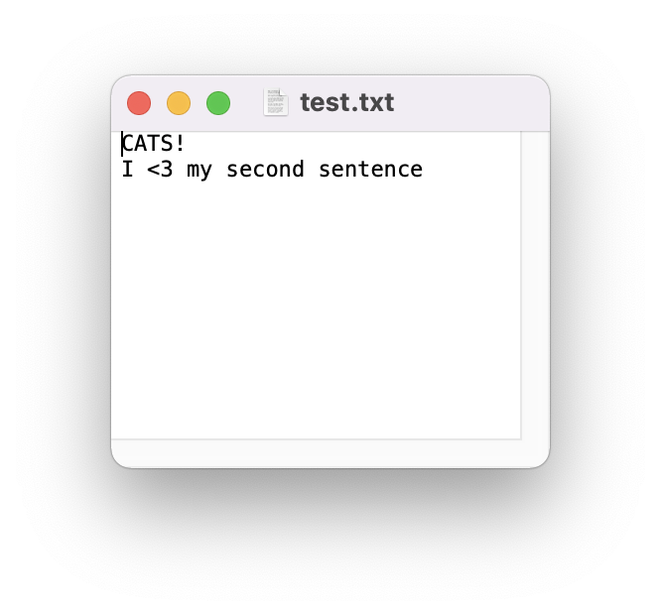
myfile = open(‘test.txt’, ‘w’)
myfile.write(‘CATS!…’)
myfile.write(‘\n’)
myfile.write(‘I <3 my second sentence… \n’)
# and eventually we close our file
myfile.close()

Slide 31
Closing a File
Once you have finished with the file, you need to close it:
This tells the system that we are done writing and makes the disk file available for reading or writing by other programs (or by our own program).
myfile.close()

Slide 32
Let’s Code!
Let’s take a look at how this works in Python!
Writing to your first file
Figure out where your files are getting saved!
Current working directory
Try playing with “w” and “a” mode!
Breakout Session!
Click Link:
2. The File Object

Slide 33
CLOSE THE FILE!
myfile.close()
Always close a file that you’ve opened!
Many changes don’t occur until after the file is closed
Leaving open is a waste of a computer’s resources
Slows down program, uses more space in RAM, impacts performance
Other files may treat the file as “open” and won’t be able to read the file
Could run into limits about how many files you have open
Not #cleancode

Slide 34
The ”Writing to Files” Recipe
# open/create a file
myfile = open("grades.txt", "w")
# write to a file
myfile.write(’string’)
# close the file
myfile.close()
go together

Slide 35
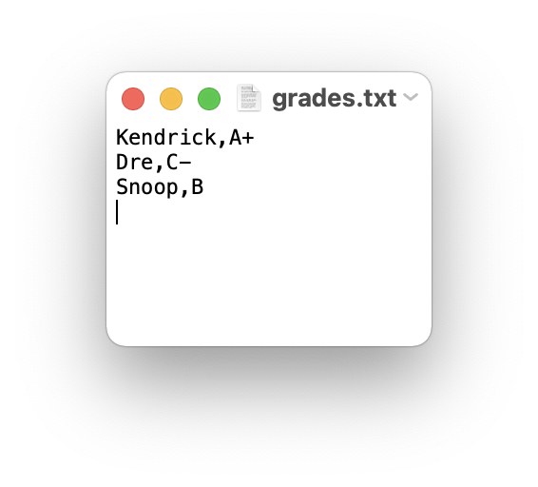
Example: Writing to Files
How would we write a string to a file?
students = ‘Kendrick,A+\nDre:C-\nSnoop:B\n’
# create a file
myfile = open("grades.txt", "w")
# store string to the file
myfile.write(students)
# close the file
myfile.close()

Slide 36
Encapsulation
Encapsulation
seb.forward(50)
kitty.scratch()
The core of object-oriented programming is the organization of the program by encapsulating related data and functions together in an object.
To encapsulate something means to enclose it in some kind of container.
In programming, encapsulation means keeping data and the code that uses it in one place and hiding the details of exactly how they work together.
Class
Attributes
Methods

Slide 37
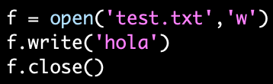
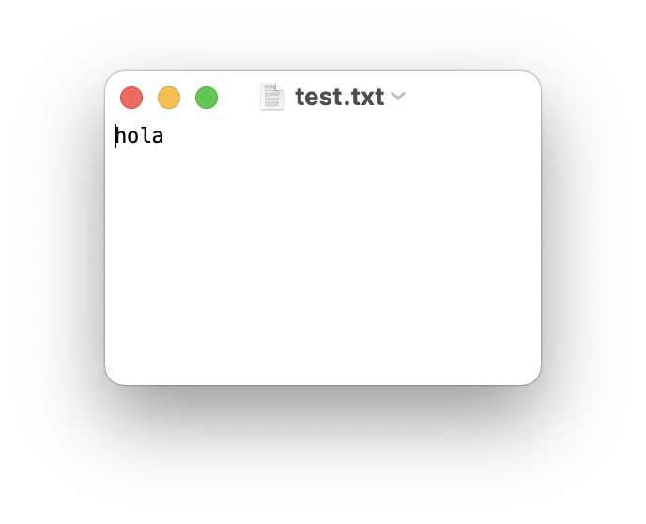
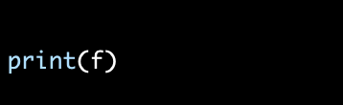
Encapsulate it!
For example, each instance of class file keeps track of which file on the disk it is reading/writing and where it currently is on that file.
The class hides the details of how it is done, so we (as programmers) can use it without needing to know how it is implemented

Slide 38


Writing and Reading
Can be any name!
myfile = open(‘test.txt’, ‘w’)
'w’ OR ‘a’
myfile = open(‘test.txt’, ‘a’)
myfile.write(‘CATS!…’)

Slide 39
Different ways of Reading a File
Reading a file is similar to writing a file. First we need to open a file for reading (“r”):
If file doesn’t exist? ERROR
Then to read a file we apply one of the following approaches which take advantage of various read methods:
The read approach
The readline approach
The for line in file approach
The readlines approach
myfile = open(‘test.txt’, ‘r’)
No correct approach!
Multiple methods to help with contexts and purposes

Slide 40
Different ways of Reading a File
Approach | Code | When to use it
The read approach | myfile = open(filename, 'r') contents = myfile.read() myfile.close() | When you want to read the whole file at once and use it as a single string.
The readline approach | myfile = open(filename, 'r') contents = '' line = myfile.readline() while line != '': contents += line line = myfile.readline() myfile.close() | When you want to process only part of a file. Each time through the loop line contains one line of the file.
The for line in file approach | myfile = open(filename, 'r') contents = '' for line in myfile: contents += line myfile.close() | When you want to process every line in the file one at a time.
The readlines approach | myfile = open(filename, 'r') lines = myfile.readlines() myfile.close() | When you want to examine each line of a file by index.
TODAY
FUTURE

Slide 41
Let’s Code!
Let’s take a look at how this works in Python!
Different read approaches
read()
readline()
for line in file
readlines()
Open your notebook
Click Link:
3. Reading Files

Slide 42
Madlibs is a story game
A story is written, and a few important words are taken out, replaced by blanks
The blanks are labelled with their part of speech or other category ("noun", "adjective", "an animal", and so on)
Replace the categories with specific words without knowing the story
When all the blanks have been filled in, the story is read out, usually with comic results
Example: https://youtu.be/kM9Wuzj4k24

Slide 43
Let’s Code!
Let’s take a look at how this works in Python!
Bringing it all together with Madlibs!
Open your notebook
Click Link:
4. Madlibs

Slide 44
introduction to Object Oriented Programming, and the file object.
Week 5 | Lecture 2 (5.2)

