Slide 1
Final REVIEW
APS106

Slide 2
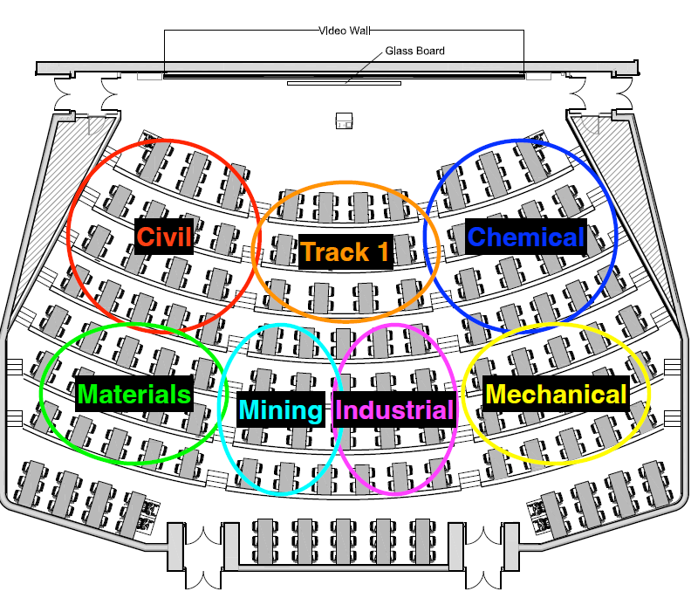

Slide 3
Dictionaries
my_dict = {} #empty
key: value pairs go inside
d = {‘a’: 1, ‘b’:2}
Can access values by calling the key
print(d[‘a’])
1
‘a’ in d
Where does it check?

Slide 4
Dictionaries
d = {‘a’: 1, ‘b’:2}
print(d.keys())
print(d.values())
print(d.items())
for __ in ____:
#do something
Is d.keys()[0] possible?
Can keys repeat?
Are keys mutable?

Slide 5
Files – REVIEW W11 L2 slides!

Slide 6
Different ways of Reading a File
Approach | Code | When to use it
The read approach | myfile = open(filename, 'r') contents = myfile.read() myfile.close() | When you want to read the whole file at once and use it as a single string.
The readline approach | myfile = open(filename, 'r') contents = '' line = myfile.readline() while line != '': contents += line line = myfile.readline() myfile.close() | When you want to process only part of a file. Each time through the loop line contains one line of the file.
The for line in file approach | myfile = open(filename, 'r') contents = '' for line in myfile: contents += line myfile.close() | When you want to process every line in the file one at a time.
The readlines approach | myfile = open(filename, 'r') lines = myfile.readlines() myfile.close() | When you want to examine each line of a file by index.
WEEK 5
TODAY

Slide 7
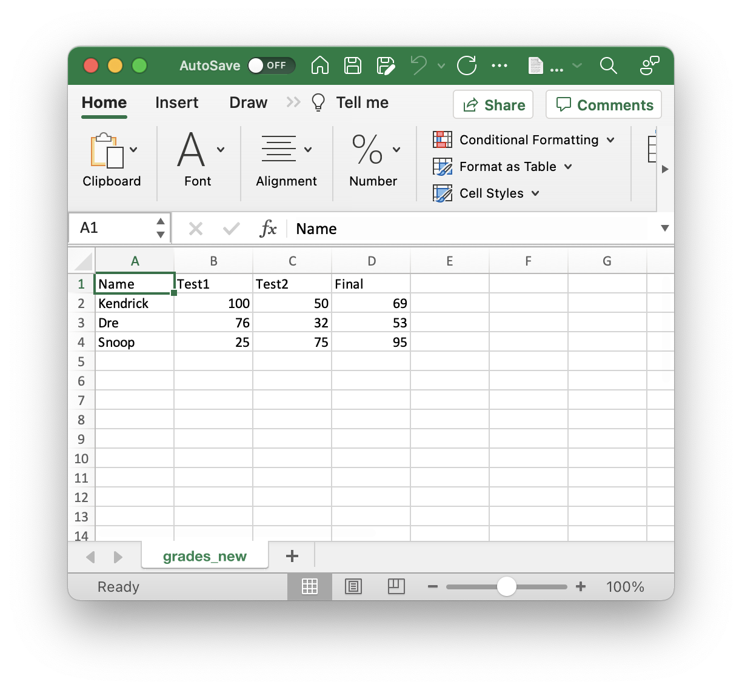
Summary: Reading CSVs
Requirement: “grades.csv”
##############################
reading a file using standard approach
##############################
# open communication to a file (to read)
myfile = open('grades.csv', 'r')
# read from file
L = myfile.readlines()
for row in L:
print(row, end = '')
myfile.close()
############################
reading a file using CSV Module
############################
import csv
# open communication to a file (to read)
myfile = open('grades.csv', 'r')
# read from file
csv_reader = csv.reader(myfile)
for row in csv_reader:
print(row)
myfile.close()
Requires find() method to obtain data!

Slide 8
Summary: Writing CSVs
Requirement: grades needs to be defined
grades = [['Name', 'Test1', 'Test2', 'Final'],
[‘Kendrick', '100', '50', '69'],
[‘Dre', '76', '32', '53'],
[‘Snoop', '25', '75', '95']]
#################################
#writing to a file using standard approach
#################################
# open communication to a file (to write)
myfile = open('new_grades.csv', 'w')
# write to file
for row in grades:
for col in row:
myfile.write(col + ',')
myfile.write('\n')
myfile.close()
#############################
#writing to a file using CSV Module
#############################
import csv
# open communication to a file (to write)
myfile = open('new_grades.csv', 'w')
# write to file
grades_writer = csv.writer(myfile)
for row in grades:
grades_writer.writerow(row)
myfile.close()

Slide 9
CLASSES – REVIEW W10 and W11 L1
Blueprints! They provide the framework for instances of the class (which are objects!)
What the heck is self?
A reference to a future instance
What is __init__? Is it required?
What does __str__ do?
Can you make variables within the class that aren’t passed as parameters?

Slide 10
Why self is necessary in method definition?
When you call a method of an object as
object.method(arg1, arg2)
it automatically converts into
Class.method(object, arg1, arg2)
The self keyword captures this reference. Therefore, self is the first parameter of any method in a class, including the __init__ method.

Slide 11
Rules of the GAME
Must use button on the table to answer question verbally and explain your answer – you will be called on to answer by one of the instructors
Must tell us which discipline you’re in before you answer for points (we’ll rely on the honour system)
If you get the answer right, you pick the next category
If you get the answer wrong, the next person whose hand is up can steal
Everyone is here to learn and review for the midterm so be kind to everyone who answers!

Slide 12
Panel
Containers Continued
Read, Write, Maybe even append
Classy Classes
$200
$200
$200
$400
$400
$400
$600
$600
$600
$800
$800
$800
$1000
$1000
$1000
Final Jeopardy

Slide 13

What is the output?
Containers Continued · $200
Question board

Slide 14

What is the output?
Containers Continued · $200
Question board

Slide 15
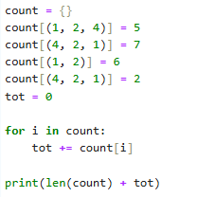

What is the output?
Containers Continued · $400
Question board

Slide 16
What is the output?
Containers Continued · $400
Question board

Slide 17
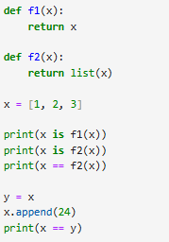
What is the output?
Containers Continued · $600
Question board

Slide 18

What is the output?
Containers Continued · $600
Question board

Slide 19
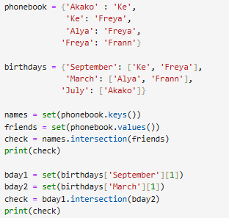
What is the output?
Containers Continued · $800
Question board

Slide 20

What is the output?
Containers Continued · $800
Question board

Slide 21
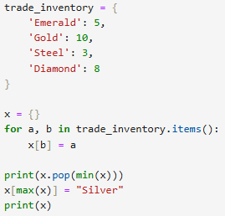
What is the output?
Containers Continued · $1000
Question board

Slide 22

What is the output?
Containers Continued · $1000
Question board

Slide 23
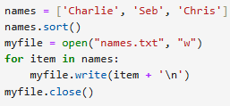
What is written to file?
Read, Write, Maybe even Append · $200
Question board
Notes:
Go to python notebook

Slide 24
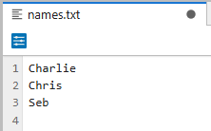
What is written to file?
Read, Write, Maybe even Append · $200
Question board
Notes:
Go to python notebook

Slide 25
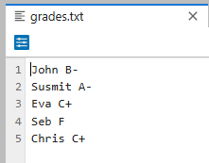

What is the output?
Read, Write, Maybe even Append · $400
Question board
Notes:
Go to python notebook

Slide 26

What is the output?
Read, Write, Maybe even Append · $400
Question board
Notes:
Go to python notebook

Slide 27
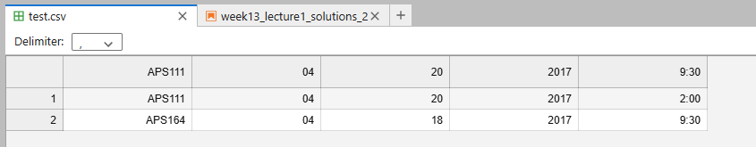
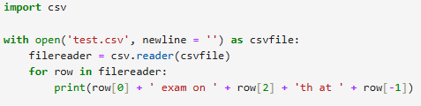
What is the output?
Read, Write, Maybe even Append · $600
Question board
Notes:
Go to python notebook

Slide 28

What is the output?
Read, Write, Maybe even Append · $600
Question board
Notes:
Go to python notebook

Slide 29
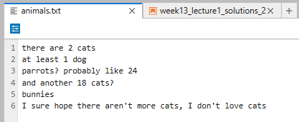
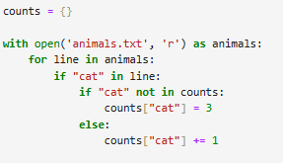
What is the output?
Read, Write, Maybe even Append · $800
Question board
Notes:
Go to python notebook

Slide 30
What is the output?
Read, Write, Maybe even Append · $800
Question board
Notes:
Go to python notebook

Slide 31
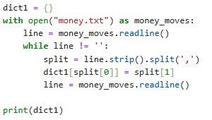
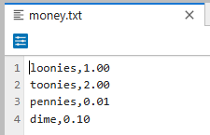
What is the output?
Read, Write, Maybe even Append · $1000
Question board
Notes:
Go to python notebook

Slide 32
What is the output?
Read, Write, Maybe even Append · $1000
Question board
Notes:
Go to python notebook

Slide 33
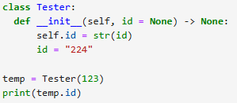
What is the output?
Classy Classes · $200
Question board

Slide 34
What is the output?
Classy Classes · $200
Question board

Slide 35
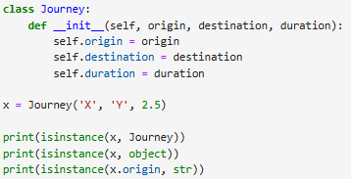
What is the output?
Classy Classes · $400
Question board

Slide 36

What is the output?
Classy Classes · $400
Question board

Slide 37
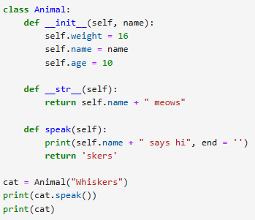
What is the output?
Classy Classes · $600
Question board

Slide 38

What is the output?
Classy Classes · $600
Question board

Slide 39
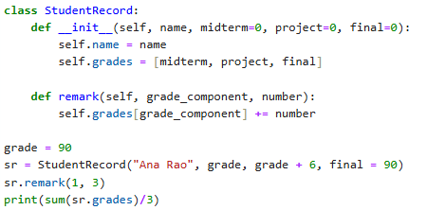
What is the output?
Classy Classes · $800
Question board

Slide 40
What is the output?
Classy Classes · $800
Question board

Slide 41

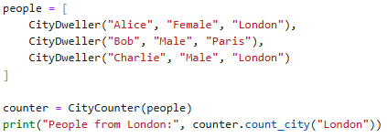
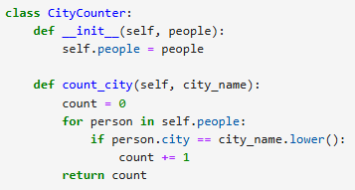
What is the output?
Classy Classes · $1000
Question board

Slide 42
What is the output?
Classy Classes · $1000
Question board

Slide 43
Final Jeopardy

Slide 44
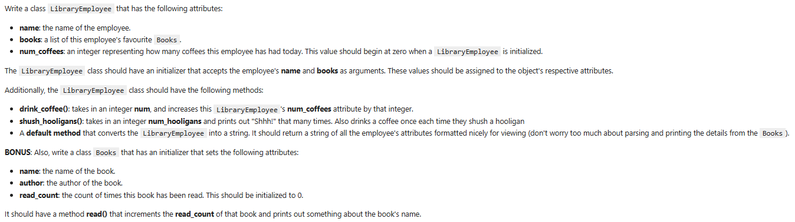
FINAL JEOPARDY

Slide 45
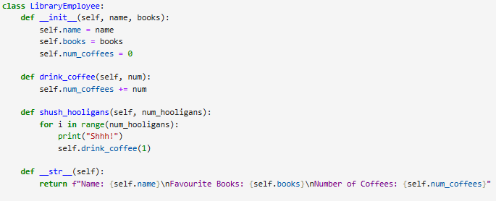
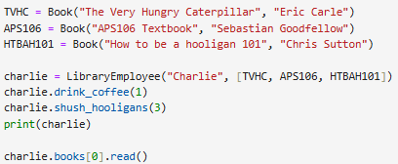
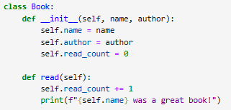
FINAL JEOPARDY - Answer

