Slide 1
TERM TEST 2 REVIEW
APS106

Slide 2
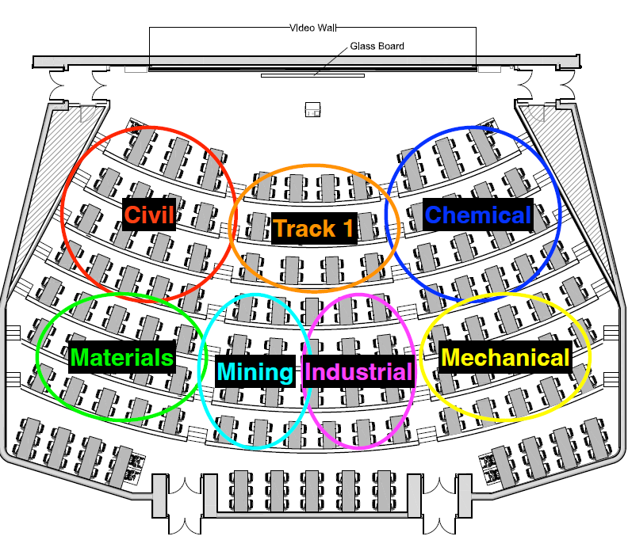

Slide 3
Rules of the GAME
Must use button on the table to answer question verbally and explain your answer – you will be called on to answer by one of the instructors
Must tell us which discipline you’re in before you answer for points (we’ll rely on the honour system)
If you get the answer right, you pick the next category
If you get the answer wrong, the next person whose hand is up can steal
Everyone is here to learn and review for the midterm so be kind to everyone who answers!

Slide 4
Panel
Difficult Dictionaries
All Things Index
For A While There…
Fantastic Containers and where to find them
$250
$250
$250
$250
$500
$500
$500
$500
$750
$750
$750
$750
$1000
$1000
$1000
$1000
Final Jeopardy

Slide 5
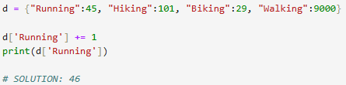
What is the output?
Difficult Dictionaries · $250
Question board

Slide 6
What is the output?
Difficult Dictionaries · $250
Question board

Slide 7
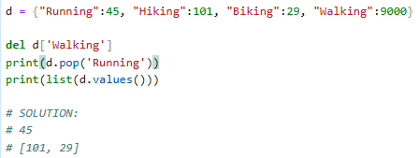
What is the output?
Difficult Dictionaries · $500
Question board

Slide 8
What is the output?
Difficult Dictionaries · $500
Question board

Slide 9
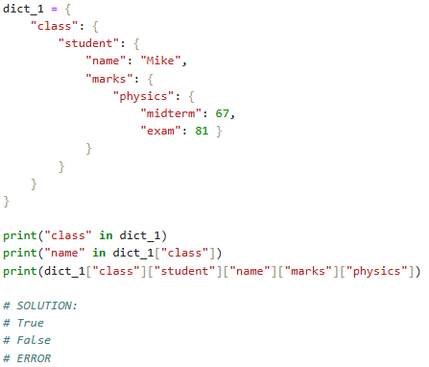
What is the output?
Difficult Dictionaries · $750
Question board

Slide 10
What is the output?
Difficult Dictionaries · $750
Question board

Slide 11
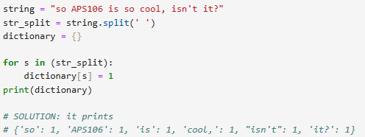
What is the output?
Difficult Dictionaries · $1000
Question board

Slide 12
What is the output?
Difficult Dictionaries · $1000
Question board

Slide 13
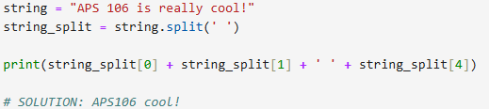
What is the output?
All Things Index · $250
Question board
Notes:
Go to python notebook

Slide 14
What is the output?
All Things Index · $250
Question board
Notes:
Go to python notebook

Slide 15
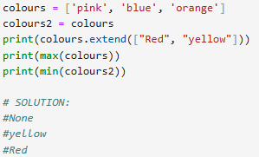
What is the output?
All Things Index · $500
Question board

Slide 16
What is the output?
All Things Index · $500
Question board

Slide 17
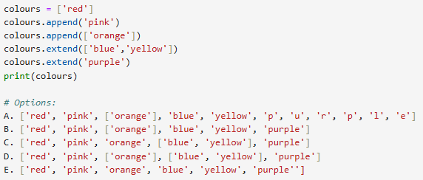
All Things Index · $750
What is the output? Multiple Choice:
Question board

Slide 18
All Things Index · $750
What is the output? Multiple Choice:
Question board

Slide 19
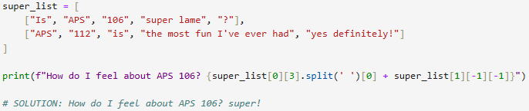
All Things Index · $1000
What is the output?
Question board
Notes:
Infinite

Slide 20
All Things Index · $1000
What is the output?
Question board
Notes:
Infinite

Slide 21
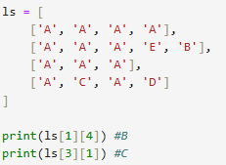
What indices are ‘B’ and ‘C’ at?
For A While There … · $250
Question board

Slide 22
What indices are ‘B’ and ‘C’ at?
For A While There … · $250
Question board

Slide 23
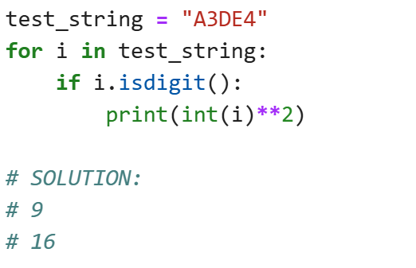
What is the output?
For A While There … · $500
Question board
Notes:
No output

Slide 24
What is the output?
For A While There … · $500
Question board
Notes:
No output

Slide 25
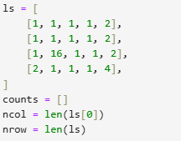
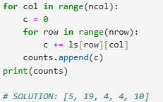
What is the output?
For A While There … · $750
Question board
Notes:
120

Slide 26
What is the output?
For A While There … · $750
Question board
Notes:
120

Slide 27
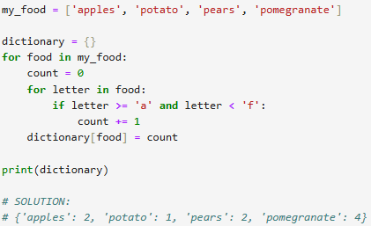
What is the output?
For A While There … · $1000
Question board
Notes:
C

Slide 28
What is the output?
For A While There … · $1000
Question board
Notes:
C

Slide 29
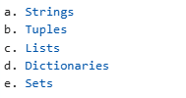
Which of the following are mutable?
Fantastic Containers and where to find them · $250
Question board
Notes:
6

Slide 30

Which of the following are mutable?
Fantastic Containers and where to find them · $250
Question board
Notes:
6

Slide 31
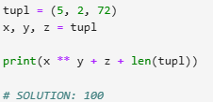
What is the output?
Fantastic Containers and where to find them · $500
Question board
Notes:
You passed a course with grade: 100

Slide 32
What is the output?
Fantastic Containers and where to find them · $500
Question board
Notes:
You passed a course with grade: 100

Slide 33
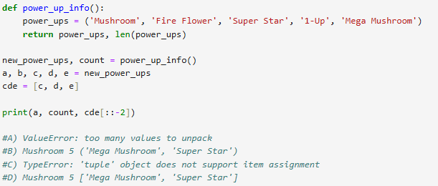
What is the output? Multiple Choice
Fantastic Containers and where to find them · $750
Question board

Slide 34
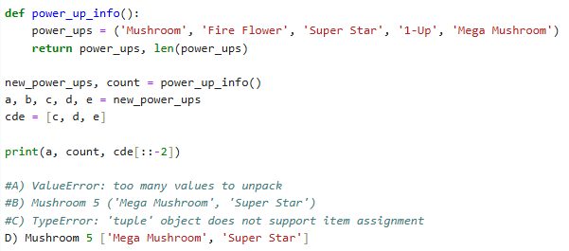
What is the output? Multiple Choice
Fantastic Containers and where to find them · $750
Question board

Slide 35
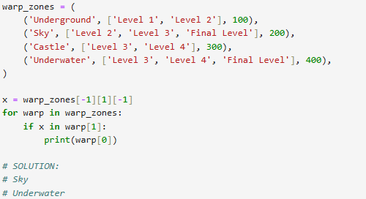
What is the output?
Fantastic Containers and where to find them · $1000
Question board
Notes:
21

Slide 36
What is the output?
Fantastic Containers and where to find them · $1000
Question board
Notes:
21

Slide 37
Final Jeopardy

Slide 38
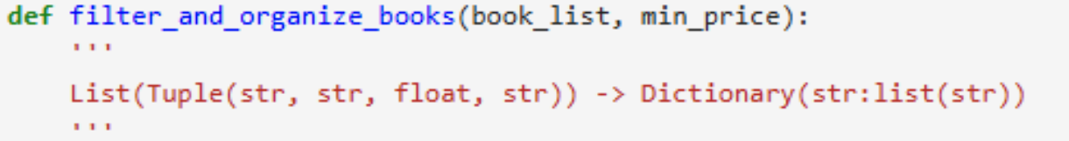
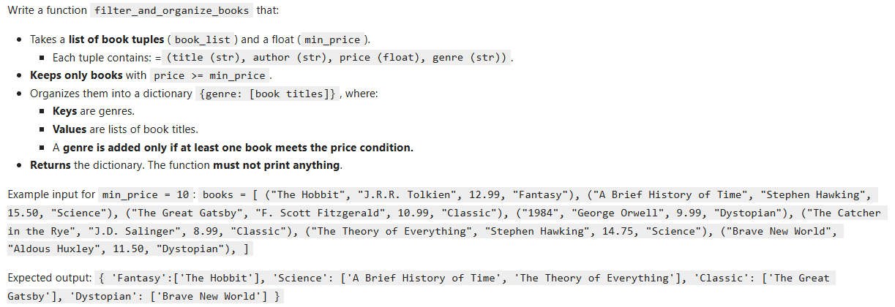
FINAL JEOPARDY

Slide 39
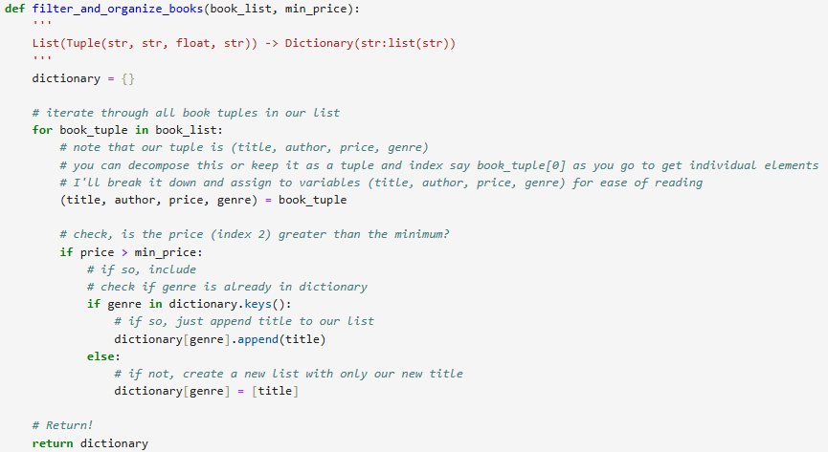
FINAL JEOPARDY - Answer

