Slide 1
more for loops.
Week 6 | Lecture 2 (6.2)
Upcoming
Term Test 1, Thursday at 7:00 pm.
Reflection 6 Released Friday 6:00 pm.

Slide 2
This Week’s Content
Lecture 6.1
Term Test 1 review
Lecture 6.2
for loops on indices, nested loops
Lecture 6.3 - Recorded
Design Problem: Cryptography

Slide 3
for loops
name = ‘Sebastian’
for character in name:
print(character)
Output:
S
e
b
a
s
t
i
a
n
A for loop starts with the keyword for.

Slide 4
for loops
name = ‘Sebastian’
for character in name:
print(character)
for item1, item2 in iterable:
do something.
Next, we provide the name of one of more variables.
We have called the variable character, but you can call it whatever you like as long as it follows rules for naming a variable.

Slide 5
for loops
name = ‘Sebastian’
for character in name:
print(character)
Output:
S
e
b
a
s
t
i
a
n
Our variable character will be bound to each of the items in the sequence in turn.

Slide 6
for loops
name = ‘Sebastian’
for character in name:
print(character)
Output:
S
e
b
a
s
t
i
a
n
Specify what the values are in.
What is the iterable?
An iterable is an object that can be iterated over.
Strings are iterable (we know these from last week).
Lists (next week) are iterable.

Slide 7
for loops
name = ‘Sebastian’
for character in name:
print(character)
Output:
S
e
b
a
s
t
i
a
n
As with the while loop, the for loop statement ends with a colon.
This is how Python knows you are going to create a new block of code.

Slide 8
for loops
name = ‘Sebastian’
for character in name:
print(character)
Output:
S
e
b
a
s
t
i
a
n
Indenting four spaces tells Python what lines of code are in that block you want to repeated.
Indent

Slide 9
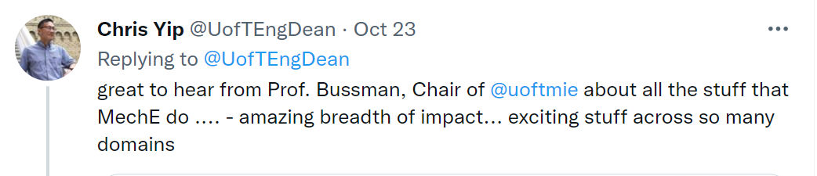
Breakout Session 1
We want to do some analysis of Dean Yip’s Tweets.
Before we can do this, we’ll need to make the tweet all lower case and replace all the punctuations with white space.
‘impact... Exciting’ → ‘impact exciting‘
Open your notebook
Click Link:
1. Breakout Session 1

Slide 10
Looping Through Indices
Last lecture we saw that we can use while loops to loop over the indices of a string.
Then we saw that a for-loop requires less code but it iterates over the values, not the indices.
while
for
i = 0
while i < len(chrome_4):
print(i, chrome_4[i])
i += 1
for character in chrome_4:
print(character)

Slide 11
Looping Through Indices
Can we use a for loop to loop over indices?
while
for
i = 0
while i < len(chrome_4):
print(i, chrome_4[i])
i += 1
for character in chrome_4:
print(character)

Slide 12
Looping on a range()
Python has a built-in function called range() that can be used to generate a sequence of numbers. The general syntax of range is as follows:
Similar to the string slicing syntax:
The stop value is not included in the sequence of numbers generated.
Can omit start and step which will result in default values being used. range(n) → range(0, n, 1)
range(start, stop, step)

Slide 13
Looping on a range()
Open your notebook
Click Link:
2. Using range()
range() is typically used in a for loop to iterate over a sequence of numbers.
range() is an iterable.
This thing has to be an iterable.
for i in range(5):
print(i)

Slide 14
Example 1
Open your notebook
Click Link:
3. Example 1
Add up all the even numbers between 1 and 100 using a for loop and range().
2+4+…..+96+98+100

Slide 15
Breakout Session 2
Open your notebook
Click Link:
4. Breakout Session 2
Write a function that returns the number of times that a character and the next character are the same.
If you have a bug in a loop, with probability ~1 its an off-by-one index error.
count_adjacent_repeats('abccdeffggh’)
>>> 3

Slide 16
Nested for Loops
for item in iterable:
do something.
The bodies of loops can contain any statement, including other loops!
When this occurs, it is known as a nested loop.
for i in range(10, 13):
for j in range(1, 5):
print(i, j)
Output
10, 1
10, 2
10, 3
…

Slide 17
Nested for Loops
Open your notebook
Click Link:
5. Nested for Loops
The bodies of loops can contain any statement, including other loops!
When this occurs, it is known as a nested loop.

Slide 18

Turtles
Open your notebook
Click Link:
6. Turtles
Turtle is a pre-installed Python library that enables users to create pictures and shapes by providing them with a virtual canvas.

Slide 19
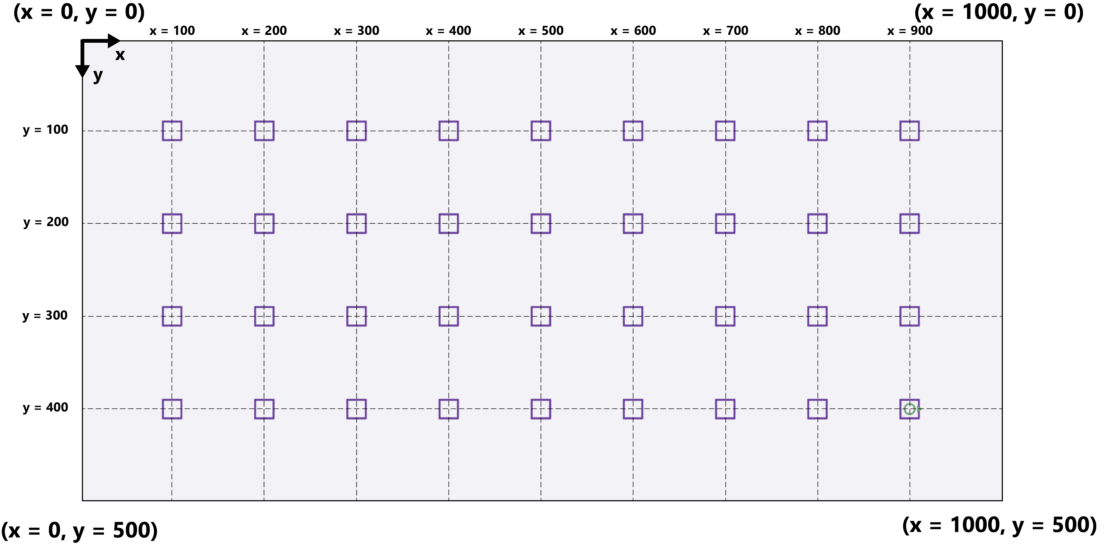
Draw A Grid
Use Turtle and nested for loops to draw a grid.
Open your notebook
Click Link:
7. Grid

Slide 20
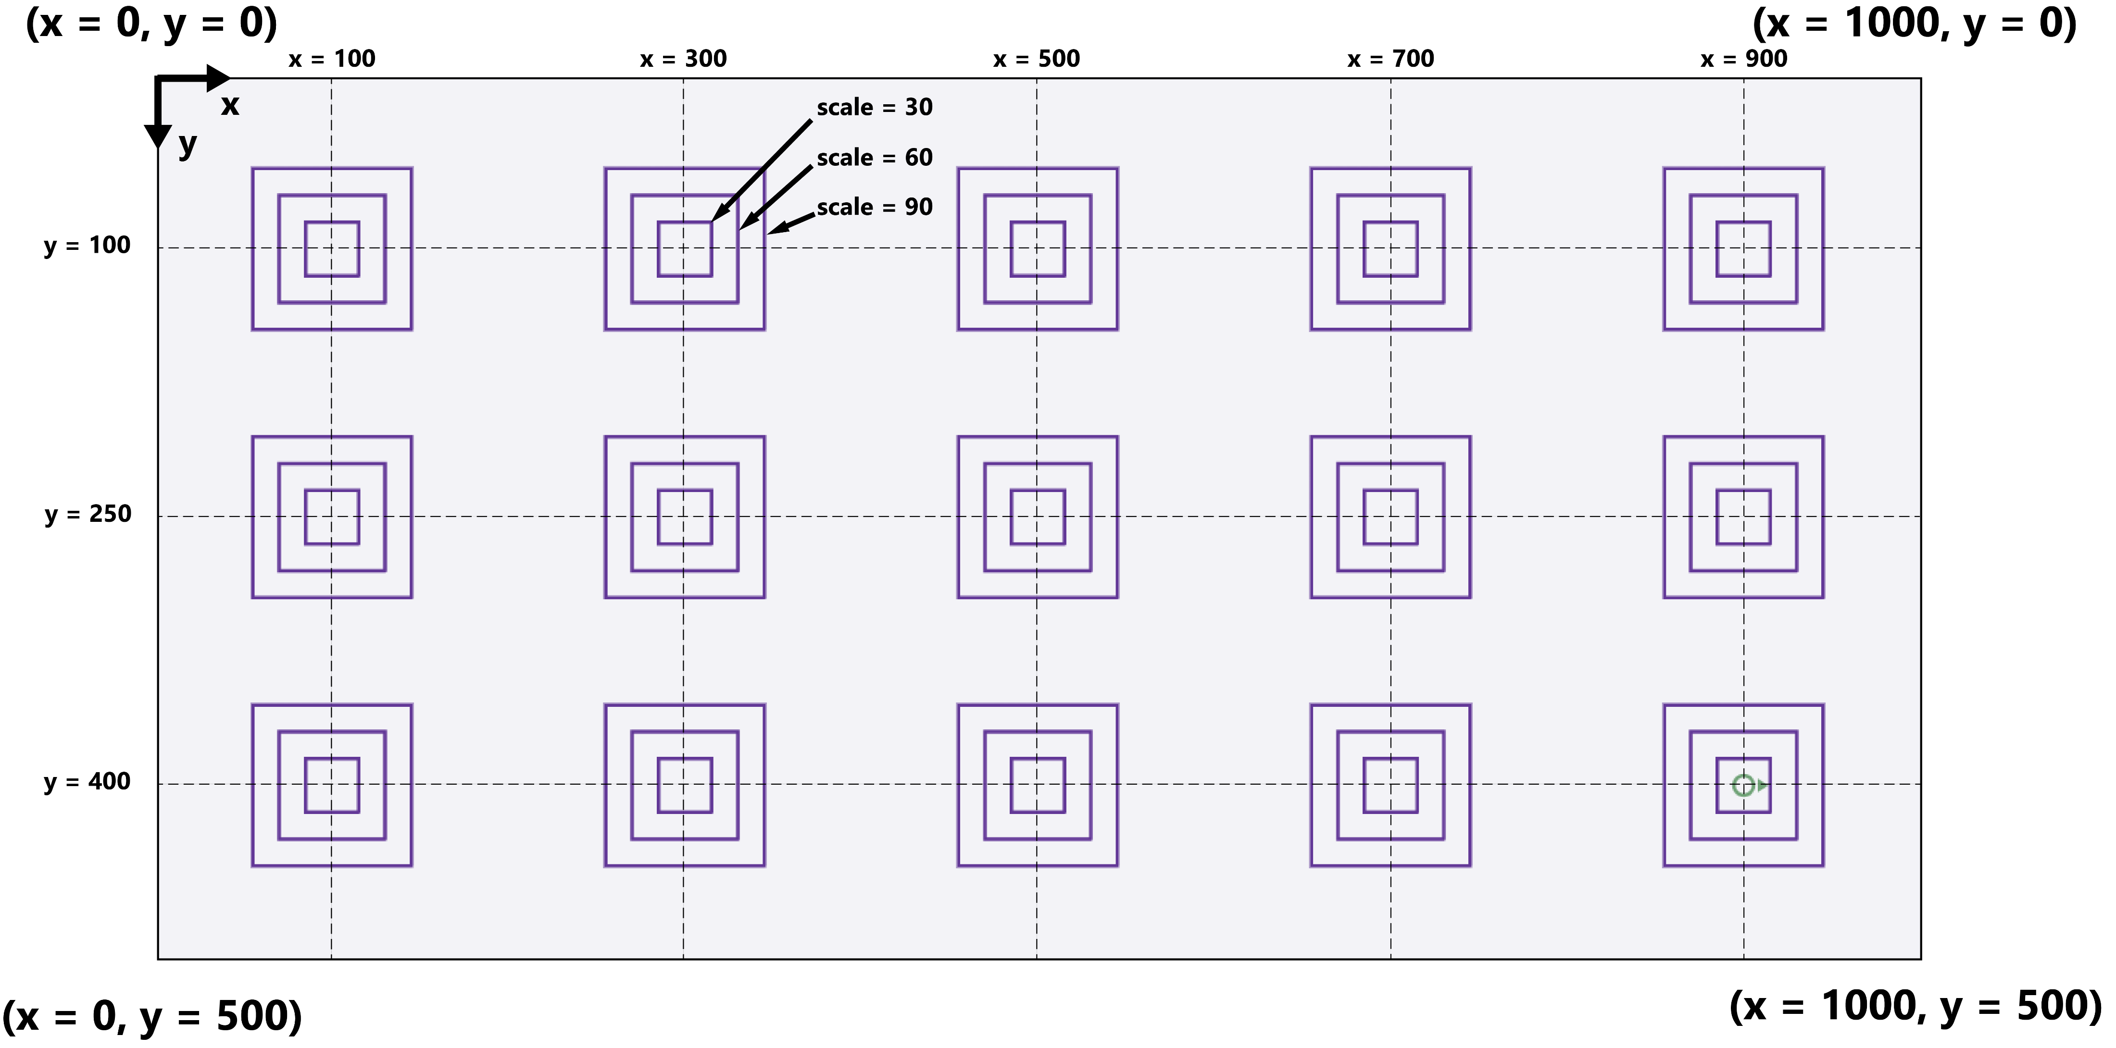
Breakout Session 3
Use Turtle and nested for loops to draw the pattern below.
Open your notebook
Click Link:
8. Breakout Session 3

Slide 21
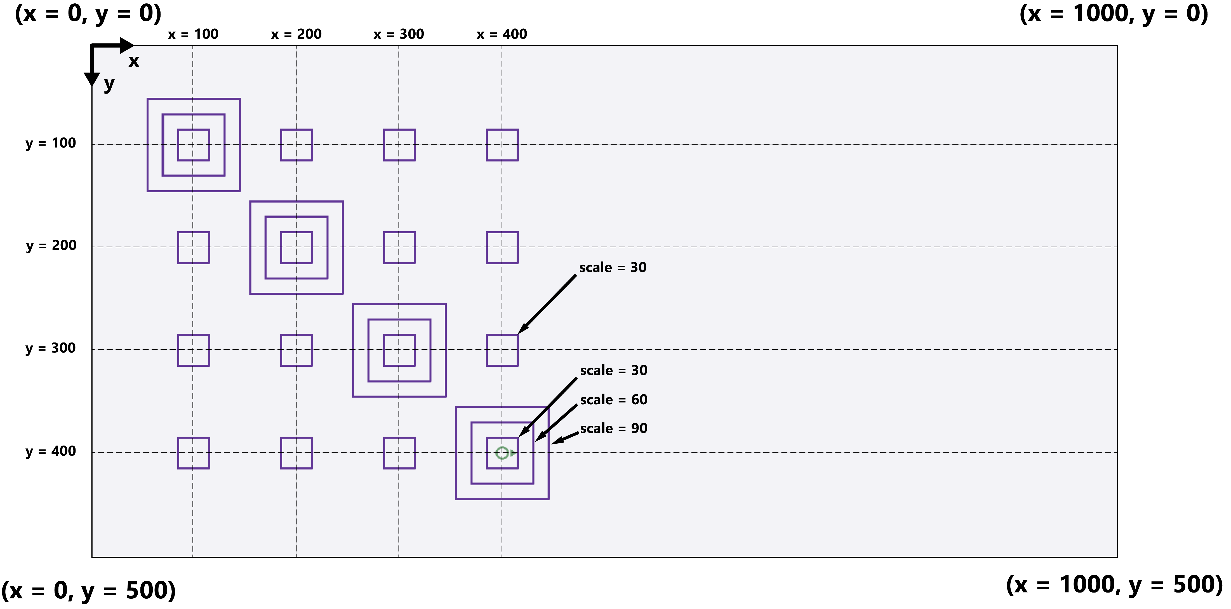
Breakout Session 4
Use Turtle and nested for loops to draw the pattern below.
Open your notebook
Click Link:
9. Breakout Session 4

Slide 22
more for loops.
Week 6 | Lecture 2 (6.2)

