Slide 1
Lists: indexing and slicing.
Week 7 | Lecture 1 (7.1)

Slide 2
This Week’s Content
Lecture 7.1
Lists: indexing and slicing
Lecture 7.2
Lists: nested lists and looping
Lecture 7.3
Design Problem! Connect 4

Slide 3

Next Midterm: March 12

Slide 4
Learning objectives
What is a list
How indexing (and slicing!) works
How to modify a list
Basic built-in list functions
How to loop through a list
How to check membership

Slide 5
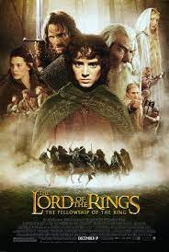
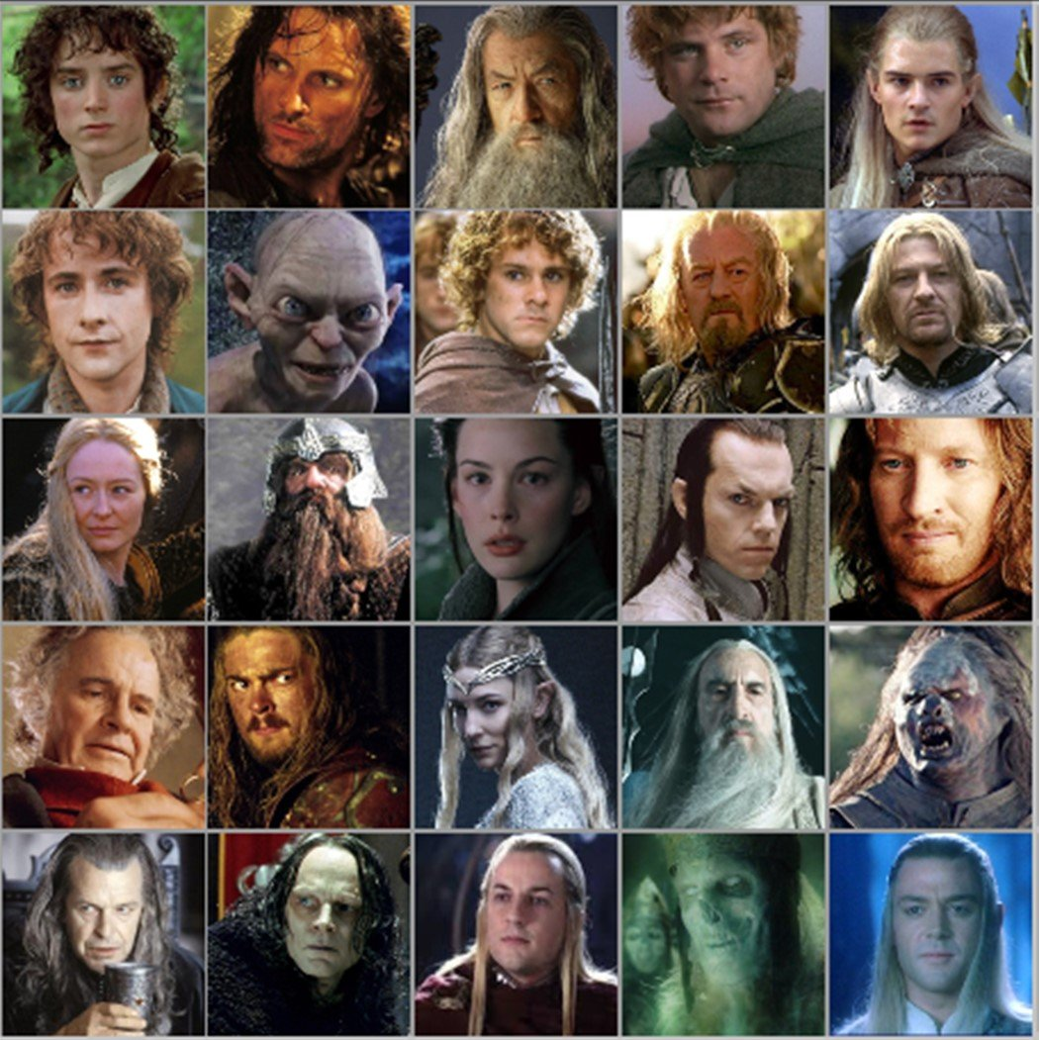


Motivation
We want to keep track of characters in a complex show/book
Name
Actor
Personality
Age
Title/Powers
We could store values in a string?
We could have unique variable names for each person?
gandalf_age = 24000
frodo = ”Frodo-Elijah Wood-brave, observant, and unfailingly polite-51-Ring bearer"
We need an efficient way to do this.

Slide 6
Motivation
We could store values in a string or other individual variables?
gandalf_name = ”Gandalf the Grey”
gandalf_age = 24000
#all other values for Gandalf in separate variables
We could have unique variable names for each person, including name, actor, personality, age and power?
frodo = ”Frodo-Elijah Wood-brave, observant, and unfailingly polite-51-Ring bearer”
#we could use frodo.split(‘-’) or frodo.find(‘-’) to split at or find the dashes
We need a more efficient way to do this

Slide 7
One way: Tables or Lists!
Name | Actor | Personality | Age | Powers
Sam
Frodo
Gandalf
Galadriel
Pippin
Aragorn
Legolas
Eowyn
Gollum
Arwen
Merry
Need to:
Create rows of data
Create columns of data
Be able to access a specific cell/index

Slide 8
Data Structures!
Data structures are “containers” that organize and group data
Built-in Python containers:
Lists
Sets
Tuples
Dictionaries
Custom containers
Custom classes/objects
Structural/abstract containers:
Linked lists
Binary trees
Stacks
Queues
Arrays
Heaps

Slide 9
Type: List
Can store an ordered collection of data using Python’s type list
The general form of a list is:
Values are enclosed in ([ ]) and separated by commas (,)
Can assign lists to a variable name:
[val1, val2, val3, …, valN]
my_list = [val1, val2, val3, …, valN]

Slide 10
List Elements
list elements can be of any type:
A list can contain elements of more than one type:
subjects = [‘bio’, ‘programming’, ‘math’, ‘history’]
grades = [75, 98, 82, 62]
street_address = [10, ‘Main Street’]
light = [‘status’, True, ‘intensity’, 3.1]

Slide 11
List Operations (Indexing and Slicing)
A list can be indexed just like a string:
A list can be sliced just like a string:
>>> grades = [80, 90, 70, 45, 98, 57]
>>> grades[1]
90
>>> grades[-3]
45
>>> grades[0:2] [80, 90]
>>> grades[::-2] [57, 45, 90]

Slide 12
Nested Lists
Lists can contain any type, including other lists!
Called “nested lists”
To access a nested item, first select the sublist, then treat as a regular list
[list1, list2, …, listN]
[val1, val2, …, valN]
>>> list_of_lists[0]
[val1, val2, …, valN]
>>> list_of_lists[0][1]
val2

Slide 13
Nested Lists Example
Let’s provide some information in our list of grades:
Now we can access different parts depending on what we want:
>>> aps106_grades = [[‘Midterm 1’, 60],[‘Midterm 2’, 90],[‘Exam’, 100]]
>>> aps106_grades = [[‘Midterm 1’, 60],
[‘Midterm 2’, 90],
[‘Exam’, 100]]
BOTH OF THESE ARE THE SAME THING!
>>> aps106_grades[0]
[‘Midterm 1’, 60]
>>> aps106_grades[2][1]
100

Slide 14
Nested Lists – like a table!
[[‘Sam’, ‘Sean Astin’, ‘Hobbit’, 33, ‘Loyalty’],
[‘Frodo’, ‘Elijah Wood’, ‘Hobbit’, 51, ‘Ring bearer’],…]
Same as:
[Sam, Frodo, …]
If:
Sam = [‘Sam’, ‘Sean Astin’, ‘Hobbit’, 33, ‘Loyalty’]
Name | Actor | People | Age | Powers
Sam | Sean Astin | Hobbit | 33 | Loyalty
Frodo | Elijah Wood | Hobbit | 51 | Ring bearer
Gandalf | Ian McKellen | Wizard | 2400 | Inspiring
Galadriel
Pippin
Aragorn
Legolas
Eowyn
Gollum
Arwen
Merry

Slide 15
Let’s Code!
Let’s take a look at how this works in Python!
Creating lists
List indexing and slicing
List operations
Nested lists!
Open your notebook
Click Link:
1. The ‘list’ Type

Slide 16
List Mutability
Lists are mutable!
This means they can be mutated (modified)
All the other types we’ve learned so far (string, int, float, and bool) are immutable (i.e. they can NOT be modified)
var1 = “Mississauga”
var1[4] = “o”
??? What will happen?

Slide 17
List Mutability Example
>>> s = “I love cats”
s[0] = “U”
Traceback (most recent call last):
builtins.TypeError: 'str' object does not support item assignment
>>> grades = [80, 90, 70, 45, 98, 57]
>>> grades[3] = 100
>>> grades[-1] = 100
>>> grades[2] = ‘Perfect’
>>> grades
[80, 90, ‘Perfect’, 100, 98, 100]
strings are immutable
lists are mutable

Slide 18
Mutability is powerful! But it can get us into trouble if we’re not careful.
>>> lst1 = [11, 12, 13, 14, 15, 16, 27]
>>> lst2 = lst1
>>> lst1[-1] = 17
>>> lst2
[11, 12, 13, 14, 15, 16, 17]
>>> id(lst1)
49012568
>>> id(lst2)
49012568
Say we want to copy a string

Slide 19
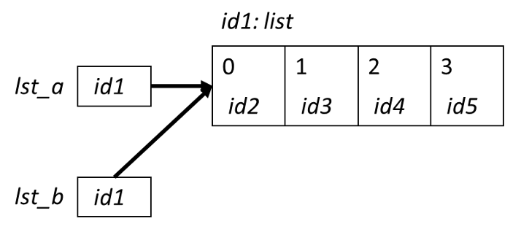


This is called aliasing
When two variable names refer to the same object, they are aliases.
When we modify one variable, we are modifying the object it refers to, hence also modifying the second variable.
This is common source of error when working with list objects.

Slide 20
Aliasing Example (with Visualizer)
Permalink:
https://tinyurl.com/aps106alias

Slide 21
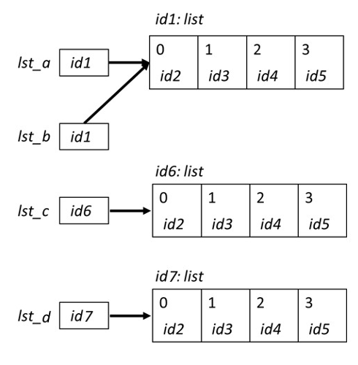
Copying Lists and Avoiding Aliasing
There are two simple ways to copy lists:
Using the list( ) function
Completely slice the list [:]
>>> lst_a = [0, 1, 2, 3]
>>> lst_b = lst_a
>>> lst_c = list(lst_a)
>>> lst_d = lst_a[:]
>>> id(lst_a)
39012510
>>> id(lst_b)
39012510
>>> id(lst_c)
54514112
>>> id(lst_d)
24514139

Slide 22
Avoiding Aliasing Example (with Visualizer)
Permalink:
https://tinyurl.com/aps106alias2

Slide 23
Let’s Code!
Let’s take a look at how this works in Python!
List mutability
Aliasing
Copying lists
Open your notebook
Click Link:
2. Mutability and Aliasing

Slide 24
Built-in Functions
Several of Python's built-in functions can be applied to lists, including:
len(list) : return the number of elements in list (i.e. the length)
min(list) : return the value of the smallest element in list.
max(list) : return the value of the largest element in list.
sum(list) : return the sum of elements of list (list items must be numeric).

Slide 25
List Methods
Lists are objects and just like other objects, the list type has associated methods that are only valid for lists
Recall you can find out which methods are associated with objects using the built-in function dir
>>> dir(list)
['__add__', '__class__', '__class_getitem__', '__contains__', '__delattr__', '__delitem__', '__dir__', '__doc__', '__eq__', '__format__', '__ge__', '__getattribute__', '__getitem__', '__gt__', '__hash__', '__iadd__', '__imul__', '__init__', '__init_subclass__', '__iter__', '__le__', '__len__', '__lt__', '__mul__', '__ne__', '__new__', '__reduce__', '__reduce_ex__', '__repr__', '__reversed__', '__rmul__', '__setattr__', '__setitem__', '__sizeof__', '__str__', '__subclasshook__', 'append', 'clear', 'copy', 'count', 'extend', 'index', 'insert', 'pop', 'remove', 'reverse', 'sort']

Slide 26
Adding Items to a List
To add an object to the end of a list, use the list method append:
To add a list to the end of a list, use the list method extend:
>>> colours = ['blue', 'yellow’] >>> colours.append('brown’) >>> colours ['blue', 'yellow', 'brown']
>>> colours = ['blue', 'yellow’] >>> colours.extend([‘pink’,‘green’]) >>> colours ['blue', 'yellow', ‘pink’, ‘green’]

Slide 27
Removing Items from a List
To remove an object from a list, use the list method remove:
How can we write it so there’s no error?
>>> colours = ['blue', 'yellow’, ‘pink’] >>> colours.remove(‘yellow’) >>> colours ['blue', ‘pink’]
>>> colours.remove(‘red’)
Traceback (most recent call last):
builtins.ValueError: list.remove(x): x not in list

Slide 28
Is something in my list?
The in operator can be used on lists too!
colours = ['blue', 'yellow’, ‘pink’]
if ‘red’ in colours:
colours.remove(‘red’)

Slide 29
Let’s Code!
Let’s take a look at how this works in Python!
Open your notebook
Click Link:
3. List Methods

Slide 30
Lists: indexing and slicing.
Week 7 | Lecture 1 (7.1)

