Slide 1
Cryptography
Design Problem 4

Slide 2

Agenda
Problem Background
Learning Objectives
Coding

Slide 3
Cryptanalysis was a defining factor in WWII.
Cryptography is the study of how to communicate securely, especially when there are potential adversaries.

Slide 4
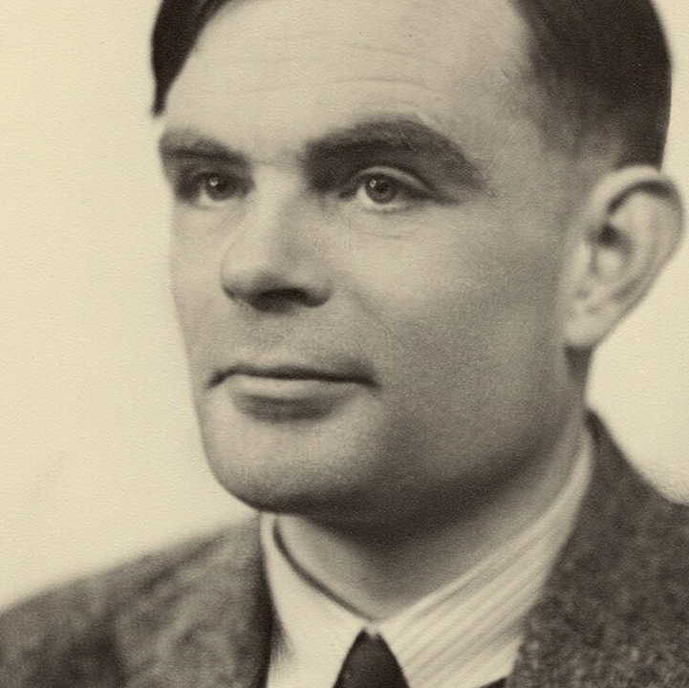
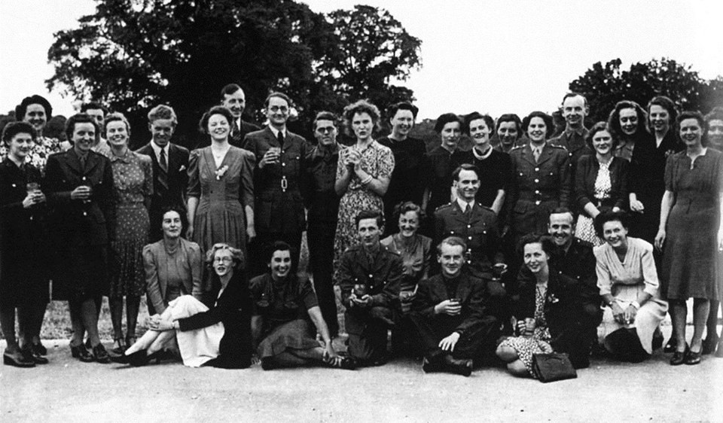
History + Technology
Alan Turing
Pioneered the technology to decrypt Nazi Germany's secret communications during World War II.
These were called “Turing machines”.
Alan Turing circa 1951
Workers of Bletchley Park circa 1938

Slide 5

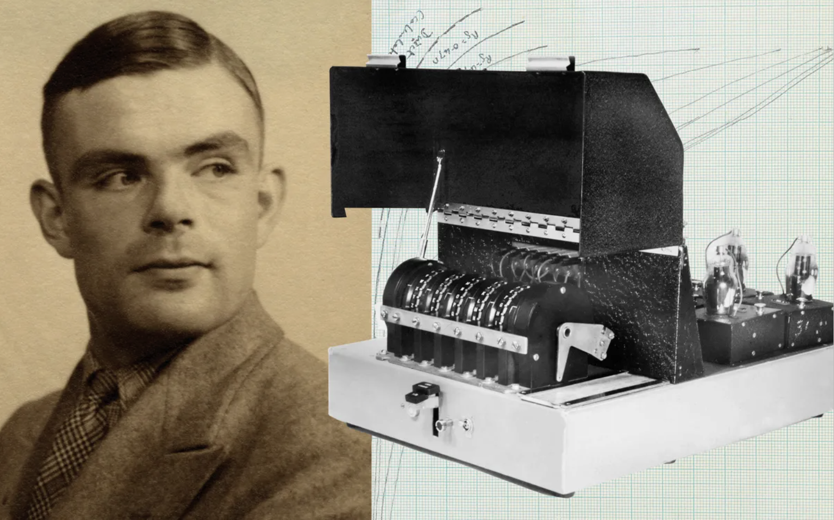

Slide 6

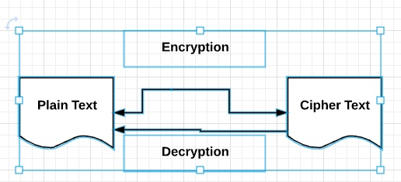

Background
Will rely on user input, functions, for loops, conditional statements, ASCII codes, string methods, and comparison operators to create our own cryptography code!
Goal: Write a Python program that enables us to encrypt a message that can only be read by someone with the secret key.

Slide 7
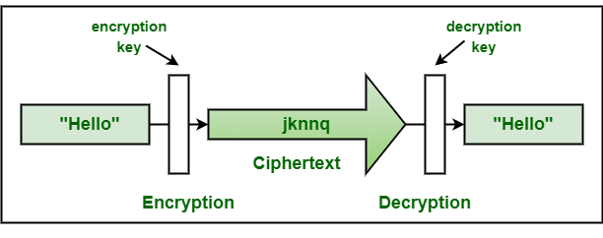
Learning Objective
Practice combining all topics covered so far with an out-of-box application.

Slide 8
Engineering Design Process
Define the problem properly.
Define test cases.
Develop an algorithm plan (i.e., a workflow!).
Program the solution and debugging.

Slide 9
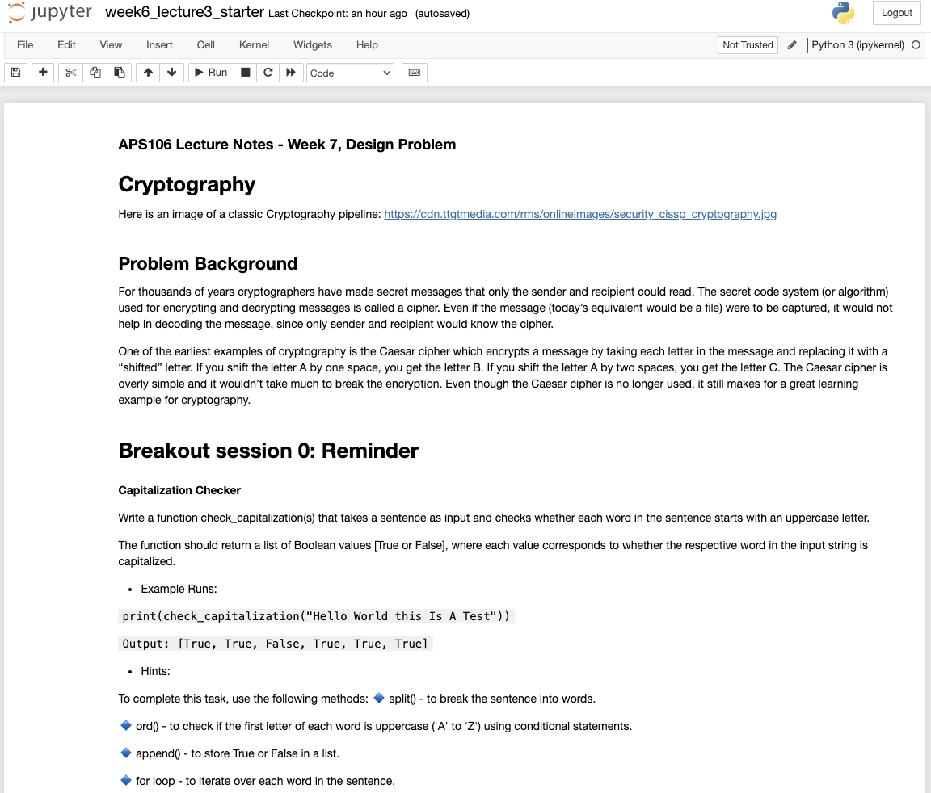
Cryptography
Design Problem 4

