Slide 1
Tutorial 0 - Week 1
We’ll be starting at the 10 minute mark

Slide 2
Agenda
TA Introductions
Logistics
Install Anaconda Navigator
Set up a Folder Structure for APS106
VSCode/Jupyter Notebook
UofT JupyterHub
Questions?

Slide 3

Introduction - TA
Amirhossein Babaei Ravandi
(TUT06, TUT09)
Current studies: Postdoctoral Fellow
Research/other interests: Agentic AI - Data Management / Violin, Camping

Slide 4
Tutorial Logistics
Tutorials are for your benefit - no grading
We will review previous weeks labs & lecture content
From Week 2, we will focus on coding problems!
Be sure to ask lots of questions and have Python open.
We are here to help you!
Questions outside of tutorial time?
Post to Piazza - all TAs/instructors and your peers can answer questions quickly
Coffee Time – drop-in hours for 1on1 help

Slide 5

Online Tutorials/Office Hours Survey
URL - https://forms.gle/s8VTXuMrVezatbQU7

Slide 6

What is one boring task in your life you wish a robot could do for you?

Slide 7



Do not edit
How to change the design
What is one boring task in your life you wish a robot could do for you?
Presenting with animations, GIFs or speaker notes? Enable our Chrome extension
Notes:
📣 This is Slido interaction slide, please don't delete it. ✅ Click on 'Present with Slido' and the poll will launch automatically when you get to this slide.

Slide 8



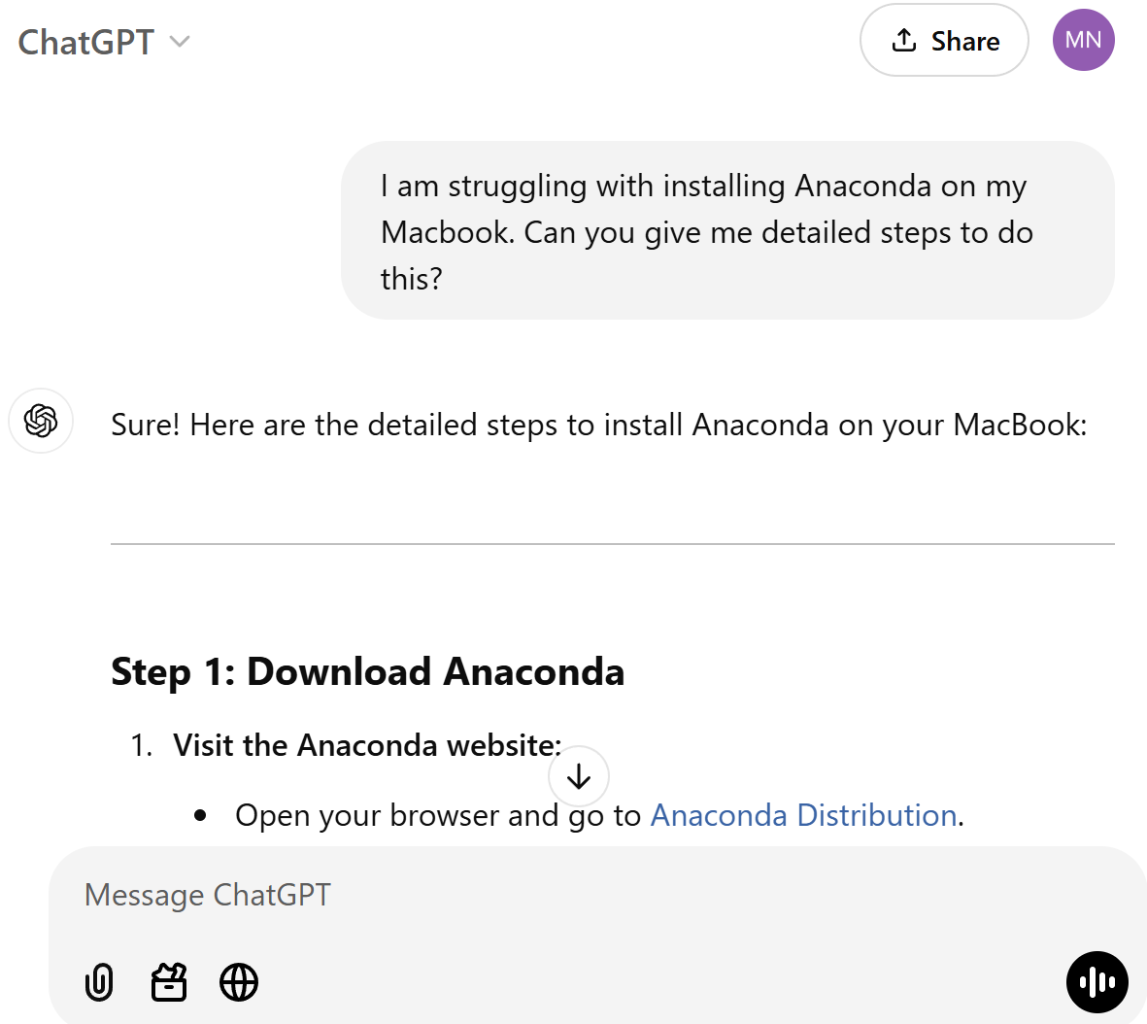

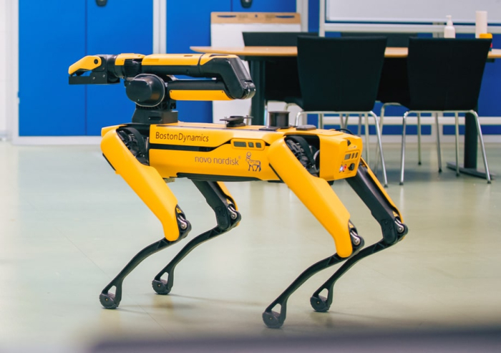
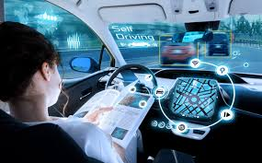
Why code?¹
Programming is awesome!
Computers are everywhere, programming is a boundless opportunity
Software engineering can be applied to almost any context in the world
Source: © Townshend et al, 2021 Science
Notes:
Chat GPT
AlphaGo
Boston Dynamics
Super Mario (video games/ 3D CG)
Autonomous driving
Ex Machina (movie about human-level conversational AI)
RNA structure prediction https://www.science.org/doi/10.1126/science.abe5650 (application to molecular biology)

Slide 9
Why code?²
Regardless of background, coding is always an achievable skill
Software engineering can be applied to almost any context in the world
NEVER THINK THAT YOU “CAN'T UNDERSTAND” CODING
Source: © Townshend et al, 2021 Science

Slide 10


Why code?¹
"Coding is the closest thing we have to a superpower!" - Drew Houston, Dropbox Co-founder
Coding empowers you to solve real-world problems creatively.
Code is the driving force behind technological innovations.
Coding opens doors to a plethora of career opportunities.
Every line of code is a step towards building solutions that make a difference.
Images Created by DALL-E, an AI Image Generation Model developed by OpenAI

Slide 11



Why code?²
Real-World Examples
Ever wondered how Netflix suggests movies you might like?
Coding and algorithms enable early disease detection, enhance diagnostic accuracy, and save lives.
Virtual Reality (VR) and Augmented Reality (AR) experiences are crafted through intricate code, with gaming, simulation, and immersive experiences depending on the skills of programmers.
AI-generated (DALL-E)
Source
Source

Slide 12
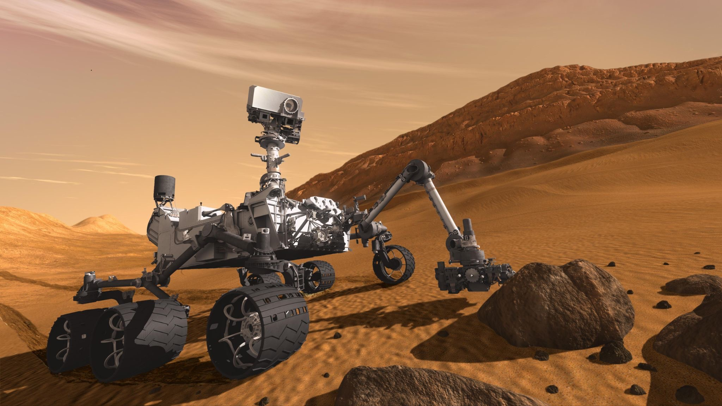
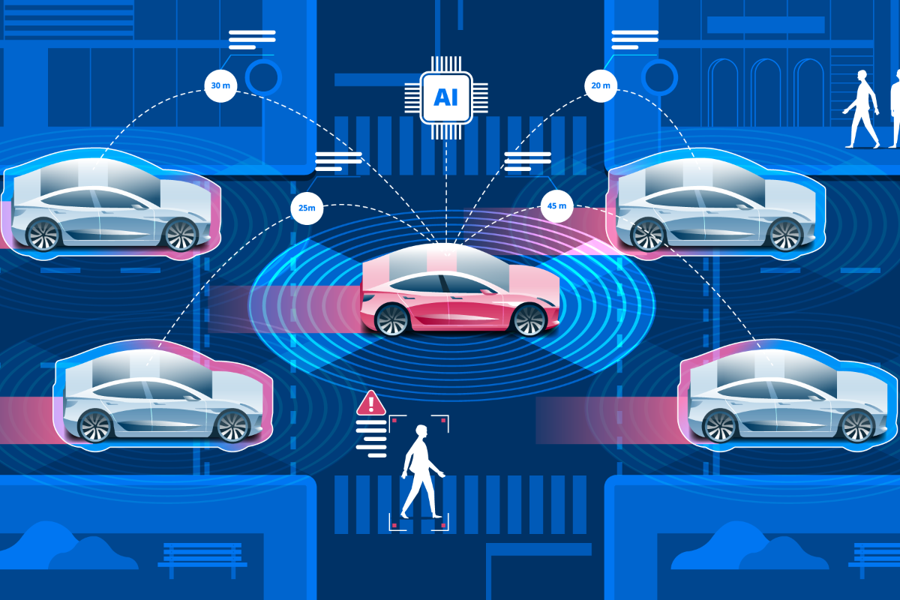
Why code?²
Space agencies, such as NASA, heavily depend on coding for space exploration missions (spacecraft navigation, data analysis, etc.).
Autonomous vehicles use image recognition for safe navigation, as cameras capture real-time surroundings and algorithms identify objects, pedestrians, and other vehicles on the road.
Regardless of background, coding is always an achievable skill
NEVER THINK THAT YOU “CAN'T UNDERSTAND” CODING
"Programming isn't about what you know; it's about what you can figure out." - Chris Pine, Learn to Program
Source
Source

Slide 13
What would you want to ideally learn how to do with computers?

Slide 14


What would you want to ideally learn how to do with computers?
ⓘ
Click Present with Slido or install our Chrome extension to activate this poll while presenting.
Notes:
📣 This is Slido interaction slide, please don't delete it. ✅ Click on 'Present with Slido' and the poll will launch automatically when you get to this slide.

Slide 15
Coding experience?

Slide 16

Coding experience?
ⓘ
Click Present with Slido or install our Chrome extension to activate this poll while presenting.
Notes:
📣 This is Slido interaction slide, please don't delete it. ✅ Click on 'Present with Slido' and the poll will launch automatically when you get to this slide.

Slide 17
Install VS Code

Slide 18
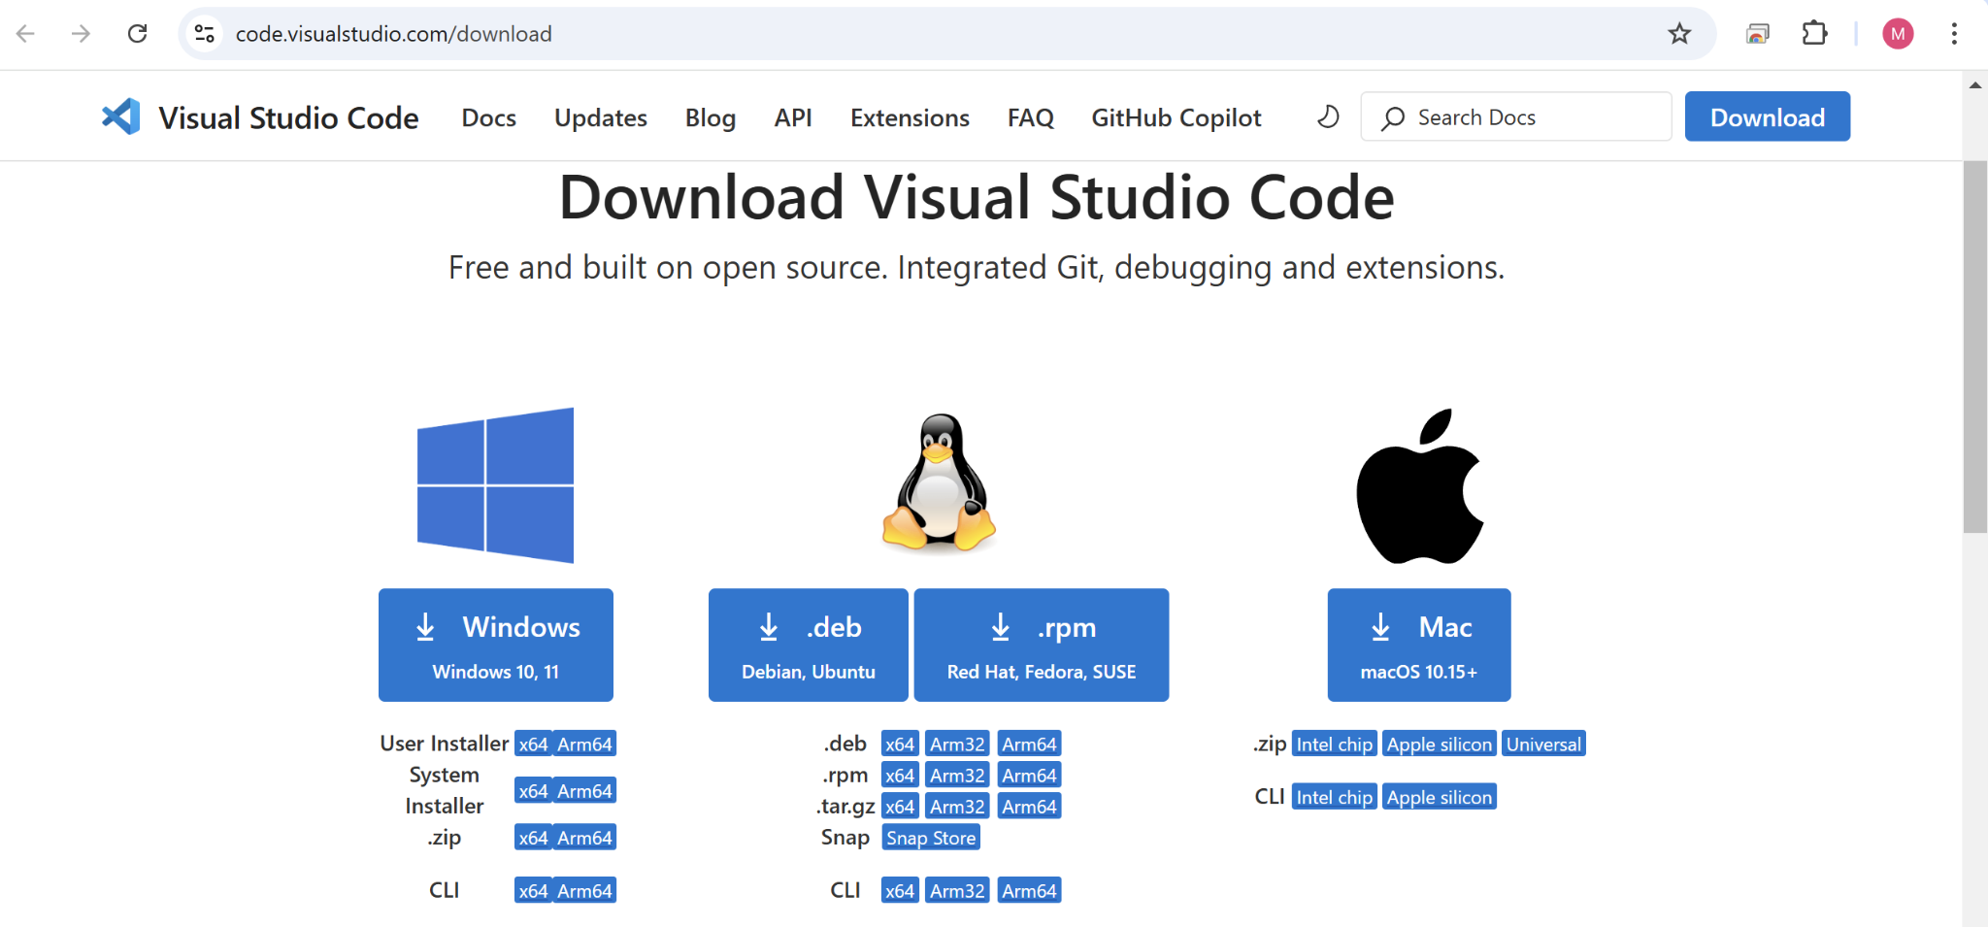
Install VS Code¹
You can install VS Code from the following link:
https://code.visualstudio.com/download

Slide 19
Install VS Code² (Windows)
Open the .exe file and install VS Code
Important: Accept all default settings.
Install VS Code² (MacOS)
If archive, extract the archive contents (e.g., VSCode-darwin-universal.zip).
Drag Visual Studio Code.app to the Applications folder

Slide 20
Install VS Code² (MacOS)
If archive, extract the archive contents (e.g., VSCode-darwin-universal.zip).
Drag Visual Studio Code.app to the Applications folder

Slide 21
Install Anaconda Navigator

Slide 22

Anaconda
Anaconda is a distribution of Python that includes tools and packages geared towards scientific computing (such as data science and machine learning)
Anaconda Navigator is the graphical user interface (GUI) allowing users to install and manage their programming environment without command line (terminal) prompts

Slide 23
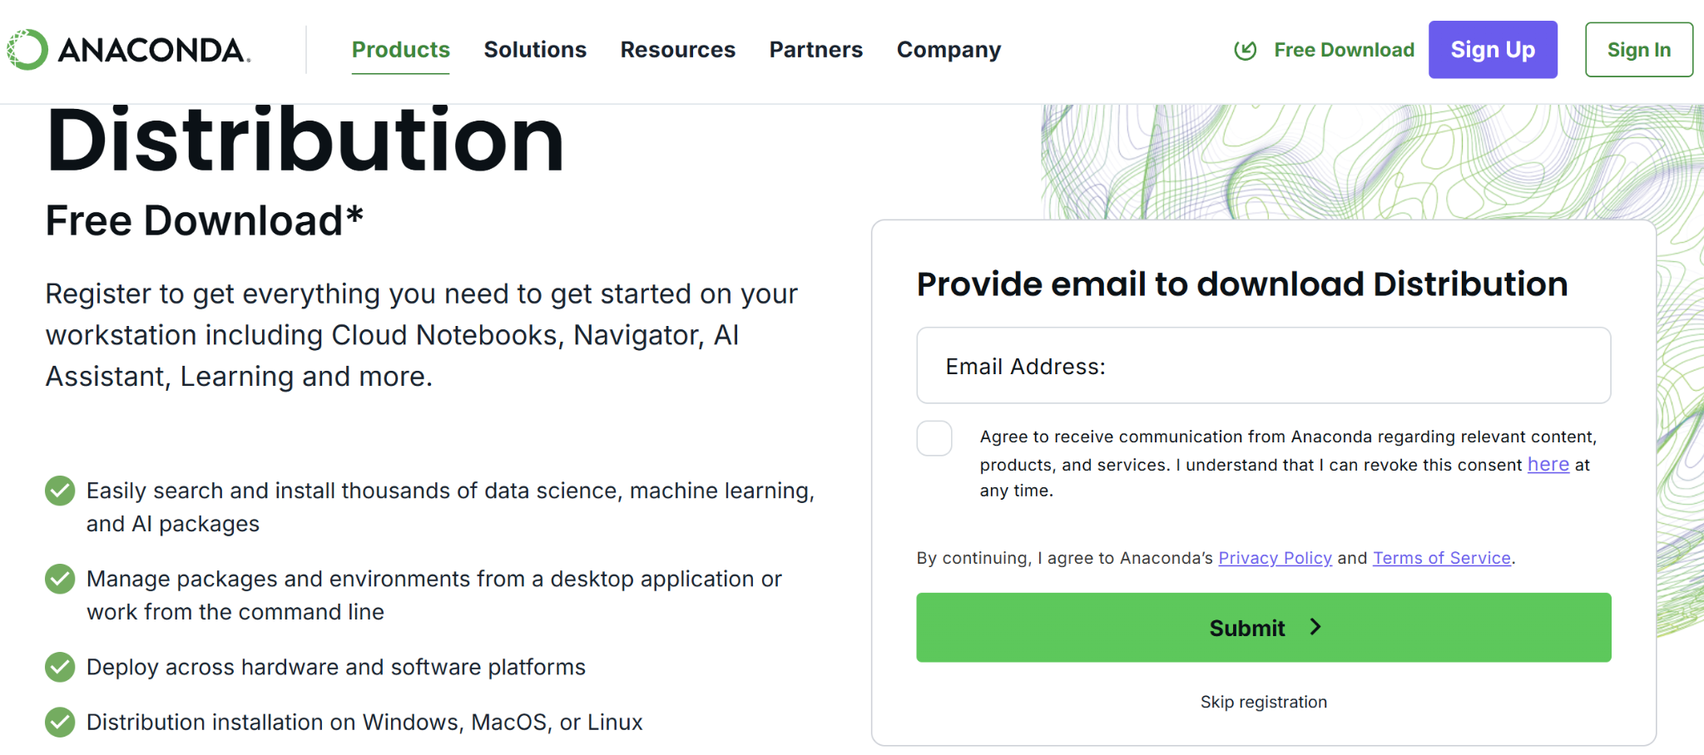
Install Anaconda
You can install Anaconda from the following link:
https://www.anaconda.com/download

Slide 24

Install Anaconda
You can install Anaconda from the following link:
https://www.anaconda.com/download

Slide 25
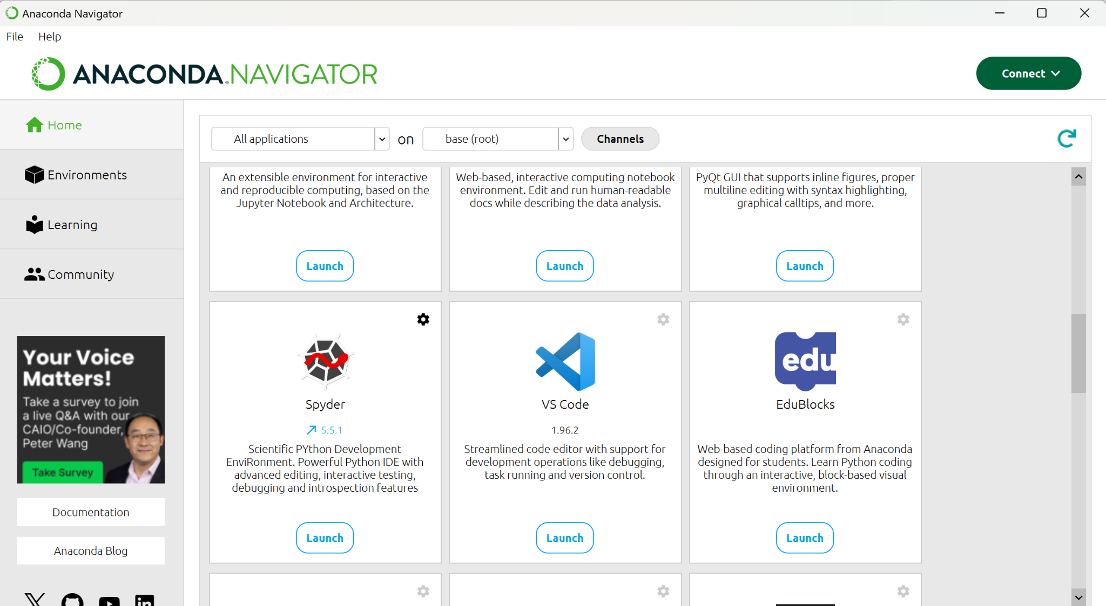
Anaconda Navigator
We will be mainly using “VS Code” in this course. Let’s click on “Launch”!

Slide 26
Set up a Folder Structure for APS106

Slide 27
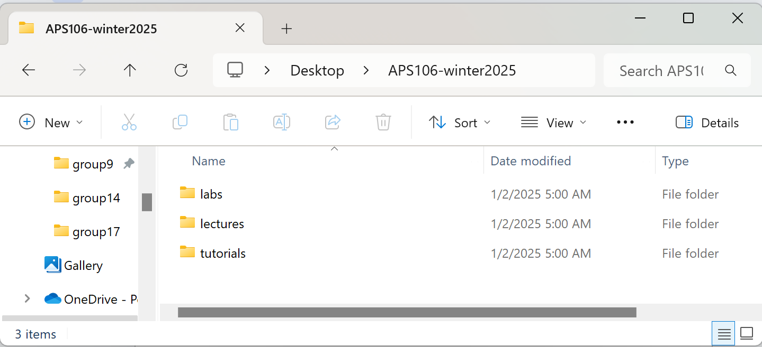
Stay Organized, Stay Efficient
It's not a good idea to store all your files in the Downloads folder!
Let's create a folder for APS106 (e.g., on Desktop) and organize your files there
lab1, lab2, …
tutorial0, tutorial1, …

Slide 28
Let’s download files from Quercus!
Go to Quercus -> Modules -> Tutorial Homepage
Click on Tutorial 0 - Setting Up A Development Environment in week1
Download “tutorial0.zip”
Unzip the zip file and move it in your folder for APS106

Slide 29
VSCode/Jupyter Notebook

Slide 30
VSCode is an IDE
Integrated Development Environments (IDEs) are programs that provides tools and features to programmers in a unified environment. Think of them as "smart" text editors specifically designed for writing code
IDEs often include:
A code editor
A place to type and edit code, usually with colour-coded syntax highlighting to improve readability
Code compilers or interpreters
Turns the readable Python code into something the machine can understand
Debuggers
Pause the code at pre-determined locations and go line-by-line through your code
So IDEs basically contain everything you need to code!

Slide 31
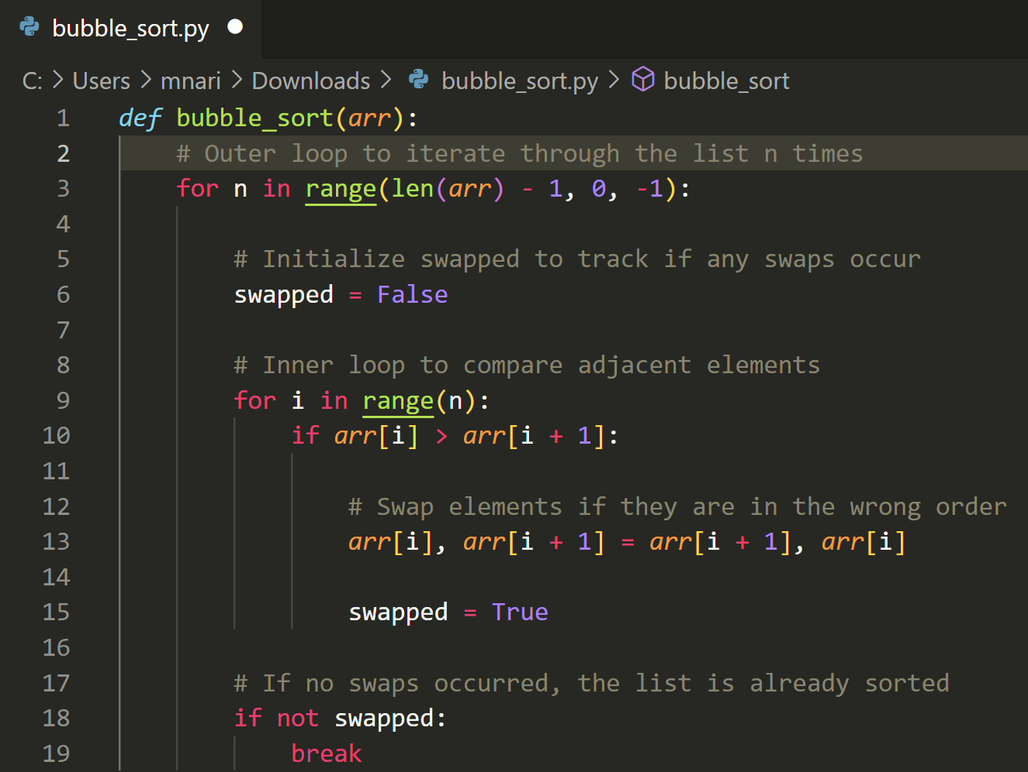
VSCode is an IDE
Integrated Development Environments (IDEs) are programs that provides tools and features to programmers in a unified environment
IDEs often include:
A code editor
A place to type and edit code, usually with colour-coded syntax highlighting to improve readability
Source

Slide 32
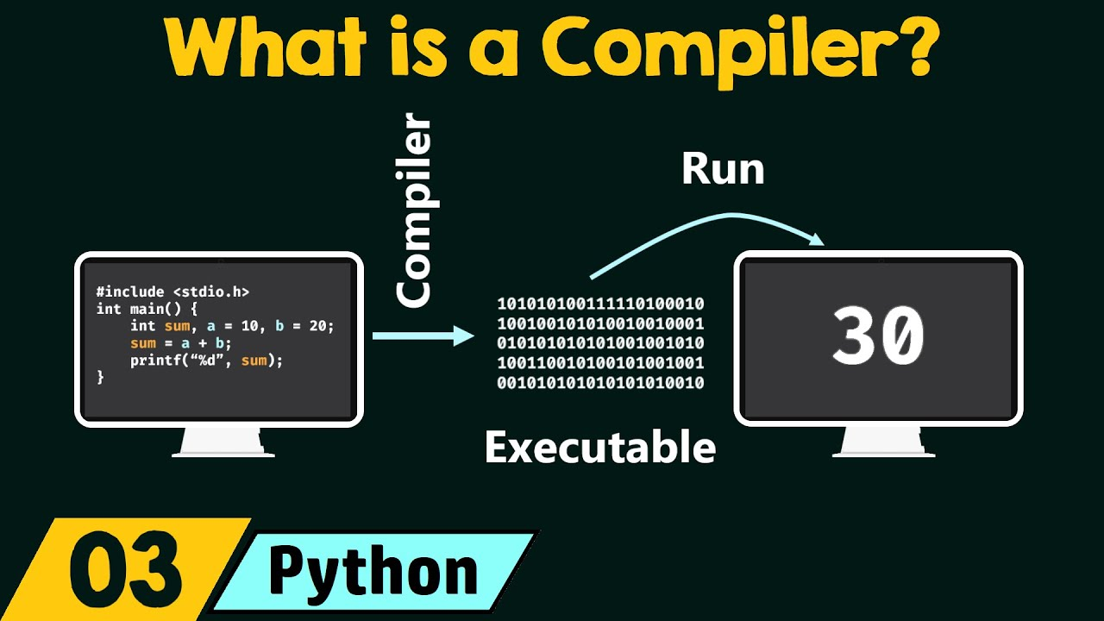
VSCode is an IDE
Integrated Development Environments (IDEs) are programs that provides tools and features to programmers in a unified environment
IDEs often include:
Code compilers or interpreters
Turns the readable Python code into something the machine can understand
Source

Slide 33
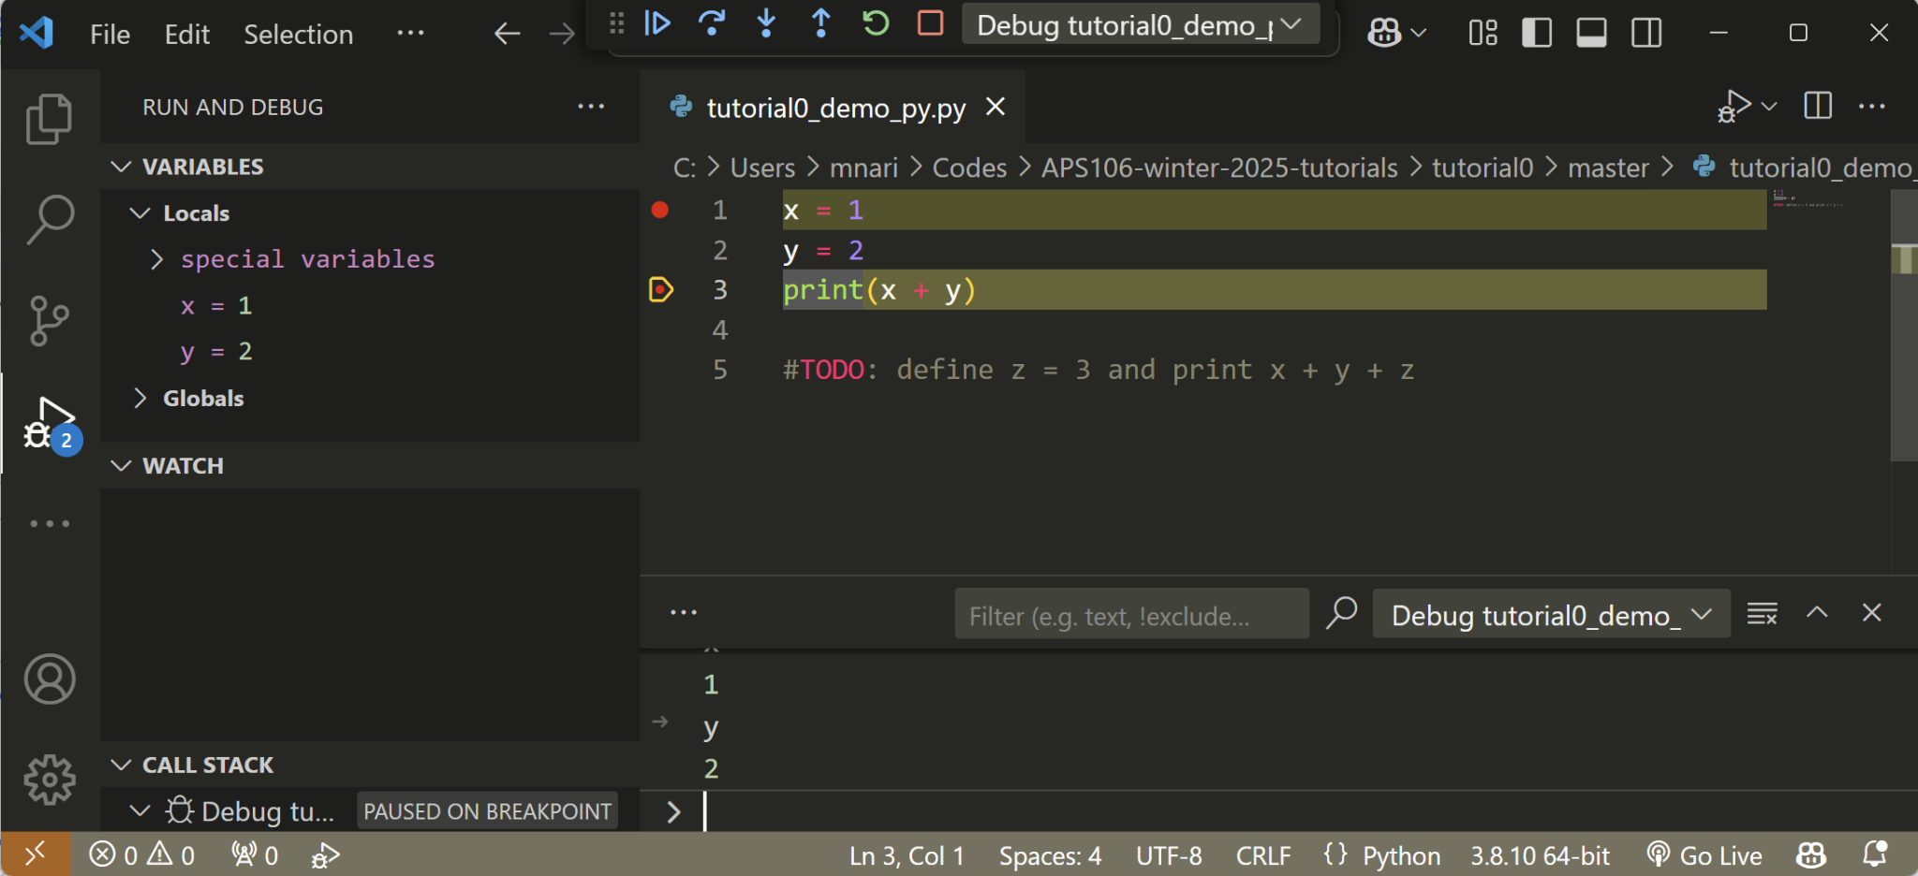
VSCode is an IDE
Integrated Development Environments (IDEs) are programs that provides tools and features to programmers in a unified environment
IDEs often include:
Debuggers
Pause the code at pre-determined locations and go line-by-line through your code
Continue, step over, step in/out, restart, stop
Run and Debug
Debug console
Source

Slide 34
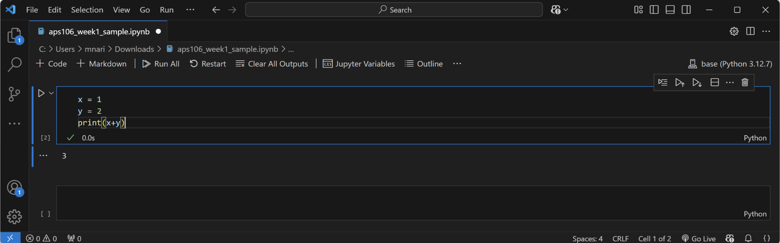
VS Code (Jupyter Notebook)
Filename
Open/Save files
File path
Code cells

Slide 35
VS Code (Jupyter Notebook)
(drag&drop or Alt + ↑ /Alt + ↓ )
Move up/down the cell
Create a new cell under the current one
Execute this cell (or Shift + Enter)
Cell
Delete the cell
Cell output

Slide 36
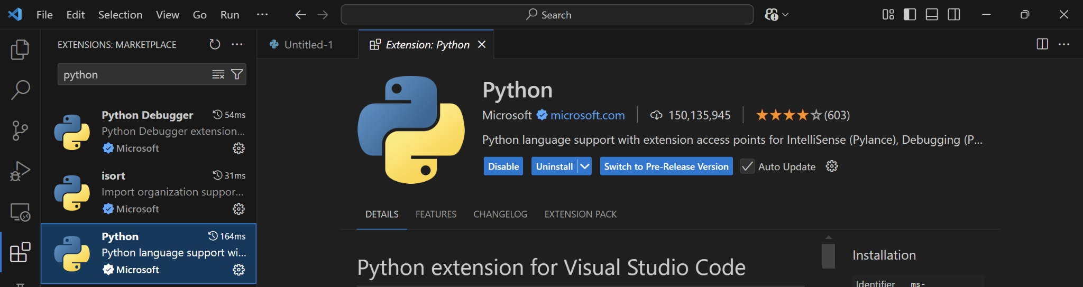
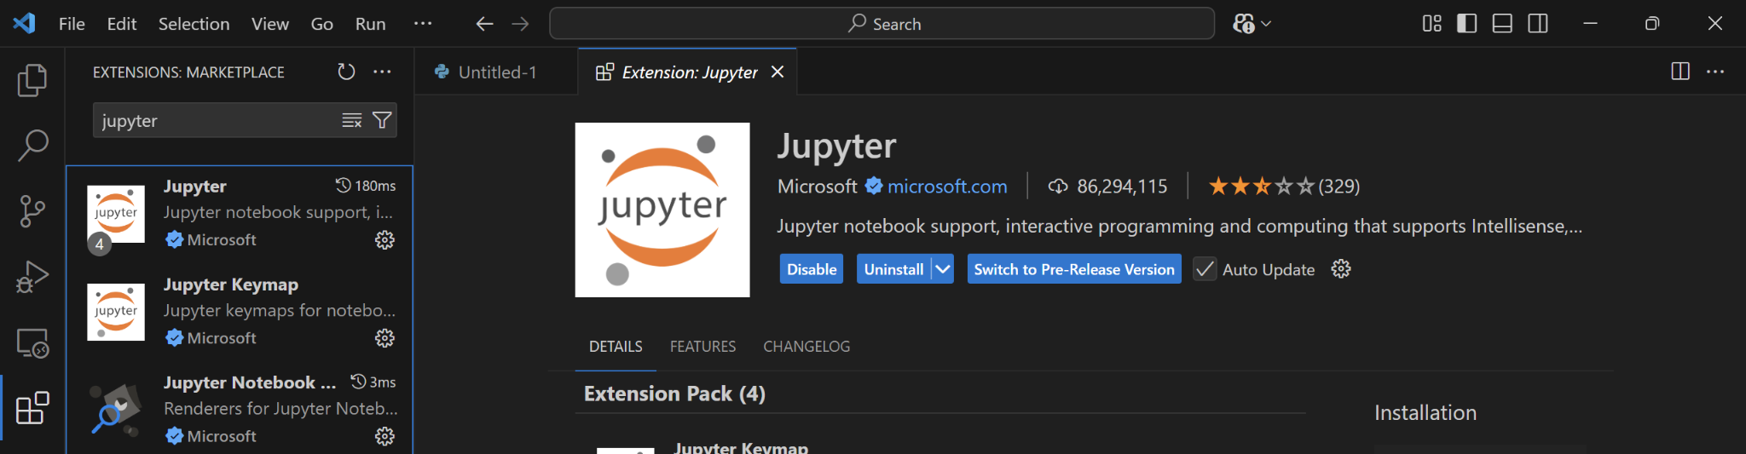
VS Code (Jupyter Notebook)
Make sure you have “Python” and “Jupyter” extensions installed!

Slide 37
Let’s practice!¹
Let’s open tutorial0_demo_jupyter.ipynb, write our first program, and save it!
Steps:
Launch VS Code through Anaconda Navigator
File -> Open File -> Go to the APS106 folder and select tutorial0_demo_jupyter.ipynb
In the first code cell, write
print("Hello World!")
Execute the cell (if asked, select “base (Python 3.12.7)”)
File -> Save as -> save it as “tutorial0_demo_jupyter.ipynb”

Slide 38
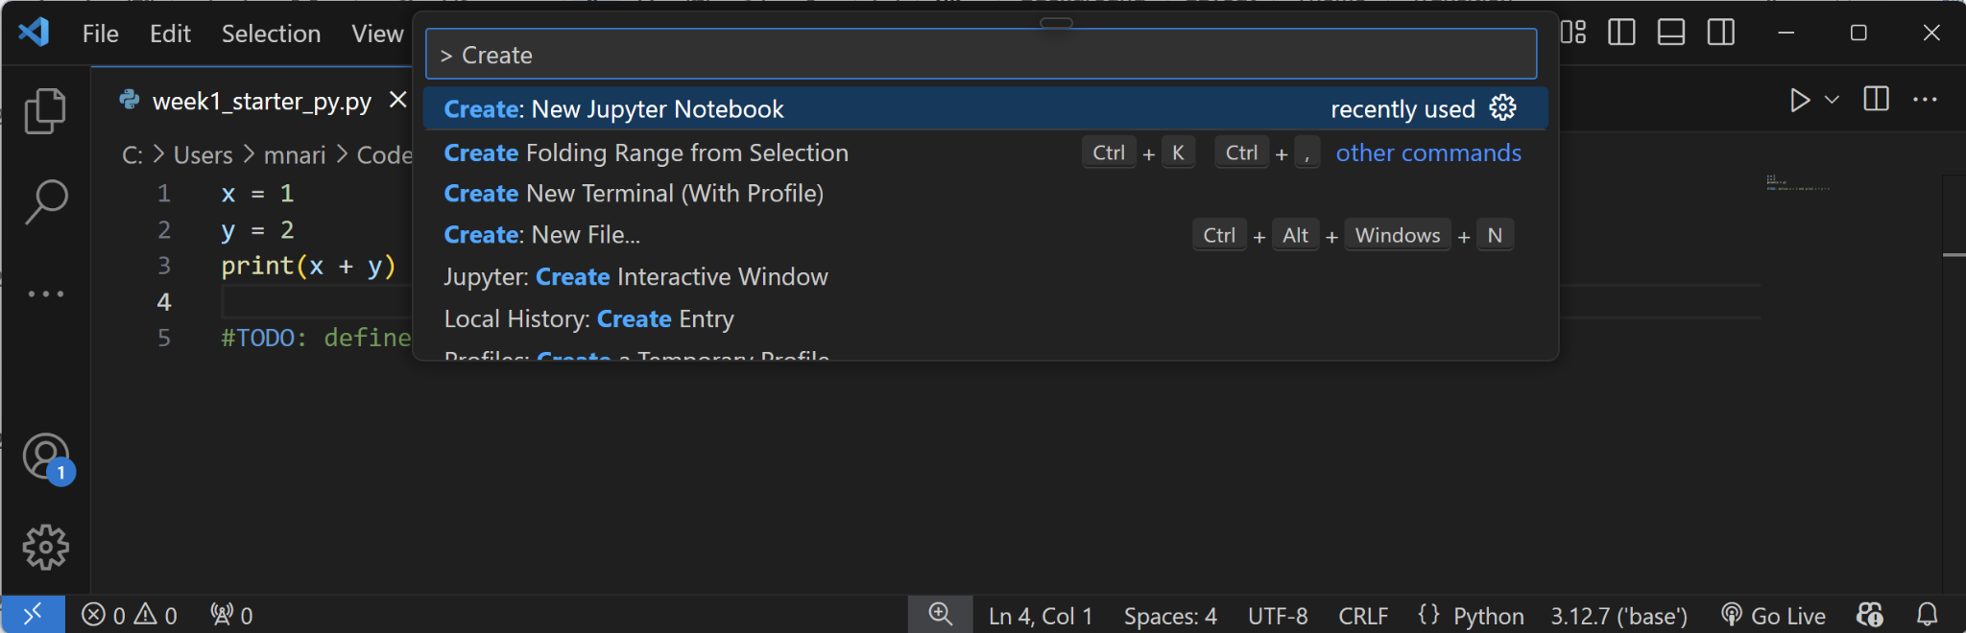
Create a new Jupyter Notebook
You can create a new notebook on VS Code too!
Steps:
Launch VS Code through Anaconda Navigator
In the command palette (“Search” on top), type in “> create new jupyter notebook” and select “Create: New Jupyter Notebook”

Slide 39
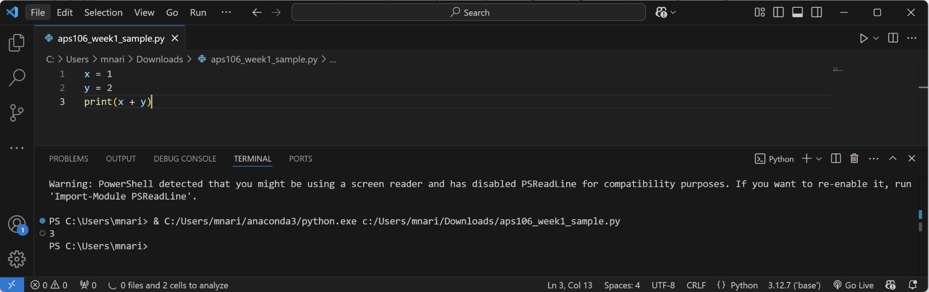
VS Code (Python script)
Execute the Python script
When you open a .py file, an editor with a different layout appears
Editor Pane
Terminal

Slide 40
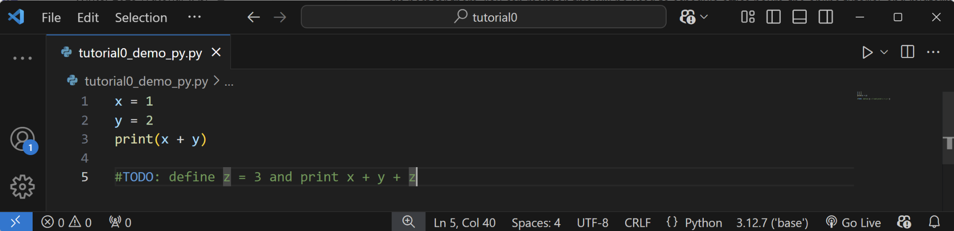
Let’s practice!²
Let’s open tutorial0_demo_py.py in VS Code, modify the code based on the instruction, and run it!

Slide 41
We'll switch from .ipynb to .py files later
Jupyter Notebooks (.ipynb) are interactive and beginner-friendly
Python scripts (.py) are the standard format for Python programs and are suited for building and running larger projects
We’ll switch to .py files in lab5!

Slide 42
UofT JupyterHub

Slide 43
What is UofT JupyterHub?
Access at https://jupyter.utoronto.ca/
Cloud-based Jupyter Notebook service that allows us to run Jupyter Notebooks (.ipynb files) directly from a web browser
Don’t need to install anything
Linked to your UofT account, all lecture notes are stored as a copy in JupyterHub!
Notes:
UofT JupyterHub is a cloud-based Jupyter Notebook service provided by the University of Toronto. It allows students, faculty, and researchers to run Python and other programming environments directly from a web browser without needing to install anything on their local machines.

Slide 44
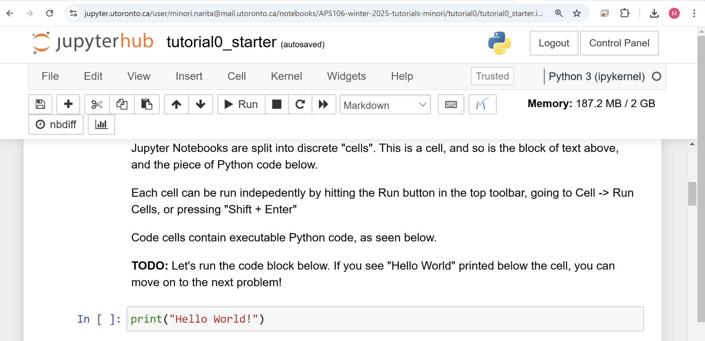
Let’s try UofT JupyterHub!
Go to Tutorial Homepage in APS106 Modules on Quercus
Click on Tutorial 0 - Setting Up A Development Environment in week1
-> Click on JupyterHub Starter Link

Slide 45
Troubleshooting
Reference: If VS Code does not appear in Anaconda.

Slide 46
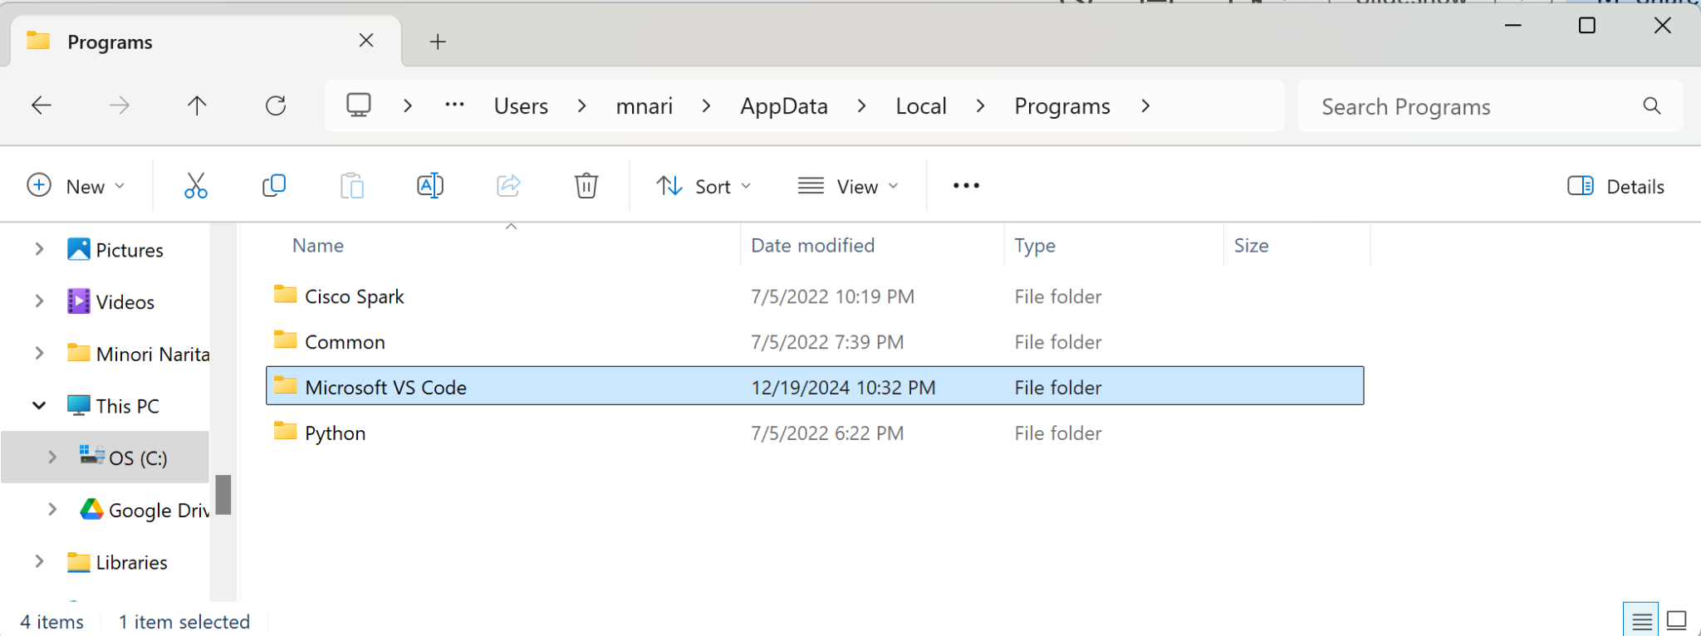
Install VS Code² (Windows)
Open the .exe file (e.g., VSCodeUserSetup-x64-1.96.2.exe) and install VS Code
Go to Anaconda-Navigator → File → Preferences → Configure Navigator → Change the following lines of code
[home]
vscode_enable = True
[applications]
vscode_path = C:\Users\{USERNAME}\AppData\Local\Programs\Microsoft VS Code
Restart Anaconda Navigator
(If you don’t see AppData, click on View -> Show -> Hidden items)

Slide 47
Install VS Code² (Windows)
Open the .exe file (e.g., VSCodeUserSetup-x64-1.96.2.exe) and install VS Code
Go to Anaconda-Navigator → File → Preferences → Configure Navigator → Change the following lines of code
[home]
vscode_enable = True
[applications]
vscode_path = C:\Users\{USERNAME}\AppData\Local\Programs\Microsoft VS Code
Restart Anaconda Navigator
Microsoft VS Code might be under C:\Program Files (x86) - if so, vscode_path should be
C:\Program Files (x86)\Microsoft VS Code
instead
(If you don’t see AppData, click on View -> Show -> Hidden items)

Slide 48
Install VS Code² (MacOS)
If archive, extract the archive contents (e.g., VSCode-darwin-universal.zip).
Drag Visual Studio Code.app to the Applications folder
Double click the VS Code icon from the Applications folder
Open Anaconda Navigator and see if you can find VS Code in Home. If not:
Open Terminal (from Finder, open the Applications/Utilities folder and double-click Terminal) and type in the following command and press Enter:
conda config --set vscode /usr/local/bin/code

