Slide 1
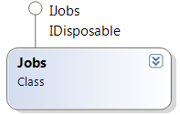


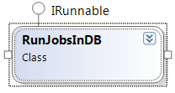
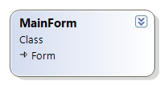
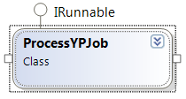

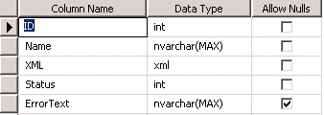

APSIM.Cloud.Service
Web service for adding, removing, cloud jobs
APSIM.Cloud.Runner.exe
Looks at jobs database and runs all jobs it finds.
Checks the DB looking for
YP jobs.
Creates a main form
Creates an instance
of JobManager and then
Adds a new job
‘RunJobsInDB’
Creates a new ProcessYPJob for each YP report
APSIM.Cloud.WebPortal
Provides a web interface for exploring cloud jobs
Log Table:
Contains a log of all errors.
Jobs Table:
Contains all jobs.
APSIM.Cloud.Shared.dll
APSIMSpec: Specification for an APSIM simulation.
YieldProphetSpec: Specification for a YP simulation(s).
YieldProphetOld: Converts old YP XML to job specification.
YieldProphetUtility: Variables utility functions.

