Slide 1
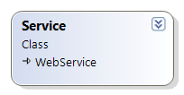



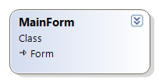


APSIM.Cloud.WebService
Web service for adding, removing, exploring cloud jobs
APSIM.Cloud.JobRunner.exe
Looks at jobs database and runs all jobs it finds.
Checks the DB looking for
YP jobs.
Uses APSIM.Cloud.Services.JobsDB
Creates a main form
APSIM.Cloud.WebPortal
Provides a web interface for exploring cloud jobs
Creates an instance
of JobManager and then
Adds a new job
‘CheckDBForJobs’
Creates a new RunAPSIMJob
for each YP report
APSIM.Cloud.Services.exe
JobsDB: Methods for reading / writing jobs database.
SimulationSpec: Specification for an APSIM simulation.
YPXMLToJobSpec: Converts old YP XML to job specification.
CreateAPSIMFilesFromJobSpec: Creates APSIM files from a job spec.
Jobs Database:
The database containing all jobs.
Fields: [ID, Name, XML, Status, URL]

