Slide 1

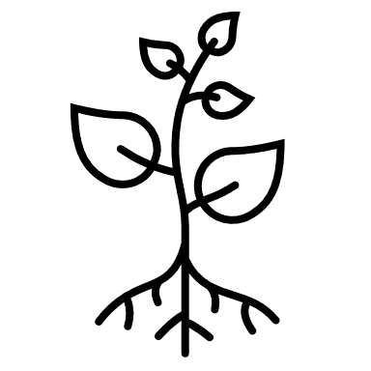

1.2 m
node in the numerical simulation
crop/vegetation
phantom node (not visible to users)
surface residues
soil in multiple layers of varying properties
soil not modelled
20 m - constant temperature

Slide 2
1.2 m
node in the numerical simulation
crop/vegetation
phantom node (not visible to users)
surface residues
soil in multiple layers of varying properties
soil not formally modelled
20 m - constant temperature

