Slide 1
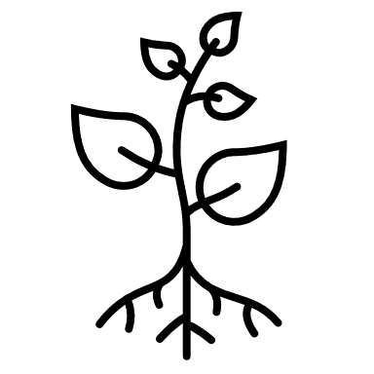

height of meteorological instruments (usually 1.2 m)
air temperature
boundary-layer conductance
crop/vegetation
surface residues
soil surface, 0 m
soil heat storage
soil in multiple layers of varying properties
soil thermal conductance
node in the numerical simulation
phantom node (not visible to users)
soil not formally modelled
constant temperature lower boundary (20 m)
annual average temperature

