Slide 1

Scenario: Kingsthorpe Soil Water Evaporation Project
Justin Fainges
APSIM Developer / Mathematician
Justin.Fainges@csiro.au
Lead Project Researchers:
Jenny Foley - Department of Natural Resources and Mines
Jeremy Whish – CSIRO

Slide 2
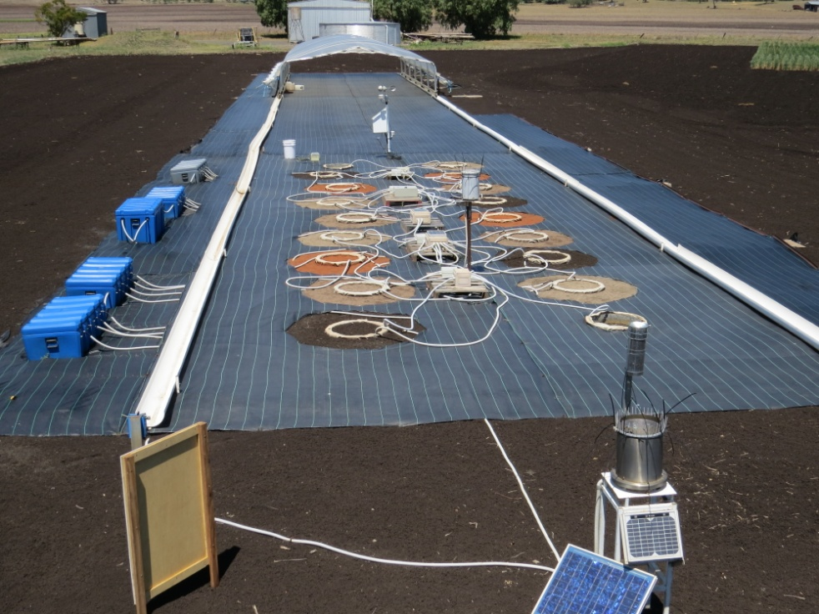
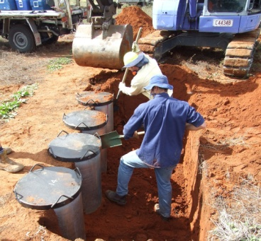
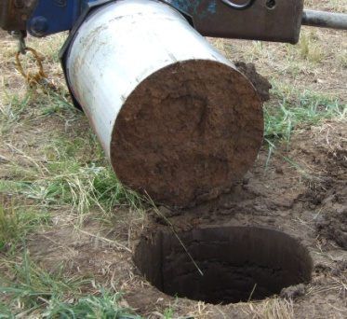
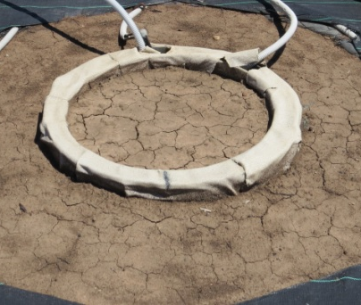
The Trial
Located at Kingsthorpe, QLD. (-27.478, 151.81)
Long term evaporation of four soils; a black vertosol, two grey vertisols and a red kandosol.
On going, started early 2010.
18 soil monolith weighing lysimeters, 0.6m diameter, 0.8m deep.

Slide 3
The Data
Weight changes are measured every 15 minutes.
15 minute data points, 4 reps per soil, 4 soils, 3 years - ~ 1.75 million data points.
Daily weights at midnight were analysed.
Weather data gathered from on site met station.
Very messy due to a number of factors (flood, equipment problems, wildlife, etc).
Looking at the Black Vertosol soil from Kingsthorpe.
The Task
For the period of April 1 to November 18 2010, use APSIM to model a number of drying curves.
Create a met file using data from an Excel spreadsheet.
Turn the observed data into APSIM format.
Create predicted vs observed plots using the model output.

Slide 4
Kingsthorpe Raw Data Sample
Date | Time | Rep1 | Rep2 | Rep3 | Rep4 | Mean
7/01/2010 | 5:00:00 PM | 304.4986 | 305.5842 | 303.281 | 312.8969 | 306.5652
7/01/2010 | 5:15:00 PM | 304.4372 | 305.5871 | 303.1087 | 312.6783 | 306.4528
7/01/2010 | 5:30:00 PM | 304.5916 | 305.7027 | 303.1523 | 312.7941 | 306.5602
7/01/2010 | 5:45:00 PM | 304.3906 | 305.5944 | 303.1726 | 312.7966 | 306.4886
7/01/2010 | 6:00:00 PM | 304.4282 | 305.4957 | 302.9885 | 312.5874 | 306.375
7/01/2010 | 6:15:00 PM | 304.3775 | 305.5053 | 302.9376 | 312.2647 | 306.2713
7/01/2010 | 6:30:00 PM | 304.2366 | 305.5129 | 302.9055 | 312.1617 | 306.2042
7/01/2010 | 6:45:00 PM | 304.391 | 305.5195 | 302.9505 | 311.9469 | 306.202
7/01/2010 | 7:00:00 PM | 304.433 | 305.5309 | 302.9923 | 312.1801 | 306.2841
7/01/2010 | 7:15:00 PM | 304.3756 | 305.4218 | 303.0455 | 312.1818 | 306.2562
7/01/2010 | 7:30:00 PM | 304.2975 | 305.4226 | 303.0781 | 311.9611 | 306.1898
7/01/2010 | 7:45:00 PM | 304.3271 | 305.196 | 302.775 | 311.9559 | 306.0635
7/01/2010 | 8:00:00 PM | 304.3357 | 305.1917 | 302.6727 | 311.9516 | 306.0379
7/01/2010 | 8:15:00 PM | 304.2542 | 305.313 | 302.7019 | 311.8515 | 306.0302
7/01/2010 | 8:30:00 PM | 304.27 | 305.2992 | 302.7176 | 311.9482 | 306.0588
7/01/2010 | 8:45:00 PM | 304.2661 | 305.298 | 302.7136 | 311.947 | 306.0562
7/01/2010 | 9:00:00 PM | 304.2657 | 305.287 | 302.7133 | 311.9358 | 306.0505
7/01/2010 | 9:15:00 PM | 304.1589 | 305.3897 | 302.7174 | 311.9274 | 306.0484
7/01/2010 | 9:30:00 PM | 304.2755 | 305.2603 | 302.723 | 311.9085 | 306.0418
7/01/2010 | 9:45:00 PM | 304.2763 | 305.2472 | 302.7239 | 311.8951 | 306.0356
7/01/2010 | 10:00:00 PM | 304.4108 | 305.2639 | 302.7474 | 312.0229 | 306.1113

Slide 5
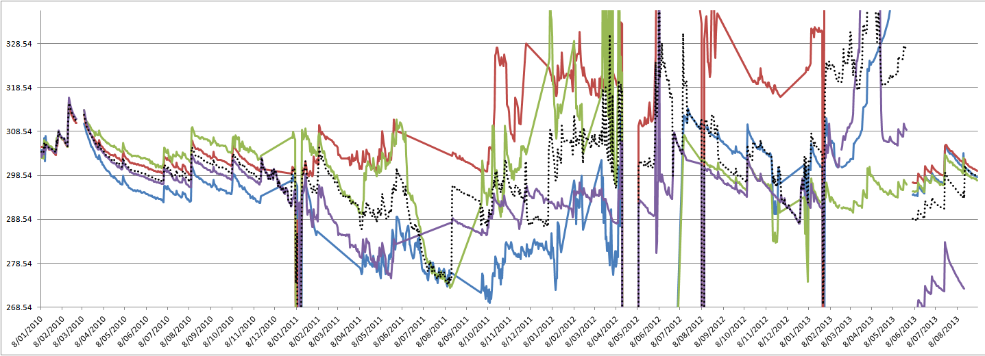
Daily Weights
Very messy in some areas. Noise needs to be accounted for and removed if possible.
We will be looking at the highlighted region.

Slide 6
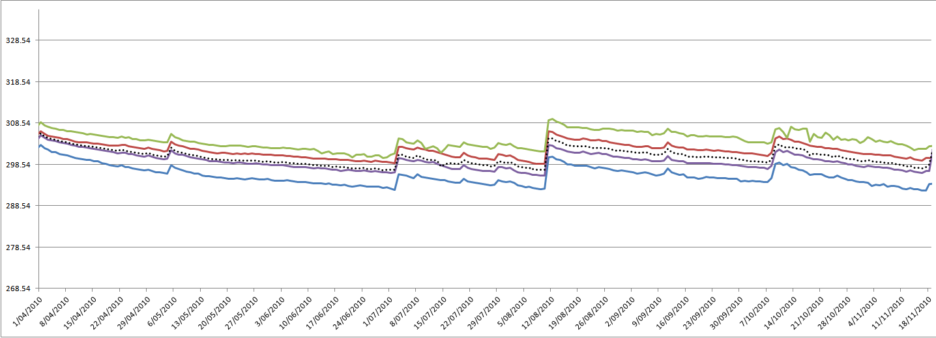
Drying Curves
Model 3 periods, 2 April - 4 May, 5 May - 2 July, 11 September – 6 October
We will use all the data available and filter it in APSIM.

Slide 7
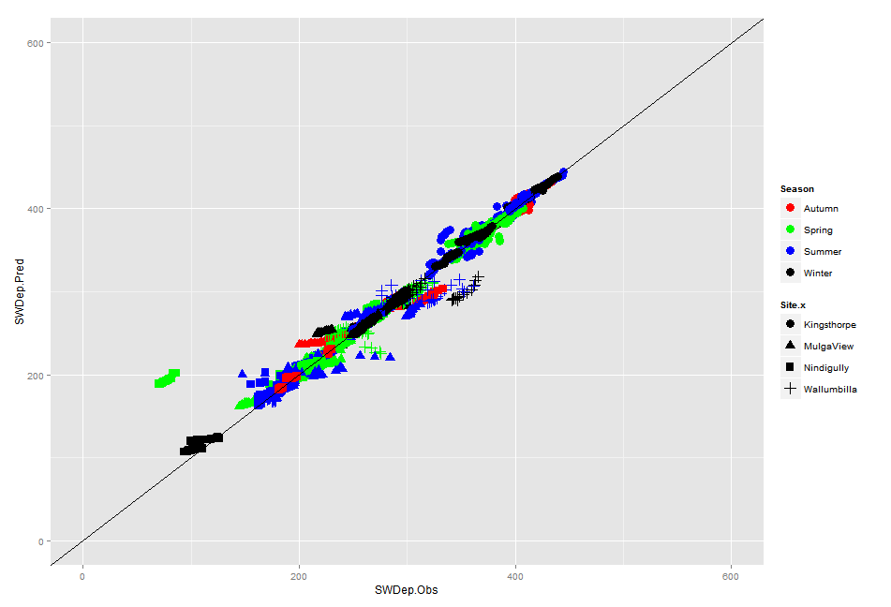
So How Did We Do?
Observed Weights vs. Predicted Weights
This graph looks great but is rubbish. Why?

Slide 8
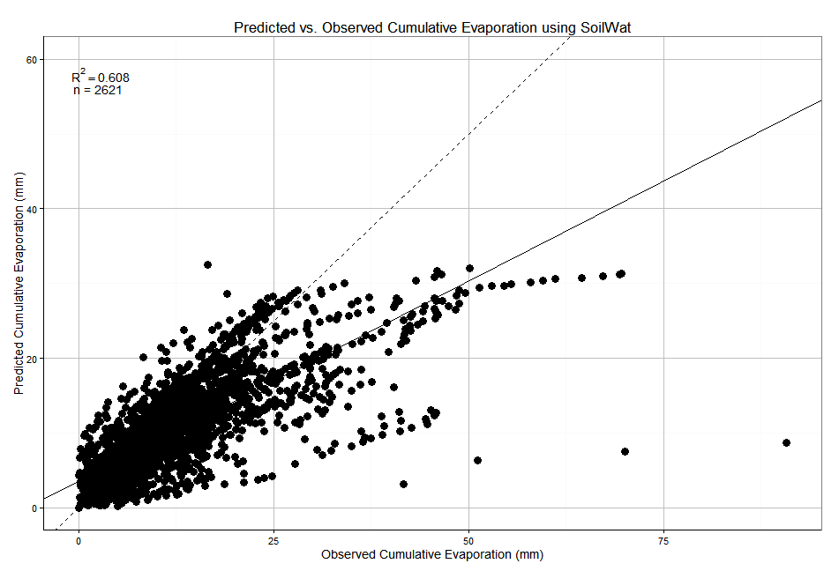
So How Did We Do?
Note linearity in deviations. This suggests the error is more in the model parameters than the model itself.

