Slide 1
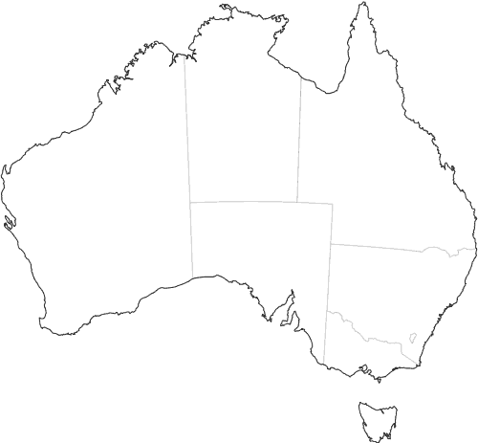
Emerald
Roma
Warra
Dalby
Mingenew
Walgett
Latham
Minnipa
Merredin
Gunnedah
Roseworthy
Waikerie
Walpeup
Wagga
Birchip
Complete
Under Construction

Slide 2
Emerald
Roma
Warra
Dalby
Mingenew
Walgett
Latham
Minnipa
Merredin
Orroroo
Gunnedah
Roseworthy
Wanbi
Lamaroo
Walpeup
Wagga Wagga
Naracoorte
Birchip

