Slide 1






























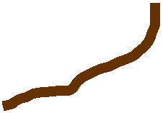











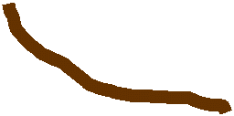













































Simulation Area
Direct Radn
Row Top Interception
Row Side Interception
Transmitted Radn
Alley
Row

Slide 2
