Slide 1
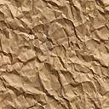

















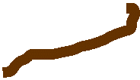







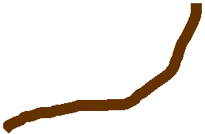



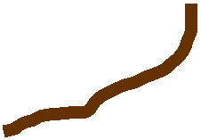











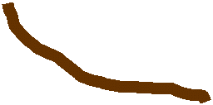
























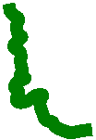
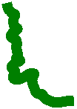










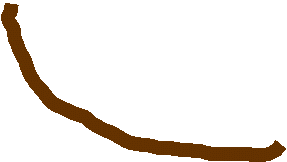








Simulation Area
Direct Radn
Row Top Interception
Row Side Interception
Transmitted Radn
Alley
Row

Slide 2
Simulation Area
Direct Radn
Row Top Interception
Row Side Interception
Transmitted Radn
Alley
Row

Slide 3
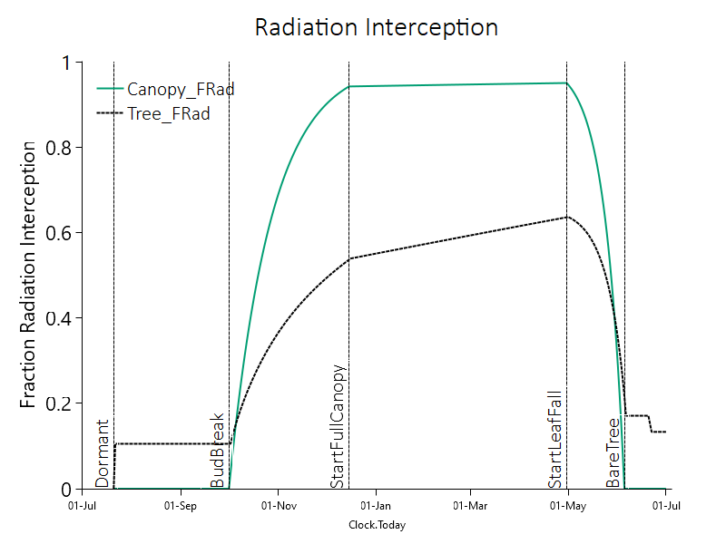

Slide 4
Radiation Interception
Canopy_FRad
Tree_FRad
Fraction Radiation Interception
Start Full Canopy
Start Leaf Fall
Dormant
Bud Break
Bare Tree
Date

