Slide 1





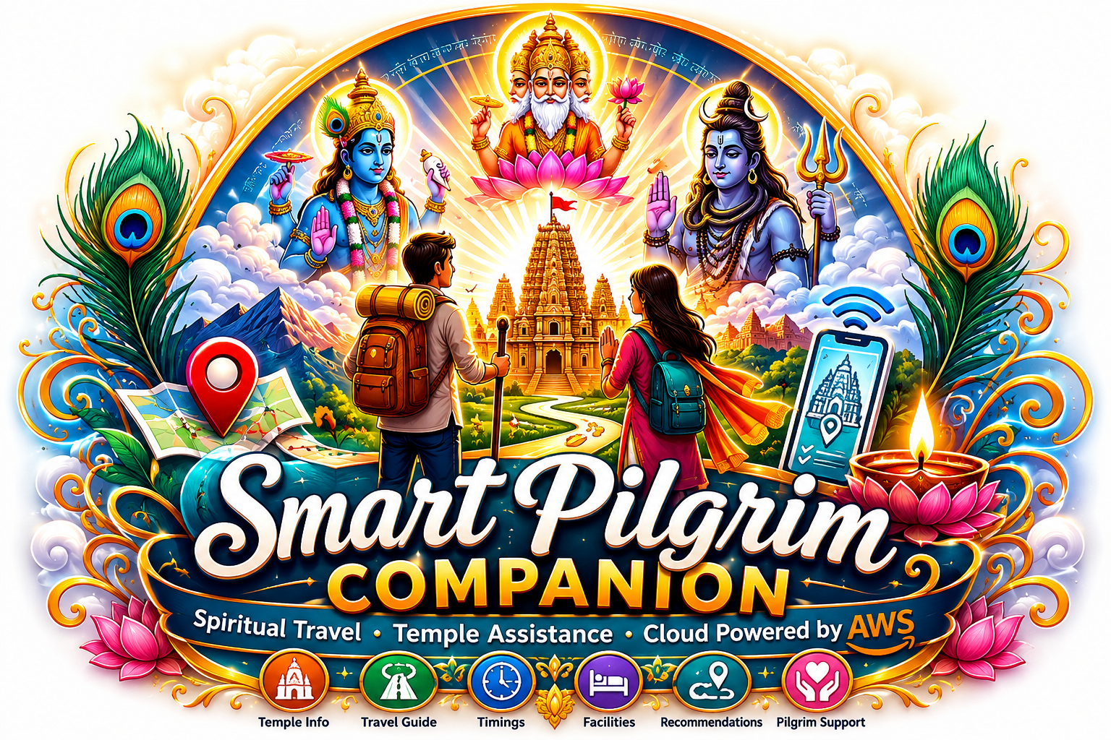
Smart Pilgrim Companion: Cloud-Based Spiritual Travel & Temple Assistance Platform Using AWS
Team Members:
• ADHIMULAM BHARGAV SAI VISWANATH (23BQ1A4201)
• BEZAWADA MEGHANA (23BQ1A4218)
• BODEPUDI NAGA SOUMYA (23BQ1A4222)
• DERANGULA VISHNUVARDHAN (23BQ1A4238)
• JUJJURI LAKSHMI SOWMYA (23BQ1A4269)
Under the Guidance of (APSSDC):
• Mrs. Bethala Sumana, APSSDC
• Mr. Juttuka Lovababu, APSSDC
Department: CSE - (AI & ML) [CSM]
College: Vasireddy Venkatadri Institute of Technology (VVIT)
Location: Nambur, Guntur

Slide 2
Pilgrimage planning is fragmented
Key challenges pilgrims face when organizing their spiritual journeys using traditional methods.
01
Scattered Info
Temple history, specific daily timings, and cultural context are scattered across multiple disjointed sites.
02
Multiple Sources
Travel logistics require planning across various transportation, lodging, and local booking agencies.
03
Hard to Compare
Budget constraints, itinerary variations, and scheduling timelines are manually tracked and hard to align.
04
Guidance Gap
Devotees lack a clear, centralized, and step-by-step assistant framework to start their spiritual path smoothly.

Slide 3
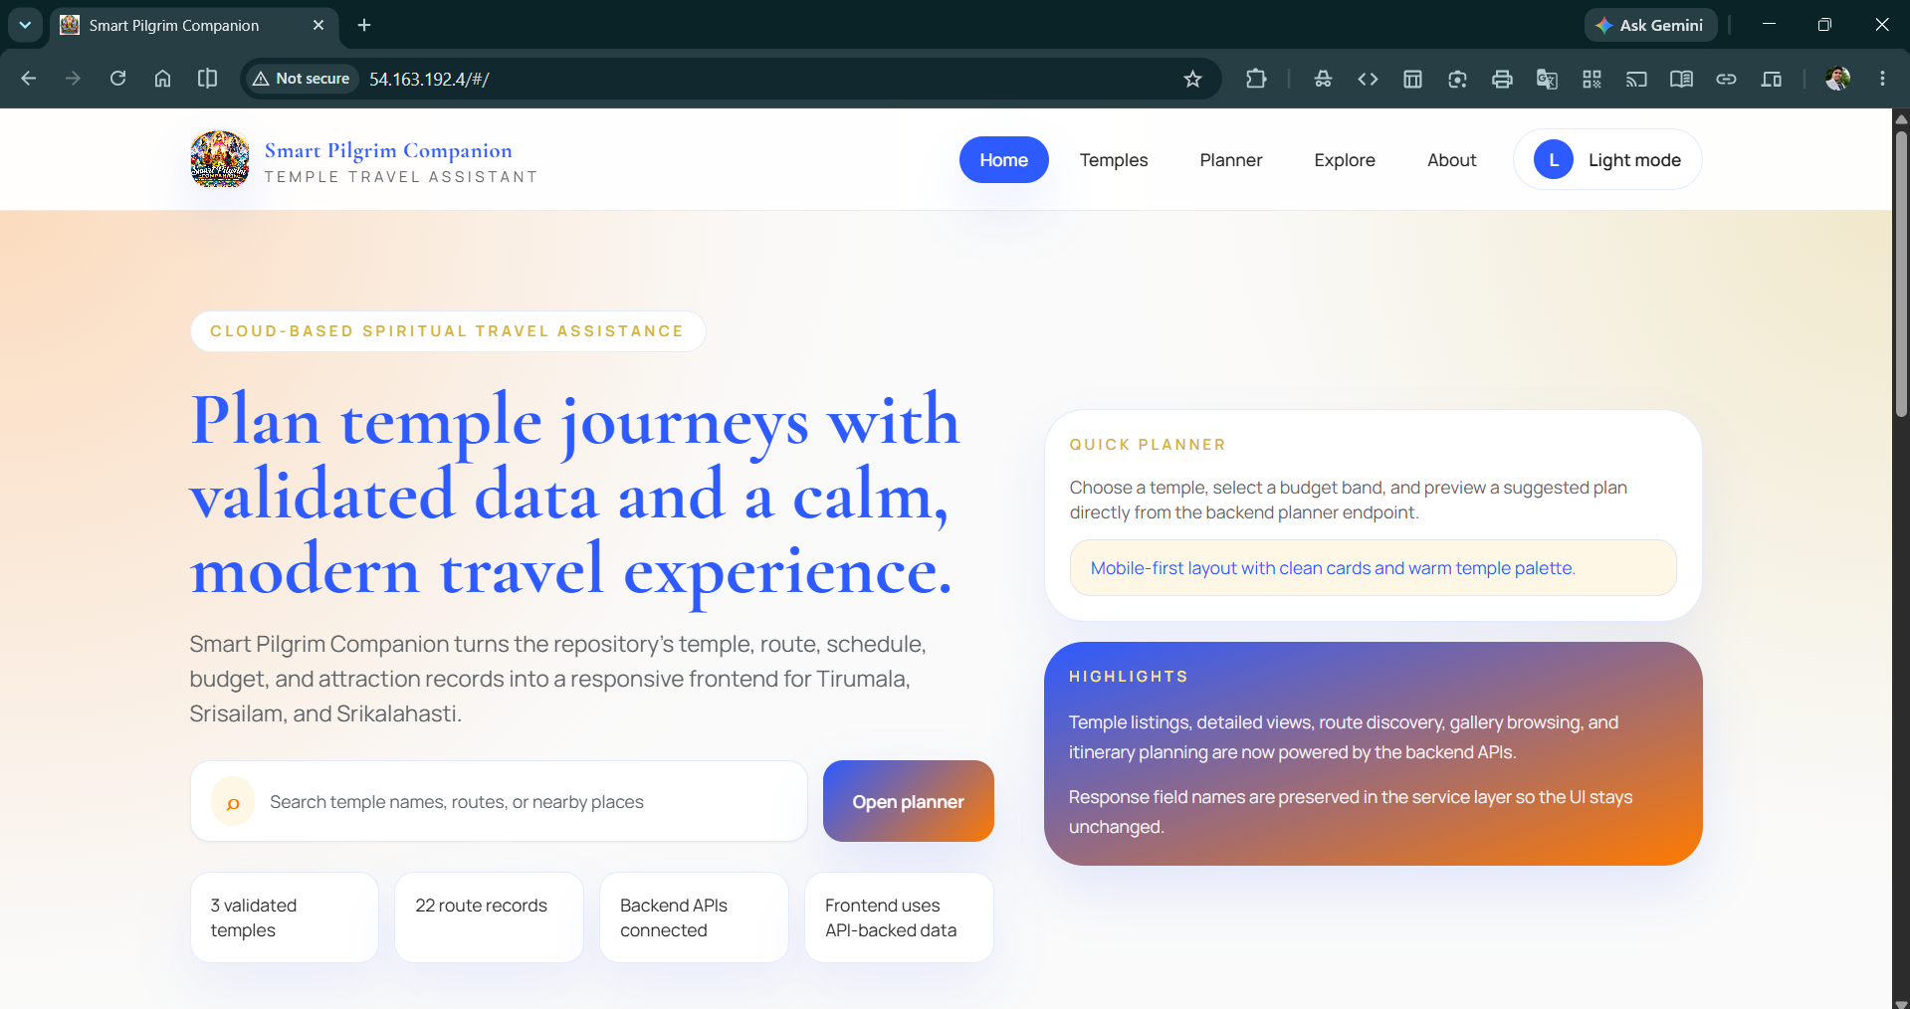
A single cloud-ready platform for temple discovery and pilgrim travel planning
Platform Features
✓Temple discovery
✓Temple details
✓Trip planner
✓Route and budget support
✓Recommendation output
✓Responsive UI

Slide 4
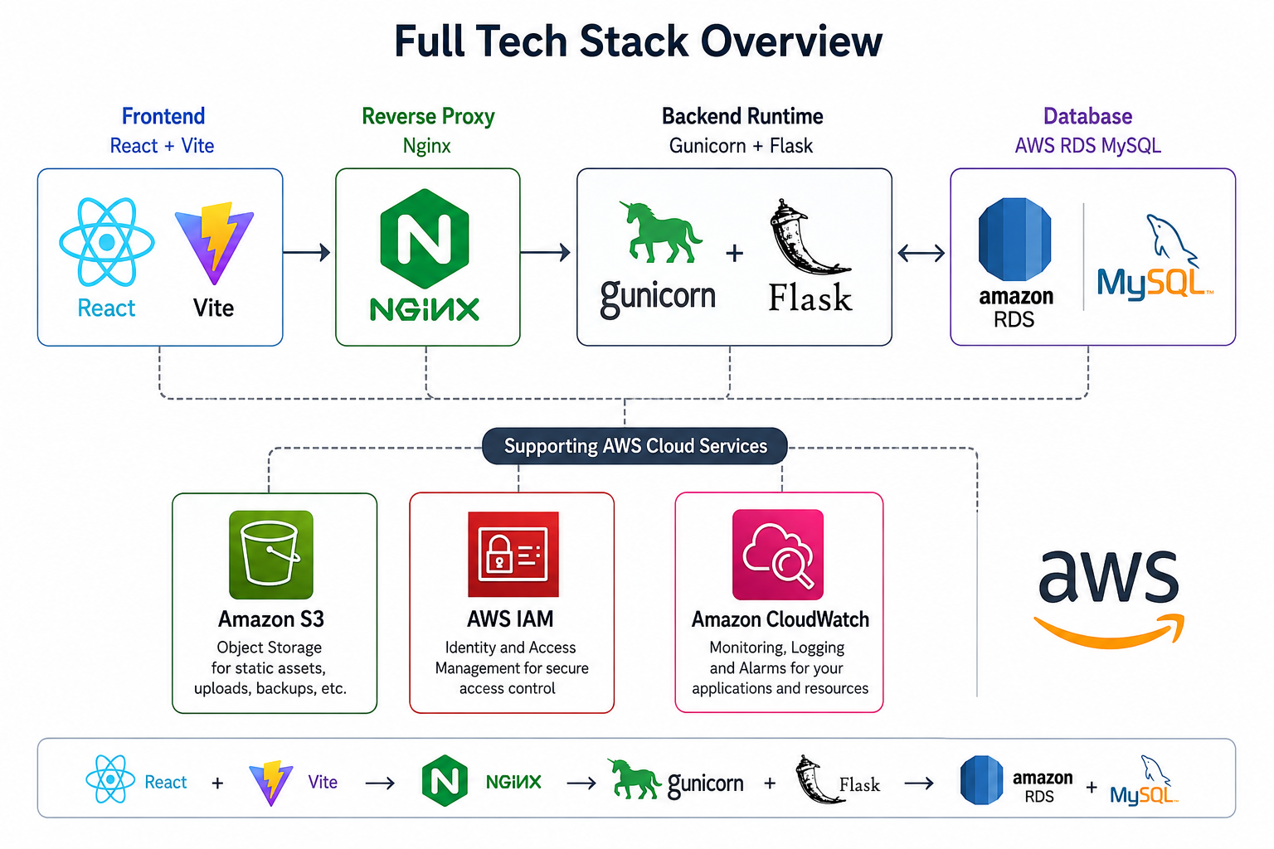
Architecture layers:

Slide 5
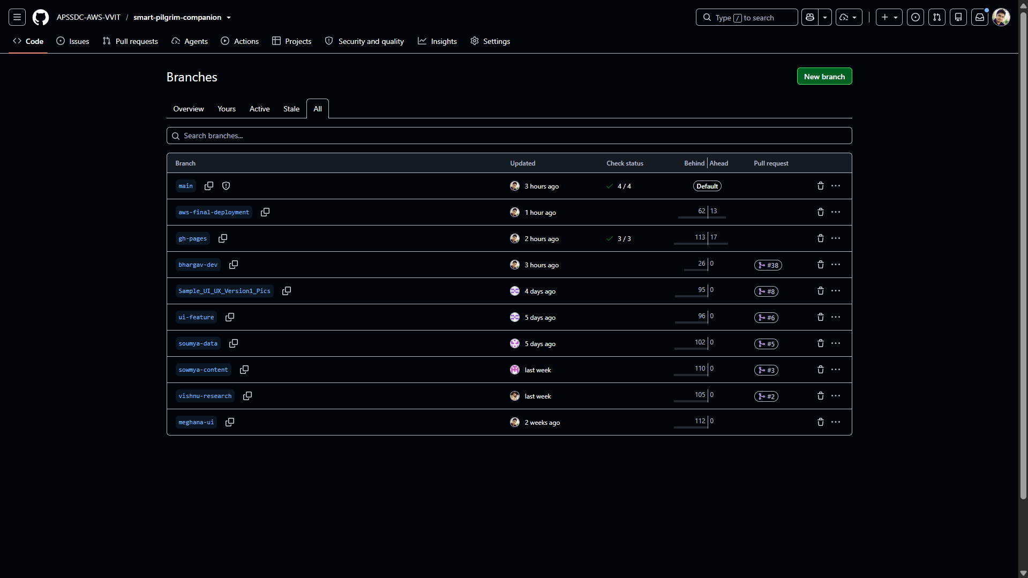
From idea to deployed cloud project

Slide 6
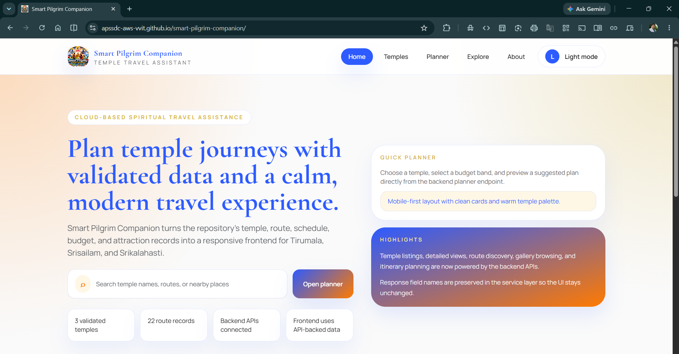
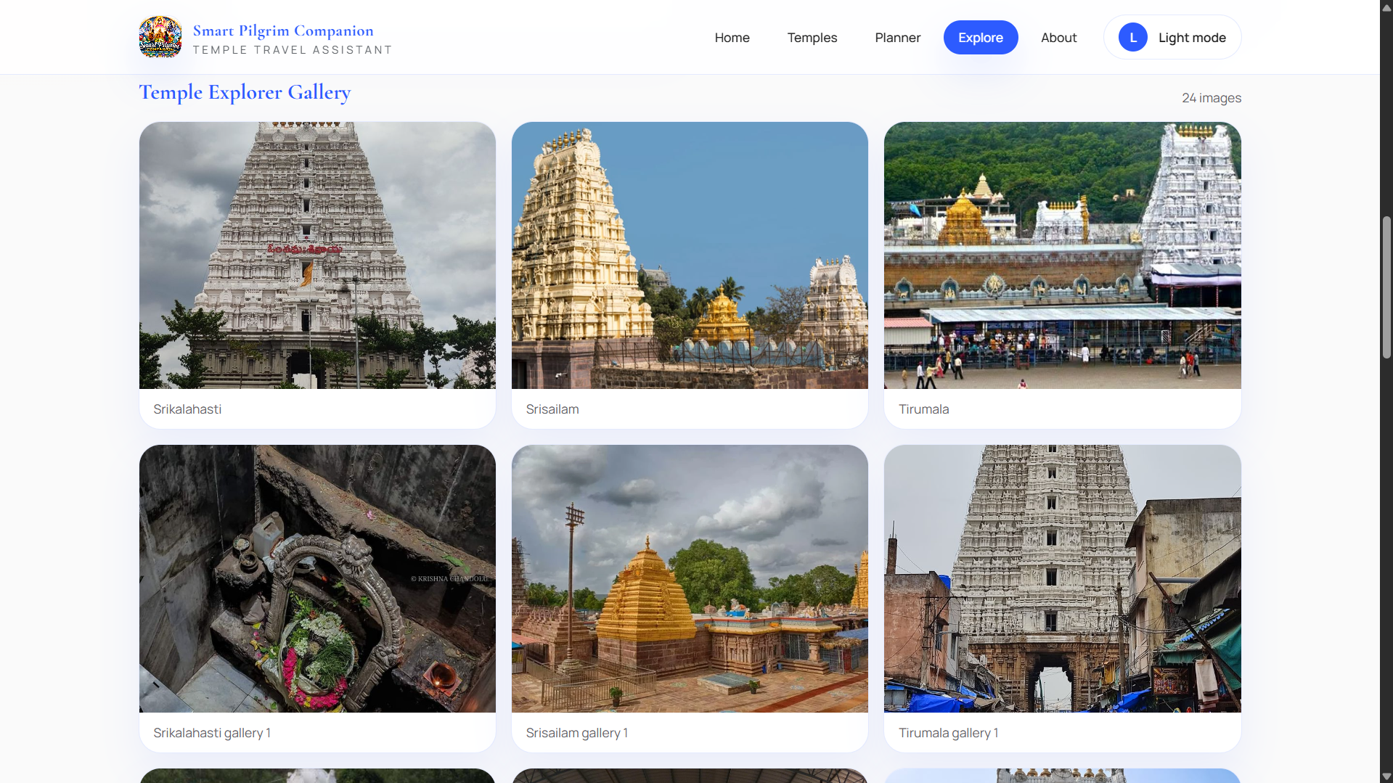
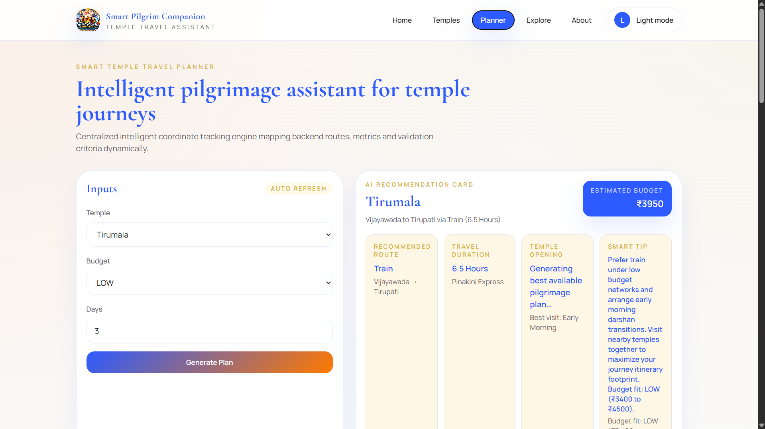
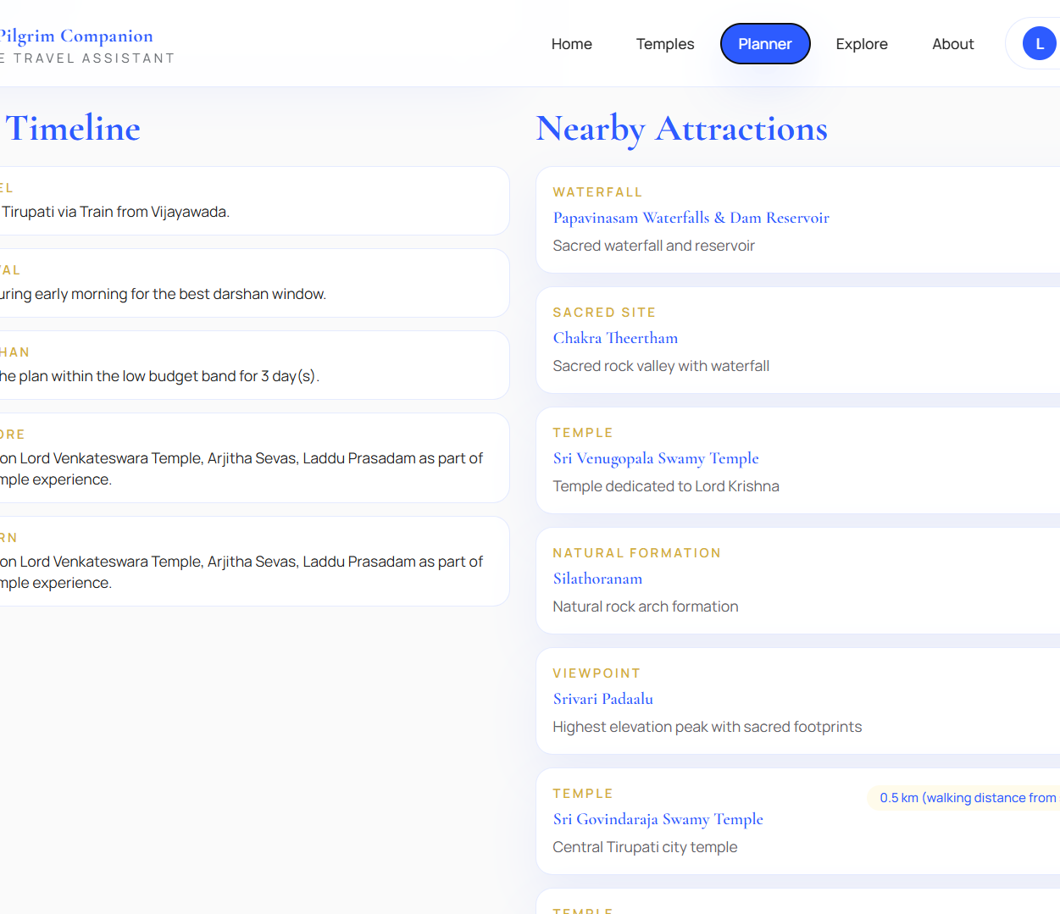
Key Features
1
Temple Search
Easily find and filter sacred destinations.
2
Trip Planner
Customize budgets, days, and routes.
3
Recommendations
Get smart, optimized itinerary suggestions.
4
Explore
Discover nearby attractions and services.
5
About & Info
Access project background and credentials.
6
Responsive UI
Seamless experience on mobile and desktop.

Slide 7
Dual Deployment Architecture
GitHub Deployment
AWS Deployment
GitHub Pages
Web hosting for static content
dns
EC2 - Virtual Server
public
router
Nginx - Web Server & Reverse Proxy
build
React build
Compiled frontend assets
settings_input_component
Gunicorn - WSGI Server
layers
Flask - Python Web Framework
devices
Public frontend output
User-accessible web interface
storage
RDS - Relational Database
visibility
CloudWatch - Monitoring Service

Slide 8
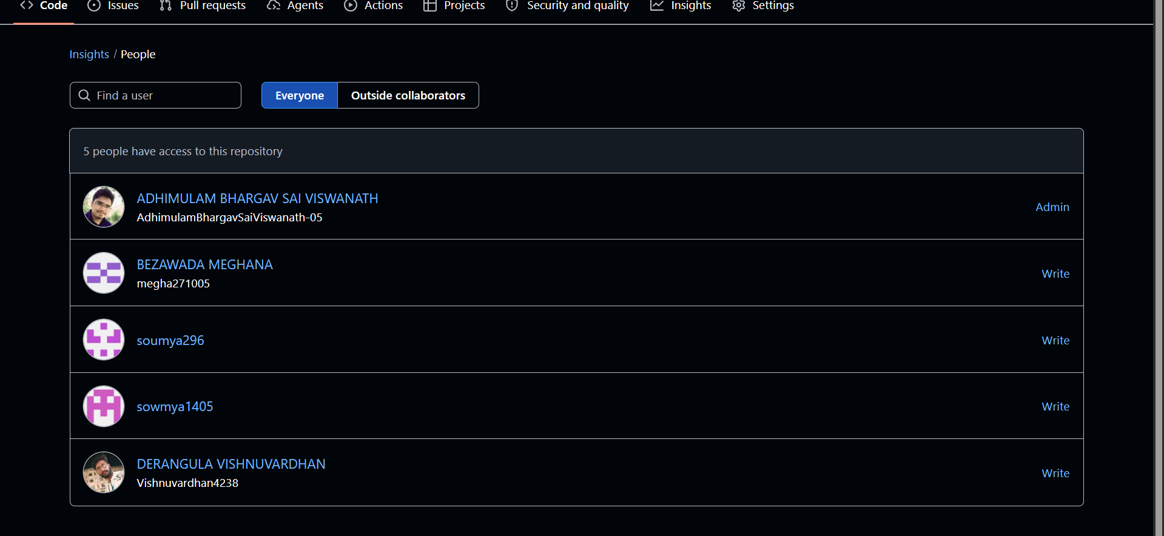
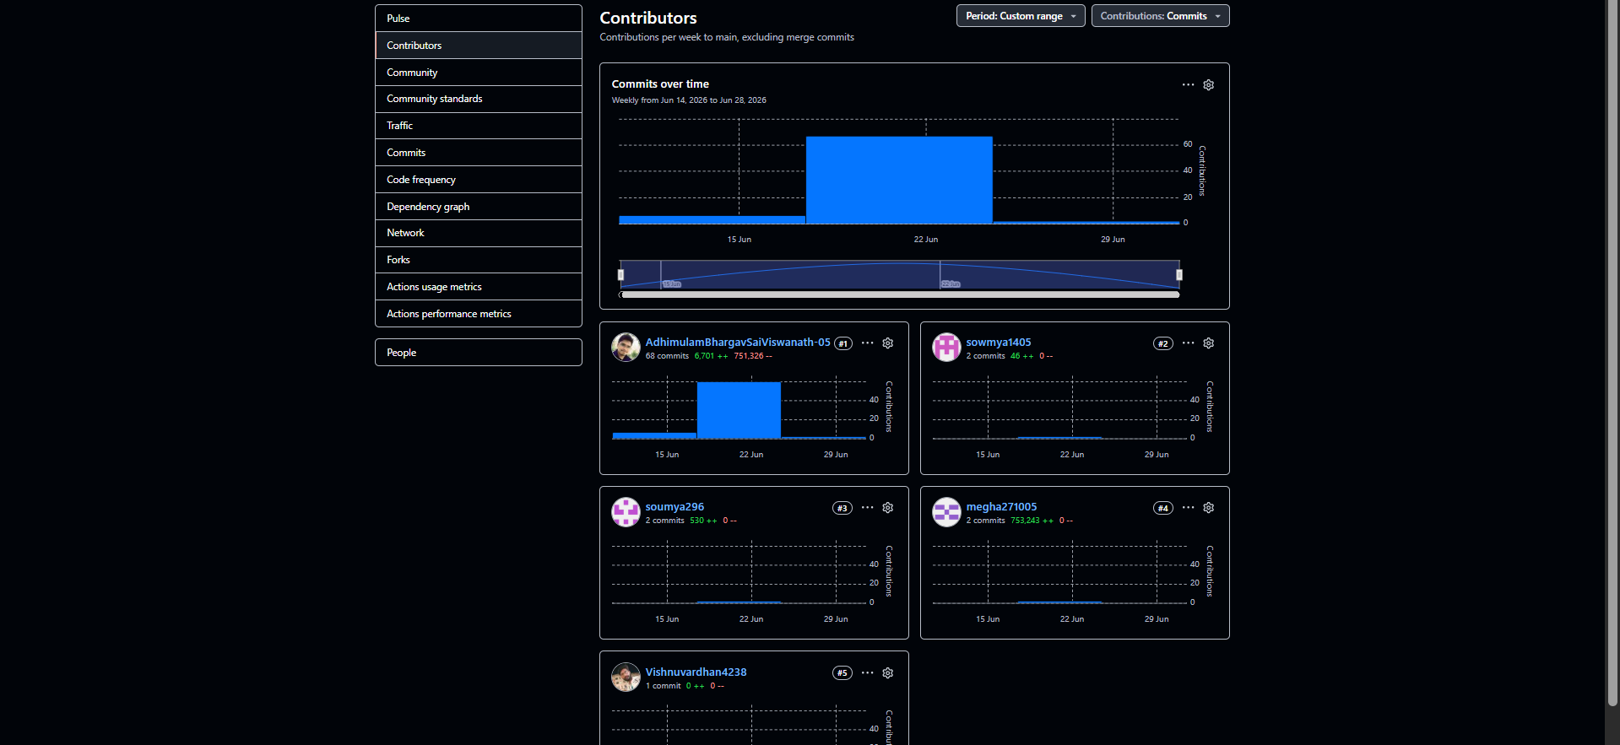
Team Contributions
REPOSITORY ACCESS CONTROLS
Bhargav Sai
Architecture, Integration, Deployment
BS
Meghana
Frontend, UI Validation, Assets
M
Soumya
Dataset, RDS
S
COMMIT ACTIVITY & INSIGHTS
Vishnu
Testing, Monitoring
V
Sowmya
IAM, Documentation
S

Slide 9
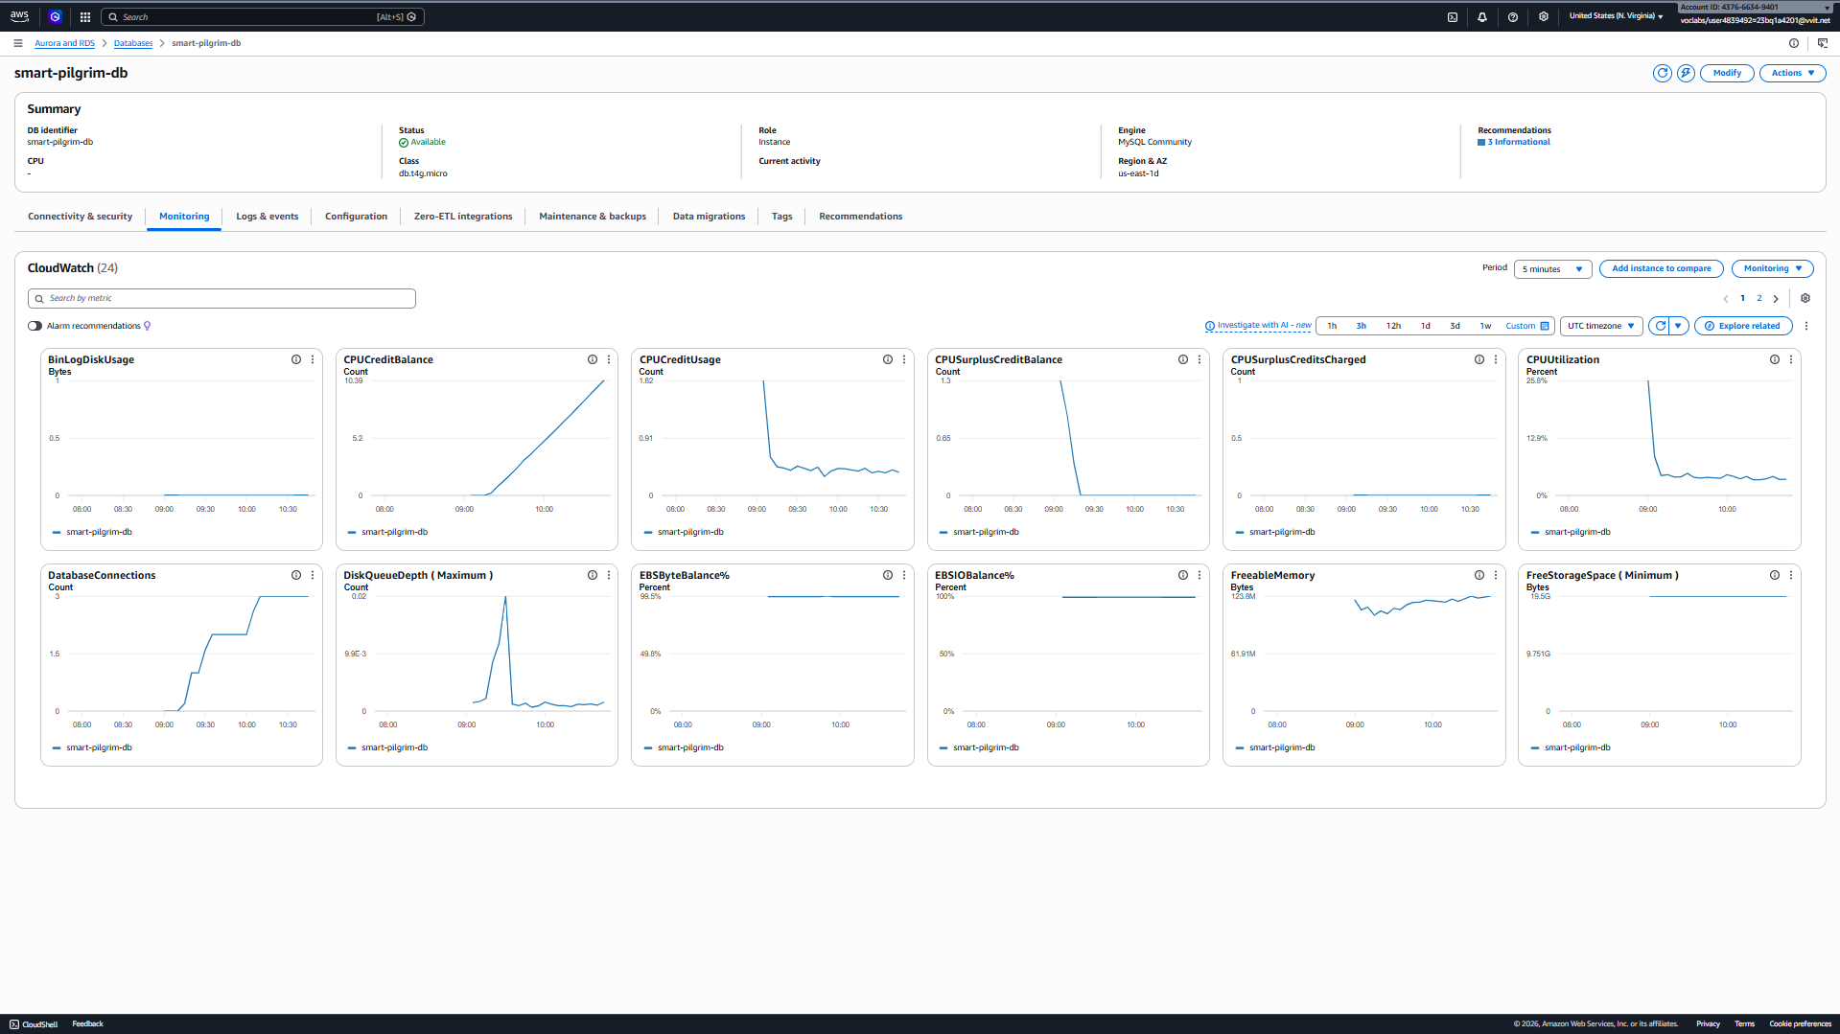
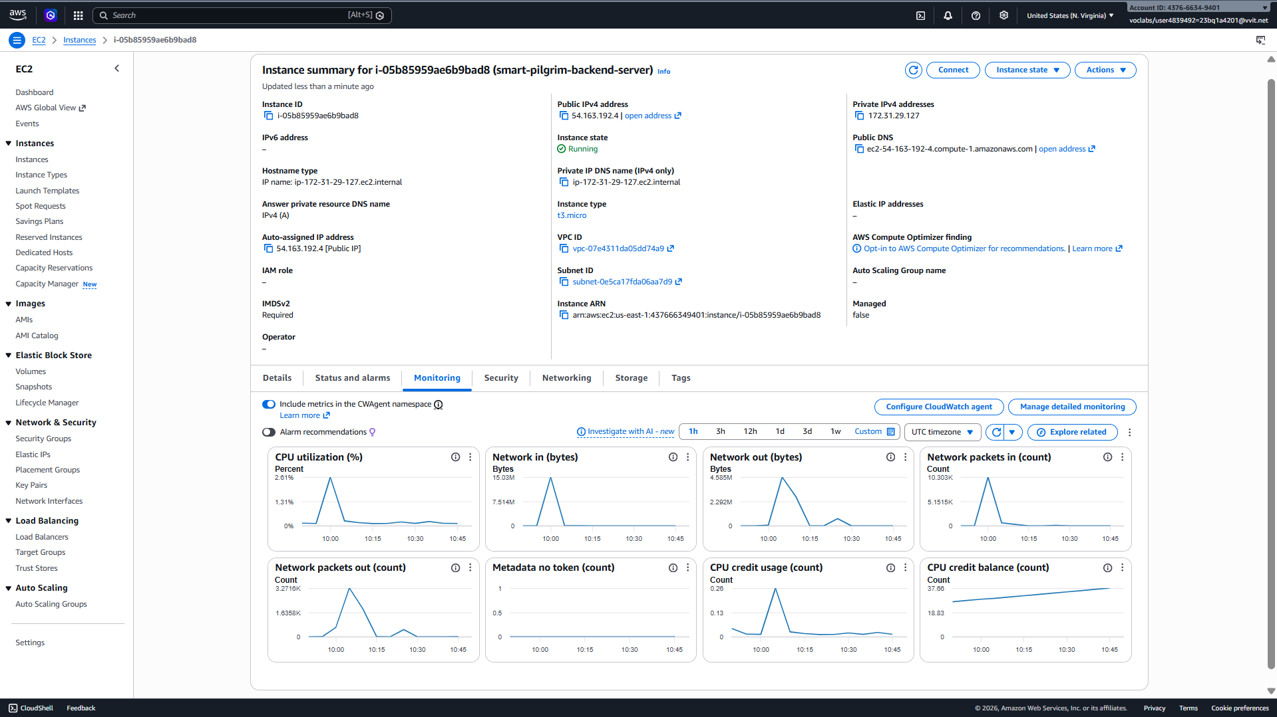
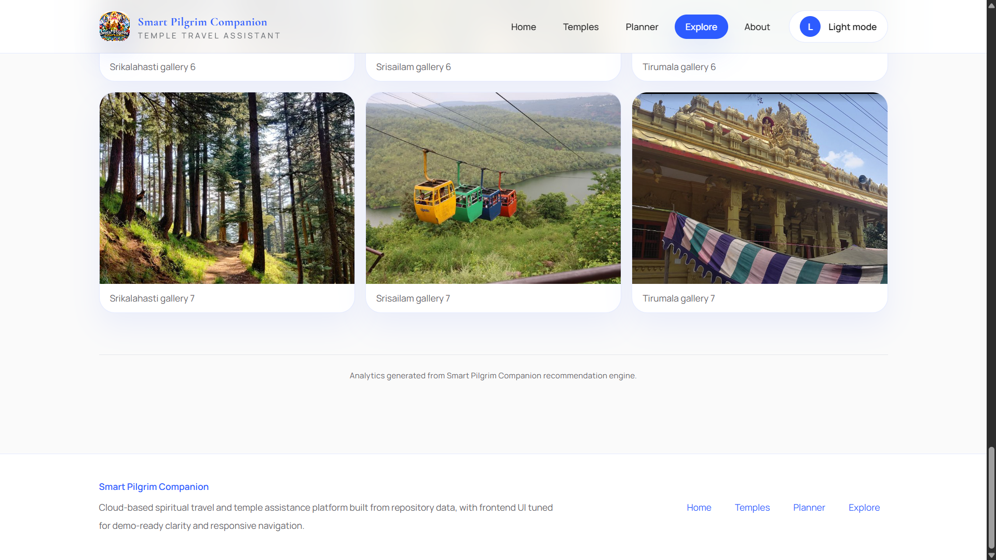
Results + Metrics
Results
Working application completed.
GitHub and AWS deployment evidence collected.
Testing and cloud validation completed.
CloudWatch (RDS)Monitoring
Evidence
Frontend pages
Backend API validation
Nginx/Gunicorn service status
RDS monitoring
Final output screens
EC2 Instance Configuration

Slide 10
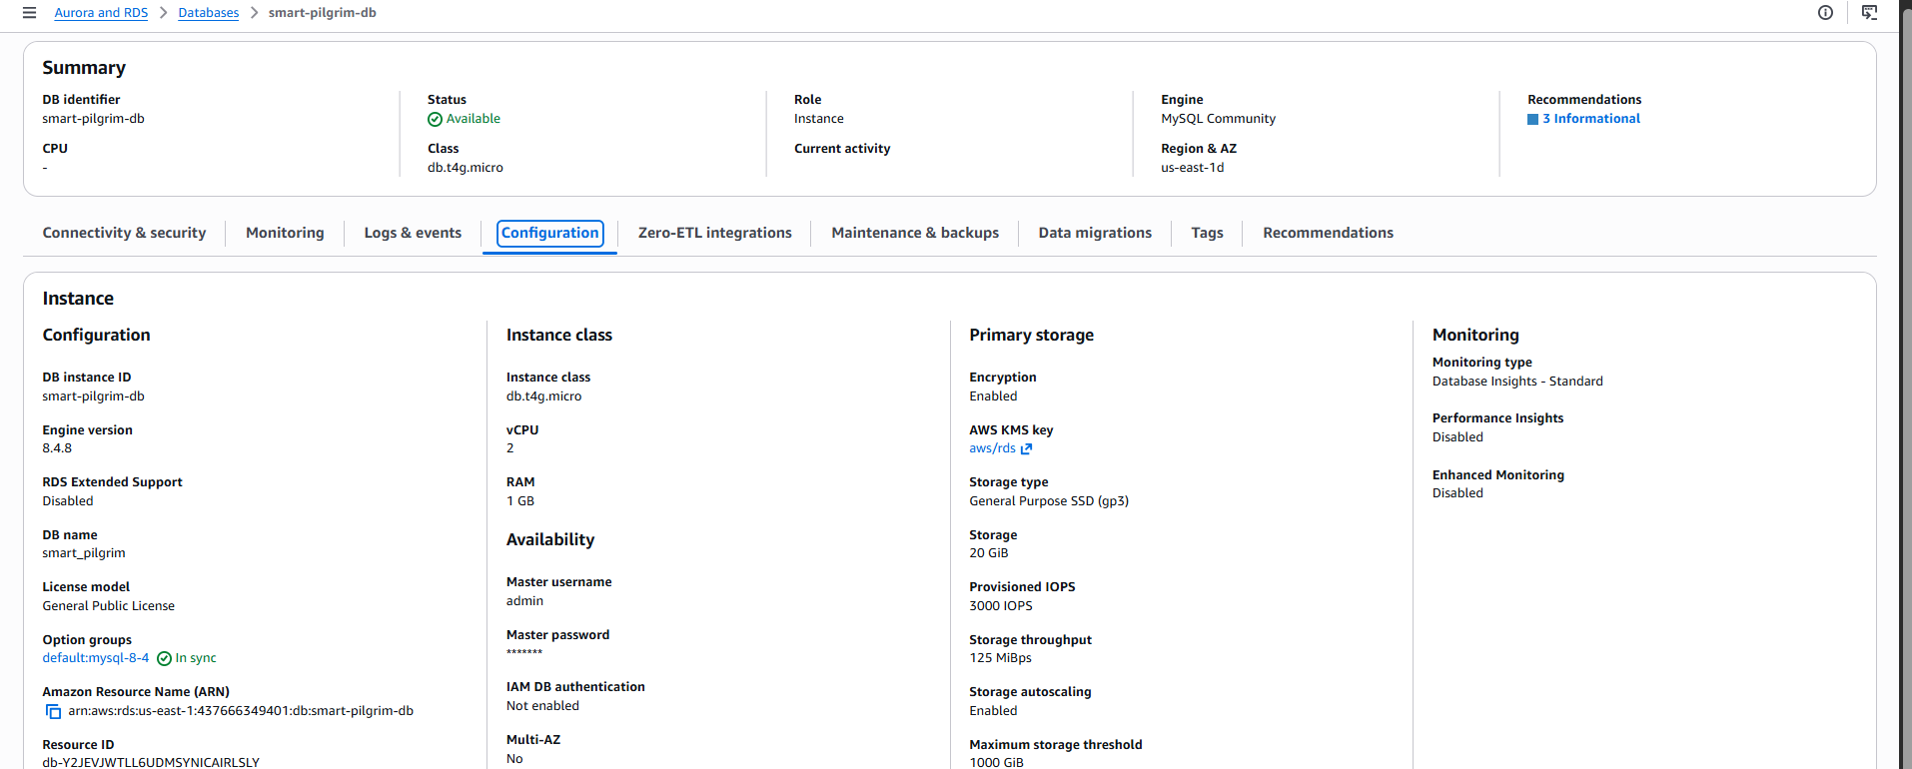
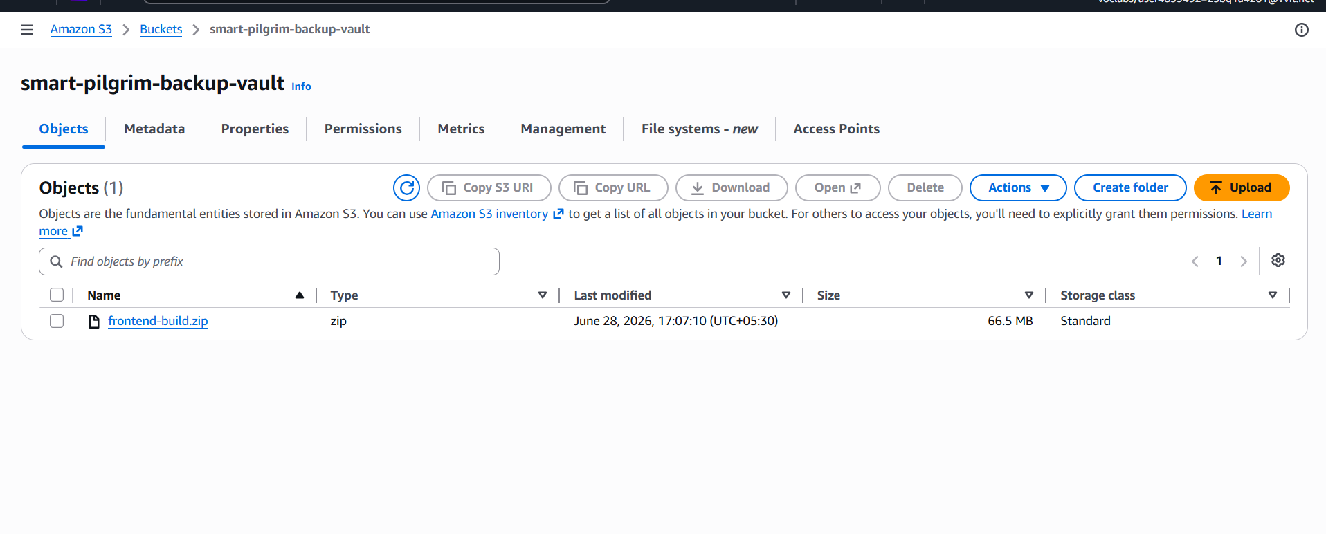
Learnings + Future Scope
RDS DATABASE CONFIGURATION
Learnings
React frontend architecture
Flask API development
Dataset-driven backend design
EC2 deployment workflow
Nginx and Gunicorn setup
RDS connectivity and monitoring
RDS Configuration
Future Scope
CloudFront CDN integration
Route53 domain management
Real-time system notifications
AI-driven pilgrim recommendations
HTTPS security and domain setup
Admin portal for data management
S3 FRONTEND ZIPFILE STORAGE
S3 Frontend ZipFile

Slide 11
Thank You
The Vision
“Smart Pilgrim Companion transforms fragmented pilgrimage planning into a unified cloud-enabled experience.”
Cloud-Enabled Experience

