Slide 1
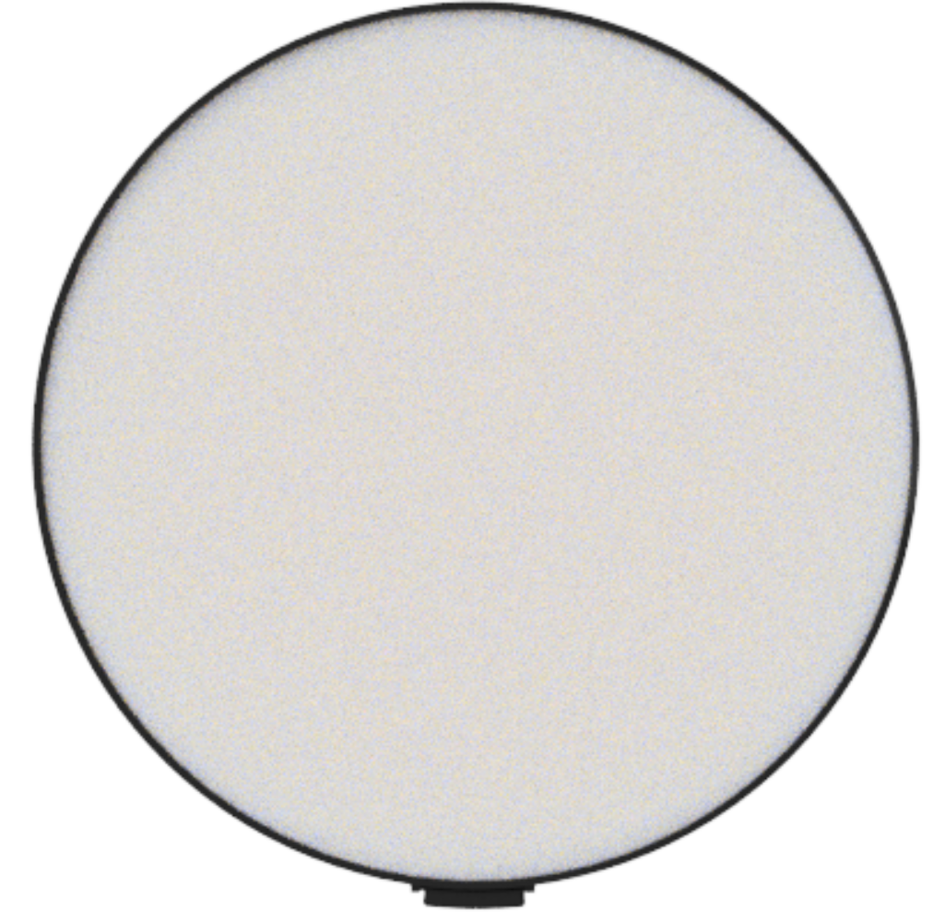
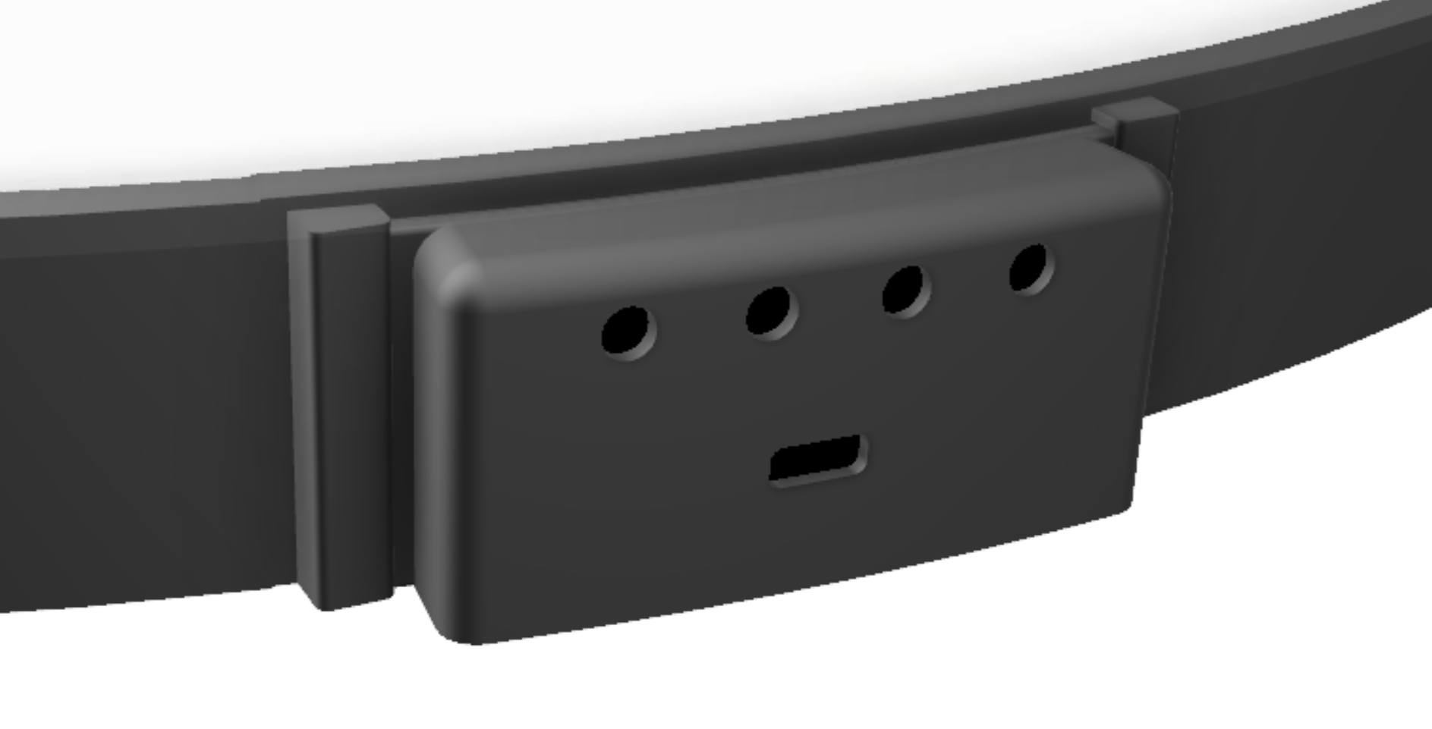

Setup Guide
Operating Description
Step 1:
Mount the mirror on the wall using the wall hanging bracket on the back of the mirror.
Step 2:
Plug the DC power adapter into the power connector on the mirror.
Step 3:
Plug the DC power adapter into the wall.
Step 4:
Enjoy!
The ”Increase Brightness” button increases the brightness in ALL modes.
The ”Decrease Brightness” button decreases the brightness in ALL modes.
Use the ”Change Mode” button to toggle between ”OFF”, ”Cycle All Animations” or ”Cycle Single Animation” modes.
In the ”Cycle All animations” mode, the ”Pause Animation / Change Animation” button pauses the animation.
In the ”Cycle Single Animation” mode, the ”Pause Animation / Change Animation” button, switches between different animations.
Infinity Mirror
Quickstart Guide
Warning!
Read all instructions and warnings prior to use
This device is for indoor use ONLY.
DO NOT store or operate this device in a high-humidity or high-temperature environment.
Use ONLY the supplied DC power adapter.
DO NOT disassemble, re-purpose or modify this device in any manner (including repair).
This device has gone through a thorough quality assurance control. If you find that your device is excessively hot, is emitting odor, is deformed, cut, or otherwise damaged, or is demonstrating an abnormal phenomenon, immediately terminate all product use and contact the Manufacturer.
3
1
2
4
5
1: Decrease Brightness
2: Change Mode
3: Pause Animation / Change Animation
4: Increase Brightness
5: Power Connector
Designed and manufactured by © APTechnologies. All Rights Reserved.
2020. Nyköping, Sweden.

