Slide 1

Intro to Python
Maverick (@mavjs)
CSFC Core Member a.k.a 0xtr0ll
Fedora Ambassador
0xn00b Python ninja

Slide 2
Agenda
Warm Up!
Get Python
Good Practices
Modules
Reserved Words
Read Input
Operators
If-Else, While, For
Practical (Fibonacci Series)
List, Tuple, Dict, Set

Slide 3
Warm Up!

Slide 4
In your favourite programming language code a simple get input and print input in <5mins :)

Slide 5
>> input_word = raw_input('Please type a word: ')
>> print(input_word)

Slide 6
Get Python!
Debian/Ubuntu:
apt-get install python -y
Red Hat/Fedora/Centos:
yum install python -y
Most Linux Distributions come with python installed.

Slide 7
python --version
Python 2.7.5
~$ python
Python 2.7.5 (default, May 16 2013, 13:44:12)
[GCC 4.8.0 20130412 (Red Hat 4.8.0-2)] on linux2
Type "help", "copyright", "credits" or "license" for more information.
>>>

Slide 8
Designed by – Guido van Rossum
Python – Monty Python
IDLE – Eric Idle
IDLE == 'Integrated DeveLopment Environment'

Slide 9
Get iPython
apt-get install ipython -y
yum install ipython -y

Slide 10
Good Practices
Use 4 spaces for indentation.
Never mix tab and spaces.
One blank line between functions.
Two blank lines between classes.
Add a space after "," in dicts, lists, tuples, and argument lists and after ":" in dicts.
Spaces around assignments and comparisons (except in argument list)
No spaces just inside parentheses.

Slide 11
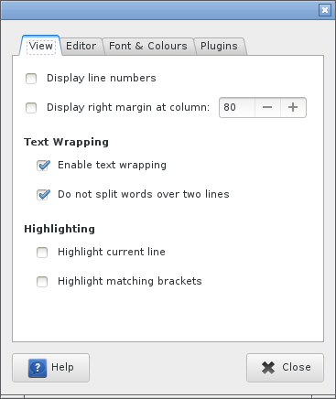
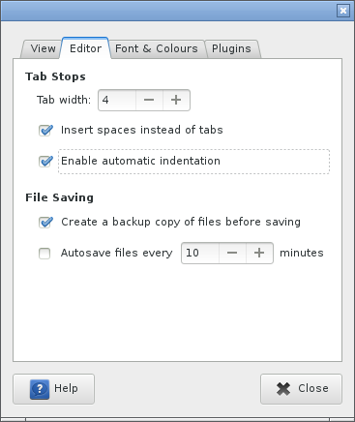
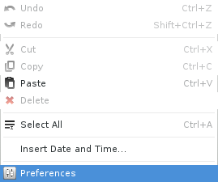
4 spaces and some

Slide 12
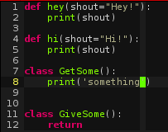
1BlankFunc 2BlankClass

Slide 13
Spaces after ',', comparison, assign
Dict = {'Name' : 'CSFC', 'Location' : 'TPM'}
List = ['a', 'b', 'c', 1, 2, 3]
Tuple = ('a', 'b', 'c', 1, 2, 3)
word = 'a'
word == 'a'

Slide 14
Modules
>>> import math
>>> print math.e
2.71828182846

Slide 15
Reserved Words
and del from not while
as elif global or with
assert else if pass yield
break except import print
class exec in raise
continue finally is return
def for lambda try

Slide 16
Operators
/ * + -
<
<=
>
>=
==
!=
and
or
not

Slide 17
If-Else
>>> if True:
... print('hi!')
... else:
... print('bye!')
...
hi!
>>>

Slide 18
If-elif-else
>>> now = 12
>>> if now < 12:
... print('goedemorgen!')
... elif now == 12 and now < 18:
... print('goedemiddag!')
... else:
... print('goedenavond!')
...
goedemiddag!
>>>

Slide 19
While
>>> n = 0
>>> while n < 5:
... print n
... n += 1
...
0
1
2
3
4

Slide 20
For
>>> a = ['Python', 'is', 'OHSM!']
>>> for x in a:
... print x,
...
Python is OHSM!

Slide 21
Apply your knowledge (1) ;)

Slide 22
Write^h^h^hCode a fibonacci series for 20 digits

Slide 23
>>> a, b = 0, 1
>>> while b < 20:
... print b
... a, b = b, a + b
...
1
1
2
3
5
8
13
>>>

Slide 24
List
word_list = ['a', 'b', 'c', 'd', 'e']
Like a zero-based array, non-empty array
word_list[0] = 'a'
word_list[-1] = 'e'
word_list[0:3] = ['a', 'b', 'c']
word_list[:3] = ['a', 'b', 'c']

Slide 25
word_list[0] = 'a'
word_list[-1] = 'e'
word_list[0:3] = ['a', 'b', 'c']
word_list[:3] = ['a', 'b', 'c']
word_list.append('f')
['a', 'b', 'c', 'd', 'e', 'f']
word_list2 = ['g', 'h', 'i']
word_list.extend(word_list2)
['a', 'b', 'c', 'd', 'e', 'f', 'g', 'h', 'i']

Slide 26
Tuple
word_tuple = ('a', 'b', 'c', 'd')
A tuple is an immutable list. A tuple can not be changed in any way once it is created.
Zero-based indices.
word_tuple[0] = 'a'
word_tuple[0:1] = 'a'
'e' in word_tuple

Slide 27
Dictionaries
word_dict = {'Name' : 'Maverick', 'Location' : 'KUL'}
Dictionaries have keys and values. Like a Hashtable Class in Java.
word_dict['Name'] = 'Maverick'

Slide 28
Apply your knowledge (2) ;)

Slide 29
Questions?

Slide 30
End of Intro
Outro:
1) Functions
2) Classes
3) $$$$$
Likes what I do?
tip me @ https://www.gittip.com/mavjs/

