Slide 1
root@glider : whoami
Maverick
Hacker, Ninja
FOSS advocate,
0xn00b Python programmer,
Hack In The Box Crew
Fedora Project Ambassador
@mavjs

Slide 2
root@glider : cat agenda.txt
HTML vs. Plaintext emails
URL expansion
Polipo + Tor to analyse suspicious webpages

Slide 3
root@glider : cat html-plaintext.txt
7 reasons why HTML e-mail is EVIL!!! - http://goo.gl/6iVoZ

Slide 4
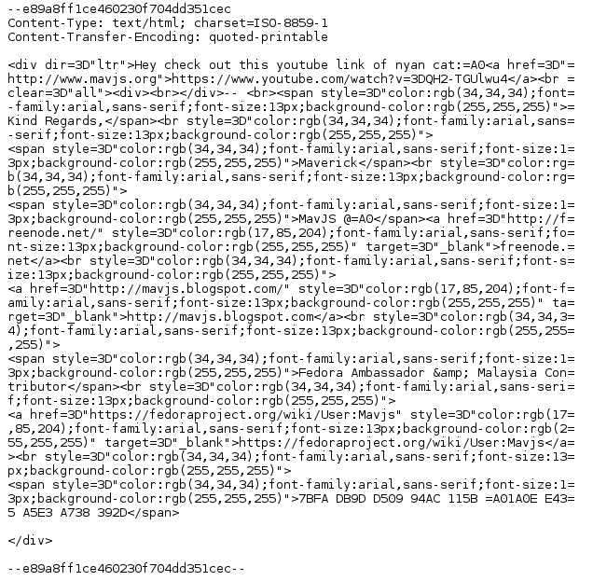
root@glider : cat html-email.txt

Slide 5
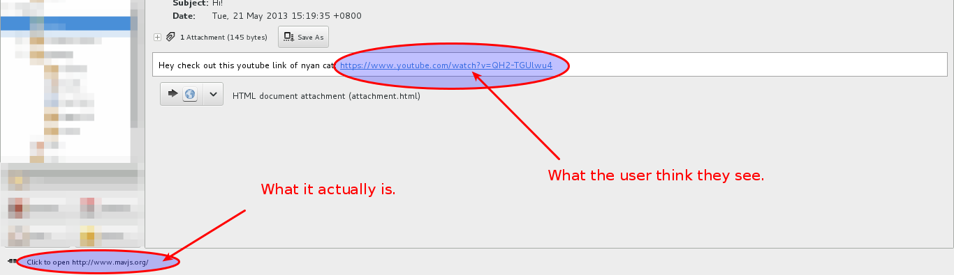
root@glider : cat html-email.txt

Slide 6
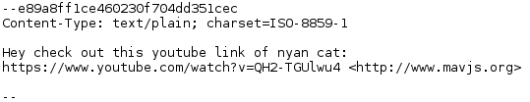
root@glider : cat plaintxt-email.txt

Slide 7
root@glider : cat url-expansion.txt
Inspired from
Use wget(1) To Expand Shortened URLs -
http://goo.gl/6qCSz

Slide 8
root@glider : cat url-expansion.txt
Code:
wget --max-redirect=0 -O - http://t.co/LDWqmtDM
Location: http://is.gd/jAdSZ3 [following]
0 redirections exceeded.
wget --max-redirect=1 -O - http://t.co/LDWqmtDM
Location: https://wiki.ubuntu.com/UbuntuOpenWeek [following]
1 redirections exceeded.

Slide 9
root@glider : cat shell-func.txt
function surl() {
if [ "$#" -ne 2 ];
then
echo "Error: url not supplied."
echo "Usage: $0 \"redirect times\" \"url\""
exit 1
fi
wget --max-redirect=$1 $2 | grep -v "Location"
}

Slide 10
root@glider : cat install-polipo-tor.txt
sudo apt-get install polipo tor
cd /etc/polipo/config
E.g. Config:
http://www.andrehonsberg.com/media/polipo.conf

Slide 11
root@glider : cat start-polipo-tor.txt
sudo service tor start
sudo service polipo start
Or
sudo /etc/init.d/polipo start

Slide 12
root@glider : cat config-wgetrc.txt
e.g. Config: http://goo.gl/KrEOD
e.g. Wgetrc commands: http://goo.gl/mgcF1
http_proxy = http://localhost:<polipo port>
use_proxy = on
robots = on
wait = 30
cookies = on

Slide 13
root@glider : cat test-wget.txt
wget -O - http://ifconfig.me/ip
wget -O - http://ifconfig.me/ua

Slide 14
root@glider : cat online-tools.txt
https://www.virustotal.com/en/#url
http://urlquery.net/
http://www.mywot.com/

Slide 15
root@glider : cat things-to-do.txt
Don't Click S**T!
Don't let JavaScript run on-demand.

