Slide 1
Digital Beam Forming Phased Array Using Software Defined Radios
Principle Investigator: Dr. Enson Chang
Program Monitor: Dr. George Thomas
Support Faculty: Dr. Rick Sturdivant
Student Team Members:
David Bartholomew (Software)
Sarah De Pillis-Lindheim (Software)
Justin Rohweller (Software)
Ryan Brown (Integration and Test Engineering)

Slide 2
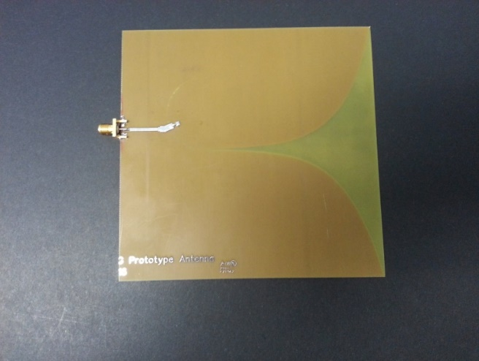
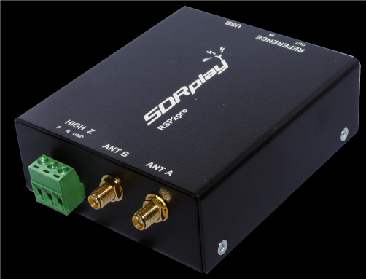
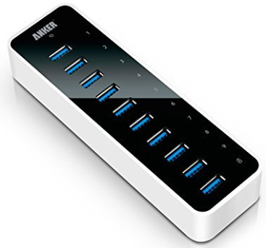

Project Description
Goal: Demonstrate a digital beam forming phased array using software defined radios.
Particulars:
Antenna Array: 8 element array using dielectric notch radiators
SDR Type: RSP2Pro from SDRPlay (sdrpay.com)
It has a metal case which improves isolation and makes it more rugged.
Output is USB. Has provision for a reference to make the receivers coherent.
Will need to use a computer laptop or desk top as the host processor.
Demonstration definition is TBD. Team will define the demonstration.
1
8
USB Hub
High Bandwidth
Host
Antenna Element
Software Defined Radio

Slide 3
System Conceptual Block Diagram
See White Board
Major concern: How will we aggregate the USB data from 8 SDRs without overloading the data bandwidth of the laptop USB connection?

Slide 4
Software Statement of Work
SW Task 1: Demonstrate custom solution for the detection and demodulation of an FM radio broadcast signal using the SDR signal outputs.
SW Task 2: Determine:
Software Platform for Digital Beam Forming: Will the digital beam former will be implemented using matlab (or scilab) or using custom software such as python or C++ or Java?
Host Computer Platform: Is it Windows or Linux?
Solution for interfacing multiple USB dongle devices to computers and maintain high speed data transfer.
SW Task 3: Develop block diagram and algorithm for digital beam forming software using the I/Q signal outputs from the SDR and perform matlab or scilab simulations.
Develop block diagram for a single beam.
Develop block diagram for multiple beams.
Simulations should show the algorithm works.
SW Task 4: Program the host computer for display of the resulting data.
SW Task 5: Program the digital beam forming block diagram for a single beam.
Perform demonstration for the single beam case.
SW Task 6: Program the digital beam forming block diagram for multiple beams.
Perform demonstration for the multiple beam case (number of beams is TBD).
SW Task 7: Perform digital beam forming demonstration with multiple beams.
SW Task 8: Write report

Slide 5
Engineering Statement Of Work
Engineering Task 1: Determine project schedule.
Write out the project schedule and track progress.
Engineering Task 2: Define the demonstration system and write the demonstrate test document.
How will we demonstrate the system? In an antenna chamber? Or on campus using and an outdoor ‘antenna range.’
What hardware is required? Will it be battery powered or AC?
How will we generate the synchronous clock?
Engineering Task 3: Perform system simulation.
Determine how to simulate the performance of the system.
Engineering Task 4: Develop bills of material and required parts lists, purchase, and track delivery.
Engineering Task 5: Build hardware system and debug.
Engineering Task 6: Write Report

