Slide 1
Lesson 2: How Neural Networks Learn
Mac AI

Slide 2
Overview
Recap of last lesson
Training and Test Data
Epochs
Loss and Cost Functions
Gradient Descent and Learning Rate
Adam Optomization
Xavier initialization
Installation
Resources

Slide 3
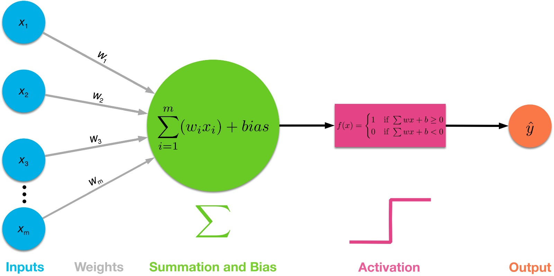
Recap
We covered Activation functions, forward propagation and touched on backward propagation

Slide 5
Resources
Great youtube video: https://bit.ly/2yQEKVP
Article on Gradient Descent + Momentum: https://bit.ly/2qsUUzS
Great Blogger on Math Behind ML: https://bit.ly/2j4kjME
Article on SGD: https://bit.ly/2LXKHEb

Slide 6
Second Part of Lesson: Installation

Slide 7
Setup Mac
Install python if not already installed (3.5.0+)
Go to terminal and check if python3 is a valid command
Pip install required modules

Slide 8
Setup Windows:
Adding python to path (3.5.0+)
Pip install tensorflow from command line
Pip install matplotlib
Pip install keras
Pip install jupyter
Pip install opencv-python

