Slide 1
Lesson 2: How Neural Networks Learn
Mac AI

Slide 2
Overview
Recap of last lesson
Training and Test Data
Epochs
Loss and Cost Functions
Gradient Descent and Learning Rate
Adam Optomization
Xavier initialization
Installation
Resources

Slide 3
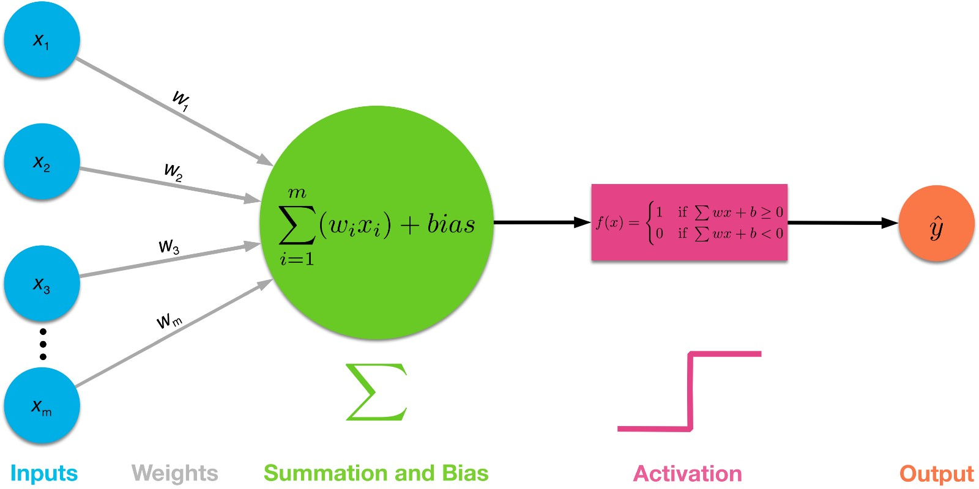
Recap
We covered Activation functions, forward propagation and touched on backward propagation

Slide 4
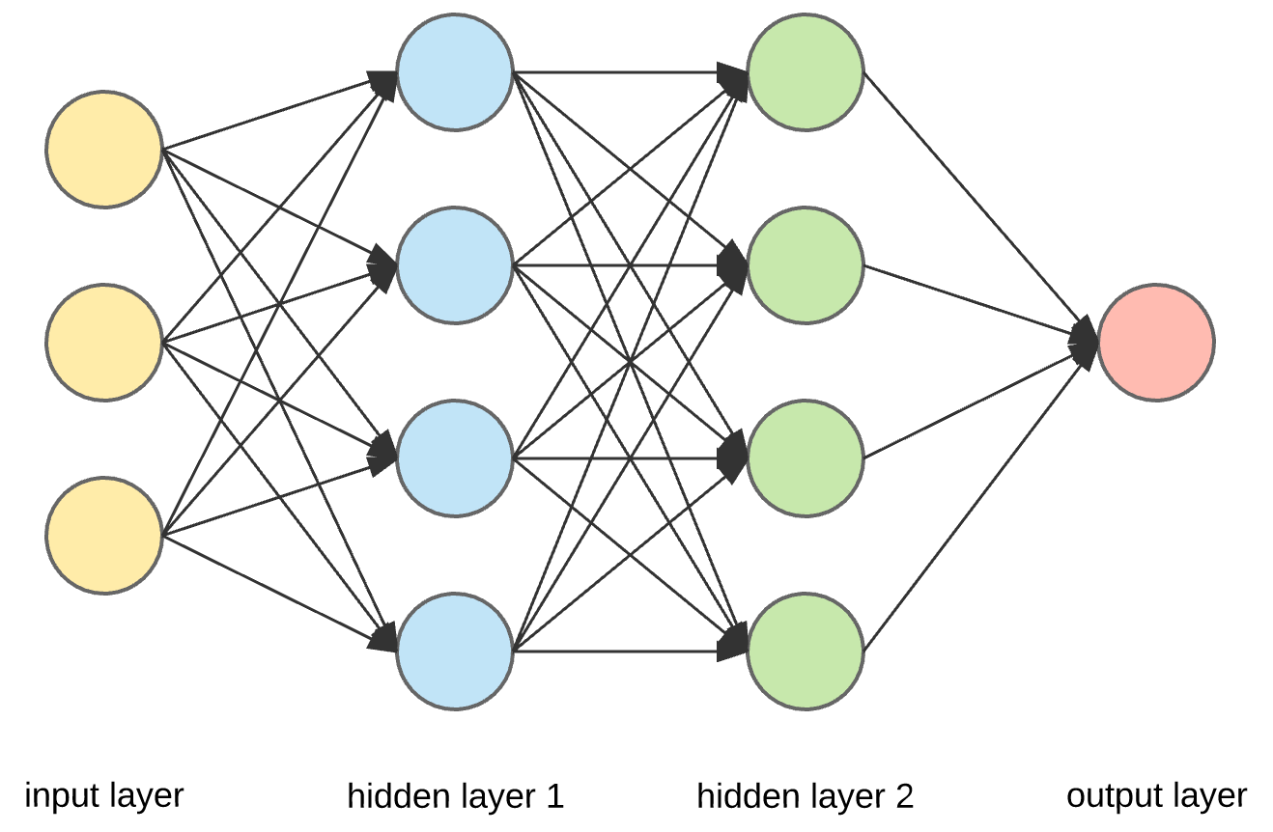
How Does the Network Learn ?
Notes:
And how does it improve upon the initial predictions that it has made; before we go into that, I need to go over a few more key principles

Slide 5
Train Test Split
To approach any ML problem, you will need a lot of data
Typically, for supervised learning problems, this data will contain the input features and corresponding label
It is common practice to randomize and then split data into 2 groups
Train group (what algorithm will learn with)
Test and/or Validation group (validate how algorithm is working on unseen data)
Different data splits depending on amount of data available
70/30 : Train Test Split for medium size data (few thousand)
70/15/15: Train Test Validation for medium size data
90/5/5: Train Test Validation for large amounts of data

Slide 6
Epoch and Training Batch
An epoch is a single pass through all the training data
To improve upon learning, the data is subdivided into small groups called training batches
Training batches allow for updates to algorithm at a faster rate than through an entire epoch
Notes:
Next aspect we should cover is an elaboration of the Iteration; epoch and training batch
Training batch is 2^n; n = 4..8

Slide 7
Epoch and Training Batch Cont’d
Notes:
10 training examples, first would be used as input, once done, it will go to next value and so on
Without training batches, updates for learning would occur at the end of an epoch, We will explain later why this is in ideal
Conversely, using training batches allows for more frequent updates, maybe after 25% of training data has been seen.

Slide 8
Loss and Cost
Loss (or error) function is used to determine how good ŷ (predicted vale from algorithm’s output) is in relation to y (labeled value) on a single training example
Conversely cost, is the loss function applied to a group of data with their values averaged
These values are to be minimized over time as we want:
ŷ ≈ y
There are many loss functions but we will briefly go over 2 most common ones.
Notes:
Here I will give a relatively simplistic over view of cost and loss and how that applies to learning, for a comprehensive understanding, refer to resources mentioned at end of presentation.

Slide 9
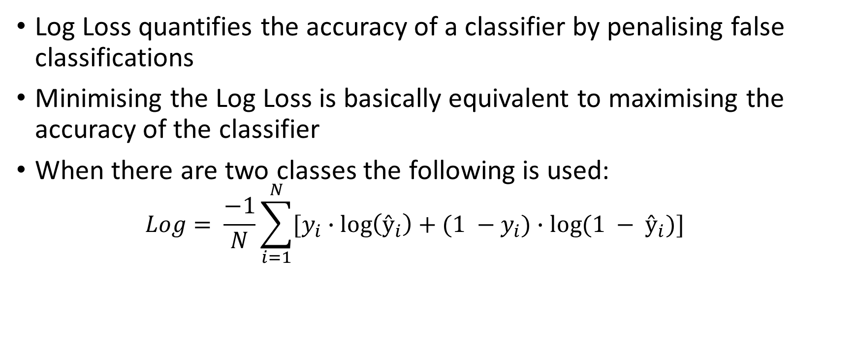
Logarithmic (Log) Loss
Log Loss quantifies the accuracy of a classifier by penalising false classifications
Minimising the Log Loss is basically equivalent to maximising the accuracy of the classifier
When there are two classes the following is used:
$$Log= \frac{−1}{N}\sum_{i=1}^{N}{[y_{i}∙\log\left(ŷ_{i}\right)+(1 −y_{i})∙log⁡(1 − ŷ_{i})]}$$

Slide 10
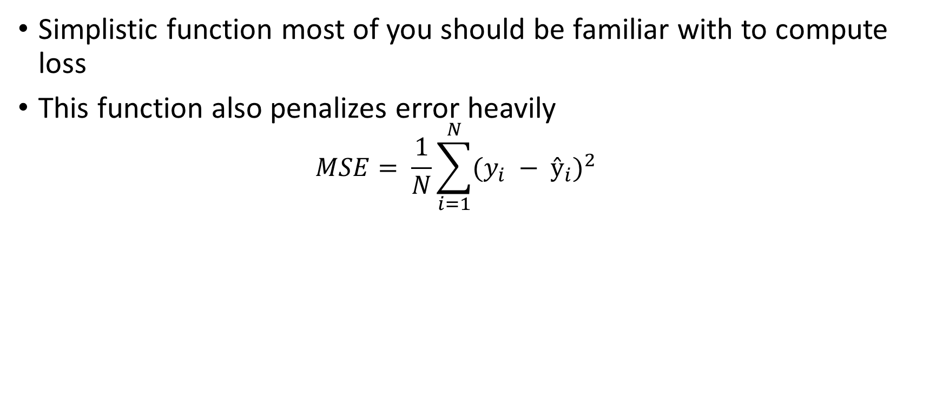
Mean Squared Error
Simplistic function most of you should be familiar with to compute loss
This function also penalizes error heavily
$$MSE= \frac{1}{N}\sum_{i=1}^{N}{{(y_{i} − ŷ_{i})}^{2}}$$

Slide 11
So what is Cost used for?
As mentioned, cost is used to determine how accurate the model is through comparing the predicted values with labeled values.
Ideally, this value needs to be minimized so that we will achieve high accuracy with our model
To actually minimize this value, we have to apply gradient descent

Slide 12
Gradient Descent
Using calculus, we are able to determine the slope of the loss and then take a “step” downward to approach the global minimum
However, as we will have many hundreds or thousands of parameters (each w and b term associated with the algorithm) we would need to calculate slopes, but gradients
This will allow us to determine which area in space we should step, with respect to all of the input variables, to get to the next smaller value

Slide 13
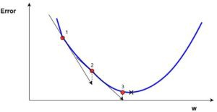
Example of Steps Taken
Each step progressively decreases the error as it approaches globabl minimum
As we mentioned earlier, a global minimum will beam accuracy of the model

Slide 14
Gradient Descent
Using calculus, we are able to determine the slope of the loss and then take a “step” downward to approach the global minimum
However, as we will have many hundreds or thousands of parameters (each w and b term associated with the algorithm) we would need to calculate slopes, but gradients
This will allow us to determine which area in space we should step, with respect to all of the input variables, to get to the next smaller value

Slide 15
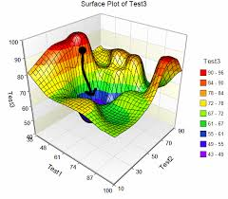
3D Visualization of GD
Good way to think of this is a ball rolling down a hill, it is trying to find a valley (our global minimum)

Slide 16
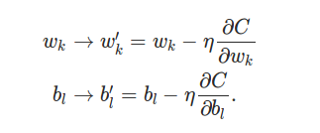
Applying Cost to Update Parameters
Using the value from the cost function as well as the computed derivatives for the specific layer, the weight and bias variables can now be updated
Essentially, partial derivatives are used t calculate the gradient, and this is used to update the parameter

Slide 17
Hyperparameters
Other than the weight and bias terms, there are also a few other aspects to training that are important to consider to get good accuracy of your model:
Learning Rate α
Number of Epochs
Method of Initialization (weights and biases)
Number of Nodes and Layers in Model
Activation Functions

Slide 18
Resources
Great youtube video: https://bit.ly/2yQEKVP
Article on Gradient Descent + Momentum: https://bit.ly/2qsUUzS
Great Blogger on Math Behind ML: https://bit.ly/2j4kjME
Article on SGD: https://bit.ly/2LXKHEb
Article on Loss Functions: https://bit.ly/2o0BK3a

Slide 19
Second Part of Lesson: Installation

Slide 20
Setup for Programming Lesson:
Adding python to path (3.5.0+)
From command line:
Pip install tensorflow
Pip install matplotlib
Pip install keras
Pip install jupyter
Pip install opencv-python

