Slide 1
Lesson 3: Coding First Neural Net

Slide 2


TensorFlow vs Keras
Tensorflow is a very well known machine learning framework created and updated by google
Keras is a higher level open source API that allows one to abstract many of the machine learning principles in an easy manner
Due to this, we will be using Keras for first tutorial, but code is available via GitHub page that outlines how to implement same problem in TensorFlow
Essentially: Front-end --- Keras, Back-end --- TensorFlow

Slide 3
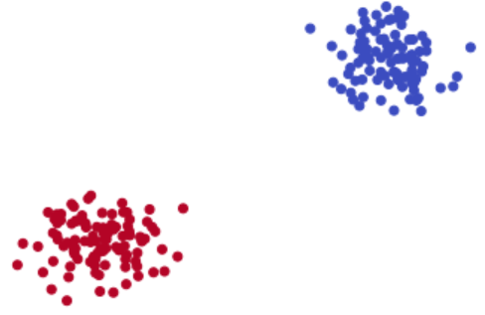
Classification Problem

Slide 4
Lets get started…
Notes:
All code in this lesson will be available via github page: github.com/akiljames83/MacAI-2018

