Slide 1
Lesson 2: How Neural Networks Learn
Mac AI

Slide 2
Overview
Recap of last lesson
Training and Test Data
Epochs
Learning Rate
Loss and Cost Functions
Gradient Descent
Adam Optimization
Glorot/Xavier Initialization
Resources
Installation

Slide 3
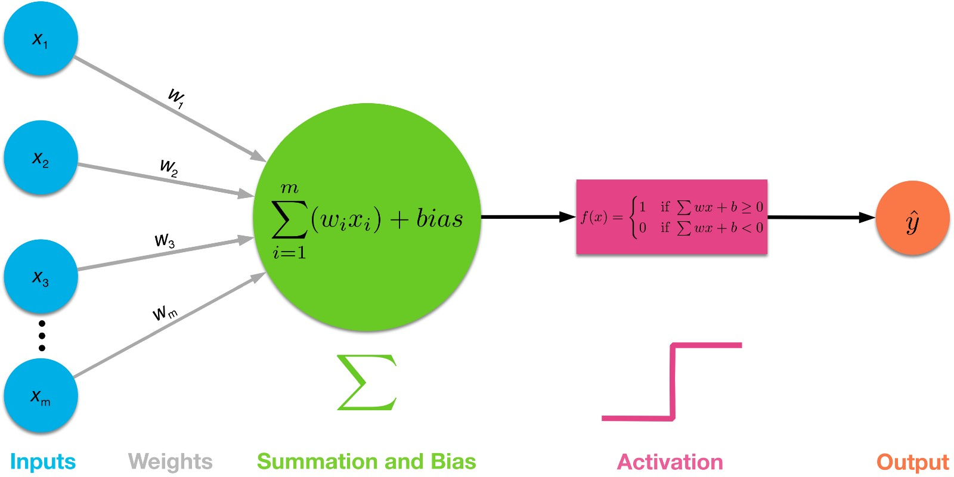
Recap
We covered Activation functions, forward propagation and touched on backward propagation

Slide 4
Train Test Split
To approach any ML problem, you will need a lot of data
Typically, for supervised learning problems, this data will contain the input features and corresponding label
It is common practice to randomize and then split data into 2 groups
Train group (what algorithm will learn with)
Test and/or Validation group (validate how algorithm is working on unseen data)
Different data splits depending on amount of data available
70/30 : Train Test Split for medium size data (few thousand)
70/15/15: Train Test Validation for medium size data
90/5/5: Train Test Validation for large amounts of data

Slide 5
Epoch and Training Batch
An epoch is a single pass through all the training data
To improve upon learning, the data is subdivided into small groups called training batches
Training batches allow for updates to algorithm at a faster rate than through an entire epoch
Notes:
Next aspect we should cover is an elaboration of the Iteration; epoch and training batch
Training batch is 2^n; n = 4..8

Slide 6
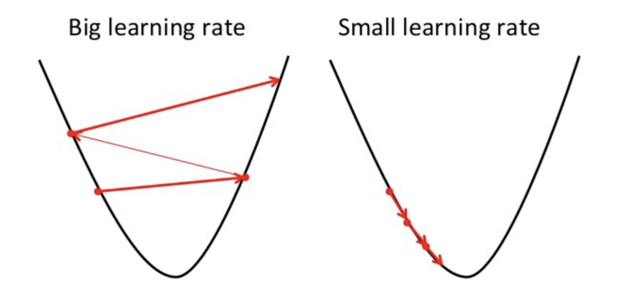
Learning Rate
In the learning process, the rate at which the model updates it parameters or “learns” is predetermined by a value learning rate
This is typically a constant term that is applied in the Update Rule of a given function
More detail will be given later on in the presentation on this topic

Slide 7
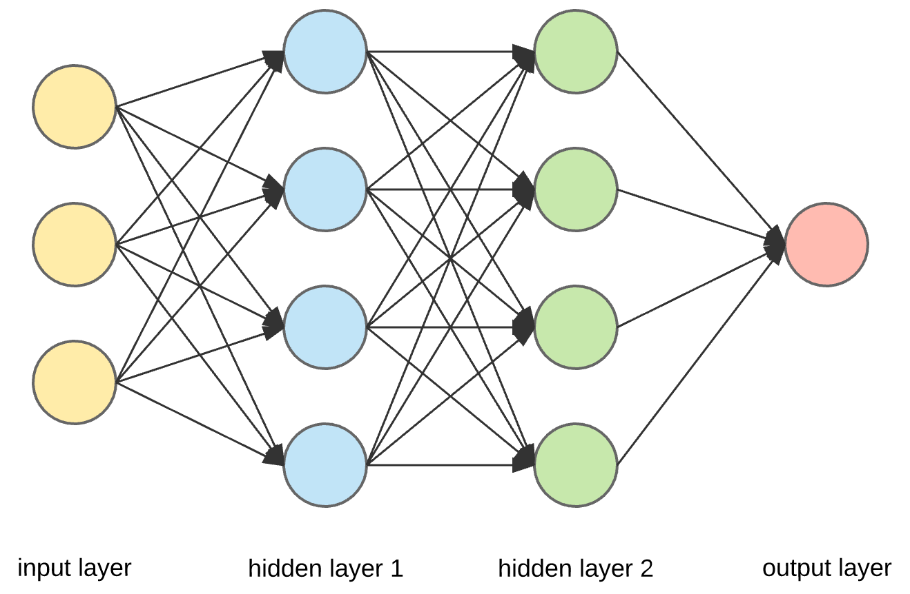
How Does the Network Learn ?
Notes:
And how does it improve upon the initial predictions that it has made; before we go into that, I need to go over a few more key principles

Slide 8
Loss and Cost
Loss (or error) function is used to determine how good ŷ (predicted vale from algorithm’s output) is in relation to y (labeled value) on a single training example
Conversely cost, is the loss function applied to a group of data with their values averaged
These values are to be minimized over time as we want:
ŷ ≈ y
There are many loss functions but we will briefly go over 2 most common ones.
Notes:
Here I will give a relatively simplistic over view of cost and loss and how that applies to learning, for a comprehensive understanding, refer to resources mentioned at end of presentation.

Slide 9
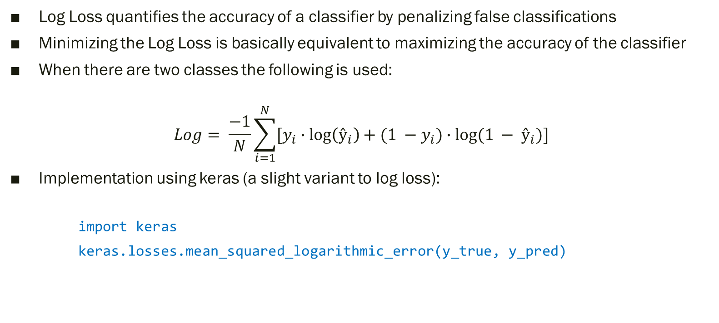
Logarithmic (Log) Loss
Log Loss quantifies the accuracy of a classifier by penalizing false classifications
Minimizing the Log Loss is basically equivalent to maximizing the accuracy of the classifier
When there are two classes the following is used:
$$Log= \frac{−1}{N}\sum_{i=1}^{N}{[y_{i}∙\log\left(ŷ_{i}\right)+(1 −y_{i})∙log⁡(1 − ŷ_{i})]}$$
Implementation using keras (a slight variant to log loss):
import keras
keras.losses.mean_squared_logarithmic_error(y_true, y_pred)

Slide 10
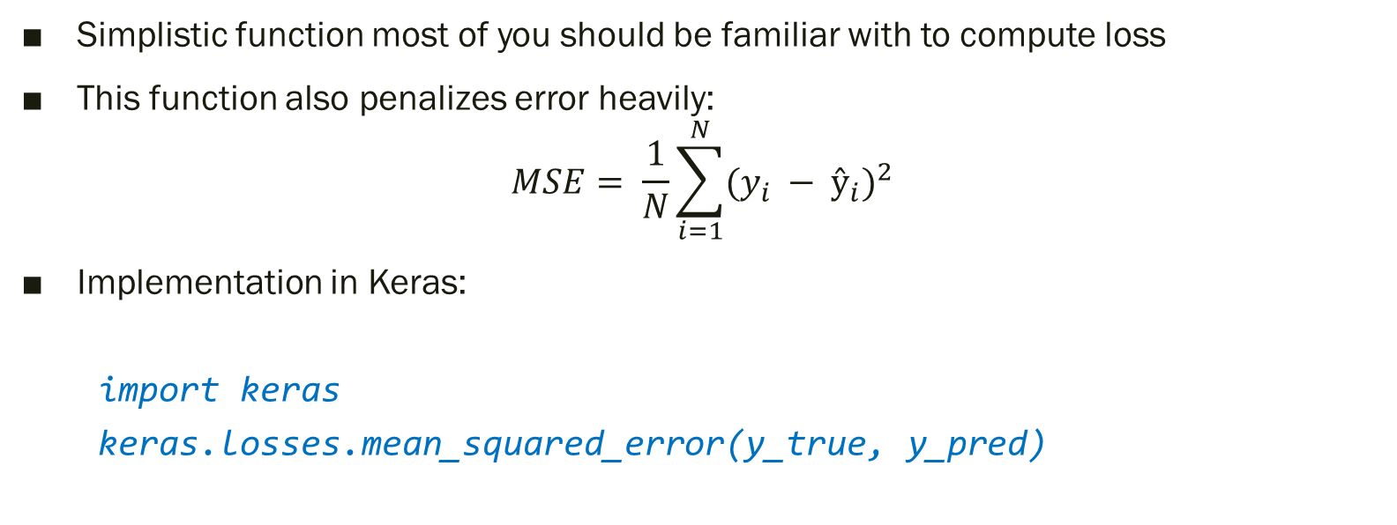
Mean Squared Error
Simplistic function most of you should be familiar with to compute loss
This function also penalizes error heavily:
$$MSE= \frac{1}{N}\sum_{i=1}^{N}{{(y_{i} − ŷ_{i})}^{2}}$$
Implementation in Keras:
import keras
keras.losses.mean_squared_error(y_true, y_pred)

Slide 11
So what is Cost used for?
As mentioned, cost is used to determine how accurate the model is through comparing the predicted values with labeled values.
Ideally, this value needs to be minimized so that we will achieve high accuracy with our model
To actually minimize this value, we have to apply gradient descent

Slide 12
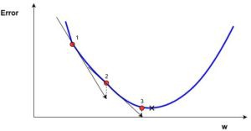
Example of Steps Taken
Each step progressively decreases the error as it approaches global minimum
As we mentioned earlier, a global minimum will best accuracy of the model

Slide 13
Gradient Descent
Using calculus, we are able to determine the slope of the loss and then take a “step” downward to approach the global minimum
However, as we will have many hundreds or thousands of parameters (each w and b term associated with the algorithm) we would not be calculating slopes, but instead gradients
This will allow us to determine which area in space we should step, with respect to all of the input variables, to get to the next smaller value

Slide 14
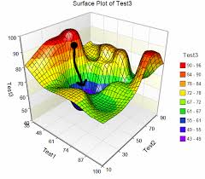
3D Visualization of GD
Good way to think of this is a ball rolling down a hill, it is trying to find a valley (our global minimum)

Slide 15
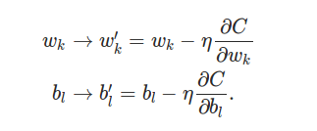
Applying Cost to Update Parameters
Using the value from the cost function as well as the computed derivatives for the specific layer, the weight and bias variables can now be updated
Essentially, partial derivatives are used to calculate the gradient, and this is used to update the parameter

Slide 16

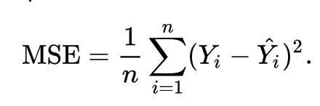
Recap

Slide 17
Adaptive Moment Estimation (Adam) Optimization
This is a very popular way update the parameters W and B
Essentially adam is an improved approach to the typical gradient descent which allows for optimized learning and smoother steps
Again, the math behind this is somewhat complex but what makes this algorithm so efficient is due to the following properties:
It stores an exponentially decaying average of past squared gradients
It keeps an exponentially decaying average of past gradients
This is the algorithm that we will be typically be using

Slide 18
Glorot Uniform / Xavier Initialization
In the initialization of weights and biases, there can be 2 problems:
If the weights in a network start too small, then the signal shrinks as it passes through each layer until it’s too tiny to be useful.
If the weights in a network start too large, then the signal grows as it passes through each layer until it’s too massive to be useful.
To address this problem Xavier Initialization is used
Notes:
Last topic I will briefly go over is Xavier initalization

Slide 19
Hyperparameters
Other than the weight and bias terms, there are also a few other aspects to training that are important to consider to get good accuracy of your model:
Learning Rate α
Number of Epochs
Method of Initialization (weights and biases)
Number of Nodes and Layers in Model
Activation Functions

Slide 20
Resources
Great YouTube video: https://bit.ly/2yQEKVP
Article on Gradient Descent + Momentum: https://bit.ly/2qsUUzS
Great Blog on Math Behind ML: https://bit.ly/2j4kjME
Article on SGD: https://bit.ly/2LXKHEb
Article on Loss Functions: https://bit.ly/2o0BK3a
Paper on Glorot: https://bit.ly/2CUrZN7

Slide 21
Second Part of Lesson: Installation

Slide 22
Setup for Programming Lesson:
Add python to path (3.5.0+) if on Windows
From command line:
Pip install tensorflow
Pip install matplotlib
Pip install keras
Pip install jupyter
Pip install opencv-python
Pip install sklearn

