Slide 1
Advanced Course
Mac AI

Slide 2
Brief Introduction
My name is Akil
Second Year iBiomed Student pursuing Software Engineering
Experience in ML:
Andrew Ng’s Deep Learning Specialization
Previous Internship
Side projects
Notes:
In experience, briefly go into each of the topics mentioned and then say that side first 2 are good ways to get good foundation
Mention that end of the presentation, I will be linking to resources that I found useful

Slide 3
Overview
What is the Purpose of ML
What is ML
Introduction to important math equations
Forward and Backward Propagation
Different types of Neural Networks
Future topics
Resources
Feedback

Slide 4
What is the Purpose of ML
At its simplest, ML is pattern matching for function arguments
Given some input X it needs to accurately predict F(X)
Through accurate representation of the function, there are many possible implications/ use cases:
Virtual Assistants
Machine Vision (Object Detection/ Image Recognition)
Pattern Replication in Art
Market Prediction in Finance
Etc.
Notes:
Key take away is that that ML is able to abstract the body of a function in a unique way, and using this custom function, many complex problems can be tackled in ways they could have been approached before

Slide 5
What is Machine Learning
Essentially math equations
Due to the use of many ML frameworks, we do not have to know how to implement low level algorithms to start a project
Despite that, an understanding of a few key algorithms will be important in completing projects
Notes:
Definition: Machine learning is a field of artificial intelligence that uses statistical techniques to give computer systems the ability to "learn" from data, without being explicitly programmed
Before we go into these math equations, I will introduce the neural network structure

Slide 6
Neural Net Structure
Network is named a “Neural network” since its based on the structure of neurons in the brain
The network is composed of layers
Each layer is composed of nodes/neurons
Each node consist of an activation function
Notes:
And how they interact with each other

Slide 7
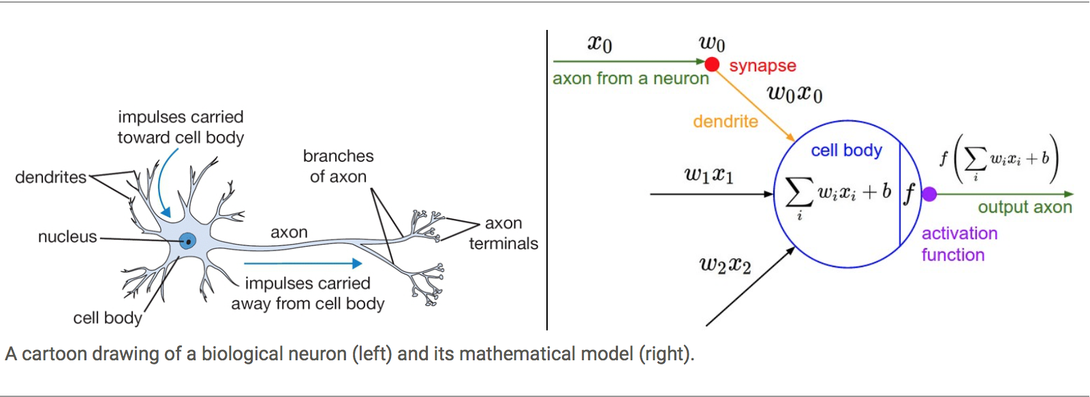
Neuron and ML Node
Notes:
Neuron on the left: key components; nucleus, dendrites, axon
ML Node on the right: key components; activation function (nucleus), inputs (dendrites), output(axon)

Slide 8
Neural Net Structure
Network is named a “Neural network” since its based on the structure of neurons in the brain
The network is composed of layers
Each layer is composed of nodes/neurons
Each node consist of an activation function

Slide 9
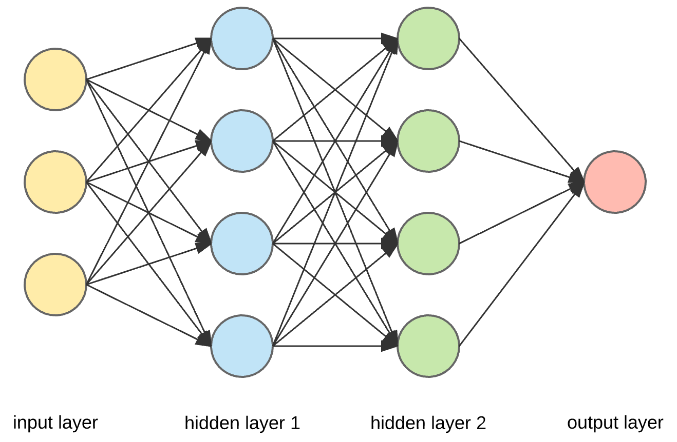
Layers of a Neural Network
0
1
2
3
Notes:
Here we have a small representation of a Neural Net
Counting of a layer
Explain input layer; output layer; everything else is hidden layer
As mentioned earlier, each node represents a series of math equations that is applied to inputs
This type is called a densey connected layer due to all the inter connections between the nodes
Their outputs are then sent into following nodes as inputs

Slide 10
Neural Net Structure
Network is named a “Neural network” since its based on the structure of neurons in the brain
The network is composed of layers
Each layer is composed of nodes/neurons
Each node consist of an activation function

Slide 11
Activation Functions – Linear Portion
Given a set of inputs, the activation is used to determine an output
These outputs are used as inputs in subsequent layers
The activation function has 3 input variables:
values Xi [ i ranges from 0 … n ]
weight Variable Wi [ i ranges from 0 … n ]
bias term b [ constant for the induvial layer]
Notes:
Here it gets a bit more into the math
There are 2 parts of the Activation Function

Slide 12
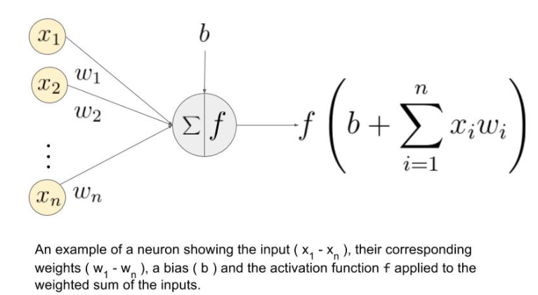
Activation Function Cont’d
Notes:
Question to see whos paying attention, How many layers are in this network?
Explain x
Explain w
Explain b
… all used for linear portion of the activation function
Explain the formula
To note, some people do the addition of the bias term inside the sum function, others leave it out all together

Slide 13
Activation Function – Non Linear Portion
The second portion of the activation is the optional non-linear portion
Each of the functions in this portions have varying advantages depending on the regression problem being approached
Main Activation functions:
Identity: identity(x) = x
Step activation: step(x) = 0 if x < 0.5 else 1
Rectified Linear Unit (ReLu): Relu(x) = max(0, x)
Leaky ReLu: LRelu(x) = 0.5*x if x < 0 else x
Sigmoid Function: sigmoid(x) = 1/(1+e^(-x))
Tanh Function: tanh(x) = 2*sigmoid(2x) - 1
Notes:
A typical use case for neural network is binary classification, this is essentially a yes/no problem
In this case, the value of 1 is assigned True/Yes and value 0 is assigned False/No
If you were to use a linear activation for your final output layer, what do you think the problem could be ?

Slide 14
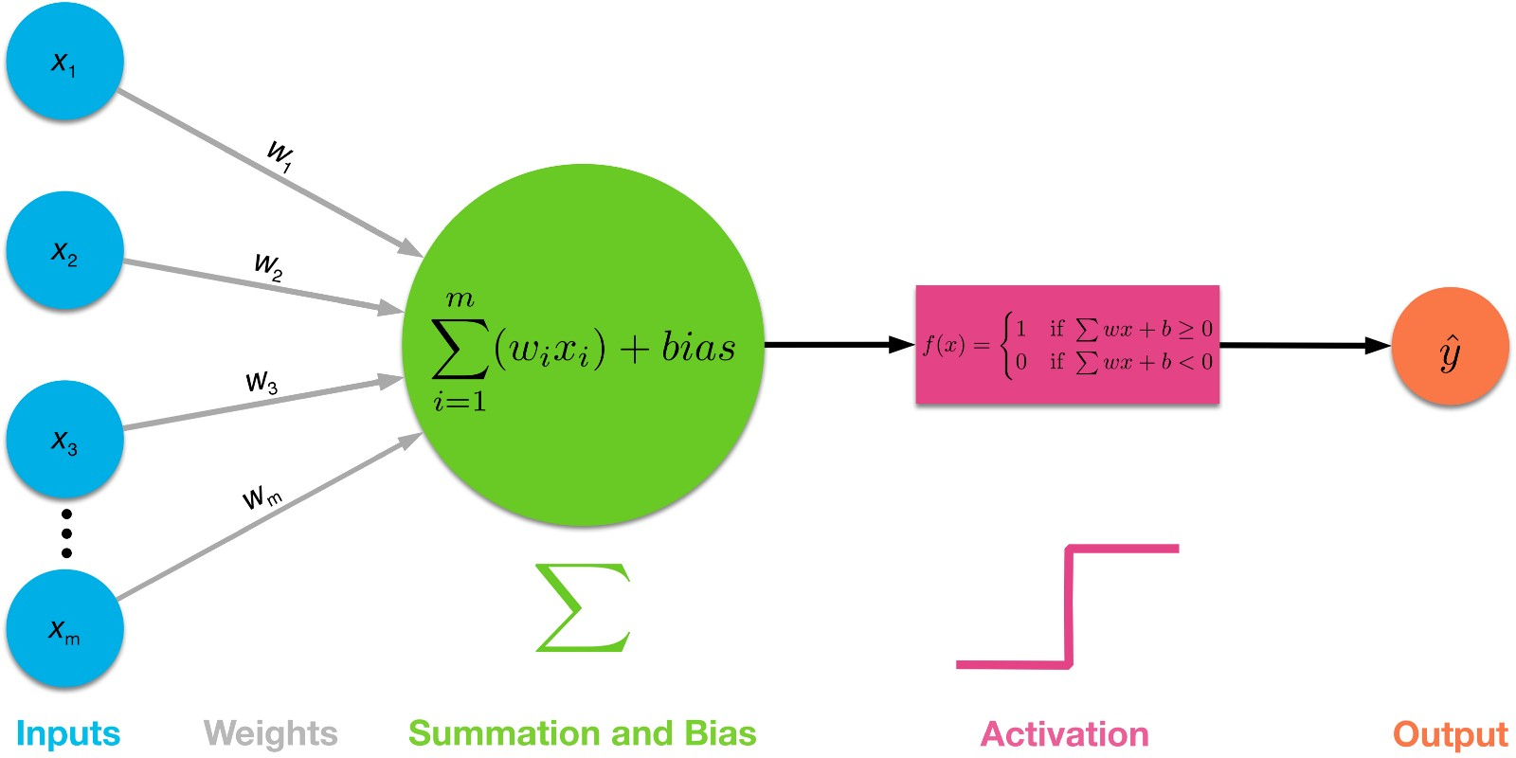
Activation Function Cont’d
Notes:
Another picture showing the optional activation layer

Slide 15
Activation Function Cont’d
The second portion of the activation is the optional non-linear portion
Each of the functions in this portions have varying advantages depending on the regression problem being approached
Main Activation functions:
Identity: identity(x) = x
Step activation: step(x) = 0 if x < 0.5 else 1
Rectified Linear Unit (ReLu): Relu(x) = max(0, x)
Leaky ReLu: LRelu(x) = 0.5*x if x < 0 else x
Sigmoid Function: sigmoid(x) = 1/(1+e^(-x))
Tanh Function: tanh(x) = 2*sigmoid(2x) - 1
Notes:
A common reason to use a non linear approach is if you need the values of the output to fall in a certain range
A typical use case for neural network is binary classification, this is essentially a yes/no problem

Slide 16
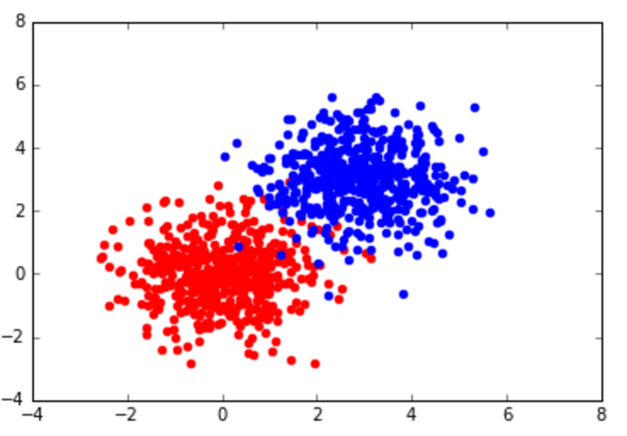
Binary Classification
1 == Yes/ True
0 == No/ False
OR
Group A and B
Notes:
Common example where the choice of activation function is important is in the use of binary classification
Many of you have probably heard of binary classification, but for those of you who haven’t it is essentially:
Binary or binomial classification is the task of classifying the elements of a given set into two groups
In this case, the value of 1 is assigned True/Yes and value 0 is assigned False/No
If you were to use a linear activation for your final output layer, what do you think the problem could be ?
You could get values that are way outside of the range you are looking for,
Problem with this is especially for optimization, something we will touch on in another lecutre

Slide 17
Activation Function Cont’d
The second portion of the activation is the optional non-linear portion
Each of the functions in this portions have varying advantages depending on the regression problem being approached
Main Activation functions:
Identity: identity(x) = x
Step activation: step(x) = 0 if x < 0.5 else 1
Rectified Linear Unit (ReLu): Relu(x) = max(0, x)
Leaky ReLu: LRelu(x) = 0.5*x if x < 0 else x
Sigmoid Function: sigmoid(x) = 1/(1+e^(-x))
Tanh Function: tanh(x) = 2*sigmoid(2x) - 1

Slide 18
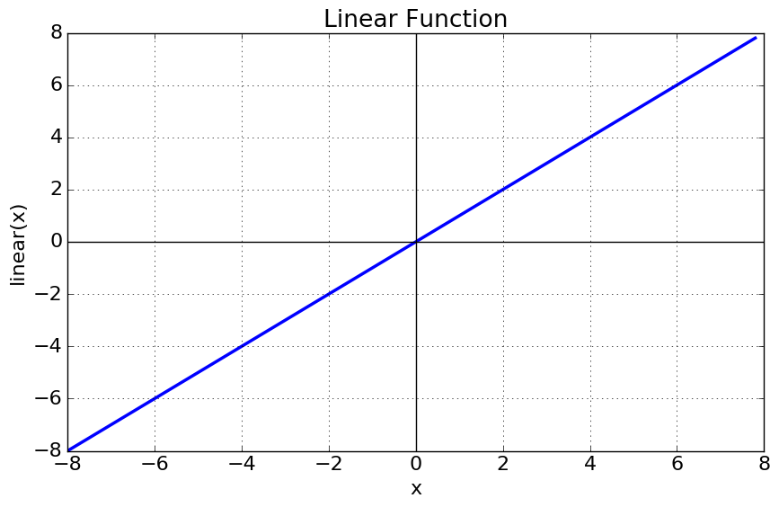
Activation Function Cont’d
The second portion of the activation is the optional non-linear portion
Each of the functions in this portions have varying advantages depending on the regression problem being approached
Main Activation functions:
Identity: identity(x) = x
Step activation: step(x) = 0 if x < 0.5 else 1
Rectified Linear Unit (ReLu): Relu(x) = max(0, x)
Leaky ReLu: LRelu(x) = 0.5*x if x < 0 else x
Sigmoid Function: sigmoid(x) = 1/(1+e^(-x))
Tanh Function: tanh(x) = 2*sigmoid(2x) - 1
Notes:
A typical use case for neural network is binary classification, this is essentially a yes/no problem
In this case, the value of 1 is assigned True/Yes and value 0 is assigned False/No
If you were to use a linear activation for your final output layer, what do you think the problem could be ?

Slide 19
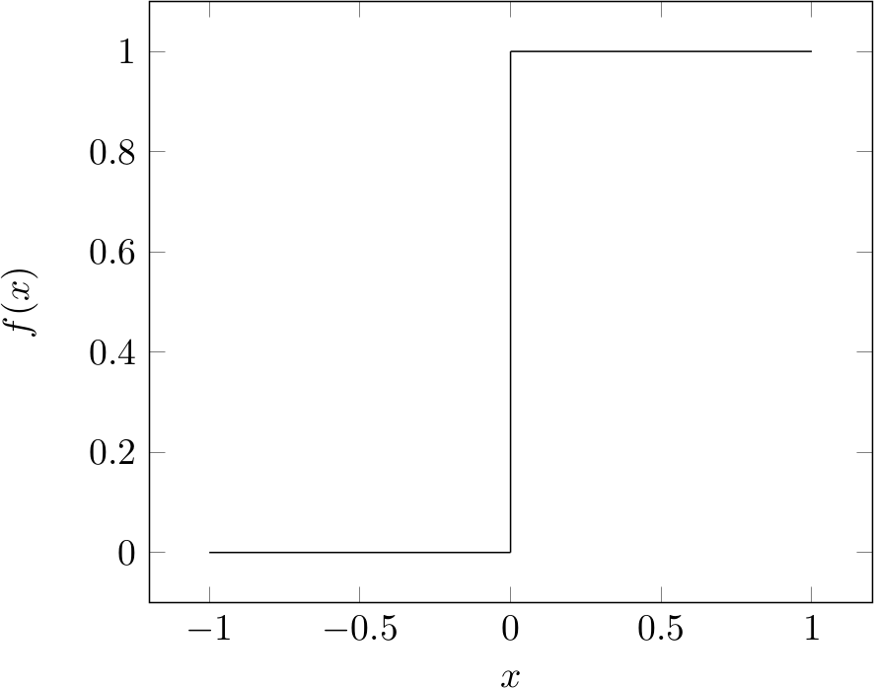
Activation Function Cont’d
The second portion of the activation is the optional non-linear portion
Each of the functions in this portions have varying advantages depending on the regression problem being approached
Main Activation functions:
Identity: identity(x) = x
Step activation: step(x) = 0 if x < 0.5 else 1
Rectified Linear Unit (ReLu): Relu(x) = max(0, x)
Leaky ReLu: LRelu(x) = 0.5*x if x < 0 else x
Sigmoid Function: sigmoid(x) = 1/(1+e^(-x))
Tanh Function: tanh(x) = 2*sigmoid(2x) - 1
Notes:
A typical use case for neural network is binary classification, this is essentially a yes/no problem
In this case, the value of 1 is assigned True/Yes and value 0 is assigned False/No
If you were to use a linear activation for your final output layer, what do you think the problem could be ?

Slide 20
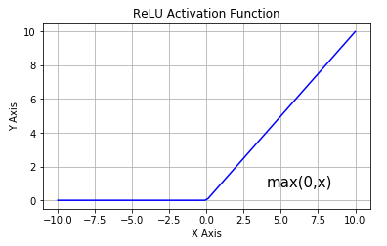
Activation Function Cont’d
The second portion of the activation is the optional non-linear portion
Each of the functions in this portions have varying advantages depending on the regression problem being approached
Main Activation functions:
Identity: identity(x) = x
Step activation: step(x) = 0 if x < 0.5 else 1
Rectified Linear Unit (ReLu): Relu(x) = max(0, x)
Leaky ReLu: LRelu(x) = 0.5*x if x < 0 else x
Sigmoid Function: sigmoid(x) = 1/(1+e^(-x))
Tanh Function: tanh(x) = 2*sigmoid(2x) - 1
Notes:
A typical use case for neural network is binary classification, this is essentially a yes/no problem
In this case, the value of 1 is assigned True/Yes and value 0 is assigned False/No
If you were to use a linear activation for your final output layer, what do you think the problem could be ?

Slide 21
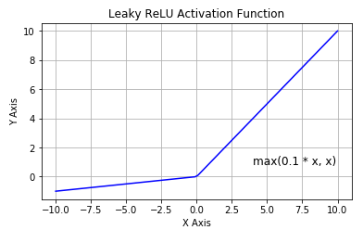
Activation Function Cont’d
The second portion of the activation is the optional non-linear portion
Each of the functions in this portions have varying advantages depending on the regression problem being approached
Main Activation functions:
Identity: identity(x) = x
Step activation: step(x) = 0 if x < 0.5 else 1
Rectified Linear Unit (ReLu): Relu(x) = max(0, x)
Leaky ReLu: LRelu(x) = 0.1*x if x < 0 else x
Sigmoid Function: sigmoid(x) = 1/(1+e^(-x))
Tanh Function: tanh(x) = 2*sigmoid(2x) - 1
Notes:
A typical use case for neural network is binary classification, this is essentially a yes/no problem
In this case, the value of 1 is assigned True/Yes and value 0 is assigned False/No
If you were to use a linear activation for your final output layer, what do you think the problem could be ?

Slide 22
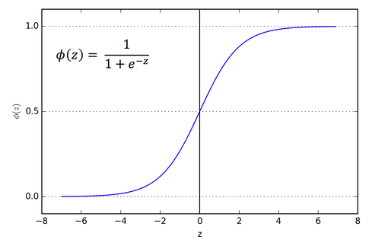
Activation Function Cont’d
The second portion of the activation is the optional non-linear portion
Each of the functions in this portions have varying advantages depending on the regression problem being approached
Main Activation functions:
Identity: identity(x) = x
Step activation: step(x) = 0 if x < 0.5 else 1
Rectified Linear Unit (ReLu): Relu(x) = max(0, x)
Leaky ReLu: LRelu(x) = 0.1*x if x < 0 else x
Sigmoid Function: sigmoid(x) = 1/(1+e^(-x))
Tanh Function: tanh(x) = 2*sigmoid(2x) - 1
Notes:
A typical use case for neural network is binary classification, this is essentially a yes/no problem
In this case, the value of 1 is assigned True/Yes and value 0 is assigned False/No
If you were to use a linear activation for your final output layer, what do you think the problem could be ?

Slide 23
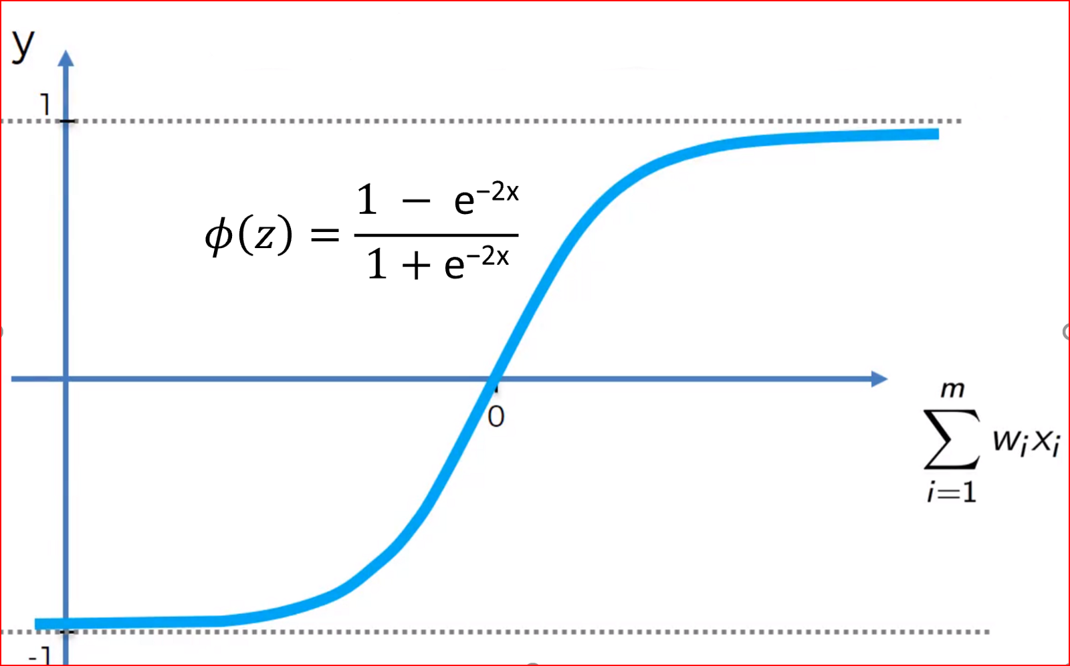
Activation Function Cont’d
The second portion of the activation is the optional non-linear portion
Each of the functions in this portions have varying advantages depending on the regression problem being approached
Main Activation functions:
Identity: identity(x) = x
Step activation: step(x) = 0 if x < 0.5 else 1
Rectified Linear Unit (ReLu): Relu(x) = max(0, x)
Leaky ReLu: LRelu(x) = 0.1*x if x < 0 else x
Sigmoid Function: sigmoid(x) = 1/(1+e^(-x))
Tanh Function: tanh(x) = 2*sigmoid(2x) - 1
Notes:
A typical use case for neural network is binary classification, this is essentially a yes/no problem
In this case, the value of 1 is assigned True/Yes and value 0 is assigned False/No
If you were to use a linear activation for your final output layer, what do you think the problem could be ?

Slide 24
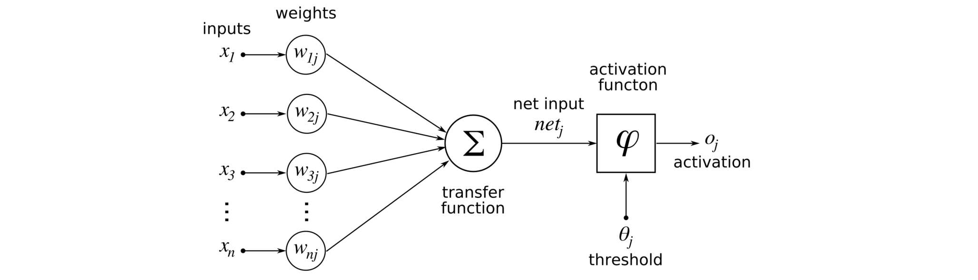
Activation Function Cont’d
Notes:
Just to reiterate onemore time, we take in the inputs, we perform the linear actication and this is subsequently followed by the non linear activation and
That is the output

Slide 25
Forward Propagation
Forward Prop is essentially the culmination of the steps I have previously mentioned
It is the forward pass through the network’s layers ending at the output layer
This is the “simpler” portion of the math behind a Neural Net

Slide 26
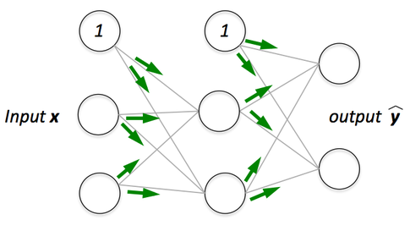
Forward Propagation
Notes:
Rep of forward prop In 2 layer network

Slide 27
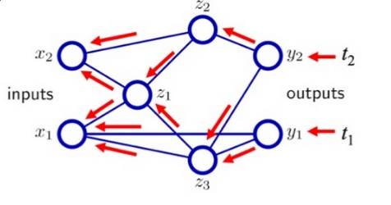
Backward Propagation
Backward Propagation is one of the main ways that a neural network “learns”
This is accomplished through use of derivatives on each of the layers
One must determine: dWi, db, dZi/dAi
Notes:
I did not explain some of these variable names as we will not be going deep into the math for this introduction course, but [explain each]

Slide 28
So what is an Iteration?
Iteration = Forward Pass + Backward Pass
FORWARD
BACKWARD
Notes:
Just one forward pass plus a backward pass
Forward: taking inputs along with current layers weight and bias terms as well as activation function to compute next layer
Backward pass: computing the derivatives for a given layer, and using those derivatives to update weight and bias values
In later lessons we will explain aspects such as training epochs and stochastic training etc, but this gives you an understanding of network structure

Slide 29
Putting it all together
Adding several layers with various these various activation functions and (forward prop.) and then through calculating the derivatives at each of the layers (backward prop.) is the fundamental in the creation of a neural net
Through proper application of these techniques, various model architectures can be created such as:
Feedforward Neural Net: Simplest network consisting of basic neuron layers
CNNs: Network use for mostly image recognition tasks
RNNs: Network used for sequence analysis
Notes:
Throughout this course, the fellow tas and I hope to give you good foundational education on these/said topics

Slide 30
Demo – Using TensorFlow Playground
https://bit.ly/2RVoniB
Notes:
This lecture had a lot of theory and we realize that, so we are going to give you a quick demo using tnesorflow’s playground
Tensorflow is an opensource ML api made by google

Slide 31
Future Topics
Optimization and Gradient Descent
Brief example of a feed forward network
Introduction project using MNIST and Tensorflow and then Keras
Notes:
As I mentioned in the tensorflow playground demo, learning rate will be covered In future lectures
In machine learning, one of the key concepts is understanding how the network actually learns
If lecture is fast we will most likely go into the example of feed forward network
Finally, we will tackle mnist data set using tensorflow and keras using a feed forward network, this might take a bit longer, but we will see
Go iver structure of course

Slide 32
Resources
Written explanation you might find useful:
https://bit.ly/2EzoY6D
Coursera Courses:
Andrew Ng’s Deep Learning Course 1
Andrew Ng’s Machine Learning Course
Udemy Courses:
Introduction to TensorFlow
Machine Vision
Modern Deep Learning
Notes:
Say coursera courses are expensive, but highly comprehensive and do have financial aid options
Udemy courses are best resources, courses are cheap and the ones I’ve provided have good content
Through courses like these you will get a firm foundation in machine learning techniques and principles
Through use of these courses I was able to get the foundational knowledge for my first coop at Telus after first year

Slide 33
Feedback
Links:
Lesson Ideas/Topics you want covered: hamila10@mcmaster.ca
https://github.com/akiljames83/MacAI-2018
Star the repo so you can easily access it
Check it for updates and solutions to tutorial exercises
Resources folder for relevant course and aritcles

