Slide 1
AI-ML Project
Movie Recommendation System
By Group No : 35

Slide 2
Why Recommendation System?
In this “era of abundance”, for any given product, there are sometimes thousands of options to choose from. Recommender systems help to personalize a platform and help the user find something they like.
From a business standpoint, the more relevant products a user finds on the platform, the higher their engagement. This often results in increased revenue for the platform itself.
Recommender systems encompass a class of techniques and algorithms that can suggest “relevant” items to users. They predict future behavior based on past data through a multitude of techniques including matrix factorization.

Slide 3
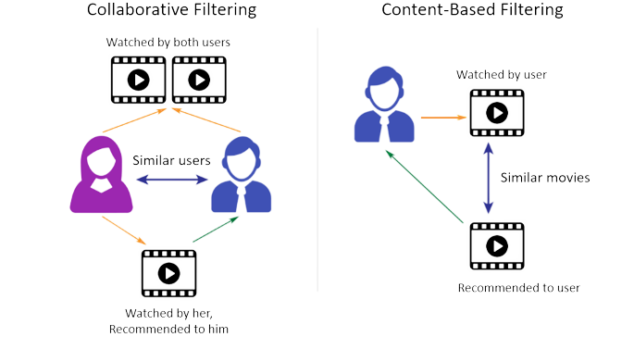
Types of Recommendations Systems
Content-based filtering
Content-based methods are based on the similarity of movie attributes.
Using this type of recommender system, if a user watches one movie, similar movies are recommended.
Collaborative filtering
With collaborative filtering, the system is based on past interactions between users and movies.
They rely on the assumption that similar users like similar items. Similarity measures between users and/or items are used to make recommendations.

Slide 4
The Dataset

Slide 5
The MovieLens Dataset
The MovieLens datasets was used to test the implemented algorithms. The datasets consist of multiple collections of anonymized data from the MovieLens website. The rating data consist of user id, movie id, a 1-5 rating, and a timestamp.
For our project we have used of 22M ratings by 240,000 users and 33,000 movies. In addition to the rating data, there are movie data consisting of movie id, title and a list of genres.
MovieLens data was used because it contained high quality of the data and there being multiple datasets in different sizes.
Link to MovieLens Dataset

Slide 6
The Models

Slide 7
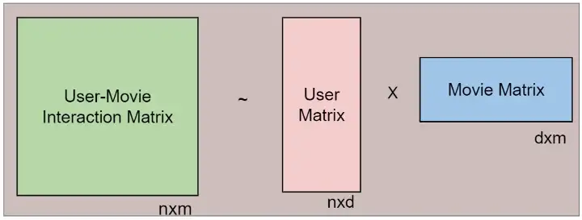
Matrix Factorization(Collaborative Filtering)
Matrix factorization is a class of collaborative filtering algorithms used in recommender systems. This algorithm works by decomposing the user-movie interaction matrix into the product of two lower dimensionality rectangular matrices(User Matrix and Movie Matrix). This helps us to populate the missing user-movie pairs in the interaction matrix.
Say user-movie interaction matrix is of n x m matrix,

Slide 8
Implementation of Matrix Factorization
To implementation of Matrix Factorization was constructed by using Stochastic Gradient Descent. The SGD algorithms was also easy to implement and efficient enough to run linearly over huge training data consisting of 10 million data points.We used Pytorch to implement this algorithm.
First we needed to get the continuous IDs in order to understand the meaning properly.
When evaluating rating predictions, we have used Root Mean Squared Error (RMSE) as a common metric. The rating data was split into 80/20% training and testing data.

Slide 9
Content-Based Filtering Implementation
Here, we filtered movies which was already rated by a particular user and created a table with his ratings.
Now we calculated a profile for that user based on his ratings on the basis of genre-by-genre.
We made a table of all movies with genres and titles and take product of that user’s profile.
Based on the user profile, we recommended top 20 movies, sorted by the above product.

Slide 10
The Conclusion

Slide 11
Final Thoughts...
Collaborative Filtering
Advantages
We don't need domain knowledge because the embeddings are automatically learned.
The model can help users discover new interests. In isolation, the ML system may not know the user is interested in a given item, but the model might still recommend it because similar users are interested in that item.
Disadvantages
Cold start is an even bigger problem when using this approach. As the information used is primarily the behaviour of the users of the system, a big number of behavioural interactions must take place before the system becomes useful.

Slide 12
Final Thoughts...
Content-based Filtering
Advantages
The model doesn't need any data about other users, since the recommendations are specific to this user. This makes it easier to scale to a large number of users.
The model can capture the specific interests of a user, and can recommend niche items that very few other users are interested in.
Disadvantages
The model can only make recommendations based on existing interests of the user. In other words, the model has limited ability to expand on the users' existing interests.

Slide 13
Thank You!

